Slide 1
Pure Objects in Smalltalk
What is Pure OO?
Smalltalk the Language.
A Working Example.

Slide 2
Agenda
Review of Image
Development Tools
Syntax
Hierarchy at 100 m.p.h

Slide 3





Major Smalltalk Components
Smalltalk Image
Development
Objects
Your Objects
Base Objects
Virtual Machine
Your ‘C’ functions
Operating System

Slide 4


A Place for Live Objects
Smalltalk Image

Slide 5
Syntax Examples
15 negative “returns -15”
shape rotate: 90. “rotates the shape 90deg.”
(Date today ) +28 “the date in four weeks”
Point x: 12 y: 200 “create new point”

Slide 6
Model & View
Smalltalk Image
15 negative
15

Slide 7
Development Tools
Class Browser
Date today
Workspace
Transcript Window
file not found
Debugger
Smalltalk Image

Slide 8
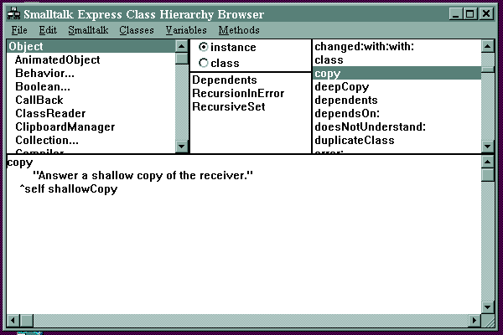
Class Browser
Classes
Variables
Methods
Method Code
Syntax Check
When Saving

Slide 9
Simple Syntax
5 reserved words.
  true false nil self super
6 order of evaluation rules.
All behavior is invoked by message sending
anObject aMessage
anObject aMessage
anObject aMessage
6 + 99

Slide 10
Objects and Messages (1)
Sender
message
answer
Receiver
  6 + 99.
  Sender is the current context
  Receiver is the object 6
  Message is +
  Argument is the object 99
YOU
6
+ 99
105

Slide 11
Objects and Messages (2)
  theDate := Date today.
  receiver is the object Date
  message is today
  no argument
  answers an object that is assigned to theDate
Sender
today
Date
1 Jan 1999

Slide 12
Hello World
Transcript
  Global variable for the transcript Window.
  Send messages to Transcript.
Transcript show: ‘Hello World’.

Slide 13
Syntax
File Unit Syntax
Class & Inheritance Syntax
Method Syntax
Statement Syntax
Syntax for Constants
Control Structure Syntax
Message Order of Evaluation Syntax

Slide 14
File Unit Syntax
File Unit
Syntax
Smalltalk Image

Slide 15
Class and Inheritance Syntax
Class &
Inheritance
Syntax
Smalltalk Image

Slide 16
Method Syntax
exampleMethod
exampleMethod “Method Name”
| anObject | “Method Variable”
“Your Comments here” “Comments”
“ . . . ” “Implementation”
^ anObject. “Return”

Slide 17
Statement Syntax
Every statement ends with a period.
‘smalltalk’ asUppercase .
Date today .
addDependent
changeAddress
Send multiple messages with semicolon
  anEmployee addDependent: aNewChild ;
  changeAddress: aNewAddress.

Slide 18
Syntax for Constants
Constants
  String ‘Hello World’
  Integer 1000
  Float 1.234
  Character $A
  Symbol #openWindow
  Array #( ringo paul george )

Slide 19
Control Structures
Control
Structures
“Don’t Panic”
      Hitchhikers Guide.
Control is accomplished by...
Sending messages to Objects.

Slide 20
Control Messages
  22 > 1 if True: [ Transcript show:
    ‘22 is greater than 1’ .
    ].
  [ george savings < george retirementTarget ]
    whileTrue: [ george workSomeMore. ].
  3 timesRepeat: [ dorothy say: ‘noplacelikehome’
    ].

Slide 21
3 types of messages
Unary messages no argument
    aString size.
    42 negated.
Binary messages one argument
  message made of non-alphanumeric characters
    3 + 6.
    index <= max.
Keyword messages > 0 arguments
  ends in a colon (:)
    aNameArray add: ‘George’.
    aString at: 4 put: $a.

Slide 22
6 Order of Evaluation Rules
Always Left to Right
  order name example
  1st. Parenthesis ( )
  2nd. Unary 4 negated
  3rd. Binary 1 + 3
  4th. Keyword aList add: ‘me’
  5th. Assignment a := 5
  6th. Return ^ self

Slide 23
Evaluation Order Example
^currentDialog := TaxIncomeDialog new open: self
rule: unary
^currentDialog := TaxIncomeDialog new open: self.
^currentDialog := tmpObject1 open: self.
rule: keyword
^ currentDialog := tmpObject1 open: self.
^ currentDialog := tmpObject2.
rule: assignment
^ currentDialog := tmpObject2.
^ tmpObject3
rule: return
^ tmpObject3
Parenthesis
Unary
Binary
Keyword
Assignment
Return

Slide 24
Find the Objects
^
currentDialog
:=
TaxIncomeDialog new
open: self

Slide 25
Object Hierarchy
printString
halt
perform:
doesNotUnderstand:
The class Object provides each subclass with common behavior including the following:
Object
Behavior
Collection
Compiler
View
Manager
Magnitude
Class
Meta
Class
Indexed
Collection
Set
Inspector
Class
Hierarchy
Browser
Number
Date
FixedSize
Collection
Debugger
Integer
Float
Fraction
Your
Application
Here
Array
ByteArray
Interval
String

Slide 26
Review
Image is Everything
Development Tools are Objects
Syntax is Simple
Powerful Hierarchy

Slide 27
References
Free Smalltalk for Windows
  http://www.objectshare.com
Smalltalk Classes on the Web ($11)
http://www.zdu.com/zdulive/catalog/catalog.htm
Cincinnati/Dayton Smalltalk Users Group
  http://www.infinet.com/~mwind/st_users.htm
Product design in Smalltalk at FORD
  www.gemstone.com/Products/PR/ford_rel.htm

Slide 28
Homework :-)
Model a House
Model a house.
The House has multiple rooms.
Each room has a name .
Doors connect the Rooms.
There is a visitor of the house.
Visitor can describe which room he is in.
Visitor can describe objects in the room.
Visitor is able to move to any connected room.
Test the model by building a house with 4 rooms and 4 doors connecting the rooms. Place the visitor in a room and start the program.

Slide 29
Next ...
Problem Solving workshop
  From Requirements to working code
Thanks for attending.

