Slide 1

Introducing Smalltalk
Mark Windholtz,
ObjectWind

Slide 2
Tutorial Objective
To leap from the ‘C’ based style of thinking to a style where everything is an object.
To get comfortable with the radical simplicity of the language.
To provide a guide to further learning Smalltalk.

Slide 3
Attendee Background
Attendees should have a background in programming in a ‘C’ based language.

Slide 4
Brief Biography
Mark Windholtz is President of ObjectWind Software.
Object Oriented development since 1990 with companies such as: NCR AT&T, Lexis-Nexis, Structural Dynamics Research Corp, and others.
Training Smalltalk since 1996 for University and Corporate audiences

Slide 5
Schedule and breaks.
2 sessions
90 minutes each
30 minute break

Slide 6
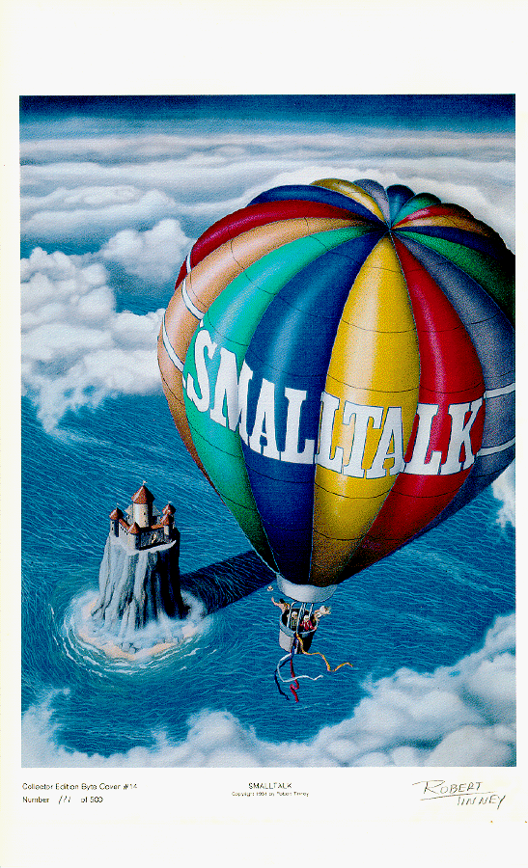
Part 1
Basic
Concepts
www.ObjectWind.com

Slide 7
How do we build software?
From the outside-in.
Function
Data
Editor
Source code files
Compiler
obj or class files
Linker / jar
Exe, DLL, or jar files
Operating System

Slide 8
Procedural Side Effects
The problem is Side Effects
  No Encapsulation
File locations effect the the Compiler.
Compiler flags effect the Linker.
Linker flags effect the Debugger.
All Because . . .
    we use functions (development tools)
    working on data (files)

Slide 9
Where are C++/Java Objects?
No Objects during development.
Only dead code.
Tool side effects
  Slow …
  You…
  Down.
Adds: Incidental Complexity

Slide 10
The Dream of OO Tools
What do we want to do?
  Build and extend Objects.
What do we want to do it with?
  Tools operating on Data? …
  Been There! Done That!
We want Objects to build Objects!
We want Object Tools
  that send messages to other objects
  and create new objects.
  etc ….

Slide 11


A Place for Live Objects
Smalltalk Image

Slide 12



Major Smalltalk Components
Smalltalk Image
Development
Objects
Your Objects
Base Objects
Virtual Machine
External ‘C’
Operating System

Slide 13
Objects and Tools
Smalltalk Image
15 negated
15

Slide 14
Part 2
Syntax
Overview
www.ObjectWind.com

Slide 15
Syntax Overview
Send Messages to Objects
anObject aMessage
anObject aMessage
anObject aMessage
4 squared
Five (5) reserved words.
  true false nil self super
Six (6) order of evaluation rules.

Slide 16
Objects and Messages (1)
Sender
message
answer
Receiver
  6 + 20.
  Sender is the Workspace
  Receiver is the object 6
  Message is +
  Argument is the object 20
  Answer is 26
Workspace
+
20
6
26

Slide 17
Objects and Messages (2)
  theDate := Date today.
  receiver is the object Date
  message is today
  no argument
  answers an object that is assigned to theDate
Sender
today
Date
9 May 2000

Slide 18
Hello World
Transcript
  Global variable for the transcript Window.
  Send messages to Transcript.
Transcript show: ‘Hello World’

Slide 19
Syntax
File Unit Syntax
Class & Inheritance Syntax
Method Syntax
Statement Syntax
Syntax for Constants
Control Structure Syntax
Message Order of Evaluation Syntax

Slide 20
File Unit Syntax
File Unit
Syntax
Smalltalk Image

Slide 21
Class and Inheritance Syntax
Class &
Inheritance
Syntax
Smalltalk Image

Slide 22
Method Syntax
exampleMethod
exampleMethod “Method Name”
| anObject | “Method Variable”
“Your Comments” “Comments”
“ . . . ” “Implementation”
^ anObject. “Return anObject”
“Default: self”

Slide 23
Statement Syntax
Every statement ends with a period.
‘smalltalk’ asUppercase .
Date today .
addDependent
changeAddress
Send multiple messages with semicolon.
  anEmployee
  addDependent: aNewChild ;
  changeAddress: aNewAddress.

Slide 24
Syntax for Constants
Constants
  String ‘Hello World’
  Integer 1000
  Float 1.234
  Character $A
  Symbol #openWindow
  Array #( ‘ringo’ ‘paul’ ‘george’ )

Slide 25
Control Structures
Control
Structures
“Don’t Panic”
      Hitchhikers Guide.
Control is accomplished by...
Sending messages to Objects.

Slide 26
Control Messages
  22 > 1 ifTrue: [ Transcript show:
    ‘22 is greater than 1’ .
    ].
  [ george savings < george retirementTarget ]
    whileTrue: [ george workSomeMore. ].
  timesRepeat: [ dorothy say:
        ‘noplacelikehome’ ].

Slide 27
3 types of messages
Unary messages no argument
  alphanumeric characters aString size.
    42 negated.
Binary messages one argument
  non-alphanumeric characters 3 + 6.
    index <= max.
Keyword messages > 0 arguments
  ends in a colon (:) anArray add: ‘George’.
    aString at: 4 put: $a.

Slide 28
6 Order of Evaluation Rules
Always Left to Right
  order name example
  1st. Parenthesis ( )
  2nd. Unary 4 negated
  3rd. Binary 1 + 3
  4th. Keyword aList add: ‘me’
  5th. Assignment a := 5
  6th. Return ^ self

Slide 29
Evaluation Order Example
^currentDialog := TaxDialog new open: taxYear
rule: unary
^currentDialog := TaxDialog new open: taxYear.
^currentDialog := aTaxDialog open: taxYear.
rule: keyword
^ currentDialog := aTaxDialog open: taxYear.
^ currentDialog := anOpenTaxDialog.
rule: assignment
^ currentDialog := aTaxDialog.
^ currentDialog
rule: return
^ currentDialog
Parenthesis
Unary
Binary
Keyword
Assignment
Return

Slide 30
Find the Objects
^
currentDialog
:=
TaxDialog new
open: self

Slide 31
Exercise 1: Reading Smalltalk
Transcript
show: ' bottles of beer on the wall ' .

Slide 32
Exercise 2: Reading Smalltalk
Transcript
show: each printString;
show: ' bottles of beer on the wall ';
show: each printString ,
' bottles of beer. ' ;
cr.

Slide 33
Exercise 3: Reading Smalltalk
Transcript
show: each printString;
show: ' bottles of beer on the wall ' ;
show: each printString, ' bottles of beer. ' ;
cr ;
show: 'Take one down, pass it around ,' ;
show: (each -1) printString;
show: ' bottles of beer on the wall. '; cr.

Slide 34
Exercise 4: Reading Smalltalk
(99 to: 1 by: -1) do: [ :each |
Transcript
show: each printString;
show: ' bottles of beer on the wall ' ,
each printString;
show: ' bottles of beer. ' ; cr ;
show: 'Take one down, pass it around ,' ;
show: (each -1) printString;
show: ' bottles of beer on the wall. '; cr. ].

Slide 35

Part 3
Standard
Tools

Slide 36
Development Tools
Date today
Workspace
Transcript Window
Refactoring Browser
file not found
(Debugger)
Smalltalk Image
(sUnit Tester)

Slide 37
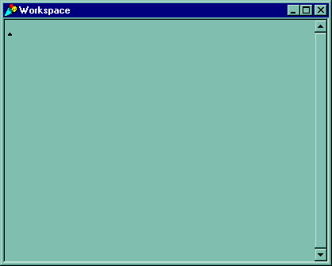
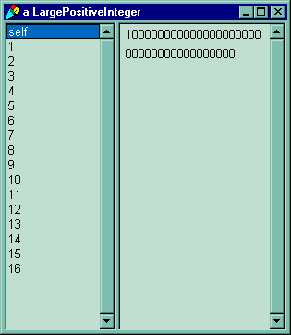
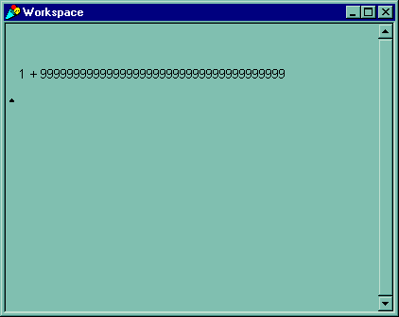
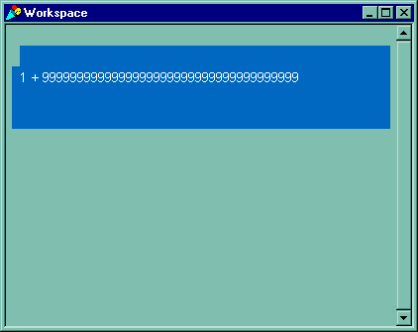
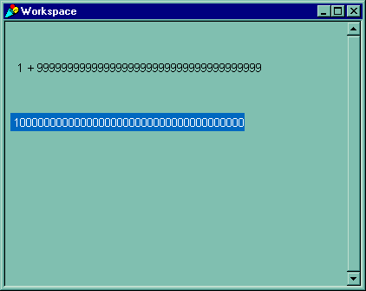


Tools – Workspace
The simplest tool that could possibly work.
Notes:
Introduce the concept of selecting code and evaluating it in place. Show a few statements and introduce the concept of building code by experimentation. Emphasize that the simplest way to make things happen it to send messages to live objects.

Slide 38
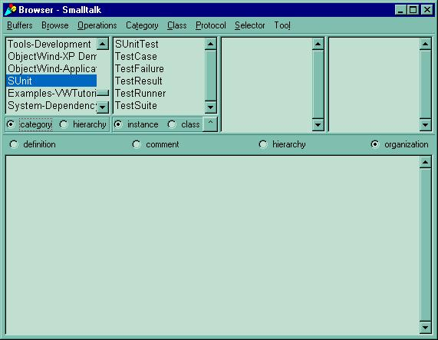
Tools - Refactoring Browser -1
Category
(Application)
Classes

Slide 39
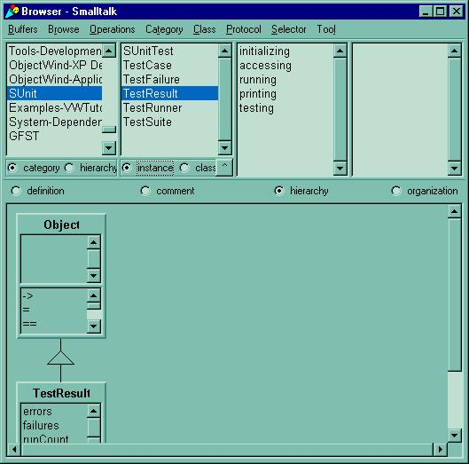
Tools - Refactoring Browser - 2
Method Protocols
(Category)
More Stuff

Slide 40
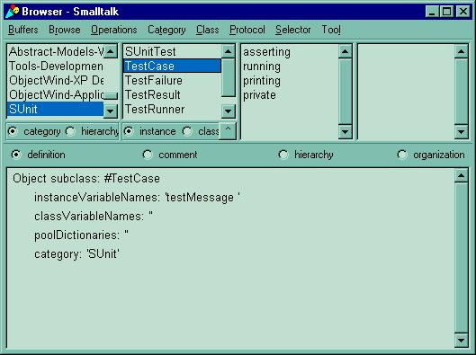
Tools - Refactoring Browser - 3
Un Selected
Protocol
Class
Definition

Slide 41
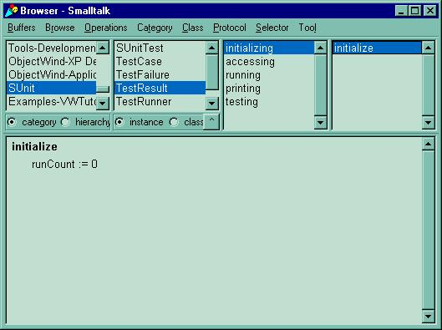
Tools - Refactoring Browser - 4
Protocol
Selected
Method
Method Code
Syntax Check
When Saving

Slide 42
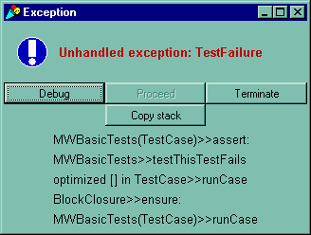
Tools - Debugger Walkback Window
Call Stack

Slide 43
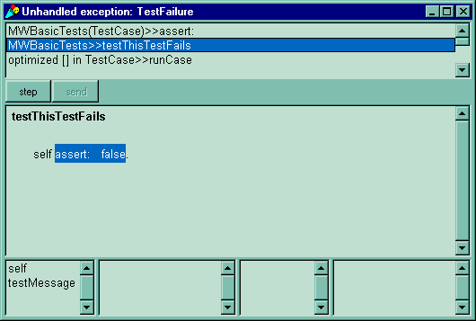
Tools -Debugger
Selectable
Call Stack
Executing
Method
Instance
Variables
Value of selected
instance variable

Slide 44

Tools – sUnit
Selectable List
of Fails and Errors

Slide 45
End of Part 1

