Slide 1
Refactoring
Improving the design of Existing Code
Mark Windholtz
ObjectWind Software Ltd

Slide 2
Who Am I
Mark Windholtz
ObjectWind Software Ltd
17 years Building Professional Software
Business, Retail, Medical, Military, Financial, etc.
First contact with XP in Oct 1996
Started Six XP teams
Consulted for Nine other XP teams

Slide 3
Time Scale
Product: Years
Release: Month(s)
Iteration: Week(s)
Acceptance Test: 1-3 Days
Episode: 1-3 hours then integrate
Test: 1 to 5 minutes
Code: 0 to 20 minutes to satisfy test case

Slide 4
XP Episode Cycle
analysis
discuss with user
test
code
design
( refactor )
integrate or toss

Slide 5
Movie Rental
Enter which movies a customer rented and for how long
Program then calculates:
  Charges which depend on
    How long the movie is rented
    Type of Movie: Regular, Children’s, or New release
  Frequent Renter Points
    Varies depending on if film is new release or not

Slide 6

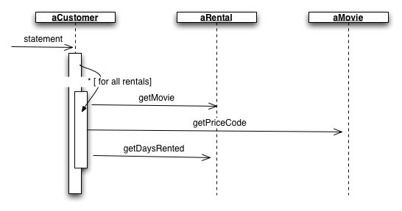
Initial Design ^{[7]} (and Code Review)
Example from: Fowler, Martin.
Refactoring: Improving the Design of Existing Code.
Addison-Wesley. 2000

Slide 7
New Customer Request
Customer wants to also print statements in HTML
  Consider the impact.
  Simple to copy and paste a whole new method
  What happens then when the rules change?
Want to change how movies are classified
  Don’t know what kind of classifications yet
  Changes could effect charge calculations
  and/or frequent renter points.
(let’s look at the statement method)

Slide 8

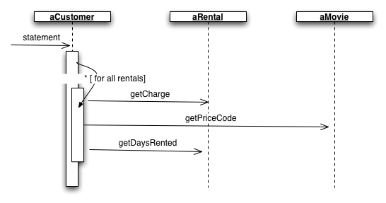
Extracted getCharge()

Slide 9
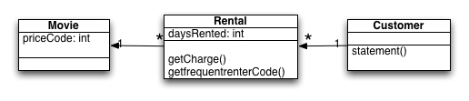
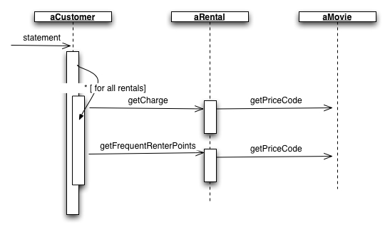
Extract, move frequent renter points 6,7

Slide 10
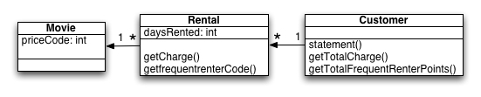
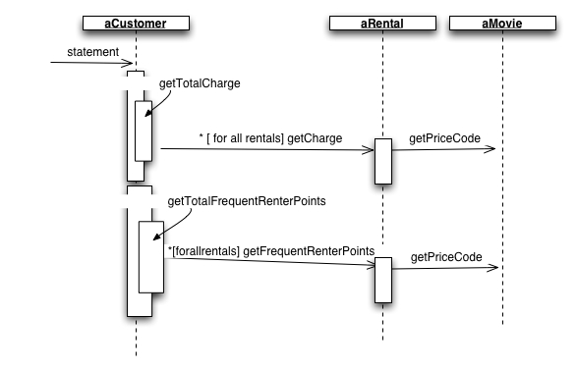
Extract totals 10,11

Slide 11
public String htmlStatement() {
String result = "<H1>Rental Record for <EM>”
+ getName() + "</EM></H1><P>\n";
Enumeration rentalsEnum = rentals.elements();
while (rentalsEnum.hasMoreElements())
{
  Rental each = (Rental) rentalsEnum.nextElement();
  // Show figures for this rental
  result += each.getMovie().getTitle()
      + ": "
      + each.getCharge()
      + "<BR>\n";
}
// Add footer lines
result += "<P>You owe <EM>"
+ getTotalCharges() + "</EM></P>\n";
result += "On this rental you earned <EM>"
    + getTotalFrequentRenterPoints()
    + "</EM> frequent renter points<P>";
return result; }

Slide 12
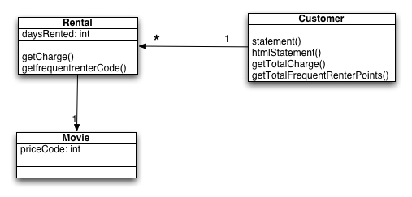
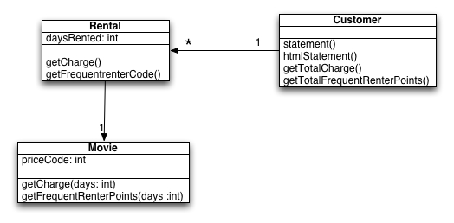
Moving methods to Movie 12,13

Slide 13
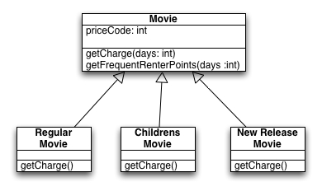
Using Inheritance on Movie 14

Slide 14
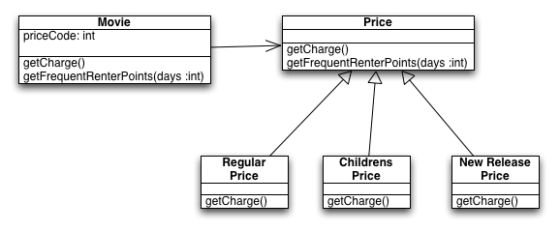
Using the State Pattern on Movie 15

Slide 15
Was it worth it?
Now it’s much easier to …
  Change price behavior
  Add new price
  Add extra price dependent behavior
In a larger (more realistic system) the number of price codes would be far greater and these changes would make a big difference
Better distribution of responsibilities
Easier to maintain
Small change, test, small change, test, etc…

Slide 16
Further Reading - 1
There are 10 kinds of people in this world. Those who read binary numbers and those who don't...
www.junit.org - testing frameworks
www.refactoring.org
Fowler, Martin. Refactoring: Improving the Design of Existing Code. Addison-Wesley. 2000
www.pairprogramming.com - resources
www.extremeprogramming.org - on-line methodology manual
www.xprogramming.org - many articles
www.objectWind.com - articles on Lean Software Development and XP

