Slide 1
One Extreme Day
Extreme Programming In One Day
Mark Windholtz
ObjectWind Software Ltd

Slide 2
Who Am I
Mark Windholtz
ObjectWind Software Ltd
17 years Building Professional Software
Business, Retail, Medical, Military, Financial, etc.
First contact with XP in Oct 1996
Started Six XP teams
Consulted for Nine other XP teams

Slide 3
The Plan for the day
30m - Introduction & Goals
60m - Concepts
60m - Day in the Life of XP
60m - Demo: Test First Programming
45m - Lunch
60m - XP Planning
90m - Exercise: Story Writing / Release Planning
90m - Demo: Refactoring
Wrap-up

Slide 4
Introduction
Instructor introduction
Classroom specifics
Room access
Restroom facilities
Start and end times
Eating facilities
Equipment & materials

Slide 5
Target Audience
Business Process Engineers: Responsible for confirming a project team’s understanding of existing business processes and identifying requirements of the future system.
Application Developers/Purchasers: Responsible for the analysis, design, selection, implementation, testing and/or deployment of the system.
IT Software Project Managers: Responsible for life-cycle project management, communicating to stakeholders & the project resources. Customers are welcome

Slide 6
Goals
Introduction to Extreme programming
Business Case for XP
XP Practices and Values
Planning in a changing world
Observe Test-first and Refactoring
Experience Iteration Estimation, Planning, and Delivery.

Slide 7
P&G-Endorsed Methodologies
Extreme programming (XP)
Rational Unified Process (RUP)

Slide 8
Class Introductions
Attendee introductions
  name,
  location,
  position
Background and interests
Attendee methodology experiences

Slide 9
The Plan for the day
Two hydrogen atoms walk into a bar.
One says, "I've lost my electron.”
The other says, "Are you sure?”
The first replies, "Yes, I'm positive..."
30m - Introduction & Goals
60m - Concepts
60m - Day in the Life of XP
60m - Demo: Test First Programming
45m - Lunch
60m - XP Planning
90m - Exercise: Story Writing / Release Planning
90m - Demo: Refactoring
Wrap-up

Slide 10
Agenda - Concepts
Standard Practices
Agile
The Business Case
  Lean Software Development
Extreme Programming

Slide 11
Standard Industry Practice
Most Software development is chaotic or bureaucratic
“Code and Fix”; or wait while doing other tasks.
Indicators
  Long Integration Phase
  Long Test Phase
  High Defect Counts

Slide 12
Solution of the 1990’s
Rigorous Heavy Process
Lots of Documents
Lots of Control Points
Blue Prints before you build

Slide 13
Why not common practice?
Not Very Successful
  if only our people would follow this great process!
Conflicting Goals
  Process vs. Product
Criticized as bureaucratic & complicated
  What's harder: building the s/w or implementing RUP?
Big Processes often introduce added organizational conflict

Slide 14
Extreme in the Middle
Compromise
  Between No Control and No Movement
  Between Chaos and Over Complicated

Slide 15
Concepts
Business
Lean Software Development
Agile
XP
Scrum
Crystal

Slide 16
Concepts
Business Model
  Lean Software Development
Approach
  Agile
Technique
  Extreme Programming, Scrum, etc …

Slide 17
Lean Thinking Companies
Fed Ex
LensCrafters
SouthWest
Toyota

Slide 18
< Lean Concepts >
Value
  What the Customer will pay for
Pull
  Respond when the Customer asks
  Not when your batch of deliverables is ready
Flow
  Move value smoothly, continuously
Perfection
  Quality is Free
  Continuous Improvement

Slide 19
Lean Goals
Remove Waste
  To increase the ratio of Value / Cost
Increase Responsiveness
  To better define Value
Amplify Learning
  So as to continuously improve…
    Identification of waste
    & Feedback cycles

Slide 20
Inventory is Waste
Inventory is a non-producing Asset
Inventory reduces responsiveness
Any Artifact not producing Current Income
Features under development are Inventory
    Don’t know if/how it will work
      until it does work (Risk)
    High Administrative costs
    Reduced response to changing markets
    Higher (Longer) Return on Investment
      Consider: Net Present Value
    Time between Idea and Market feedback

Slide 21
Phases Lead to no-value Artifacts
Specification
Phase
Design
Phase
Coding
Phase
Test
Phase
Production

Slide 22
What else is Waste?
Inventory
  Software In Process (SIP)
Defects not caught
Over -production, elaboration
Extra Process Steps
Motion getting the needed information
Waiting for information
Transportation - handoffs

Slide 23
Example 1
3 applications into production
Web portals
very complex employee transition management
Delivers every 2 weeks to production
SIP ~10
  One Defect in last 9 months
Notes:
Low defect rate enable low SIP
Provides feedback to keep defects low

Slide 24
What’s your top Problem?
That’s Easy!
Typical s/w project 6-12 months
Quiz:
  One year from now,
  what will be your top 10 business problems?
Ummm ??

Slide 25
Just In Time Software
Let Customer choose Value
Reduces waste of Over-Engineering
Deep Focus on quickest payback
Most
Important
feature
Most
Important
feature
Most
Important
feature
Most
Important
feature
Specify
Specify
Specify
Specify
Design
Design
Design
Design
Code
Code
Code
Code
Test
Test
Test
Test
Deploy
Deploy
Deploy
Deploy

Slide 26
Example 2
www.lifeware.ch
4000 tests run with every change
Changes go into production every evening
Only needed workflows implemented
Policy redemption not coded until requested
Low cost of operation
SIP = 1

Slide 27
< XP Values >
Communication
  visibility
Simplicity
  don’t solve problems you don’t have
  Remove Waste
Feedback
  define short term success/failure criteria
  Start with the end in mind
Courage
  Skiing advice: “lean forward”
  Communication + Simplicity + Feedback => Courage

Slide 28
The Plan for the day - (One Day)
Q: What's the difference between going to jail and installing a new Microsoft product on your computer?
A: When you go to jail you get one free phone call.
30m - Introduction & Goals
60m - Concepts
60m - Day in the Life of XP
60m - Demo: Test First Programming
45m - Lunch
60m - XP Planning
90m - Exercise: Story Writing / Release Planning
90m - Demo: Refactoring
Wrap-up

Slide 29
< A Day in the life of XP >
15 minute team stand-up meeting.
Pair-up
Go to the open workspace
Get a story from task board
Talk with the customer sitting with the team
Engage in programming episodes
Monitor the automated build & test system
Deliver a few fully tested, integrated business Stories
Go home at a reasonable time

Slide 30
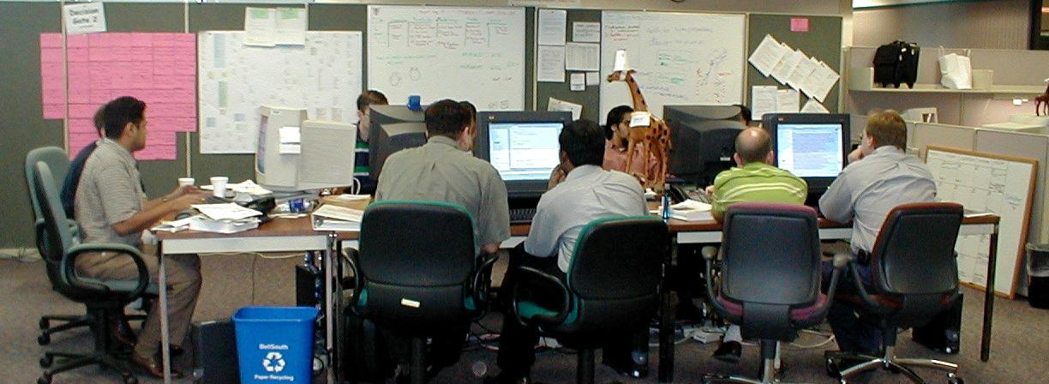
Open Workspace

Slide 31
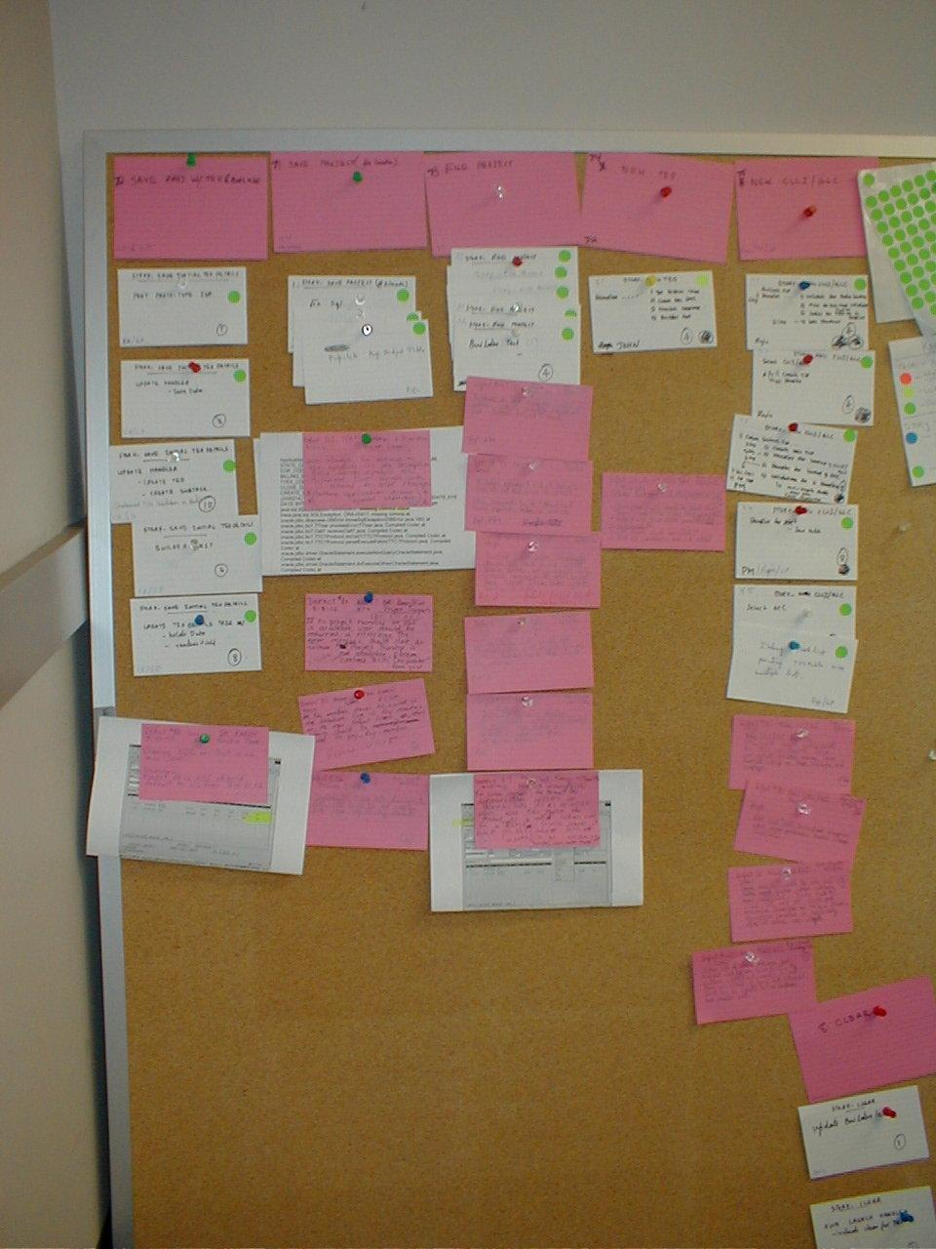
The Task Board

Slide 32
XP Episode Cycle
analysis
discuss with user
test
code
design
( refactor )
integrate or toss

Slide 33
< Core Practices >
Customer Programmer Team
How to
Define Features Iteratively
How to
Build Features Iteratively
How to
Communicate & Schedule
Planning Game
On-site Customer
Acceptance Tests
Small Releases
Test-First
Simple Design
Pair Programming
Coding Standard
Continuous Design
(Refactoring)
Open Workspace
Continuous Integration
Collective Ownership
Sustainable Pace
Ubiquitous Language
(Domain Model)

Slide 34
Customer Practices - 1
Planning Game
  Programmers estimate, Customer chooses stories
  Game means optimizing available resources
  Two types: Release planning & Iteration planning
  Adapt the plan to reality (not vise versa)
On-site Customer
  Customer representative sits with the team
  Separates business decisions from technical decisions
  Allows team to proceed quickly without fear of missing info

Slide 35
Customer Practices - 2
Acceptance Tests
  Automated end-to-end testing of Customer specified features
  Customer determines when a story is correct
  Allows continuous regression testing
Small Releases
  Go live as quickly and often as possible (4-weeks, every day?)
  Quicker feedback from customer
  Smaller ratchet steps forward
  Instills the discipline of delivery & deployment

Slide 36
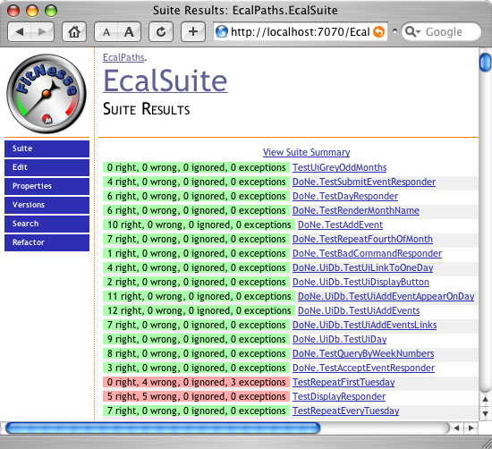
EcalSuite

Slide 37
Programmer Practices - 1
Test-First
  All production code is written after a failing test
  Start with the end in mind
  Defines the task completion criteria
  Defines the interface
  Supports Continuous Integration
Simple Design
  Design the simplest thing that could possibly work
    Passes all tests
    Expresses all concepts clearly
    No Duplicate code
    Fewest Classes and Methods
  Don’t solve problems you don’t have
  Easier to understanding, maintain, and extend
  Eliminates Over-Engineering

Slide 38
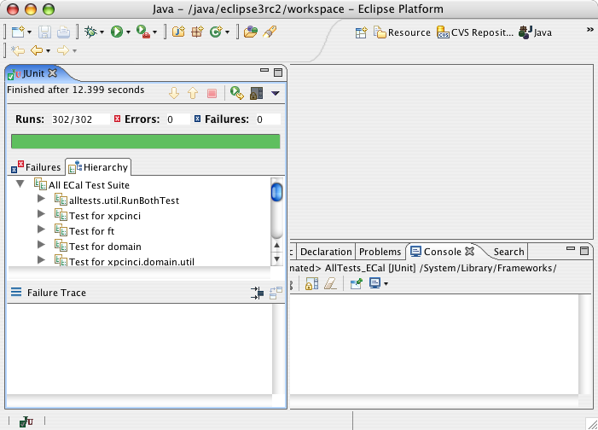
JUnit TestRunner in Eclipse 3.0

Slide 39
Unit & Functional Tests

Slide 40
Unit & Functional Tests w/ Notes
Iteration 012 3 4 5 6 7 8 9 10 11 12 13 14 15 16 17 18

Slide 41
Programmer Practices - 2
Coding Standard
  Code should look similar across whole the system
  Code is quickly understood
  Code is quicker to write
  No code castles
Continuous Design (Refactoring)
  Continuously Eliminate duplicate code
  Allows for Micro-design
  Eliminates the waste of duplicate code
  Supports the growth of the Domain Model
  Increases code reuse
  Decreases effort in fixing defects
  Decreases effort in changing code when features tomorrow

Slide 42
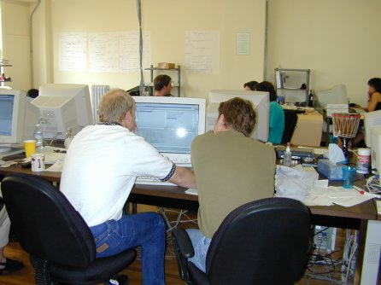
Programmer Practices - 3
Pair Programming
  All production code written by two programmers on one keyboard
Code review is good,
So review all code as it is typed in
One person types (tactical)
One person thinks (strategic)
Roles switch continuously
Fewer defects
Reduces unneeded tasks
Increases spread of understanding
Reduces bottlenecks

Slide 43
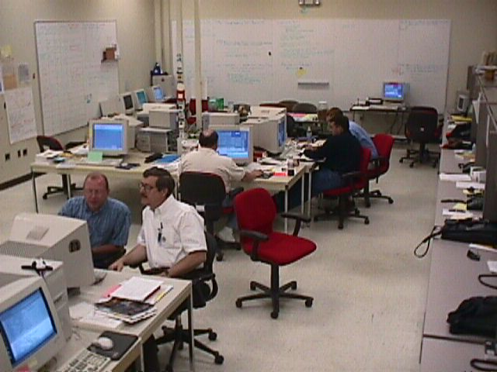
Pair Programming Photos

Slide 44
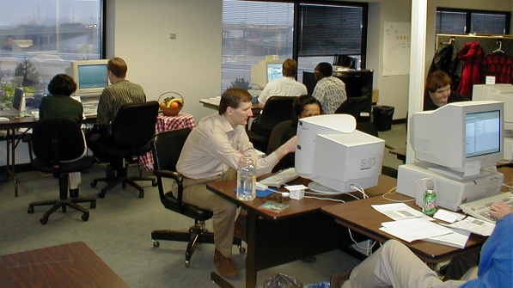
Pair Programming

Slide 45
Team Practices - 1
Open Workspace
  Team sits together in the same room
  Remove barriers to communication
  It’s not noise if it’s related to the same project
  Allows valuable Incidental Communications
  Best flow of information
Continuous Integration
  Integrate Code Often (every 1-2 hours)
  Small Integrations are painless
  Eliminated need to branch and merge the source tree
  Reduces task dependencies to minimum
  Increases visibility of project progress
  Allows automated build and test to run continuously

Slide 46
Auto Build
Build tools
  Cruise Control
  Anthill
What it does
  Check out of source control
  Build code on clean machine
  Run unit tests
  Run Acceptance tests
  Run metrics
  Version stamps passing code
  Email report of unexpected results
  Details available on a web interface

Slide 47
* Cruise Control Example
<< insert screen capture >>

Slide 48
Team Practices - 2
Collective Ownership
  Removes code castles
  Reduces Information Hoarding (no squirrels)
  Encourages coding standard
Sustainable Pace
  Increases accuracy of planning
  Reduces defects from burned out programmers
Ubiquitous Language
  Metaphor (original)
  System of Names
  Domain Model, Ubiquitous Language (Eric Evans)
  Conceptual Integrity (Fred Brooks)

Slide 49
Practices Support Each Other
On-site Customer
Planning Game
Sustainable Pace
Ubiquitous
Language
Simple Design
Short Releases
Testing
Refactoring
Continuous
Integration
Pair Programming
Tools available
Coding Standards
Workshops available
Collective Ownership

Slide 50
Simple Process
People easily know what they should do.
People talking together, and learning.
Tested and running clean code.
Short term measured goals.
Defined Completion and Quality
Focus on Sustainable, Repeatable, Deployment

Slide 51
Quality code is faster to produce
Quality
  Pair Programming
  Unit testing, Acceptance Testing
  Anyone can clean the code
Less Backtracking
  80% Less debugging
  Dramatically Less Defects
Clean, Tested code is easier to change than a UML model

Slide 52
The Plan for the day
What did the zero say to the eight?
Nice belt.
30m - Introduction & Goals
60m - Concepts
60m - Day in the Life of XP
60m - Demo: Test First Programming
45m - Lunch
60m - XP Planning
90m - Exercise: Story Writing / Release Planning
90m - Demo: Refactoring
Wrap-up

Slide 53
< Demo: Test First >
Ecal is a web based Event Calendar application being built
Open-Source for Children’s Hospital by the xp-cinci User’s Group.
    (xp-cinci is Extreme-Programming users group of Cincinnati, www.objectwind.com/xp-cinci )
add a new feature to ECal.
Event scheduling on a day-of-month.
You will see:
  Acceptance Testing with FitNesse to set completion criteria
  Unit testing with jUnit, failing tests then successful tests
  How tests lead to the next logical implementation step

Slide 54
The Plan for the day - Lunch
A sandwich walks into a bar.
The bartender looks and him and says,
"Hey, we don't serve food here."
30m - Introduction & Goals
60m - Concepts
60m - Day in the Life of XP
60m - Demo: Test First Programming
45m - Lunch
60m - XP Planning
90m - Exercise: Story Writing / Release Planning
90m - Demo: Refactoring
Wrap-up
Q: Whats black and white and moos like a cow?
A: A Cow.

Slide 55
The Plan for the day - Planning
Werner Heisenberg is pulled over by a policeman who says, "Do you know how fast you were going?"
Heisenberg answers, "No, but I know exactly where I am.
30m - Introduction & Goals
60m - Concepts
60m - Day in the Life of XP
60m - Demo: Test First Programming
45m - Lunch
60m - XP Planning
90m - Exercise: Story Writing / Release Planning
90m - Demo: Refactoring
Wrap-up

Slide 56
Delivering to Deadline
  XP is about delivering to deadline.
  Every two weeks you release something
  and every two weeks you check your plan.
  You get really good at getting stuff done.
        - James Grenning, ObjectMentor

Slide 57
Need for Planning
General Dwight D. Eisenhower said
    In preparing for battle, I have always found that
    plans are useless, but planning is indispensable.
Don’t let the plan become more central than reality
Management is about building realistic plans, and adjusting the plan as reality changes

Slide 58
What Management Gets
Management gets …
  An Overall release plan (What, when, and how much)
  Most value out of each programming week
  Visible Progress: code running repeatable tests
  To Change direction as business changes
  Be informed early of schedule changes

Slide 59
What Programmers Get
Programmers are …
  told what is needed in priority order
  Allowed to produce quality work
  Allowed to ask for help
  Allowed to make and update estimates
  Allowed to accept responsibility

Slide 60
Business to Code Process
Product is a bunch of …
Release is a bunch of …
Iteration is a bunch of …
Acceptance Tested Stories is a bunch of …
Episode is a bunch of …
Test is a bunch of …
Code

Slide 61
Time Scale
Product: Years
Release: Month(s)
Iteration: 1-2 Week(s)
Acceptance Test Story : 1-3 days
Episode: 1-3 hours then integrate
Test: 1 to 5 minutes
Code: 0 to 20 minutes to satisfy test case

Slide 62
User Story
Written on an index card by the Customer
Simple title to remind everyone of the feature
Business focused feature
Promise to continue the conversation to get more detail later
  Information Just-In-Time
Story completion is checked by an Acceptance test
Four operations on a User Story for planning
  Discuss it until enough detail to estimate
  Split it if it’s too big
  Spike it if the technology is not understood
  Estimate it

Slide 63
Example User Stories
Student purchase monthly parking pass online.
Accept credit card payment
Accept PayPal ™ payment
Professor input student grades
Student view of current seminar schedule
Student order of official transcripts.
Students can only enroll in seminars for which they have prerequisites
Transcripts will be available online
Support for browsers: IE, FireFox, &Safari

Slide 64
What is Progress?
A Story is either Done or Not Done
  70% done is meaningless
Done means done!
  Done but not tested is meaningless
  Done but not integrated is meaningless
Code is written in small, running, tested pieces
No large leaps forward in a fog …
… and falling off a cliff

Slide 65
Velocity
Stories are estimated
  1 to 3 ideal days or hours
  Measured in relative story points
How many story points were delivered?
Historical velocity data
  Rough (but real) predictor future progress
  Cost, scope, schedule

Slide 66
Release Planning Game
(Exploration )
Write a Story
(Customer)
“Too Big”
“Don’t Know”
Split
the Story
(Customer)
Rough
Estimate
a Story
(Programmers)
Spike
the Story
(Programmers)
Go to Planning
Goal
  Understand what the system is to do
Result
  A working set of estimates

Slide 67
Release Planning Game
(Planning )
Sort Stories
by Value
(Customer)
Declare
Velocity
(Programmers)
Choose
Scope
(Customer)
Goal
  Plan the next Release so it gives the most bang for the buck.
Input
  Set of estimated stories
Result
  A prioritized list of stories currently planned to by included in next release

Slide 68
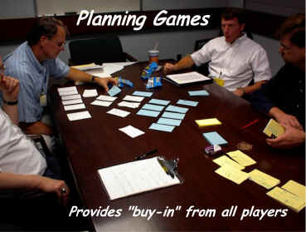
Release Planning

Slide 69
Iteration Planning Game
( finding a fit )
Biz
  Scope
  Priority
  Features per Release
  Date of Release
Tech
  Estimates
  Consequences
  Process
  Detailed Schedule
Feature Requests
Estimates & Budget
What’s in / What’s out

Slide 70
Iteration Planning Activities (4-8 hours)
Large meeting room with white boards and room to pace
Snacks and toys provided
Begin with Retrospective
  Review of previous iteration
  Calculate previous iteration velocity results
  Improvement plan
Customer provides stories for iteration
Discussion
Spike (experiments)
Initial High level design of each Story as needed
Estimation of Stories
Splitting Large Stories
Programmers sign-up and commit to individual stories

Slide 71
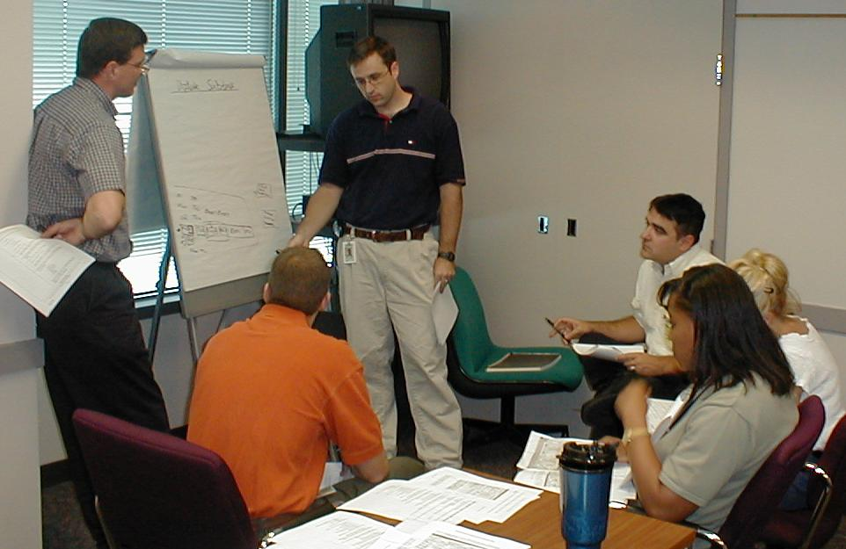
Iteration Planning

Slide 72
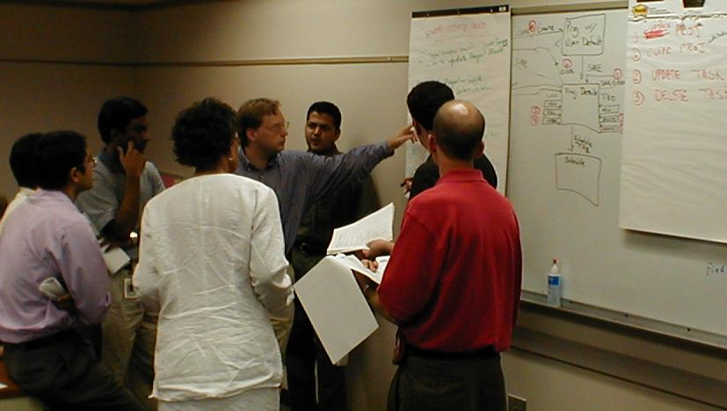
Iteration Planning

Slide 73
Iteration Planning Results
List of stories and tasks for the iteration
Basic design for each story is understood
Estimate for each story has been committed to by a programmer
Story cards are posted on the Task board with the initials of the programmer
Programmers can begin coding the Stories
Customer can begin defining the Acceptance tests for those stories

Slide 74
Time Scale
Product: Years
Release: Month(s)
Iteration: Week(s)
Acceptance Test: 1-3 Days
Episode: 1-3 hours then integrate
Test: 1 to 5 minutes
Code: 0 to 20 minutes to satisfy test case

Slide 75
XP Episode Cycle
analysis
discuss with user
test
code
design
( refactor )
integrate or toss

Slide 76
The Plan for the day - Exercise
A neutron walks into a bar and orders a drink.
The bartender says: “for you, no charge”.
30m - Introduction & Goals
60m - Concepts
60m - Day in the Life of XP
60m - Demo: Test First Programming
45m - Lunch
60m - XP Planning
90m - Exercise: Story Writing / Release Planning
90m - Demo: Refactoring
Wrap-up

Slide 77
Story Writing Exercise: 90 minutes
Q: What did the cannibal say about the clown?
A: “He tastes funny.”
Project Charter: Build a better mouse trap
Split into a customer, & developers
Customer writes stories, and acceptance tests
Developers estimate, design, and implement (by drawing) a solution.
Customer runs acceptance tests on the solution

Slide 78
The Plan for the day - Wrap
A neutron walks into a bar and orders a drink.
The bartender says: “for you, no charge”.
30m - Introduction & Goals
60m - Concepts
60m - Day in the Life of XP
60m - Demo: Test First Programming
45m - Lunch
60m - XP Planning
90m - Exercise: Story Writing / Release Planning
90m - Demo: Refactoring
Wrap-up

Slide 79
Continuous Feedback
Continuous…
  Code reviews (pair programming)
  Unit testing
  Integration testing
  User acceptance testing
Feedback through estimation, testing, short releases
  Gives user confidence
  Gives developers confidence
  Gives Management confidence
  Growing Software (iterative process)
Use feedback to update the Plan

Slide 80
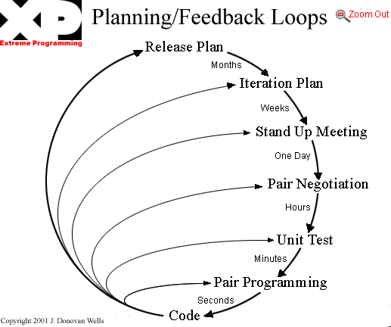
Feedback Loops

Slide 81
Continuous Best Practices -1
If design is good, make it everyone’s job (Refactoring, domain design)
If simplicity is good, use the simplest design that supports the current features (simple design)
If delivering code is good, make iterations really short (days instead of months)? (short releases & acceptance testing)

Slide 82
Continuous Best Practices - 2
If code reviews are good, do it all the time (pair programming)
If testing is good, do it all the time…even customers? (continuous unit and acceptance testing)
If integration testing is good, do it several times a day? (continuous integration)

Slide 83
Transition to XP
Culture shift can be difficult for Developers and Managers
Requires experienced OO developers (but not gurus)
May not get all practices, all the time
A good XP coach can help guide team to
  Work with what you’ve got
  Add practices as needs appear
  Increase testing and OO design skills
  Diffuse common interpersonal conflicts
  See how the practices save effort and time
  Keep the team on-task in a changing environment

Slide 84
Challengers to XP success
Additional practices may be needed when attempting
  Rigid organizations (controls instead of goals)
  Fearful organizations (shoot the messenger)
  Rewards based on input rather than results
    The time spent at work is primary measure of employee value.
  Prima donna developers
    Sub-species: Information Hoarders (squirrels)
  Wrong physical environment (isolated cubes)
  Large teams over 35 ^{[16]}
  Distributed “team” members
  See: www.industrialxp.org

Slide 85
XP and the wider world
Documentation?
  Focus on cleaner, unit tested, peer reviewed code.
  Other documentation as needed (consider a wiki).
  Be aware that it is an expense
XP & UML?
  Use UML if it helps. Be aware that it is an expense
  Don’t let “pictures” and models bog you down
  Don’t be afraid of reading the code
  See “Agile Modeling” ^{[14]}
XP & RUP
  RUP provides an XP Plug-in
Does XP work within context of CMM?
  XP practices map to CMM processes ^{[12,13]}

Slide 86
< XP & RUP >
Characteristics
Extreme Programming
Rational Unified Process
Project Size
Small to medium
Medium to large
Delivery time
Need quick delivery
Can afford to take longer, developing key modules
Number of development resources
Up to a 20 programmers
More than a 20
Programmer Approach
Programmers work together in same room, and contribute their entire skill set.
Geographically dispersed programmers. May have a need for role separation.
Code Review Approach
Pair programming, Test-First, aggressive Refactoring, continuous Integration, automated builds.
Code reviews with more than two programmers. Accepts code duplication.
Iteration Size
End to end, iterations may be 1, 2 or 3 weeks long
Iterations may be longer than 3 weeks.
Release Approach
Characterized by small and often releases. Start with small, useful feature set. Customers are available to accept multiple releases.
Releases can be planned out. May include larger module releases. Customer may want single release to minimize user impact.
Project Documentation
The code and tests are the documentation. Other models as needed.
Allows for visual models. Models may be used to generate downstream code.

Slide 87
References - 1
There are 10 kinds of people in this world. Those who read binary numbers and those who don't...
XP Cincinnati, Users Group www.objectwind.com/xp-cinci
  Local group to explore tools, techniques, and practices of XP
Beck, Kent. Extreme Programming explained, 2000
Fowler, Martin. “The New Methodology”. Nov 2001. www.martinfowler.com/articles/newMethodology.html
Jefferies, Ron. “They’re called practices for a reason”, Sept 2000. www.xprogramming.com/xpmag/PracticesForaReason.htm
www.junit.org - testing frameworks
www.refactoring.org
Fowler, Martin. Refactoring: Improving the Design of Existing Code. Addison-Wesley. 2000
www.pairprogramming.com - resources
www.extremeprogramming.org - on-line methodology manual
www.xprogramming.org - many articles
www.objectWind.com - articles on Lean Software Development and XP

Slide 88
References -2
A thief broke into the local police station and stole all the toilets. A spokesperson was quoted as saying, "The police have absolutely nothing to go on."
Paulk, Mark (SEI). “XP from a CMM Perspective”. Invited Talk. XPUniverse, July 2001. Raleigh, NC.
http://c2.com/cgi/wiki?ExtremeProgrammingRoadmap - The Extreme Programming Roadmap on the Portland Pattern Repository. Where most of the discussions and good information take place in Wiki-style.
www.agilemodeling.com – Scott Ambler’s site
www.agilealliance.org - Non-profit organization dedicated to promote agile methodologies
Agile Software Development in the Large - Diving Into the Deep, by Jutta Eckstein; Dorset House, New York, 2004 ISBN 0-932633-57-9
The Central Florida Patterns Group http://groups.yahoo.com/group/cflpatternsgroup/
Industrial XP, additional Practices for large scale XP - www.industrialxp.org

Slide 89
References -3
P&G Internal Web Sites
Sys Dev Competency Web Site : http://edlecom1.na.pg.com/sysdevcomp/default.htm
Sys Dev Competency COP Teamspace: http://sysdevcomp.internal.pg.com/
Java Community Of Practice Teamspace: http://javacop.pg.com/
.NET Community Of Practice Teamspace: http://dotnetdev.pg.com/
External Web Sites
Articles: www.xprogramming.org
Articles: www.objectmentor.com/resources/articleIndex
Extreme Programming: www.extremeprogramming.org
Agile Modeling: www.agilemodeling.com
Modeling: www.modelingstyle.info
Agile Alliance: www.agilealliance.com
Unit Testing: www.junit.org
Conferences: www.xpuniverse.com

Slide 90
References - 4
Some Useful Books
Extreme Programming Explained: Embrace Change by Kent Beck
Planning Extreme Programming by Kent Beck, Martin Fowler
Agile Software Development, Principles, Patterns, and Practices by Robert C Martin
Agile Software Development by Alistair Cockburn
Agile Modeling: Effective Practices for Extreme Programming and the Unified Process
by Scott W. Ambler, Ron Jeffries
Writing Effective Use Cases by Alistair Cockburn
Lean Software Development (An Agile Toolkit) by Mary Poppendieck
Refactoring: Improving the Design of Existing Code by Martin Folwer, Addison-Wesley. 2000

