Slide 1
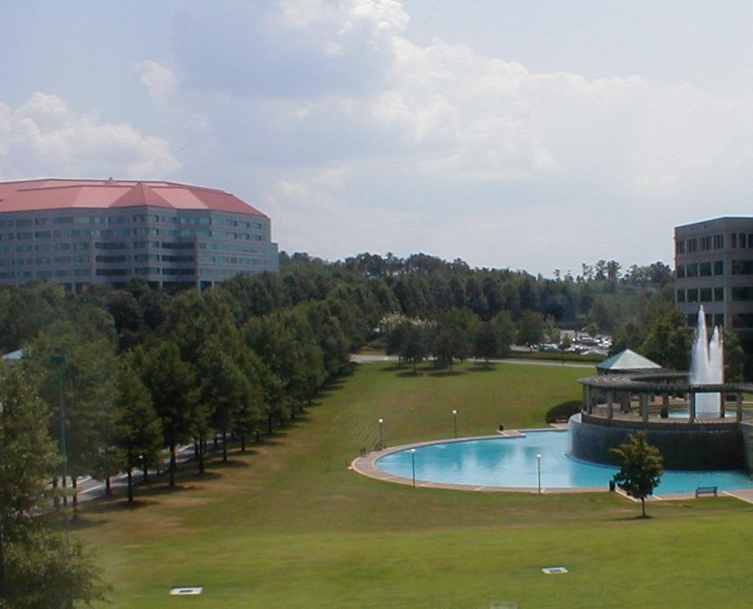
A Day In The Life of an Extreme Programmer
Mark Windholtz
ObjectWind
Software Ltd

Slide 2
Agenda -1
Why XP
A Day in the Life
Why does it work?

Slide 3
Standard Industry Practice
Most Software development is chaotic
“Code and Fix”
Indicators
  Long Integration Phase
  Long Test Phase
  High Defect Counts
  “Second Attempt” Analysis Paralysis

Slide 4
Solution of the 1990’s
Rigorous Heavy Process
Lots of Documents
Lots of Control Points
Blue Prints before you build

Slide 5
Why not common practice?
Not Very Successful
  if only our people would follow this great process!
Conflicting Goals
  Process vs. Product
Criticized as bureaucratic & complicated
  What's harder: building the s/w or implementing RUP?
Big Processes often introduce added organizational conflict

Slide 6
Extreme in the Middle
Compromise
  Between No Control and No Movement
  Between Chaos and Over Complicated

Slide 7
Agenda -2
Why XP
A Day in the Life
Why does it work?

Slide 8
Delivering to Deadline
  XP is about delivering to deadline.
  Every two weeks you release something
  and every two weeks you check your plan.
  You get really good at getting stuff done.
        - James Grenning, ObjectMentor

Slide 9
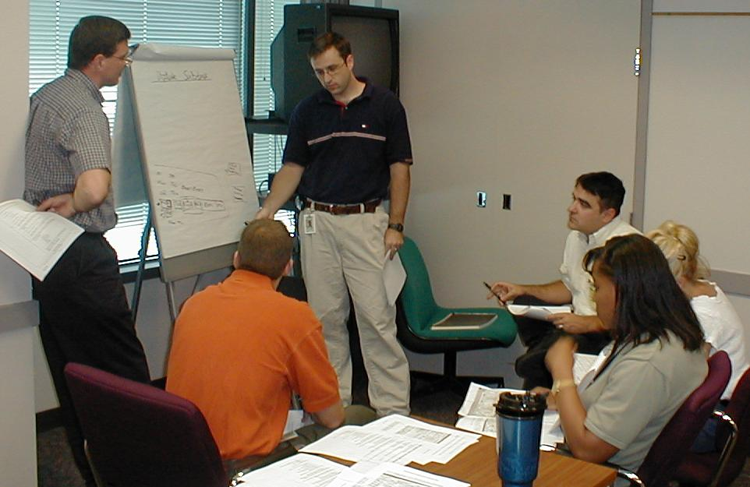
Team Planning

Slide 10
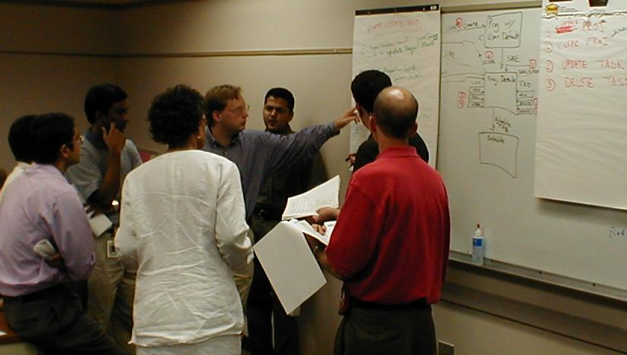
Iteration Planning

Slide 11
A Day in the life of XP
15 minute team stand-up meeting.
Pair-up on a task.
Go to the open workspace
Where the customer sits with the team
A number of Programming episodes.
Improve any code that smells bad.
Go home at a reasonable time.

Slide 12
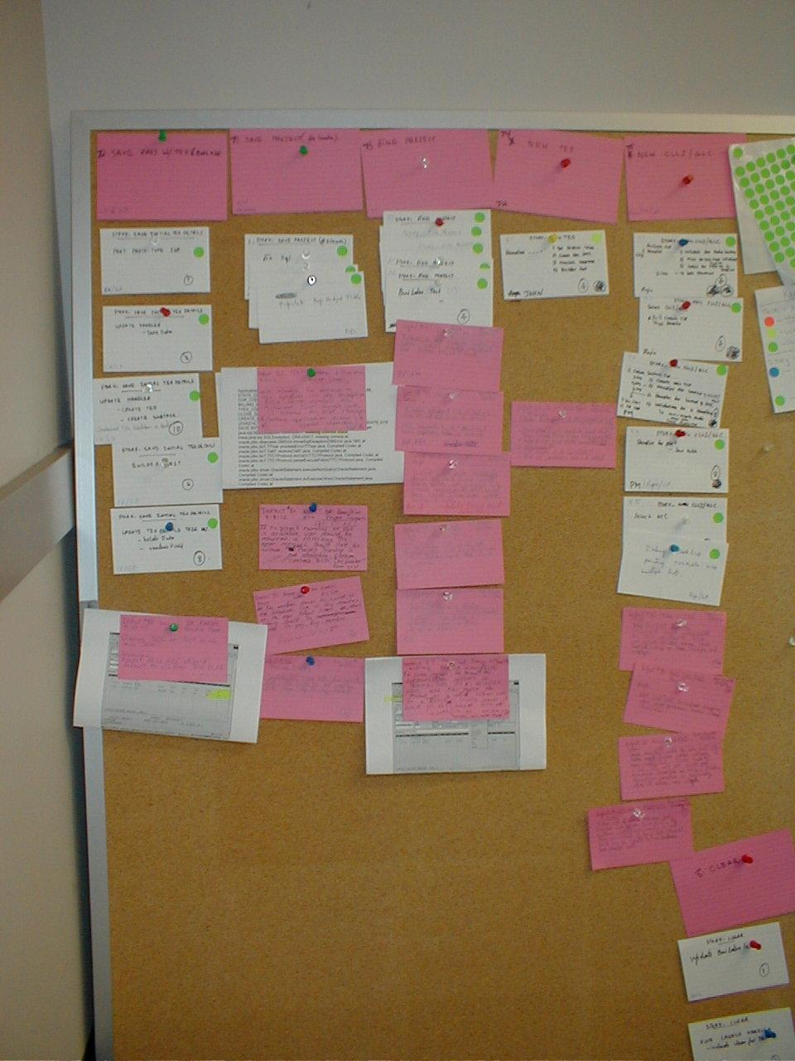
The Task Board

Slide 13
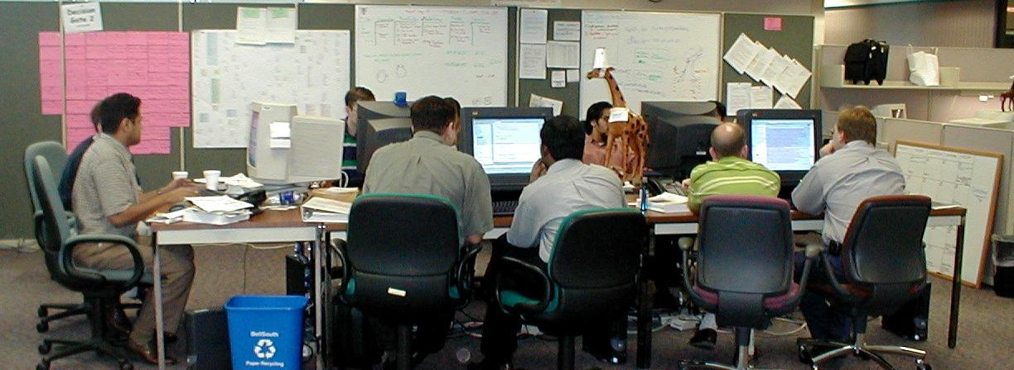
Open Workspace

Slide 14
XP Episode Cycle
analysis
discuss with user
test
code
design
( refactor )
integrate or toss

Slide 15
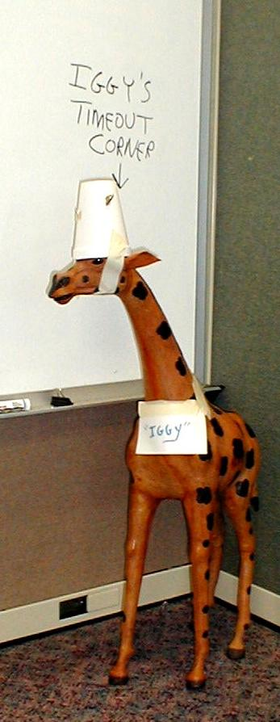
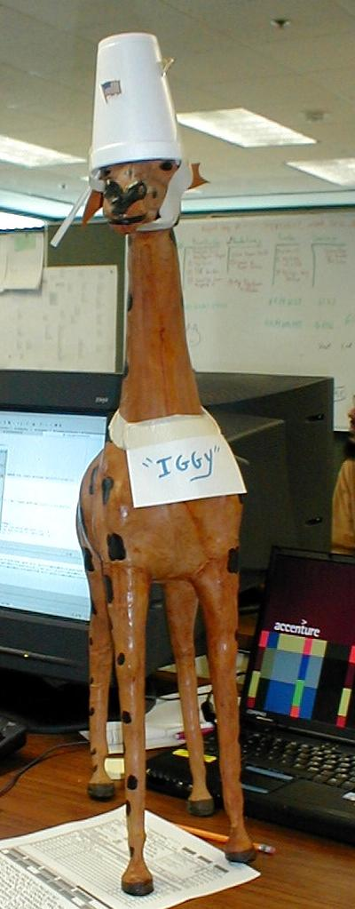
Integration
“Token”

Slide 16
Core Practices
Customer Programmer Team .
How to
Define Features Iteratively
How to
Build Features Iteratively
How to
Communicate & Schedule
Small Releases
Planning Game
On-site Customer
Open Workspace
Continuous Integration
Collective Ownership
Sustainable Pace
Test-First
Pair Programming
Continuous Design Improvement
Simple Design
Coding Standard

Slide 17
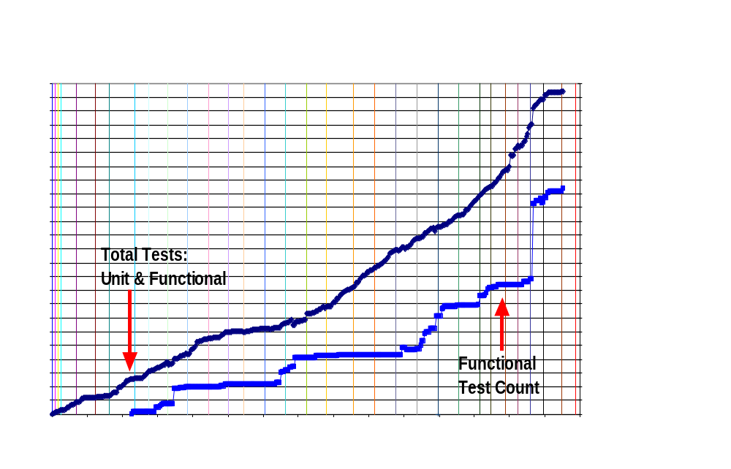
Unit & Functional Tests

Slide 18
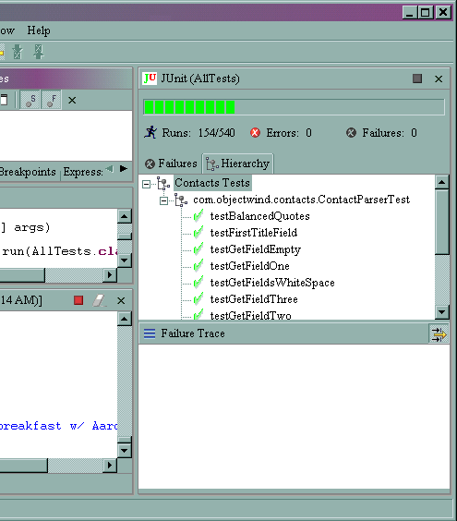
JUnit TestRunner in Eclipse

Slide 19
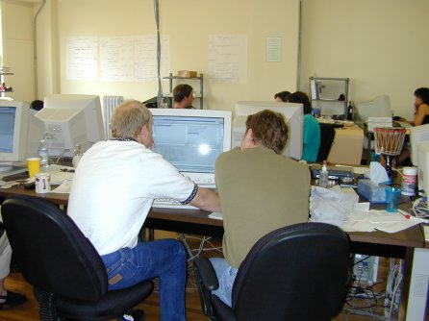
Pair Programming
Code review is good,
So review all code as it is typed in
One person types (tactical)
One person thinks (strategic)

Slide 20
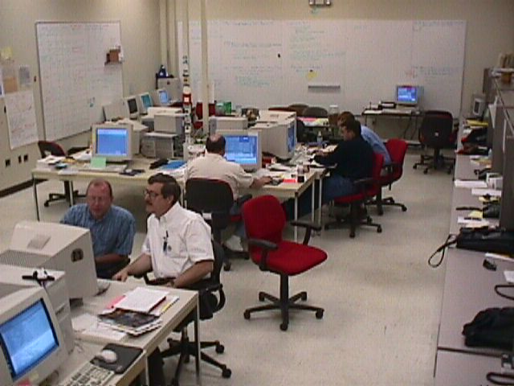
Pair Programming Photos

Slide 21
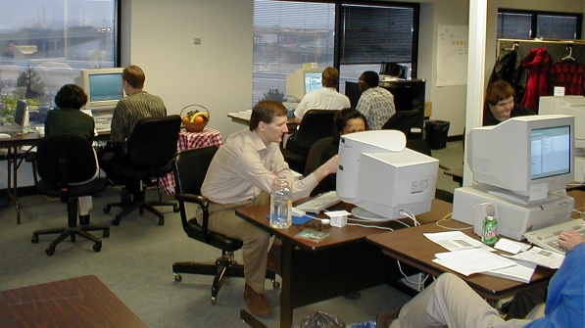
Pair Programming Photos

Slide 22
Agenda -3
Why XP
A Day in the Life
Why does it work?

Slide 23
Simple Process
People talking together, and learning.
Tested and running clean code.
Short term measured goals.
Practice of Agility in everything.
As Japan taught Detroit
  Quality can be free

Slide 24
Quality code faster to produced
Quality
  Pair Programming
  Unit testing, Acceptance Testing
  Anyone can clean the code
Less Backtracking
  80% Less debugging
  Dramatically Less Defects
Clean, Tested code is easier to change than a UML model.

Slide 25
Summary
Why
  There was chaos
  Big design produced a poor record
What
  A simple, more predictable way to work
Why does XP work?
  Supports Complex Systems approach
  Simple Process
  Quality code is faster to build

Slide 26
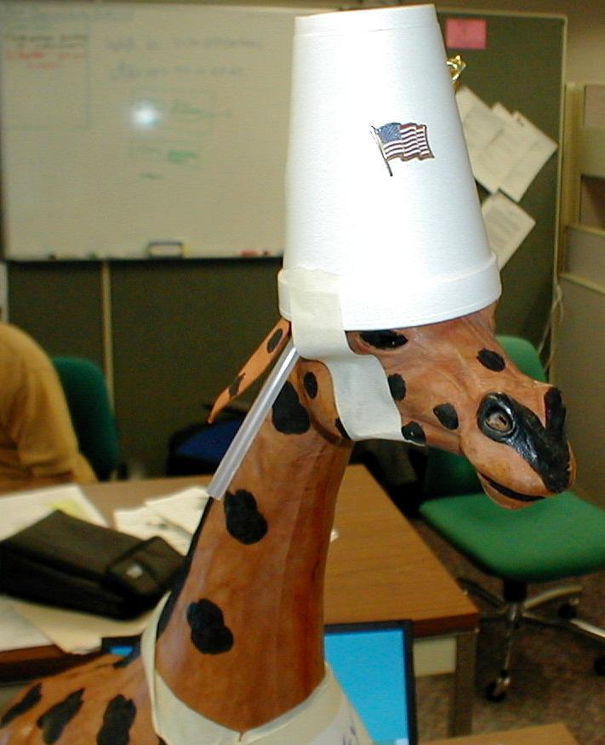
Say “Goodbye” Iggy
OK.
Goodbye,
Iggy.

