Slide 1
XP is Extreme Programming
Planning XP
Mark Windholtz
ObjectWind Software Ltd

Slide 2
Delivering to Deadline
  XP is about delivering to deadline.
  Every two weeks you release something
  and every two weeks you check your plan.
  You get really good at getting stuff done.
        - James Grenning, ObjectMentor

Slide 3

A Local XP Team

Slide 4
What Management Gets
Management gets …
  An Overall release plan (What, when, and how much)
  Most value out of each programming week
  Visible Progress: code running repeatable tests
  To Change direction as business changes
  Be informed early of schedule changes

Slide 5
What Programmers Get
Programmers are …
  told what is needed in priority order
  Allowed to produce quality work
  Allowed to ask for help
  Allowed to make and update estimates
  Allowed to accept responsibility

Slide 6
Business to Code Process
Product is a bunch of …
Release is a bunch of …
Iteration is a bunch of …
Acceptance Test is a bunch of …
Task is a bunch of …
Episode is a bunch of …
Test is a bunch of …
Code

Slide 7
Time Scale
Product: Years
Release: Month(s)
Iteration: Week(s)
Acceptance Test: Small piece of Biz value
Task: Technical task
Episode: 1-3 hours then integrate
Test: 1 to 5 minutes
Code: 0 to 20 minutes to satisfy test case

Slide 8
Release Planning Game
(Exploration )
Write a Story
(Customer)
“Too Big”
“Don’t Know”
Split
the Story
(Customer)
Estimate
a Story
(Programmers)
Spike
the Story
(Programmers)
Go to Planning
Goal
  Understand what the system is to do
Result
  A working set of estimates

Slide 9
Release Planning Game
(Planning )
Sort Stories
by Value
(Customer)
Declare
Velocity
(Programmers)
Choose
Scope
(Customer)
Goal
  Plan the next Release so it gives the most bang for the buck.
Input
  Set of estimated stories
Result
  A prioritized list of stories currently planned to by included in next release

Slide 10
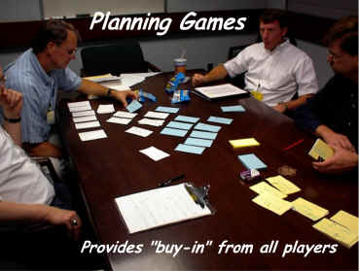
Iteration Planning Game
( finding a fit )
Biz
  Scope
  Priority
  Features per Release
  Date of Release
Tech
  Estimates
  Consequences
  Process
  Detailed Schedule
Feature Requests
Estimates & Budget
What’s in / What’s out

Slide 11
Time Scale
Product: Years
Release: Month(s)
Iteration: Week(s)
Acceptance Test: Small piece of Biz value
Task: Technical task
Episode: 1-3 hours then integrate
Test: 1 to 5 minutes
Code: 0 to 20 minutes to satisfy test case

Slide 12
XP Episode Cycle
analysis
discuss with user
test
code
design
( refactor )
integrate or toss

Slide 13
Velocity
Tasks are estimated
  1 to 3 ideal days
  Measured in relative task points
How many task points were done?
Historical velocity data
  Rough (but real) predictor future progress
  Cost, scope, schedule

Slide 14
What is Progress?
A Task is either Done or Not Done
  70% done is meaningless
Done means done!
  Done but not tested is meaningless
  Done but not integrated is meaningless
Code is written in small, running pieces
No large leaps forward in a fog …
… and falling off a cliff

Slide 15
Unit Tests
All production code is tested
Tests provide incremental certitude
Test graph
  Rough measure of accomplishment
  Quick indicator of a stalling project

Slide 16
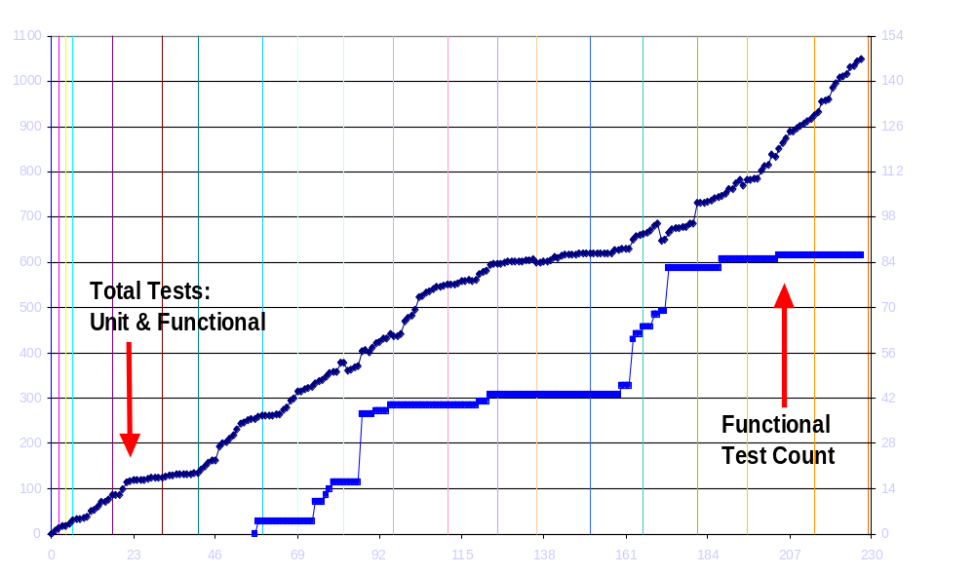
Unit & Functional Tests: 7/30
Iteration 012 3 4 5 6 7 8 9 10 11 12 13 14 15 16 17 18

Slide 17
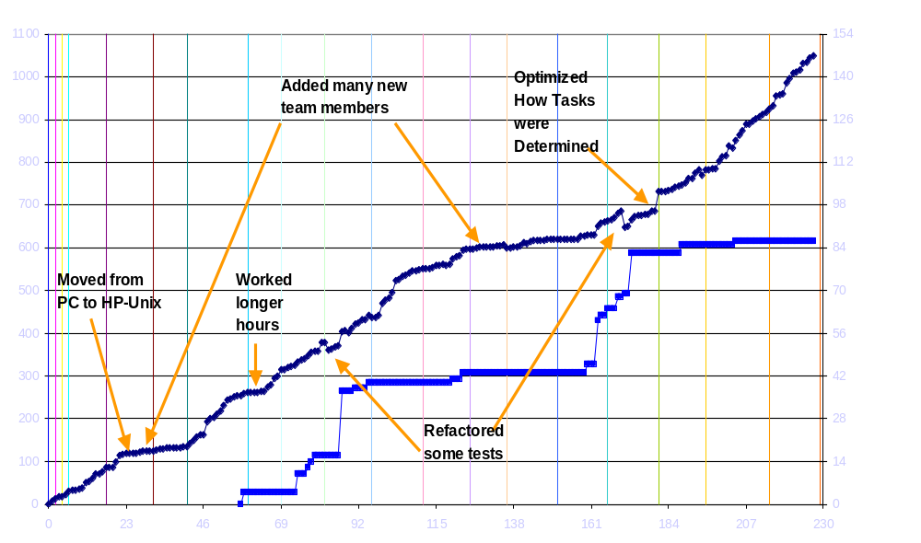
Unit & Functional Tests w/ Notes
Iteration 012 3 4 5 6 7 8 9 10 11 12 13 14 15 16 17 18

Slide 18
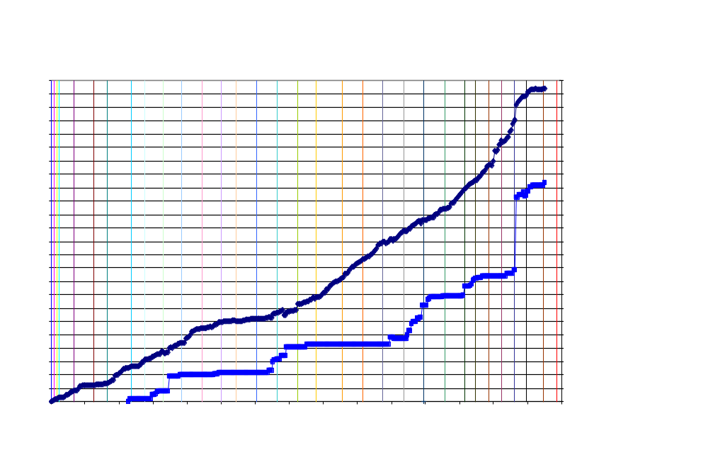
Unit & Functional Tests: Feb 2002

Slide 19
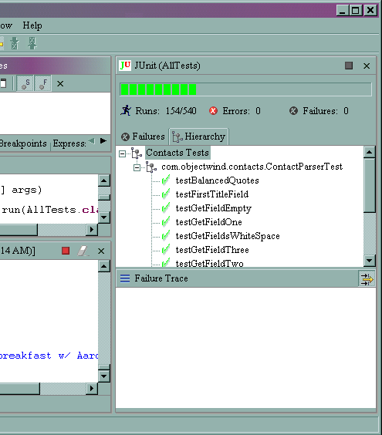
JUnit TestRunner in Eclipse

