Slide 1
Pure Objects in Smalltalk
What is Pure OO?
Smalltalk the Language.
A Working Example.

Slide 2
Introduction & Warning
Syntax Overview Last Session
  That Was Only One Hour.
Now a Working Example
  This is also an Overview
  This is also Only One Hour.
Hopefully Interesting.
But Cannot Be Complete.
Normally class #3 in college course

Slide 3
Agenda
Review Image, Tools, Syntax
Problem Statement
Build OO Model
Code It
Add a GUI

Slide 4





Major Smalltalk Components
Smalltalk Image
Development
Objects
Your Objects
Base Objects
Virtual Machine
‘C’ Functions
Operating System

Slide 5

Model & View
Smalltalk Image
15 negative
15

Slide 6
Development Tools
Transcript Window (out)
file not found
Workspace (in)
Date today
Class Browser
Debugger
Smalltalk Image

Slide 7
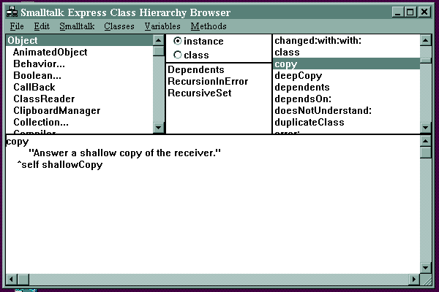
Class Browser
Classes
Variables
Methods
Method Code

Slide 8
Hello World
Transcript
  Global variable for the transcript Window.
  Send messages to Transcript.
Transcript show: ‘Hello World’.

Slide 9
Method Syntax
exampleMethod
exampleMethod “Method Name”
| anObject | “Method Variable”
“Your Comments here” “Comments”
“ . . . ” “Implementation”
^ anObject. “Return”

Slide 10
House Example
Model a house.
The House has multiple rooms.
Each room has a name .
Doors connect the Rooms.
There is a visitor of the house.
Visitor can describe which room he is in.
Visitor can describe objects in the room.
Visitor is able to move to any connected room.

Slide 11
OO Modeling Guidelines
1) Never right the first time, so Iterate.
2) Find the Classes.
  Look for Nouns in the problem statement.
3) Find the Behavior.
  Look for Verbs in the Problem statement.
4) Find Relationships
  Look for HasA and Uses Relationships
5) Location, location, location
  Place the behavior in the hierarchy.
6) Abstract (apply polymorphism)
  Moved behavior up the hierarchy for shared use.
7) Object Interaction and Control

Slide 12
Find the classes
Look for Nouns in the problem statement.
Current
Room
Things
In Room
House
Name
Door
Room
Visitor
Model a house.
The House has multiple rooms.
Each room has a name .
Doors connect the Rooms.
There is a visitor of the house.
Visitor can describe which room he is in.
Visitor can describe objects in the room.
Visitor is able to move to any connected room.

Slide 13
Find the behavior.
Look for Verbs in the Problem statement.
Current
Room
Things
In Room
House
Name
Door
Visitor
tellRoom
describeRoom
visit:
Room
Model a house.
The House has multiple rooms.
Each room has a name .
Doors connect the Rooms.
There is a visitor of the house.
Visitor can describe which room he is in.
Visitor can describe objects in the room.
Visitor is able to move to any connected room.

Slide 14
Find Relationships
Look for HasA and Uses Relationships
Which classes should communicate?
  Containment “HasA”
  Association “Uses”
Name
House
*
Room
Visitor
tellRoom
describeRoom
visit:
2
Current Room
*
*
RoomItem
( was:
ThingsInRoom )
Door

Slide 15
Location, location, location
Place the behavior in the hierarchy
Delegate Responsibilities to the most knowledgeable Objects.
Don’t “Operate” on an object’s internals.
Let the Object calculate & give an answer.
Visitor
tellRoom
describeRoom
visit:
Room
describe
RoomItem
describe
*
describeRoom
describe
describe
describe
describe

Slide 16
For more complicated models ...
Abstract (apply polymorphism)
  Moved behavior up the hierarchy for shared use.
Object Interaction and Control
  How does the model start and how does it run ?
  We will apply this step to our model later.

Slide 17
Add
Behavior
Name
Room
createDoorTo:
addItem:
description
doors
items
name
name:
otherRoomList
roomNamed:
Visitor
tellRoom
describeRoom
visit:
House
addRoom:
firstRoom:
*
2
*
*
RoomItem
name
name:
Door
otherRoom:
otherRoomName:
rooms
rooms:and:

Slide 18
Instance Variables (get and set)
Object subclass: #RoomItem
  instanceVariableNames: ' name '
  classVariableNames: ''
  poolDictionaries: ' '
  -------------------------------------------------------
name: aName
  ^name := aName
  -------------------------------------------------------
name
  ^name

Slide 19
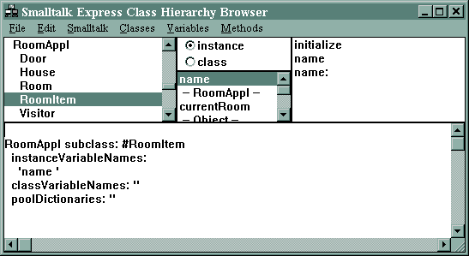
RoomItem Class

Slide 20
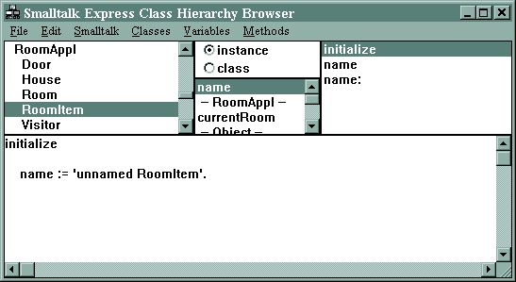
RoomItem>>initialize

Slide 21
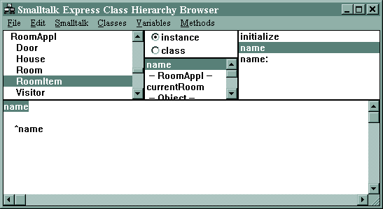
RoomItem>>name

Slide 22
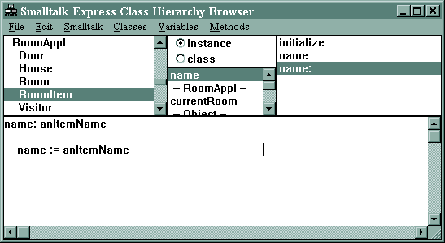
RoomItem>>name:

Slide 23
Add Getters and Setters
Room
createDoorTo:
addItem:
description
doors
items
name
name:
otherRoomList
roomNamed:
Visitor
tellRoom
describeRoom
visit:
Getters and setters in italics.
Collection methods are also easy.
House
addRoom:
firstRoom:
*
2
*
Door
otherRoom:
otherRoomName:
rooms
rooms:and:
*
RoomItem
name
name:

Slide 24
Collection Methods
initialize
  rooms := OrderedCollection new.
  -----------------------------------------------
addRoom: aRoom
  " Add a room to this house "
  rooms add: aRoom.
  -----------------------------------------------
rooms
  ^rooms

Slide 25
Add Collection Methods
Getters and setters in italics.
Add-to-collection methods in italics.
The rest need to be done one at a time.
Room
createDoorTo:
addItem:
description
doors
items
name
name:
otherRoomList
roomNamed:
Visitor
tellRoom
describeRoom
visit:
House
addRoom:
firstRoom:
*
2
*
Door
otherRoom:
otherRoomName:
rooms
rooms:and:
*
RoomItem
name
name:

Slide 26

Door>>rooms:and:
rooms: room1 and: room2
"specify that this door connects
the given two rooms"
rooms := Set new: 2.
rooms
add: room1 ;
add: room2.
room1 addDoor: self.
room2 addDoor: self.

Slide 27
Door>>otherRoom:
otherRoom: aRoom
" given the first room,
answer room on the otherside of the door."
^ rooms detect: [ :room |
room ~= aRoom ].

Slide 28
Door>>otherRoomName:
otherRoomName: aRoom
" given the first room,
answer the name of room on the
otherside of the door."
^ ( self otherRoom: aRoom) name.

Slide 29
Room>>otherRoomsList
otherRoomList
" answers a list of names of connected rooms "
| list |
list := OrderedCollection new.
doors do: [ :door |
list add: (door otherRoomName: self )
].
^ list.

Slide 30
Room>>description
description
Transcript show: ' This room is named: ' , name ; cr.
Transcript show: ' Doors connect to: ' ; cr.
( self otherRoomList )
do: [ :roomName |
Transcript show: ( roomName ); cr ].
Transcript show: ' Items in the room: ' ; cr.
( self itemsList )
do: [ :itemName |
Transcript show: itemName ; cr ].

Slide 31
Room>>createDoorTo:
createDoorTo: otherRoom
" create new door set the two rooms "
| door |
door := Door new.
door rooms: self and: otherRoom.

Slide 32
What’s Done, What’s Not
Room
createDoorTo:
addItem:
description
doors
items
name
name:
otherRoomList
roomNamed:
Visitor
tellRoom
describeRoom
visit:
Next Step:
Object Interaction
and Control.
How does the model start
and how does it run ?
Design for
Implementation
House
addRoom:
firstRoom:
*
2
*
Door
otherRoom:
otherRoomName:
rooms
rooms:and:
*
RoomItem
name
name:

Slide 33
One Possible House
LivingRoom
Kitchen
Door
Door
Door
Door
Bedroom
Bathroom

Slide 34
example1
| liv kit bed bath visitor |
liv := (Room new) name: 'Livingroom'.
kit := (Room new) name: 'Kitchen'.
bed := (Room new) name: 'Bedroom'.
bath := (Room new) name: 'Bathroom'.
liv createDoorTo: kit.
liv createDoorTo: bed.
bath createDoorTo: kit.
bath createDoorTo: bed.
visitor := (Visitor new) startRoom: liv .
visitor beginVisiting.

Slide 35
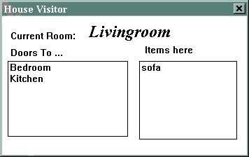
The GUI (12 lines of code).

Slide 36
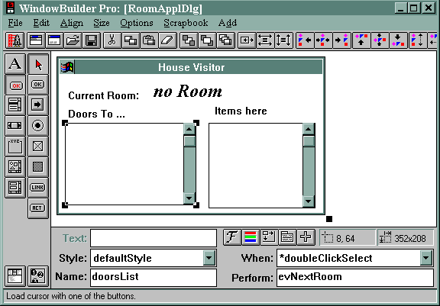
WindowBuilder
Launch the live objects
ListBox Widget
User Event
Message to Send
Edit the Code
Name

Slide 37
RoomApplDlg>>evNextRoom:
evNextRoom: aPane
  "Callback for the #doubleClickSelect event
  in the ListBox named 'doorsList'.
  (Generated by WindowBuilder)"
| nextRoomName |
nextRoomName:=(self paneNamed: 'doorsList') selectedItem.
visitor visit: nextRoomName.
self refresh.

Slide 38
The Beginning?
Cincinnati Area Smalltalk Users Group
  50 recipients and growing.
  Subscribe to the email list below:
  Windholtz@acm.ORG
SDRC Smalltalk Lunch group ?
October Intro to Smalltalk
  U.C. evening college.
Thanks for attending.

