Slide 1
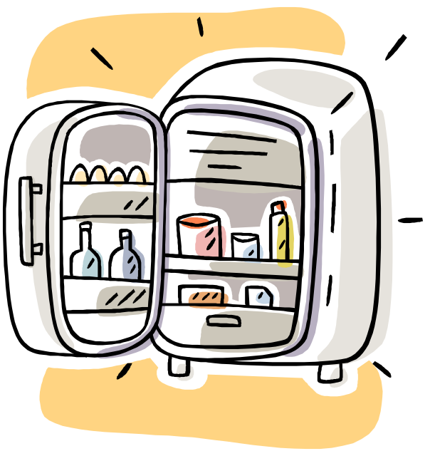
Coding an eFrige
with XP style
Notes:
Control Message, Object Hierarchy, Classes and Methods, Scope

Slide 2
What ?
What’s an eFrige?
What’s XP Style?

Slide 3
eFrige
Internet enabled household kitchen refrigerator.
Monitors (eventually)
  What goes in
  What comes out
  Expiration dates
  Available storage locations
  Maintenance Alerts
  Shopping list

Slide 4
What is XP style?
One step at a time …
  Writing Tests first
  Doing the Simplest Thing that could possibly work.
XP Things we skip (unfortunately)
  Pair programming
  Metaphor
  Refactoring, etc…

Slide 5
Obvious Problem
How do we write tests when we don’t know the language?
We will …
Fake it until we make it.

Slide 6
Simplest Possible Test
method name
testTheSimplestPossibleTest
self assert: true.
condition to test

Slide 7
Test Variations
testTestVariations
self assert: ( true ).
self should: [ true ].

Slide 8
Assignment Test Example
testAssignment
| aLocalVariable |
aLocalVariable := true.
self assert: (aLocalVariable).

Slide 9
EFrige User Stories
Show the Contents
Add an item
Add multiple items
Remove an item
Remove expired items
first
iteration

Slide 10
Story #1 and Tasks
User Story:
  Show the Contents.
Tasks:
  create a new class: EFrige
  create an instance of the EFrige.
  show contents of EFrige.

Slide 11
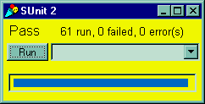
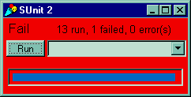
Write the test first
testEFrigeClassExists
  self assert:
  (Smalltalk includes: EFrige).

Slide 12
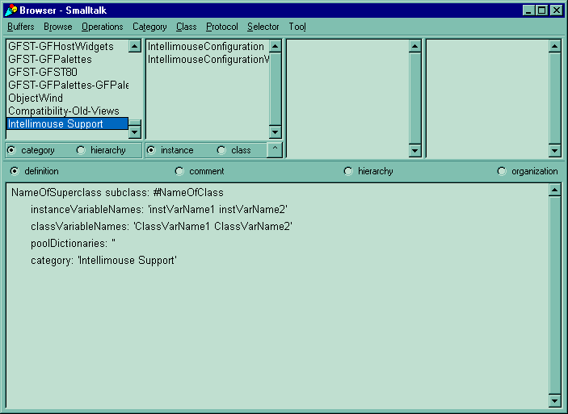

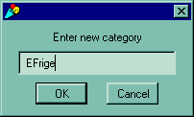
Create A Class Category

Slide 13
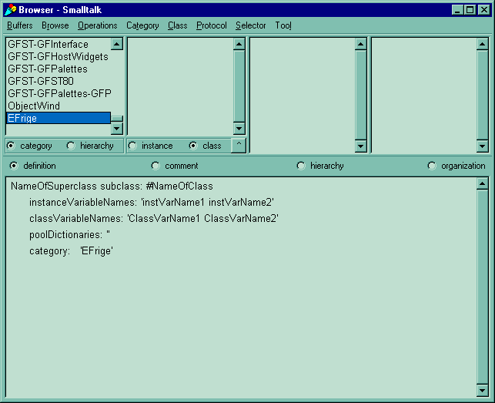
Create a Class

Slide 14
Creating Subclass Message
Object subclass: #EFrige
instanceVariableNames: ''
classVariableNames: ''
poolDictionaries: ''
category: 'EFrige'

Slide 15
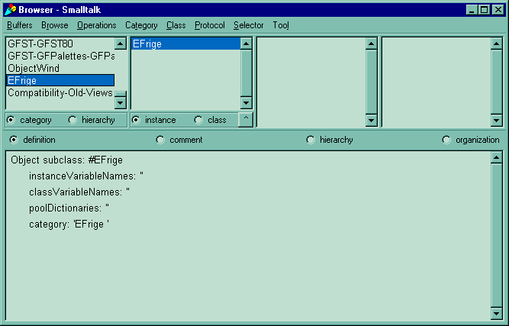

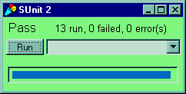
Object subclass: EFrige

Slide 16

Task #3: Create Instances
testCreateInstances
| anItem aFrige |
aFrige := EFrige new.
self assert: ( aFrige notNil ).

Slide 17
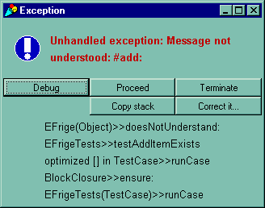
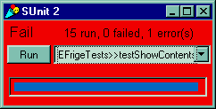
Task #4: Show EFrige contents
testShowContents
| aFrige |
aFrige := EFrige new.
self assert:
(aFrige showContents = 'Empty' ).

Slide 18
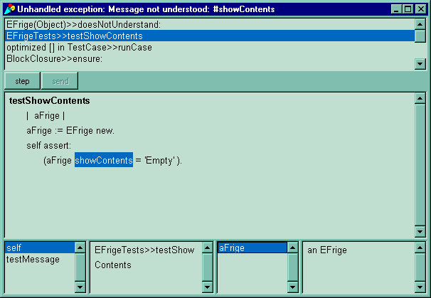
doesNotUnderstand #showContents
error
point
instance
variables
local
variable
value
selected instance
variable value
local
variable

Slide 19
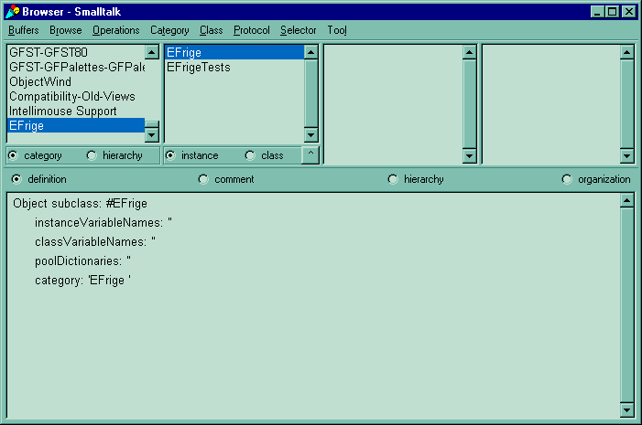
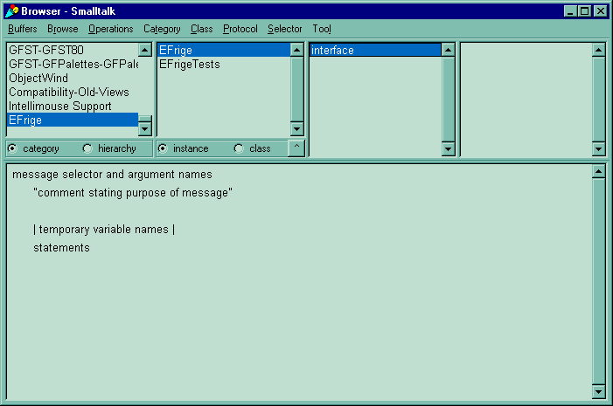
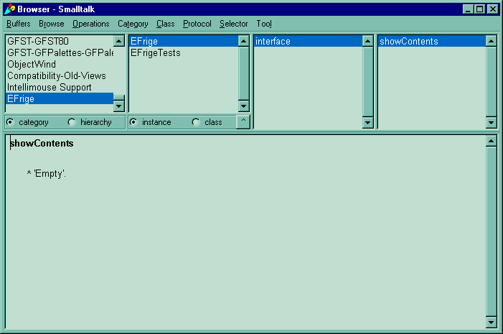

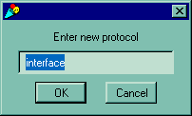
New Method #showContents
the simplest thing
that could possibly work.
method template.
delete this and type in your own

Slide 20
Story #2 and Tasks
User Story:
  Add an Item.
Tasks:
  create a new class: Item
  create an instance of the Item.
  add theItem to theFrige

Slide 21

Create Item class
Repeat previous steps for Item
  Write a Test: Does Item Exist?
  Test Fails
  Open Refactoring Browser
  Fill out message template
  Accept subclass method
  Run Tests
  Tests Pass
-- Celebrate !

Slide 22
Review Item class tests
testItemClassExists
self assert: (Smalltalk includes: Item).
testCreateItemInstances
| anItem |
anItem := Item new.
self assert: ( anItem notNil ).

Slide 23
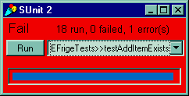
Task #3: Add Item to EFrige
testAddItemExists
| anItem aFrige |
anItem := Item new.
aFrige := EFrige new.
aFrige add: anItem.
self assert:
(aFrige includes: anItem).

Slide 24
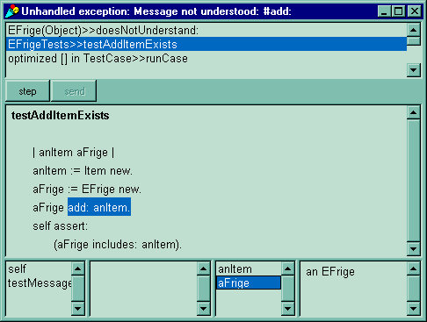
Finally! Something to do.
Call Stack
local variables
error
point
Selected
variable
value

Slide 25
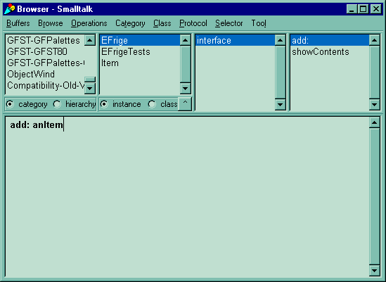
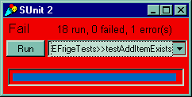
Adding #add:

Slide 26
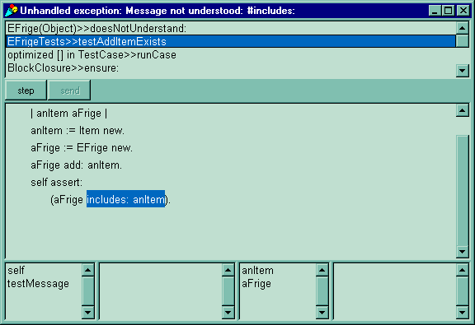
doesNotUnderstand: #includes
The message #includes: looks if the given item is already in the eFridge.
This requires that the eFridge track what is added to it.
Now we need an instance variable.

Slide 27
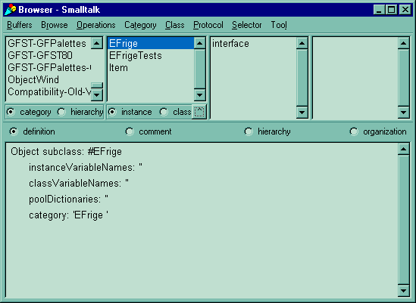
Adding an instance Variable
unselect all
methods to see
Class definition
enter instance variable names
between the single quotes
separated by spaces

Slide 28
Creating an Instance Variable
Object subclass: #EFrige
instanceVariableNames: 'item'
classVariableNames: ''
poolDictionaries: ''
category: 'EFrige'

Slide 29
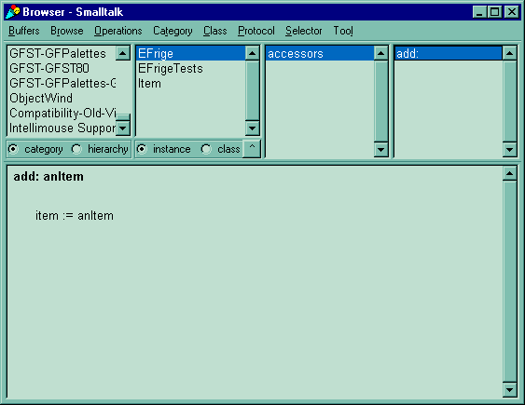
Assignment to Instance Variable
doesNotUnderstand: #includes:

Slide 30
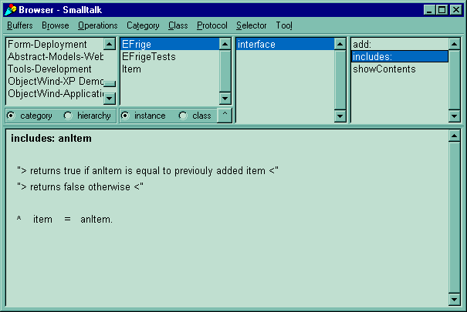
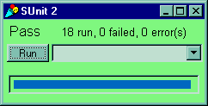
Compare and Return Syntax
= message sent to item with argument anItem
= method returns one of two objects
either the object: true
or the object: false
this resulting object is returned
this method answers: true or false
But wait review the other tests

Slide 31

Update a Previous Test
testShowContents
| aFrige |
aFrige := EFrige new.
self assert:
(aFrige showContents = 'Empty' ).
aFrige add: Item new.
self assert:
(aFrige showContents = 'an Item' ).
#showContents always returns 'Empty'.

Slide 32
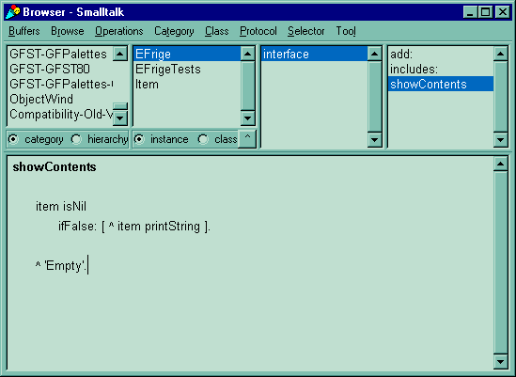
Updating #showContents

Slide 33
Story #2 and Tasks
User Story:
  Add Multiple Items.
Tasks:
  Add an OrderedCollection instance variable named: items
  Change references to item, to the new ivar named: items.

Slide 34
Task #1 Add Multiple Items.
testAddMultipleItems
| last first aFrige |
aFrige := EFrige new.
first := Item new.
last := Item new.
aFrige
add: first;
add: last.
self assert:(aFrige includes: first).
self assert:(aFrige includes: last).
use a semi-colon to send multiple
messages to the same object.
this is called Cascading.

Slide 35
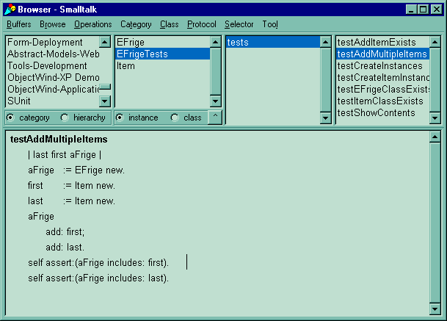
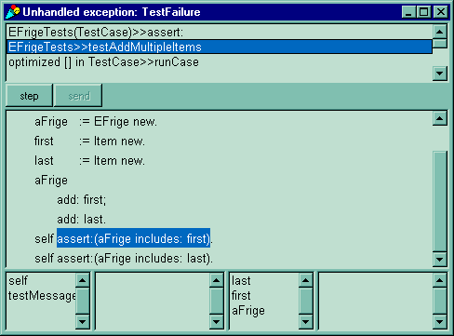
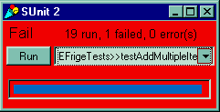
Add Multi Item Test code

Slide 36
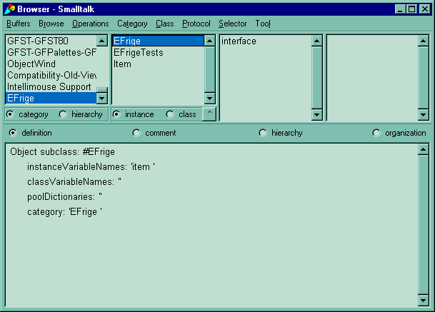

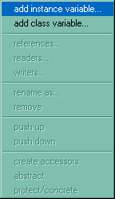
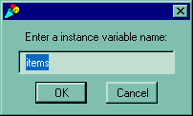
Add Another Instance Variable
the benefit of using the browser is that you can then undo the change.

Slide 37
What are Accessors?
Methods that …
… get an instance variable value.
  same name as the variable.
  for example items
… set an instance variable value.
  same name with a colon.
  for example items: anObject

Slide 38
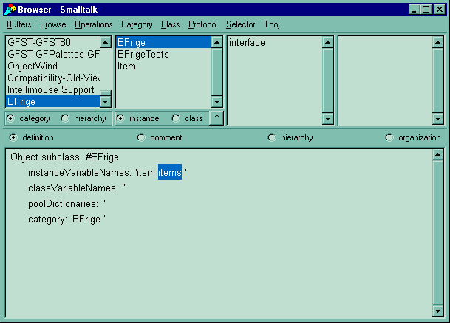
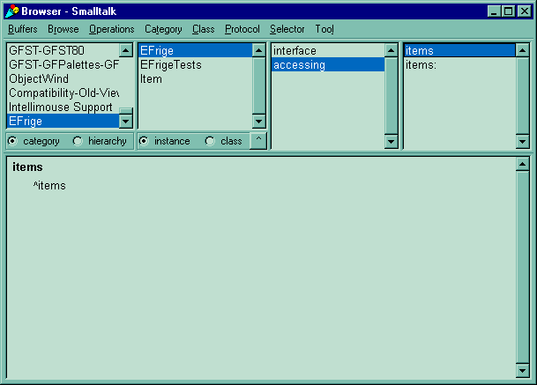
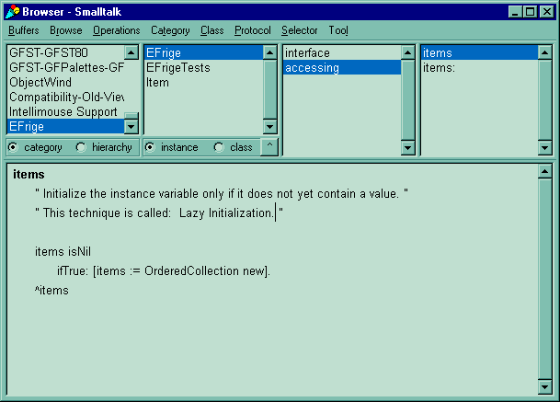

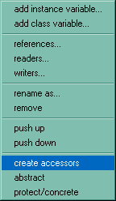
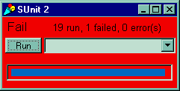
Make iVar a Collection
lazy initialization code block
code still uses the item variable.
we need to replace it with calls to items

Slide 39
Change References to item (1)
add: anItem
item:= anItem.
add: anItem
self items add:anItem.

Slide 40

Change References to item(2)
includes: anItem
^item = anItem.
are we done now ?
run the tests …
includes: anItem
^ self items includes: anItem.

Slide 41
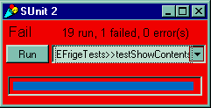
Change References to item(3)
showContents
| retVal |
self items isEmpty
ifTrue: [ ^ 'Empty' ].
retVal := String new.
self items do:
[ :each |
retVal := retVal, ' ', each printString].
^ retVal.
humm. What now?
lets check the debugger…

Slide 42
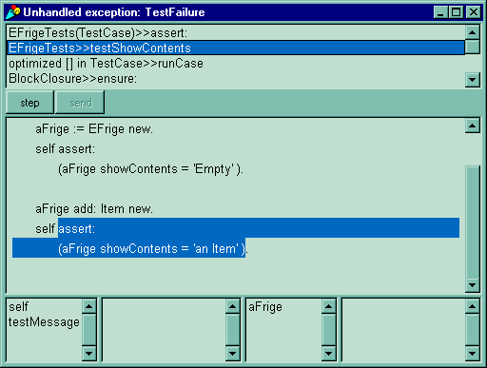
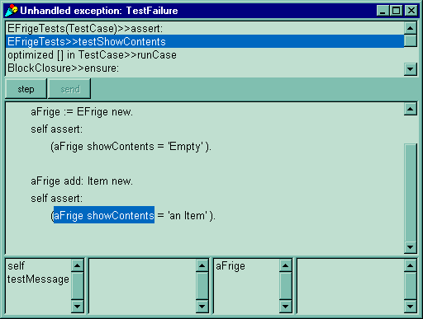

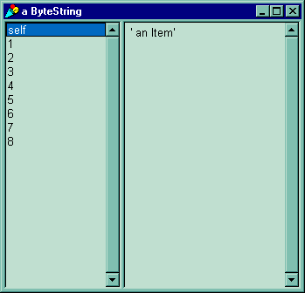
Using the Inspector
extra space

Slide 43
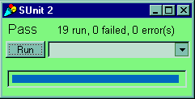
Fix the Test
testShowContents
| aFrige |
aFrige := EFrige new.
self assert:
(aFrige showContents = 'Empty' ).
aFrige add: Item new.
self assert:
(aFrige showContents = ' an Item' ).
added a space

Slide 44
Expand the Test
testShowContents
| aFrige |
aFrige := EFrige new.
self assert:
(aFrige showContents = 'Empty' ).
aFrige add: Item new.
self assert:
(aFrige showContents = ' an Item' ).
aFrige add: Item new.
self assert:
(aFrige showContents = ' an Item an Item' ).
test showContents
with multiple items

Slide 45
Completed User Stories
Show the Contents
  Created a new class: EFrige
  Created an instance of the EFrige.
  Showed contents of EFrige.
Add an Item.
  Created a new class: Item
  Created an instance of the Item.
  Added theItem to theFrige
Add Multiple Items.
  Added an OrderedCollection instance variable named: items
  Changed references to item, to the new ivar named: items

Slide 46

Conclusion ? Or Beginning ?
Software to get you Started:
http://www.objectwind.com/xp/quicklinks.html

