Slide 1

Using jUnit
Testing: Practices and Patterns
Notes:
1- TEFactoryTest testTEDayOfMonth
2- TE.DAYNUM
3-TEDayOfMonthTest testOccursOn()

Slide 2
Outline - Intro -
Intro ⬅ ☺
jUnit API
Lunch
Testing Existing Code
Test First Programming
End Day 1
jUnit and Ant
Code coverage
Mock Objects
Dynamic Mock Objects
Web Testing
Struts Testing
Testing Tips

Slide 3
Lesson, Objectives
To install, setup/customize, and write JUnit tests for Java applications.
Learn jUnit Best Practices and Patterns to perform unit-level testing.
Learn how to integrate jUnit with Ant and Clover test coverage tool.
Students will understand how to implement a valid test suite with quality tests that cover a majority of the code. Students will be responsible for implementing isolated, scalable tests and should obtain the appropriate experiences in this course.
To be able to create JUnit tests in real development projects.

Slide 4
What is jUnit?
Java implementation of the xUnit testing framework
Industry standard, open source
Focused primarily on unit testing Object Oriented programs
Lots of add-ons (not all covered in this course)
  www.junit.org

Slide 5
Unit Testing vs. Acceptance Testing
Unit Tests | Acceptance Tests
Programmer Tests | Customer Tests
Increases Developer Confidence | Increases Customer Confidence
Test individual Modules | Test full application end-to-end behavior
Low-Level | High-Level
Run in less than 10 minutes | May take a long time
Fully Automated | Unfortunately sometimes manual. Automatable with Fit
Run continuously by programmers | Run during check-in, Manual tests usually only run before code release

Slide 6
Limits of Unit testing
Two types of defects:
  Technical defects
  Requirement defects
jUnit is great at reducing technical defects
Incomplete at exposing missing or misunderstood requirements
Excellent place to start growing testing habits
Not covered in this class
  J2EE Container Specific Tools
    Cactus
  Load and Stress Testing:
  Acceptance Testing:
    Fit/FitNesse

Slide 7
Why Unit Test?
Greater coverage
  The best functional tests cover a fraction of the code.
Promotes Teamwork
  Rely on others’ code if it is well tested.
Reduce Debugging
  Debugging is the most expensive phase of software development
  Tests quickly point to the failure
Easier Refactoring
  Tested code can be changed without fear
Better more modular design
  Good design is easier to test.
  Tested code is more modular.
Documentation
Piece of Mind
  Tested code is comfortable code.

Slide 8
jUnit Features
API to create repeatable unit tests giving pass/fail results
Multiple ways to run the tests
Group tests into TestCase and TestCases into TestSuites
Light weight
Minimal and Reliable
Provides hooks for Refactoring your tests
Extensible
Industry Standard

Slide 9
jUnit Goals
to write a framework so that developers will actually write tests.
  Based on familiar tools.
  Minimal amount of work to use to write a new test.
  It has to eliminate duplicated effort.
Tests retain value over time
  Others can run and interpret the results.
  Combine tests from various authors and run them together.
Leverage existing tests to create new ones
  Fixtures can be difficult and expensive
  Setup of Fixtures should be shared among tests.

Slide 10
Unit Testing Goals
Atomic
  Each test can run on its own. No dependency on other tests
Repeatable
  Deterministic. Predictable input data.
Simple
  Understandable. Few lines of Code.
Scalable
  Adding tests is linearly scalable
Automated
  Lowers the cost to run often (even continuously)
    Which raises the benefit of testing

Slide 11
What jUnit Does?
Runs a Test
A Test is a method in a TestCase class.
A TestSuite contains many TestCase-s.
Each Test is run independently in isolation
Optionally defines setUp and tearDown behavior.
Reports the test results in terms of:
  Runs
  Failures: an assertion failed.
    Example: assertEquals(3 , 1+1);
  Errors: something outside of the expected test results occurred.
    Example: an unexpected null pointer exception occurred.

Slide 12
jUnit Example
Calendar eCal ;
public void setUp() {
eCal = new Calendar();
eCal.createEvent("xpCinci", "programming", ”2004-10-10");
}
public void testSameGroup() {
assertEquals(1, eCal.countOfGroups());
eCal.createEvent("cinjug", "programming", ”today");
assertEquals(1, eCal.countOfGroups());
}
public void testDiffGroup() {
eCal.createEvent("hornTrio", "music", ”today");
assertEquals(2, eCal.countOfGroups());
}

Slide 13
Installation
Download from www.junit.org then:
unzip the junit.zip file
add junit.jar to the CLASSPATH. For example: set classpath=%classpath%;INSTALL_DIR\junit3\junit.jar
test the installation by using either the batch or the graphical TestRunner tool to run the tests that come with this release. All the tests should pass OK.
Notice: that the tests are not contained in the junit.jar but in the installation directory directly. Therefore make sure that the installation directory is on the class path
  for the batch TestRunner type:
  java junit.textui.TestRunner junit.samples.AllTests
  for the graphical TestRunner type:
  java junit.awtui.TestRunner junit.samples.AllTests
  for the Swing based graphical TestRunner type:
  java junit.swingui.TestRunner junit.samples.AllTests

Slide 14
Installing as Eclipse 2 Plug-in
In Eclipse (or WSAD) package explorer:
  Right Click
  Import
  External Plug-ins and Fragments
  Next
  Next
  At bottom of list, check: org.junit
  Finish
Plug-in now appears in the package explorer
  If it has a compile failure open then close
    properties | Java Build Path
In your project’s properties
  Java Build Path | Libraries
  Add junit.jar to your project.

Slide 15
Shake Down Cruise (Command line)
Open a DOS window
Run:
  java –version
Computer should answer (at least):
  Java version “1.4….”

Slide 16
jUnit self-tests
Goto the directory
  Cd c:eclipse/workspace/Jwsample
C:/eclipse/workspace/JWsample/> java junit.samples.AllTests
.........................................
.........................................
......................................
Time: 1.822
OK (119 tests)

Slide 17
< dos:Exercise 01 >
Simple Test 1 (15 min)
In project JWexercises, package /ex01
  create a file named: FirstTest.java
We want a new class to work in. So, enter:
  public class FirstTest { }
Compile:
  javac *.java
We want this class to hold tests. So, It must be a subclass of TestCase
TestCase requires a constructor with a String argument. Add and compile:
  import junit.framework.*;
  public class FirstTest extends TestCase
  {
  public FirstTest(String name)
  { super(name);
  }
  }

Slide 18
< dos:Exercise 01 >
Simple Test 2
We want to run the tests in this class. So, have main start a TestRunner.
Add an import:
  import junit.textui.*;
And add a main method:
  public static void main(String[] args) {
  new TestRunner().run(OneTest.class);
  }
Compile and Run it.
  java FirstTest.java
Every TestCase needs at least one test method. So, add:
    public void testOne()
    {
    }
Compile, Run, and examine the output.
But writing empty tests is useless and inflates the test count. So to show that the framework is behaving as expected, force a failure.
    public void testOne()
    {
    fail(“one empty test”);
    }

Slide 19
< ide:Exercise 01 >
Shake down cruises for Eclipse (15 min)
In the JWexercises project
Create a class named TestOne in package ex01
    package ex01;
    import junit.framework.TestCase;
    public class TestOne extends TestCase {
    }
In Package Explorer select TestOne and Run as jUnit
    Run | Run as | 3 jUnit Test
TestCase class must have at least one test. Add one:
    public void testFail() {
    fail(“ouch");
    }
Run tests, then create a passing test
    public void testPass () {
    }
Run tests, then create an Error test
    public void testError () {
    String s =null;
    s.charAt(0);
    }

Slide 20
< ide: Exercise 01e >
TestSuite
In Package Explorer, choose the ex01 package
Right Click | New | Other … | Java | JUnit | TestSuite
Click Next | Finish
  public static Test suite() {
  TestSuite suite = new TestSuite("Test for ex01");
  //$JUnit-BEGIN$
  suite.addTest(new TestSuite(TestOne.class));
  //$JUnit-END$
  return suite;
  }
In Package Explorer select AllTests and Run as jUnit
    Run | Run as | 3 jUnit Test

Slide 21
Review
We have experienced
  how to build a simple test.
  a passing test.
  a failing test.

Slide 22
Outline - jUnit API -
Intro
jUnit API ⬅ ☺
Lunch
Testing Existing Code
Test First Programming
jUnit and Ant
Code coverage
Mock Objects
End Day 1
Dynamic Mock Objects
Web Testing
Struts Testing
Testing Tips

Slide 23
jUnit Classes
Test
A
s
s
e
r
t
a
s
s
e
r
t
E
q
u
a
l
s
(
.
.
.
)
B
a
s
e
T
e
s
t
R
u
n
n
e
r
TestDecorator
j
u
n
i
t
.
t
e
x
t
u
i
.
T
e
s
t
S
u
i
t
e
TestCase
T
e
s
t
R
u
n
n
e
r
a
d
d
T
e
s
t
(
T
e
s
t
t
e
s
t
)
a
d
d
T
e
s
t
S
u
i
t
e
(
C
l
a
s
s
t
e
s
t
C
l
a
s
s
)
TestSetup
Official documentation available at:
JWSample\javadoc\index.html
JWSample\doc\*

Slide 24
TestRunner
Add main() to AllTests and Run as an application
  public static void main(String[] args) {
  junit.textui.TestRunner.run(TestOne.class);
  }
Also try using the:
swingui

Slide 25
assert…()
jUnit assert…() different than java language keyword: assert()
Check a boolean condition of the code
    assertTrue(target.isValid());
Optional first parameter is a string message
    assertTrue(“addition failed”, target.add(3,4));
Usually clearer to use assertEquals:
    int expected = 7;
    int actual = target.add(3,4);
    assertEquals(“addition failed!”,expected,actual);

Slide 26
assert…()
Is it null ?
  assertNull() assertNotNull()
Is it the same object?
  assertSame(expected,actual)
  assertNotSame(expected,actual)
Boolean
  assertTrue() assertFalse() fail()
Doubles
  assertEquals(expected, actual, delta)
  assertEquals(1.01, 1.022, 0.02); //passes
  assertEquals(1.01, 1.022, 0.01); //fails
Make your own assert methods if needed
  call fail();

Slide 27
Testing Exceptions
Test Exceptional behavior along with every other behavior.
    public void testInvalidBig() throws Exception {
    try {
    new Week(200103014);
    fail("should throw exception");
    } catch (RuntimeException x) {
    assertEquals(“Week number too big“,
    x.getMessage());
    }
    }
No need to catch every unexpected exception…
Let jUnit catch and report them.

Slide 28
setUp() and tearDown()
A “Fixture” in jUnit lingo is the code used to set the environment in a state that the target code can be tested.
Repeated setup code should be moved into setUp()
Scalability requires that after each test the system returns to the same state as it was before the tests. Use: tearDown() to insure this.
tearDown() always executes even when an exception is thrown
  protected void setUp() throws Exception {
  super.setUp();
  // your stuff here
  }
  protected void tearDown() throws Exception {
  super.tearDown();
  // your stuff here
}

Slide 29
TestSuite Setup & TearDown
Decorate the TestSuite using the TestSetup class
Available in the package: junit.extensions
A Decorator can add behavior to a class without the class or the client knowing that behavior was added.

Slide 30
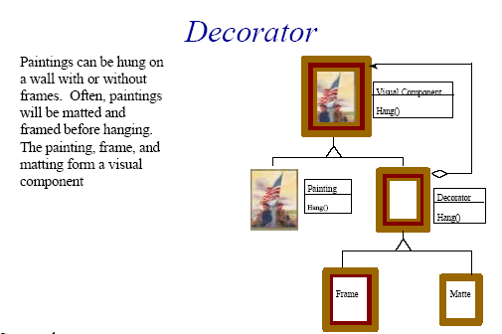
Pattern: Decorator
credit: www.agcs.com

Slide 31
TestSetup class
For expensive setup (like starting a server) use a TestSetUp class for an entire Suite.
This runs setUp() and tearDown() once per suite
  package alltests;
  import junit.extensions.TestSetup;
  import junit.framework.Test;
  public class StartEcalServer extends TestSetup {
  // … ctor removed
  protected void setUp() throws Exception {
  super.setUp();
  System.out.println("starting ecal");
  RunServer.main();
  }
  protected void tearDown() throws Exception {
  super.tearDown();
  System.out.println("ending ecal");
  }
  }

Slide 32
Add your own TestSetup to any suite.
package alltests;
public class AllTests_Ecal
{
  // . . .
  public static Test suite()
  {
  TestSuite suite = new TestSuite("All ECal Test Suite");
  suite.addTest(xpcinci.domain.AllTests.suite());
  suite.addTest(xpcinci.render.AllTests.suite());
  suite.addTest(xpcinci.time.AllTests.suite());
  suite.addTest(fitnesse2.AllTestSuite.suite());
  return new StartEcalServer(suite);
  }
}

Slide 33
Concurrent Testing
Use an ActiveTestSuite
  public static Test suite() {
    TestSuite suite
    = new ActiveTestSuite("Test for xpcinci.responders");
    //$JUnit-BEGIN$
    suite.addTestSuite(DisplayResponderTest.class);
    suite.addTestSuite(NotFoundResponderTest.class);
    suite.addTestSuite(FrontPageResponderTest.class);
    //$JUnit-END$
    return suite;
  }

Slide 34
RepeatedTest
Helpful for performance checks or intermittent problems
  public static Test suite() {
  TestSuite suite = new TestSuite("Test for domain");
  //$JUnit-BEGIN$
  suite.addTest(new TestSuite(DayTest.class));
  suite.addTest(new TestSuite(EventGroupTest.class));
  suite.addTest(new TestSuite(WeekTest.class));
  //$JUnit-END$
  return new RepeatedTest(suite,1000);
  }
Use a RepeatedTest

Slide 35
< Exercise 02 >
Testing Existing Code (30 min)
Create a subclass of junit.framework.TestCase named ex02.GridFormatTest
  Add a failed test method and run it
    This makes sure that everything is connected and ready to go.
  What tests need to be written for this class?
  Make a list of test cases with specific test data
  Add tests for all GridFormat behavior
  Then run the tests 10 times each
  Then run the tests Concurrently
Notes:
What if client passes in negative numbers?
How should formatDay() behave if day is missing?
As far as we want to go.

Slide 36
Lunch Time.

Slide 37
Outline - Existing Code -
Intro
jUnit API
Lunch Time
Testing Existing Code ⬅ ☺
Test First Programming
jUnit and Ant
Code coverage
Mock Objects
End Day 1
Dynamic Mock Objects
Web Testing
Struts Testing
Testing Tips

Slide 38
Handling Simple Dependences
A class that creates objects internally the dependency is hard to test. Especially if the created object has dependencies of it’s own.
If the internally created objects are simple enough, a simple approach to testing is a Factory Method Override
xpcinci.template.Template reads a file with text and macros. The macros get replaced with given values producing a String. How can we do this without generating lots of temporary files?
See JWecal example:
  workspace/JWecal/src/xpcinci.template.TemplateTest

Slide 39
Java Review: Anonymous Inner Classes
Used to change method behavior for an instance.
For testing, use this technique to isolate the target method from other methods that the target method uses.

Slide 40
PopCorn - the target
  public class PopCorn {
  boolean expanded = false;
  public void heat() {
  expanded = true;
  }
  protected String state() {
  return (expanded) ? "popped" : "kernal";
  }
  public void display() {
  System.out.println("white corn " + state());
  }
  }

Slide 41
Popper - custom display()
  public void runYellowCorn() {
  final String yellow = "yellow";
  PopCorn one = new PopCorn() {
  public void display() {
  System.out.println(yellow +" corn " + state());
  }
  }; // end of inner class
  one.display();
  one.heat();
  one.display();
  }

Slide 42
Pattern: Factory Method
A Factory Method defines an interface for creating an object and lets the subclass decide how to actually create it.
Parent
Object makeObject() {
return new OneThing ();
}
makeObject()
Child
Object makeObject() {
return new Another();
}
makeObject()

Slide 43
Factory Method Override
Create an anonymous inner class subclass of the Template class. The sole responsibility of the subclass is to override the readRaw() method to provide the content when requested. Visibility of the method must be at least package, so that it can be overridden.
Create inner class and override readRaw().
    Template t = new Template() {
    void readRaw(String fileName) throws IOException {
    raw ="1234<%name%>456"; // dummy data
    }
    }; // end inner-class
Warning: rename method refactoring can break these tests, since child methods are not renamed.
Tip: Always run all tests after every refactoring.

Slide 44
<Exercise 03>
Factory Method Override Exercise (30 min)
The class ex03.Environment opens a file and reads in the properties. Then makes them available to the rest of the program.
Test the class without using real files or file-system
Break complex methods into smaller methods and use Factory Method Override
  For example: Extract getProperty() from the larger functionality.
Test the following conditions
    getApplPath() should return “c:\ecal”
    getProperty("not.real") should throw a Runtime Exception with the message: "Environment() property not found: not.real“
    getApplPath() with no file, should throw a Runtime Exception with the message: "Can't Find: classes/ecal.properties“
Hint: To create an InputStream from a String use:
    new ByteArrayInputStream(“ABC".getBytes())
Hint: The format of the properties file is name=value. For example:
    appl.path=C:\\ECAL
    (on Windows: to test you need to escape the escapes) C:\\\\ECAL

Slide 45
Outline - Test First Programming -
Intro
jUnit API
Lunch Time
Testing Existing Code
Test First Programming ⬅ ☺
jUnit and Ant
Code coverage
Mock Objects
End Day 1
Dynamic Mock Objects
Web Testing
Struts Testing
Testing Tips

Slide 46
Testing: Sooner is Better
Restructuring untested code to make it testable is no fun.
Why not write it testable from the start?
Also…
Defects are cheaper to find and fix the earlier they are detected. Detection requires testing.
Therefore, write code test first and save money
Fewer defects lead to quicker delivery
The biggest problem is that code that isn’t written with tests in mind typically isn’t very testable
-Kent Beck

Slide 47
Test Driven Development Cycle
Think of the one simplest requirement?
Write one short failing unit test (until RED)
Code the simplest thing to pass the test (until GREEN)
Refactor to clean-up the code (keep it GREEN)
Rinse, and repeat
  Think -> red -> green -> green -> repeat …
  Goal -> test -> code -> design -> repeat …

Slide 48
TDD - Cycle
analysis
discuss with user
test
code
design
( refactor )
integrate or toss

Slide 49
Demo: Test First
Ecal is a web based Event Calendar application being built
Open-Source for Children’s Hospital by the xp-cinci User’s Group.
    (xp-cinci is Extreme-Programming users group of Cincinnati, www.objectwind.com/xp-cinci )
add a new feature to ECal.
Event scheduling on a day-in-month.

Slide 50
< Exercise 04 >
Test First iteration #1 is 60 min
A seaside-fishing village is losing jobs because of the decreasing fish populations. They decide to move into the software industry and make big bucks by building a computer game about fishing. Market research is on-going. Start building a game with fishing nets.
Iteration #1, model a fishing net, which is 5 ropes by 5 ropes
Each intersection of ropes may catch a fish.
If a fish is caught at a particular intersection on the 5 by 5 grid indicate (yes or no)
Write code in pairs.
Do not write a line of code without a failing test.
Notes:
10 min:Iteration #2
The initial size of 5 by 5 is not going to be large enough.
Expand the net size to 8 by 8.
all behavior outside of the net is ignored.
15 min: Iteration #3
The marketing effort has determined that there is no market for fish games.
But they found an interest in other grid games.
Each intersection should now hold a value of black, white, or empty.
15 min: Iteration #4
Jackpot! Marketing has just discovered that the game “Go” is selling like crazy.
Add a scoring ability and we will be rich.
First, count all the black, white, and empty points regardless of the size of the game.

Slide 51
Outline - jUnit and Ant -
Intro
jUnit API
Testing Existing Code
Test First Programming
jUnit and Ant ⬅ ☺
Code coverage
Mock Objects
Dynamic Mock Objects
Web Testing
Struts Testing
Testing Tips

Slide 52
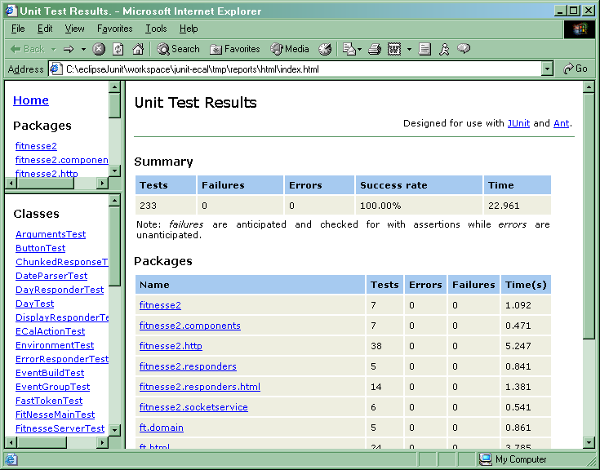
Web Reporting

Slide 53
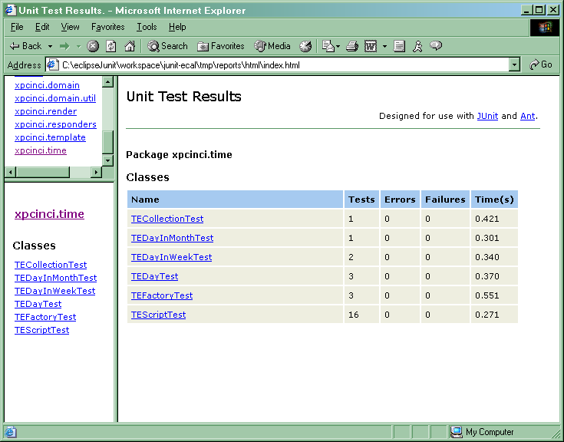
Results Per Package

Slide 54
Ant jUnit tags
Needs optional.jar
  <target name="test" depends="init_tests, build" >
  <junit printsummary="true" fork="true"
  failureproperty="junit.failed" timeout="30000">
  <batchtest fork="yes" todir="${reports}">
  <fileset refid="alltest.classes"/>
  </batchtest>
  <formatter type="xml" />
  <classpath>
  <pathelement location="${classes}"/>
  <fileset dir="${lib}">
  <include name="**/*.jar"/>
  </fileset>
  </classpath>
  </junit>
  <antcall target="junit_results" />
  </target>

Slide 55
jUnit reports in html
Init
  <target name="init_tests">
  <mkdir dir="${junit.reports}"/>
  <fileset id="alltest.classes" dir="${classes}">
  <include name="**/*Test.class"/>
  <exclude name="**/AllTests.class"/>
  <exclude name="**/*$*.class"/> <!– innerclasses - ->
  </fileset>
  </target>
Run
  <target name="reports" depends="test">
  <junitreport todir="${reports}">
  <fileset dir="${reports}">
  <include name="TEST-*.xml"/>
  </fileset>
  <report format="frames" todir="${reports}/html" />
  </junitreport>
  </target>

Slide 56
Displaying Results
  <target name=“junit_results">
  <antcall target=“junit_results_fail"/>
  <antcall target=“junit_results_pass"/>
  </target>
  <target name="junit_results_fail" if="junit.failed" >
  <echo message="**** jUNIT FAILED ****"/>
  <fail/>
  </target>
  <target name="junit_results_pass" unless="junit.failed" >
  <echo message="! j U N I T P A S S E D ! "/>
  <echo message="! ${basedir}"/>
  </target>

Slide 57
Ant Build Output
. . . [junit] Running ft.domain.EventBuildTest
[junit] Tests run: 3, Failures: 0, Errors: 0, Time elapsed: 0.48 sec
[junit] Running ft.html.HtmlFixtureTest
[junit] Tests run: 24, Failures: 0, Errors: 0, Time elapsed: 3.785 sec
junit_results:
junit_results_pass:
[echo] ! j U N I T P A S S E D !
[echo] ! C:\eclipseJunit\workspace\junit-ecal
junit_results_fail:
reports:
[junitreport] Using Xalan version: Xalan Java 2.4.1
[junitreport] Transform time: 5888ms
BUILD SUCCESSFUL
Total time: 1 minute 12 seconds

Slide 58
Removing Tests from Production Code
Mix them in packages and deploy all of it.
Keep a separate code tree.
    myproject/src/com/…
    myproject/junit/com/…
Mix them in packages and remove later with ant. (preferred)
    <javac destdir=“${dir.dest}”>
    <src path=“${dir.src}”/>
    <exclude name=“**/*Test.java”/>
    </javac>

Slide 59
Outline - Code coverage -
Intro
jUnit API
Lunch Time
Testing Existing Code
Test First Programming
jUnit and Ant
Code coverage ⬅ ☺
Mock Objects
End Day 1
Dynamic Mock Objects
Web Testing
Struts Testing
Testing Tips

Slide 60
Coverage vs. Mutation Testing
Clover http://www.thecortex.net/clover/
    Execution coverage
    Easy to set-up
    Good reporting
    Commercial product
Jester (not covered in this class) http://jester.sourceforge.net
    Mutation testing
    Odd set-up requirements
    Good reporting
    Open-Source

Slide 61
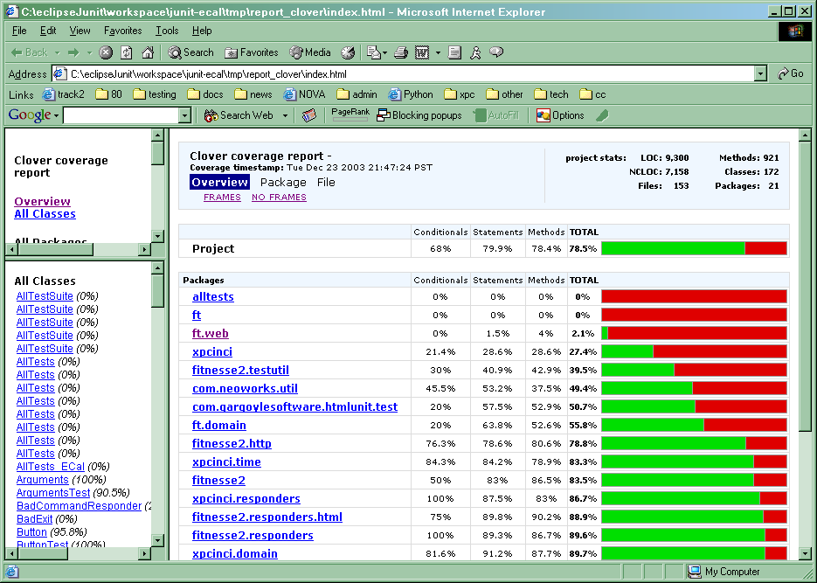
Clover Example Reports
See example code:
  junit-ecal/tmp/report_clover/index.html

Slide 62
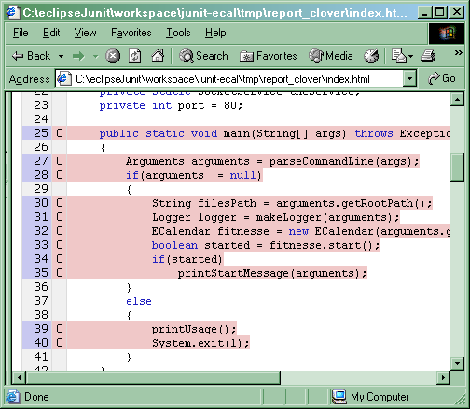
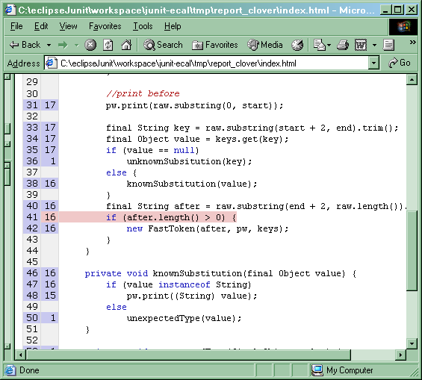
Not tested, & Conditional Not exercised

Slide 63
Ant: Clover tags
<!-- Clover: Begin -->
<taskdef resource="clovertasks"/>
<target name="clover" depends="with.clover,test,clover.html" >
<description>Build and test with Clover coverage reporter</description>
</target>
<target name="with.clover">
<mkdir dir="${reports.data}"/>
<clover-setup initString="${reports.data}/clover.db"/>
</target>
<target name="clover.html" depends="with.clover">
<clover-report>
<current outfile="${clover.reports}">
<format type="html"/>
</current>
</clover-report>
</target>
<!-- Clover: End -->

Slide 64
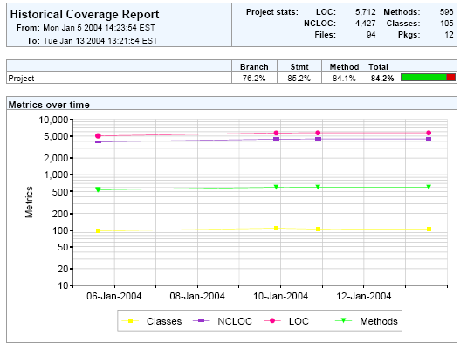
Clover Historical Metrics

Slide 65
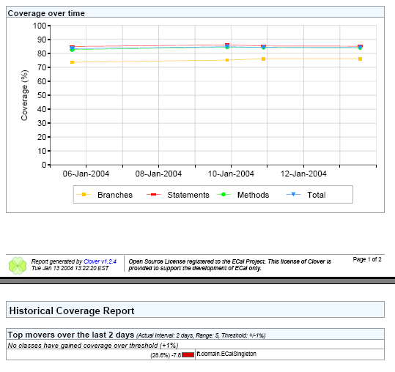
Coverage Over Time

Slide 66
Outline - Mock Objects -
Intro
jUnit API
Testing Existing Code
Test First Programming
jUnit and Ant
Code coverage
Mock Objects ⬅ ☺
Dynamic Mock Objects
Web Testing
Struts Testing
Testing Tips

Slide 67
Difficult to Test
Large Complex Methods
  Too many if() and while() statements in one place
Target class creates it’s own service classes
    Helper h = new Helper();
Too Many Dependencies
  Target class uses other services that it creates or manages.
Hidden State
  Target does not reveal it’s internal state, so checking after a method call is not possible.
Too Much State
  Databases (for example) are tricky to set up just right for a test.
Notes:
[explain banker example]

Slide 68
State or Interaction
Sometimes it is easier to test interactions than state.
To check if receipt was printed.
Either add a special test method (not recommended):
    boolean Printer.didPrintReciptFor(transationId)
    { return something; }
Or check interaction
  Was the method Printer.print() called with the expected argument?
If the ATM interacted with the Printer Interface in all the expected ways, we assume that when connected to a real Printer the proper thing will happen.

Slide 69
Testing around Dependencies
tests
Real ATM
Creates & uses
RealPrinter
Test ??
uses
Production
Client

Slide 70
Mock Objects
Mock objects stand in for the real object and implement the interface of the target class.
Allow you to write tests for every possible path of the target object.
Interfaces and subclasses allow this trick.
Testing the RealATM …
tests
Real ATM
uses
<<interface>>
Test
Printer
create
MockPrinter
uses
RealPrinter
Production
Client
create

Slide 71
Vocabulary
1: create
2: set
<<interface>>
Client or
Test
Target
3.1: uses
Service Interface
3: test
Service or Mock
Implementation

Slide 72
Types of Mock Objects
Library www.mockobjects.org (not covered)
  Early implementation
  Jdbc mockObjects, etc…
Hand coded
  More later
Generated (not covered)
  MockMaker, MockCreator
  Generated code == maintenance burden
Dynamic
  EasyMock

Slide 73
When to Mock
Use a Mock when the Real object is
non-deterministic (Printer could be out-of-paper etc)
Hard to set-up
Hard to generate certain behavior
  rare error conditions, Hardware failure etc…
Slow (like a database)
Does not have interface for test conditions
Not yet coded

Slide 74
Common structure For Mock Tests
Create a context, including mock objects.
Define expectations on the mock objects. (optional)
Execute the behavior to be tested
Verify expectations
Assert additional post conditions not checked in step 2.

Slide 75
Pattern: Log String
Record that a method has been called.
Optionally record the parameters
  public interface Printer {
  public abstract void print(String output);
  }
  public class MockPrinterLogString implements Printer {
  public String log = "";
  public void print(String output)
  { log += "print: " + output;
  }
  }

Slide 76
Using the Log String
  package demo01_atm;
  public class RealATMTest extends TestCase {
  RealATM atm = new RealATM();
  Transaction xact = new Transaction(123, 14.95);
  public void testUsingLogString() {
  MockPrinterLogString mockPrinter
  = new MockPrinterLogString();
  atm.setPrinter_ForTest(mockPrinter);
  atm.doTransaction(xact);
  assertEquals(mockPrinter.log,
  "print: transaction:123, total:14.95");
  }

Slide 77
Setting the Mock Object
You need to tell the target object to use the mock.
Often the target object has control of the service objects it needs.
What approaches allow us to take that control away from the target object …
So that the Test can decide what the service objects really are?

Slide 78
Inversion Of Control (IOC)
Move control of service instance creation from the target object to the client object.
  Set the service in the target from the client
  The client now has control of the service
IOC to set the service in the target
  Constructor
  Parameterized Mocking
  Deferred Factory Method Mocking
  Dependency Injection Pico-Containers (not covered)
    See: www.martinfowler.com

Slide 79
IOC: Constructor
Set the service class in the constructor of the target class.
  public Target(Service mockService)
  { service = mockService;
  }
Pros: Does not require a subclass. Fewer line of code
Con: Need to have the service already created when the Target is created.

Slide 80
IOC: Parameterized Mocking
Set the service class with a special setter for the test class to use. Name the setter so that it is clear that only the test class should use it. If your tests are in the same package, make the method visibility private.
Move instance creation to a lazy initializer
  private Service getService ()
  { if (service!=null) return service;
  return (service = new Service());
  }
provide a public method
  public void setService_forTest( Service mockService)
  { service = mockService;
  }
Pro: Does not require a subclass
Con: Exposes a test setter method to other production code.

Slide 81
IOC: Deferred Factory Method Mocking
Create a subclass of the Target class. The sole responsibility of the subclass is to override the getService() method to provide the mock service when requested. Visibility of the method must be at least package, so that it can be overridden.
Create subclass and override the lazy createService() in Target_underTest to provide a mock Service.
    class Target_underTest extends Target {
    Service getService ()
  { if (service!=null) return service;
  return (service = new MockService();
  }
Warning: rename method refactoring can break these tests, since child methods are not renamed.
Tip: Always run all tests after every refactoring.

Slide 82
ATM testing with Mocks
ATM & Printer
Printer: accepts a string and prints it to System.out with the prefix “real printer:”
ATM: takes a transaction and executes it. Then logs it. Then prints a receipt.
* * * Demo01_atm * * *
  Show Tests that
    use Factory Method Override
    use Expectations
    set the Mock in the Constructor

Slide 83
<Exercise 05>: Handcode Mock
The method ex05.DayResponder.makeResponse() is already tested. But it uses an untested method: runTemplate()which is stubbed out for testing.
Write tests in DayResponderTest.java to test runtemplate() using a hand coded mock Template.
  Which IOC approach did you choose to set the service in DayResponder? Why?
Reimplement using a second approach to IOC.
Notes:
Needs ooX number

Slide 84
Outline - Dynamic Mock Objects -
Intro
jUnit API
Lunch Times
Testing Existing Code
Test First Programming
jUnit and Ant
Code coverage
Mock Objects
Dynamic Mock Objects ⬅ ☺
Web Testing
Lunch
Struts Testing
Testing Tips

Slide 85
Easy Mock
Pros:
  Hand-writing classes for Mock Objects is not needed.
  Supports return values and exceptions.
  Supports changing results for the same method call.
  Supports call count checking.
  Supports default values for method calls.
  Supports checking the order of method calls.
Cons
  The possible functionality of the Mock Objects is limited.
  EasyMock works only for interfaces.
  EasyMock requires Java 1.3.1 and above.

Slide 86
Intro EasyMock
<<interface>>
6: test
Real ATM
6.1: Print
Test
Printer
1: createControl(Printer.class)
3: Print
MockPrinter
2: getMock
4: setReturnValue
5: replay
2.1: create
MockPrinterControl

Slide 87
Steps to using EasyMock
Create a control for the interface to mock.
getMock() from the control and cast it into your interface.
Call methods on the mock object in the order that the method expects, passing the parameters you expect the the target to pass.
Set expected return values with the control directly after the method call on the mock.
Call control.replay() to switch from record mode to replay mode.
Set the Target to use the Mock
Call the production method on the Target
Call control.verify() to ensure that all expected methods have been called

Slide 88
EasyMock ATM
public void testUsingEasyMock() {
  MockControl control = MockControl.createControl(Printer.class);
  Printer mockPrinter = (Printer)control.getMock();
  // set expectations
  mockPrinter.print("transaction:123, total:14.95");
  // change from record mode to replay mode
  control.replay();
  // set mock
  ATM atm = new ATM(mockPrinter);
  // run
  Transaction xact = new Transaction(123, 14.95);
  atm.doTransaction(xact);
  // ensure that all methods were called
  control.verify();
}

Slide 89
<Exercise 06>: EasyMock
Use Mocks to test the OptionsGateway class:
    Gateway classes provide database access to domain objects
    Options is for drop-down list options
    DB_Impl is a mess and thank goodness we don’t need to use it, because we can Mock out the DB interface
  Test: OptionsGateway.insert()
  If time allows test DbException conditions.
  Consider using various techniques covered earlier
  Make the large method testable
  Factory Methods help to focus the testing on insert()
  Find the one essential class to Mock
Notes:
Needs ooX number

Slide 90
Outline - Web Testing -
Intro
jUnit API
Testing Existing Code
Test First Programming
jUnit and Ant
Code coverage
Mock Objects
Dynamic Mock Objects
Web Testing ⬅ ☺
Struts Testing
Testing Tips

Slide 91
Web Testing tools
htmlUnit
    built on httpClient.jar (not active project)
Grinder
    primarily focused on performance/stress testing and provided a distributed network of (fairly simple) agents which pound your application. Uses jython
TestMaker
    (from PushToTest) is the most comprehensive of the three tools you mentioned and most complicted. It provides both performance/stress testing and functional/system unit testing and offers a test recorder as well. It also uses Jython.
Cactus
    test framework for unit testing server-side java code (Servlets, EJBs, Tag Libs, Filters, ...). In-container testing for Ejb 2.0
    Others
Others
    www.junit.org (extensions tab)

Slide 92
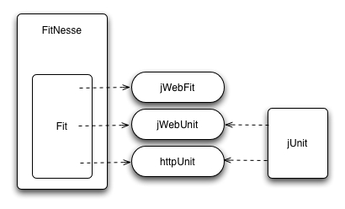
Most popular Web Testing Tools
httpUnit
    low level API for http protocol
jWebUnit
    simpler API over httpUnit which allows you to direct a browser client and make assertions about content received over the web, from your application. Used for functional testing or system-level unit tests of a web application written by a Java programmer.
Fit
    html table driven multi language Acceptance testing framework
FitNesse
    Customer Usable web editor for writing
    and maintaining Fit pages & fixtures
    Also can be the team wiki
jWebFit
  Fixture for using jWebUnit from FitNesse

Slide 93
jWebUnit intro
http://jwebunit.sourceforge.net/
jWebUnit is a java-based testing framework for web applications
based on httpUnit and jUnit
Provides
  a high-level API for navigating a web application
  A set of assertions to verify the application's correctness.
  WebTester is the primary API
Using jWebUnit
  Create a Junit TestCase that extends WebTestCase
  Delegate to WebTester in your normal testABC() methods
Explore httpUnit as needed
Consider Fit/FitNesse with jWebFit for customer driven testing

Slide 94
WebTestCase example
import net.sourceforge.jwebunit.WebTestCase;
public class ExampleWebTestCase extends WebTestCase {
public void testMainPageLinks() {
getTestContext().setBaseUrl("http://myserver:8080/myapp");
beginAt("/mainPage");
assertLinkPresent("addLink");
clickLink("addLink");
assertTitleEquals("Widget Add Page");
beginAt("/mainPage");
assertLinkPresentWithText("Edit Widget");
clickLinkWithText("Edit Widget");
assertTitleEquals("Widget Edit Page");
} }

Slide 95
A Taste of the WebTestCase API
beginAt(String relativeURL)
  Begin conversation at a url relative to the application root.
checkCheckbox(String checkBoxName)
clickButton(String buttonId)
clickLink(String linkId)
clickLinkWithText(String linkText)
assertTextPresent(String text)
assertCheckboxNotSelected(String checkBoxName)
assertCheckboxSelected(String checkBoxName)
gotoFrame(String frameName)
gotoRootWindow()
gotoWindow(String windowName)
setWorkingForm (java.lang.String nameOrId)
TestContext getTestContext ()

Slide 96
Other Classes
HttpUnitDialog getDialog()
  Provides access to the httpunit wrapper for subclasses
  For lower lever control of http protocol
  Look at the httpUnit documentation if needed.
TestContext getTestContext()
  Provides access to test context.

Slide 97
A Taste of TestContext API
Establish context for tests (things such as locale, base url for the application, cookies, authorization).
setAuthorization(String user, String passwd)
setEncodingScheme(String encodingScheme)
setLocale(Locale locale)
setProxyName(String proxyName) setProxyPort(int proxyPort)
setResourceBundleName(String name)

Slide 98
<Exercise 07>: Web Testing
This exercise requires that the eCal server and FitNesse are running.
  To do this locate JWecal2/src/alltests/RestartServers
  Run RestartServers.class as a Java Application
  This will start the two servers on ports 7070, and 9090
You will use the following URLs
  FitNesse to test security http://localhost:7070/SafePages
  Ecal is available at http://localhost:9090/ECal
Test web navigation
  goto ecal front page
    and test the link to "Display Calendar" works
  go directly to the display page
    and test that you press the thisWeek button
    and test that Month name and year are displayed
  go directly to the display page
    and test that a number of expected cells are displayed
  go directly to the display page
    use the cell for today to navigate to the Event page for today.
Test authorization
  The page at http://localhost:7070/SafePages is password protected (user:jackie, pw:chan)
  Implement ex07_localhost.SecureTest
  The test should go to the page and check that the title is SafePages
Notes:
Needs ooX number

Slide 99
Outline - Struts Testing -
Intro
jUnit API
Lunch
Testing Existing Code
Test First Programming
jUnit and Ant
Code coverage
Mock Objects
Dynamic Mock Objects
Web Testing
Struts Testing ⬅ ☺
Testing Tips

Slide 100
JW Ttrack2
Simple time tracking application
“JW” removed db, and web testing code
  Original Ttrack2 code available by request
3 screens
  Login
  Main - add an episode
  Report - browse and delete episodes
Episode
  Person, project, time span, date, & object id

Slide 101
Struts-config.xml
<action-mappings>
<action path="/Logon"
forward="/pages/Logon.jsp"/>
<action path="/LogonSubmit"
type="app.struts.logon.LogonAction"
name="logonForm"
scope="request"
validate="true"
input="/pages/Logon.jsp">
<forward name="success"
path="/EnterTime.do"/>
</action>
<action path="/EnterTime"
type="app.struts.episode.EnterTimePrepAction"
name="episodeForm"
scope="session"
validate="false">
<forward name="success"
path="/pages/EnterTime.jsp"/>
</action>
<action path="/EnterTimeSubmit"
type="app.struts.episode.EnterTimeSubmitAction"
name="episodeForm"
scope="session"
validate="true"
input="/pages/EnterTime.jsp">
</action>
<action path="/Logoff"
type="app.struts.logon.LogoffAction">
<forward name="success"
path="/pages/Logon.jsp"/>
</action>
<action path="/Report"
type="app.struts.report.ReportAction"
name="reportForm"
scope="request"
validate="false">
<forward name="success"
path="/pages/Report.jsp"/>
</action>
<action path="/EpisodeDelete"
parameter="/pages/Report.jsp"
type="app.struts.episode.EpisodeDeleteAction"
name="oidForm"
validate="false"
scope="request"/>
</action-mappings>

Slide 102
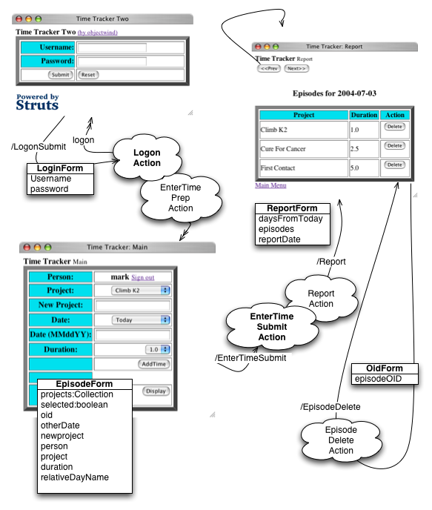
graphic

Slide 103
Testing Struts config.xml
http://strutstestcase.sourceforge.net/
Some things to test for Struts:
  Content of the FormBean
  Correct forwarder called
  Content of the Session state
  Application methods called
Some things not to test
  Business logic
  DB access
  JavaScript

Slide 104
Separating Concerns
Separate Business Logic from Page Routing
  Application Façade (aka SessionFacade)
  State Wrapper
  Minimal conversion logic in Action itself.

Slide 105
Pattern: State Wrapper
State exists in a servlet in various places…
  ActionForm
  HttpServletRequest
  HttpServletResponse
  HttpSession
If each is managed separately …
  Then testing would require complex setup
Encapsulate and manage these (except ActionForm) together in a State Wrapper
  Provides documentation of what is expected
  Easier to test the ApplicationFacade layer
  Encapsulated constants(!) inside the Stare Wrapper
Alternative:
  Strutstest.jar includes servletunit.HttpServletRequestSimulator (and others)

Slide 106
EnterTimePrepAction
public ActionForward execute(…) {
SessionState state = new SessionState(request);
state.setDaysFromToday(0);
EpisodeForm episodeForm = (EpisodeForm) form;
episodeForm.setPerson(state.getUsername());
episodeForm.setProjects(TtrackApplication.getProjectOptions());
logMessages();
return mapping.findForward(FORWARDS.SUCCESS);
}

Slide 107
EnterTimePrepActionTest extends TTrackStrutsTest
MockApplication appl;
public void setUp() throws Exception {
super.setUp();
LogonForm user = new LogonForm();
user.setUsername("MARK");
SessionState state = new SessionState(getRequest());
state.setLogonForm(user);
}
public void testEnterTime() {
List list = new ArrayList();
MockApplication.return_projectOptions = list;
setRequestPathInfo("/EnterTime.do");
actionPerform();
assertEquals(0,new SessionState(getMockRequest()).getDaysFromToday());
EpisodeForm form = (EpisodeForm)getActionForm();
assertEquals("MARK",form.getPerson());
assertSame(list,form.getProjects());
verifyNoActionErrors();
verifyForwardPath("/pages/EnterTime.jsp");
}

Slide 108
TTrackStrutsTest extends MockStrutsTestCase
public void setUp() throws Exception {
super.setUp();
setConfigFile("/WEB-INF/struts-config.xml");
TtrackApplication.setMonostate_forTest(new MockApplication());
// cleaner tests w/o logging
turnOffLogging();
}
private void turnOffLogging() {
if (logsoff) return;
logsoff = true;
Logger.getLogger("servletunit.ServletContextSimulator")
.setLevel(Level.OFF);
Logger.getLogger("org.apache.struts.util.PropertyMessageResources")
.setLevel(Level.OFF);
// …

Slide 109
<Exercise 08>: Struts Testing
In project JWttrack2
Action
  app.struts.episode.EpisodeDeleteAction
    Gets the object id from OidForm
    Calls the ApplicationFacade to do the rest
Run suite
  alltests.AllTests_local_Ttrack2
Complete
  app.struts.episode.EpisodeDeleteActionTests
    was oid passed correctly?
    was the correct forwarder called?
Notes:
Needs ooX number

Slide 110
Outline - Testing Tips -
Intro
jUnit API
Testing Existing Code
Test First Programming
jUnit and Ant
Code coverage
Mock Objects
Dynamic Mock Objects
Web Testing
Struts Testing
Testing Tips ⬅ ☺

Slide 111
Making Large Complex Methods Testable
Use automatic Acceptance Tests to prevent new defects
Remove static to allow for mocks and deferred data loading
Extract code within if and while to more focused methods
Test each extracted method on it’s own as soon as possible
Log String Pattern for the control method (aka:Template Method)
  Extend the Target class.
  Call it Target_underTest
  Override the methods called by the control method
  Log to a String the methods that have been called
  Assert that the log string is what you expect
  Warning: When testing legacy code it’s common to override all the methods by mistake, and test only the mock.

Slide 112
Pattern: Template Method
Provides an algorithm the parts of which are implemented by other methods.
Allows testing of the algorithm disconnected from the parts.

Slide 113
Example Template Method
package xpcinci.render;
public class RenderCalendar {
// .. .
public Map using(Schedule current) {
this.current = current;
renderWeek(current.week01());
renderWeek(current.week02());
renderWeek(current.week03());
renderWeek(current.week04());
map.put(CALENDAR, cal.toString());
map.put(MONTHNAME, titleMonthNameWithYear());
return map;
// .. .

Slide 114
Test Template Method
public void testUsing() {
RenderCalendar rc = new RenderCalendarForUsing();
MockSchedule mock = new MockSchedule();
Map map = rc.using(mock);
assertEquals(
"week01:renderWeek:week02:renderWeek:week03:renderWeek:week04:renderWeek:",
callPath);
assertEquals("", map.get(rc.CALENDAR));
assertEquals("titleMonthNameWithYear", map.get(rc.MONTHNAME));
}

Slide 115
Anti-Patterns (1)
Mocks within Mocks
  Too much dependency (Coupling)
Testing the MockObject
  Overriding everything by mistake
Large Complex Setup
  Too much dependency (Coupling)
Long Test Methods
  Too much dependency (Coupling)
Multiple assert methods
  Break into separate more targeted test methods
Few or Zero assert methods
  Not just execute but execute with a goal

Slide 116
Anti-Patterns (2)
Slow tests (longer than 10 minutes)
  Are they really integration tests?
  Separate Unit tests from Integration tests into specialized suites
  Find the resources that can be replaced with Mocks
  Use junit.extensions.TestSetup to reduce redundant setup code
Duplicate code in setup or test
  Refactor into Super class or Helper classes
Duplicate tests for test different parts of the production code
  Remove duplicate production code by Refactoring
Tests fail during integration (broken tests checked-in)
  Don’t check in code with failing or no-tests

Slide 117
Consider Automatic Build Tools
    Automatic Build
      Checkout
      Build & run jUnit
      Tag the version number
    AntHillOS (openSource)
      Easy set up as webapp
      Good documentation
      Buggy, but good support
    AntHillPro (product)
      Larger Feature set
      Still Buggy, but good support
    CruiseControl (openSource)
      Nice plug able architecture
      Poor Documentation
      Command Line

Slide 118
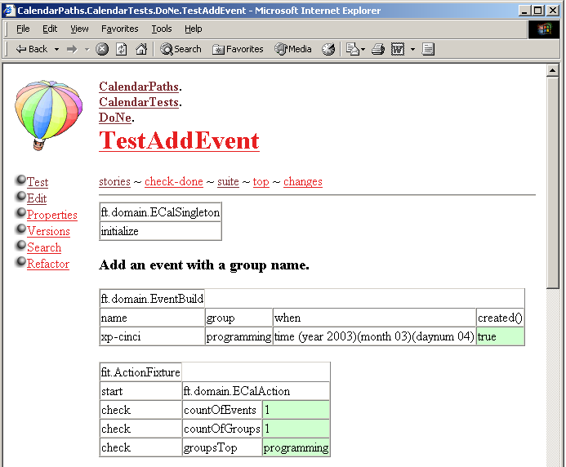
FitNesse

Slide 119
References
Ecal
    :pserver:anonymous@cvs.sourceforge.net:/cvsroot/ecal
Test-Driven Development
    By Kent Beck, Addison-Wesley, 2003
Java Open Source Programming
    By Walnes, Abrahamian, Cannon-Brookes, & Lighbody, Wiley 2004
Java Extreme Programming Cookbook
    By Eric Burke, O’Reilly, 2003
JUnit in Action
    By Vincent Massol, Manning, 2004
www.mockobjects.com
“Don’t Mock Me”
    By Jeff Langr: www.langrsoft.com/articles/mocking.html
Junit Add ons
    http://sourceforge.net/projects/junit-addons

