Slide 1



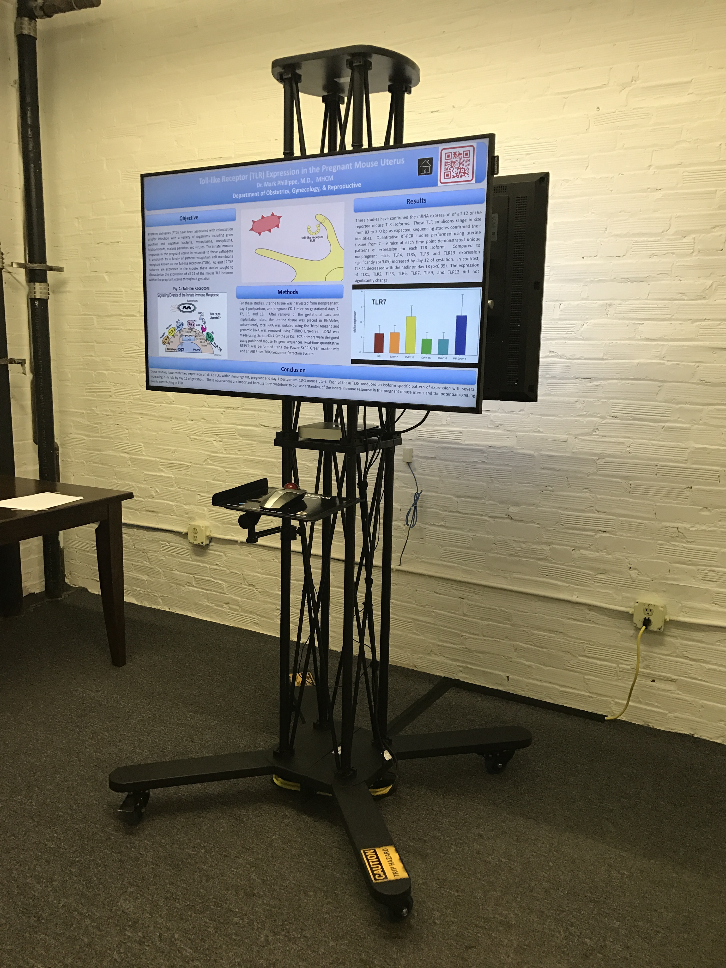
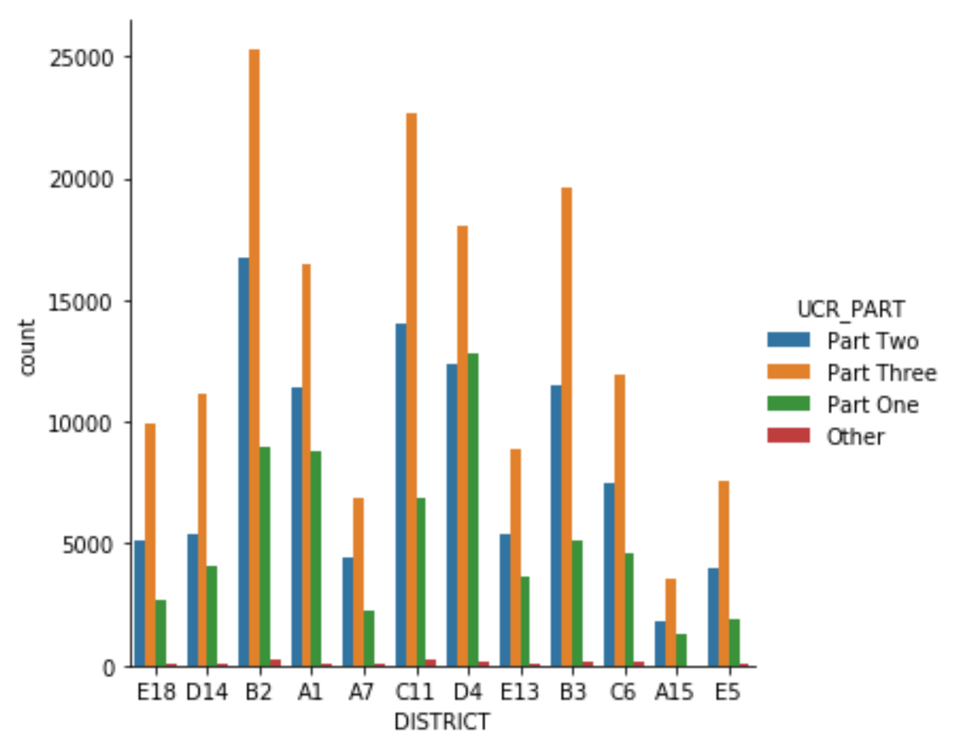
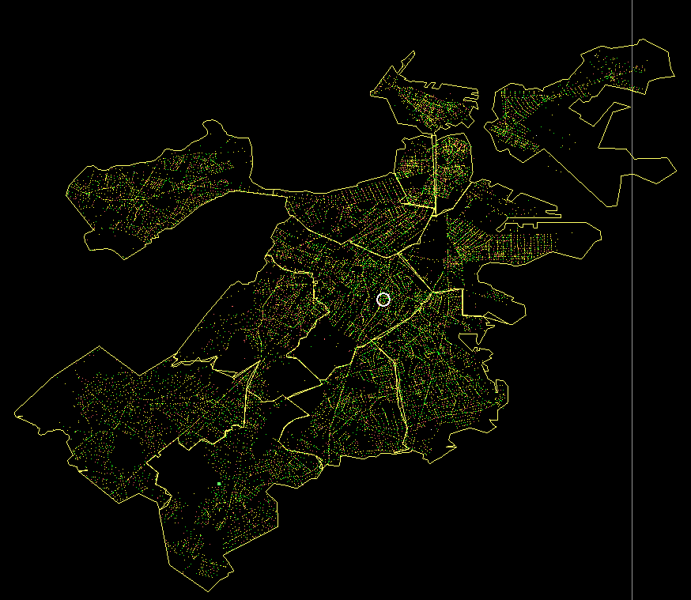
Predicting Crime in Boston
Julie Osborne, Mary Wishart, Marco Alverez, Chris McCooey
Department of Computer Science and Statistics, University of Rhode Island
Introduction
Limitations of Existing Work
Other existing work requires other social statistics for predicting crime
We wanted to be able to predict crime without having to know other factors such as area income
Crime
Machine Learning
Purpose: Try to predict where various crimes are likely to happen within the city of Boston
Use Multi-class logistic regression to predict where a specific crime was likely to happen•
Use Decision Tree algorithm to predict where a crime was likely to happen
Discussion
Did you follow our formatting steps?
Layout should always be in landscape orientation & recommended 1-5 slides max unless you hyperlink.
Check all your hyperlinks to make sure it goes to your desired slides
Slide Show Toolbar: Select “Setup Slide Show” then select “loop continuously until stopped”
Embedded videos can only be displayed in the following formats: .mov, .mp4, .mpeg. Note: Upload your video file along with your PowerPoint file.
Save all mathematical formulas and equations to images (.jpg, .png) when embedding or upload your excel file along with your PowerPoint file.
Save PowerPoint as .pptx to ensure all your embedded images and videos are included.
Set-up & Methods
Figure 2. The amount of crime divided by UCR part numbers for each police district in Boston.
•Each crime has a latitude and longitude
•Divide the city into a grid, and predict the location on this grid
•Individual crimes are given an offense code number. These are then put into offense groups
•For our analysis, we used the offense group, not the individual offense code number
•67 offense groups in total
•One Hot encoded all of our variables as they were categorical
•Data was spilt into 80/20 training, testing datasets
Figure 1. DESCRIPTION
Results
You can write your results in this text box
Figure 3. Each dot on this map of Boston is a point in our dataset

Slide 2
Predicting Crime in Boston
Author’s name
Department of Computer Science and Statistics, University of Rhode Island
TOPIC
SECOND PAGE OPTIONAL
TOPIC
Content
This slide was added in case you do not have enough space on your first slide.
You can change the shapes and layout of this page by going to THEMES, EDIT MASTER, MASTER VIEW and EDIT 1st or 3rd slide.
Content
TOPIC
TOPIC
Content
Content
TOPIC
Content

