Slide 1
Final Project
Scott Bingham & Marika Witt

Slide 2
World War III
A computer virus has run rampant and has led to World War III.
Almost every city on Earth has been destroyed. There are only five cities remaining: Seattle, Boring, Toronto, Tokyo, and Paramaribo.
You are required to move to one of these five cities.
You need to find a home you can afford.

Slide 3
Loans $$
Home buyer wishes to borrow a certain amount of money at a certain interest rate in order to buy a home.
Interest is compounded continuously, and payments are made continuously.
Determine monthly payment required to pay off loan in a certain amount of time.

Slide 4
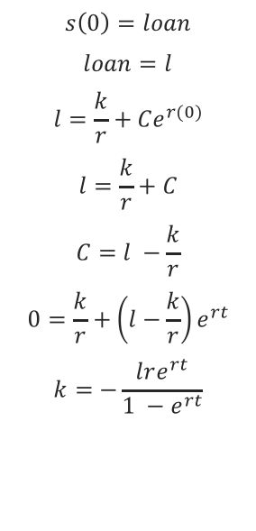
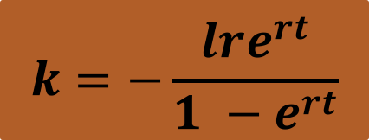
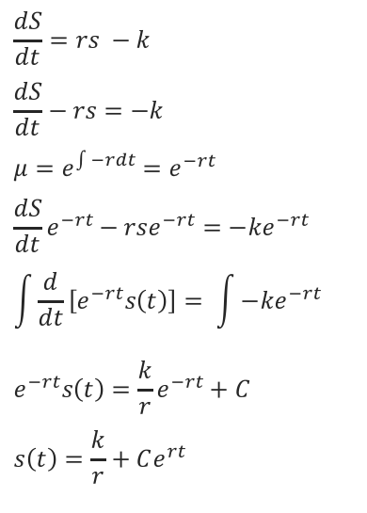
Using Differential Equations
$$\frac{dS}{dt}=rs −k$$
$$\frac{dS}{dt}−rs=−k$$
$$μ=e^{\int{−rdt}}=e^{−rt}$$
$$\frac{dS}{dt}e^{−rt}−rse^{−rt}=−ke^{−rt}$$
$$\int{\frac{d}{dt}}\left[e^{−rt}s\left(t\right)\right]= \int{−ke^{−rt}}$$
$$e^{−rt}s\left(t\right)=\frac{k}{r}e^{−rt}+C$$
$$s\left(t\right)=\frac{k}{r}+Ce^{rt}$$
$$s\left(0\right)=loan$$
$$loan=l$$
$$l=\frac{k}{r}+Ce^{r(0)}$$
$$l=\frac{k}{r}+C$$
$$C=l −\frac{k}{r}$$
$$0=\frac{k}{r}+\left(l−\frac{k}{r}\right)e^{rt}$$
$$k=−\frac{lre^{rt}}{1 −e^{rt}}$$
$$k=−\frac{lre^{rt}}{1 −e^{rt}}$$

Slide 5
Challenges
Best way to set up classes.
Making the input/output files work efficiently.
Manipulating the differential equation to work in C++.

