Slide 1
C-8.5 : Sorting Balls
By: Michael Muller

Slide 2
The Problem
C-8.5 Suppose we are given a sequence S of n elements, each of which is colored red or blue. Assuming S is represented as an array, give an in-place method for ordering ‘S’ so that all the blue elements are listed before all the red elements. Can you extend your approach to three colors?
For my approach I converted all colors into numbers. So for red and blue, red = 0 and blue = 1. You can switch the values and the result will be the same. The value is just an association with the color and doesn’t effect the sorting.

Slide 3
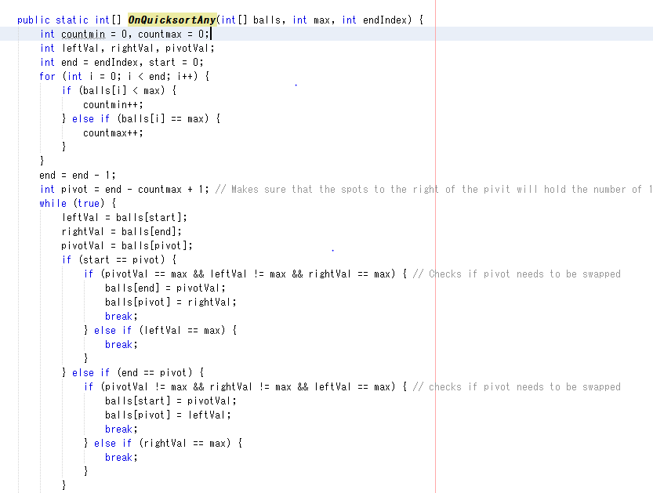
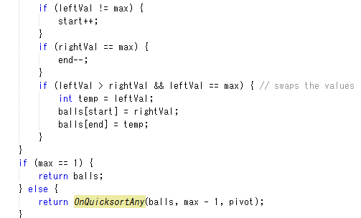
The Sorting Algorithm
This for loop iterates through the elements of the array and counts the number of balls based on the highest value.
The largest valued ball will be counted as Max and the others will be counted as min.
This will take O(N) time. Where N is the previous number of min elements.
(Continuation of Loop)
This while loop iterates through the array using a modified quicksort algorithm to swap the elements. The loop will swap all max value balls with non-max value balls. So at the end, all balls from the pivot to the end of the array are Max valued balls.
This will always take O(N) time.

Slide 4
The Recursive Step
The Recursive call to “OnQuicksortAny” will pass the current array, the next value before the max value, as well as the current pivot to itself to begin sorting the next portion of the array.
If the max value is equal to 1, then we know it is sorted because sorting an array with only 1 element is trivial. (The element in this case being ‘0’)

Slide 5
Time/Space Complexity
Since we only have 2 colored balls in the first example. We will only run through the quick sort once, as all elements less than 1 will all be the same.
For 3 colored balls, the quick sort will run twice because we have all elements lower than 2, then we will refer to the base case, which is the sorting of an array with 2 colors.
For each iteration of the sort, we count the elements, which at worst case takes O(n), the average case being O(n – max), where max is the sum of all the elements counted as “Max” values from previous sorts.
The sorting portion is at worst O(n) because we use max and min value, which is either true or false. So we assume all value less than the max are in the same set.
The total time complexity is O(2n*c) where C is the total number of unique colors. And O(2n*c) = O(n).
Space complexity: Since we only use one array and never create a new array, the space complexity is O(n) where n is the number of balls.

Slide 6
Demo

