Slide 1
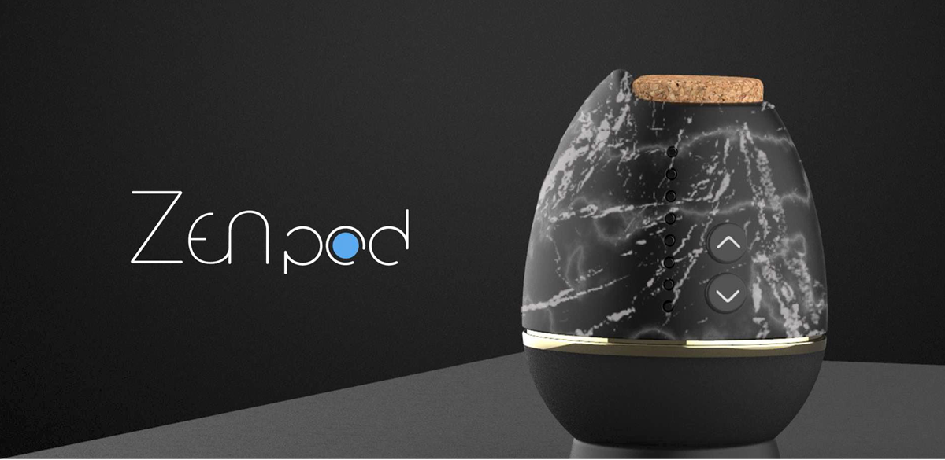
Brikena Dulaj, Michael Muller,
Sumit Raut, Pavan Singh
Project Designer: Tomoya Ono

Slide 2
MOTIVATION
To bring the luxury and efficiency of automation to a ‘technology free activity’
Detach from your phone
Center yourself
Focus on breathing
Could the ZenPod bridge the gap?

Slide 3
OVERVIEW
The Zenpod is a meditation assistance device designed by Tomoya Ono
Promote a simple and handsoff yoga/meditation experience
Provided through haptic, aromatic, and acoustic features. (Breathing Vibrations, Heating element, and music respectively)

Slide 4
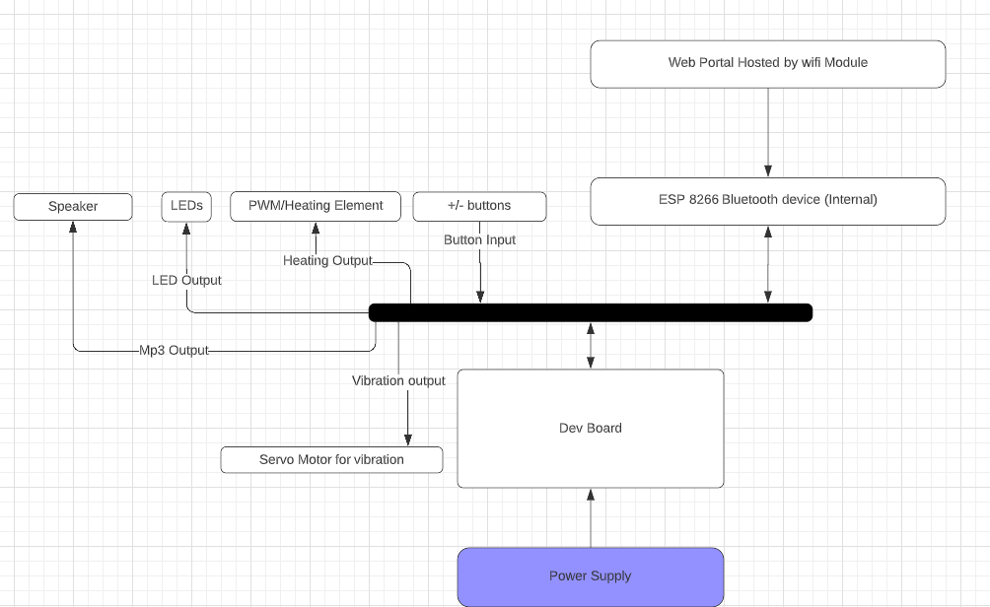
Block Diagram

Slide 5
MEDITATION TIME - SUMIT
Overview:
The main goal of this part is that users should be able to increment or decrement the meditation time by pressing + or - Switch respectively. Hardware required for this part is 4 LEDs which will increment the time selected by the user,
Hardware:
KL25Z Freedom Board,
2 - SPST Switches,
4 - 220 ohm resistors.
4 - LEDs
Functions:
Systick Timer
Meditation time Increment
Meditation time Decrement
States (based on Finite State Machine)

Slide 6
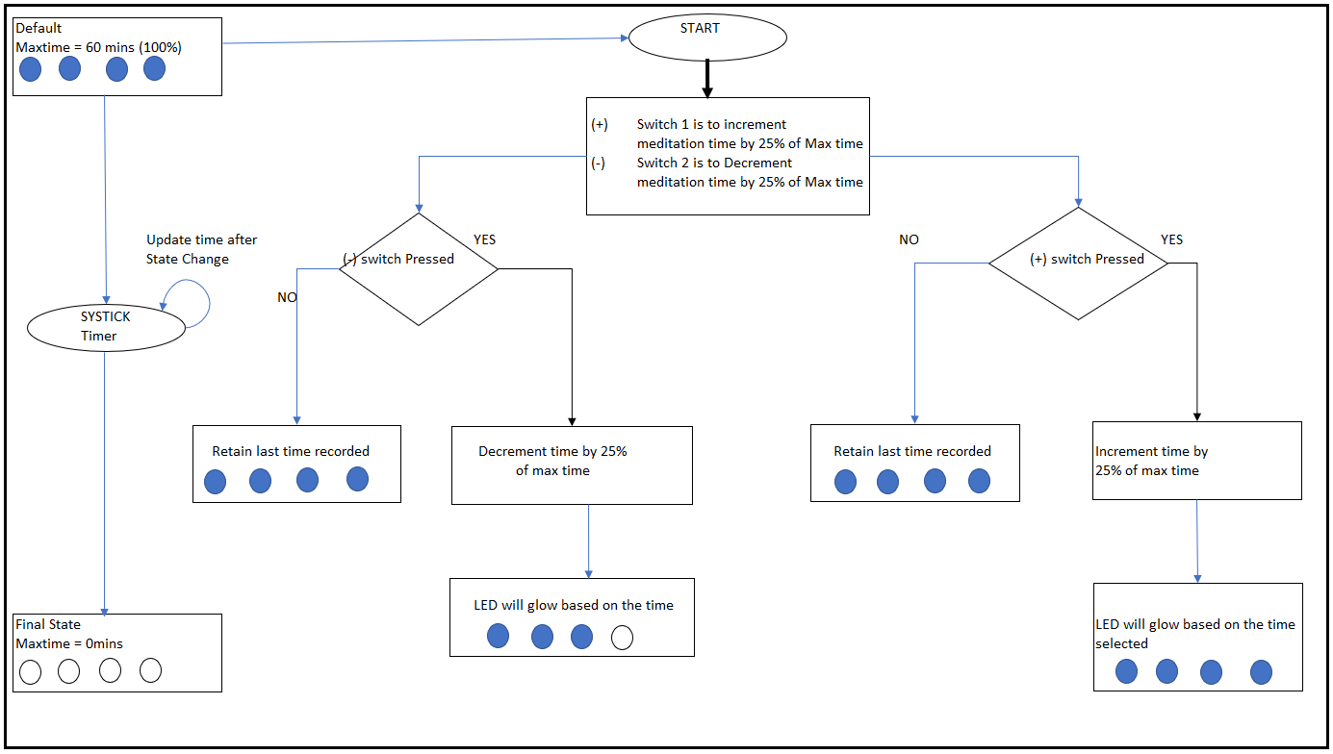
MEDITATION TIME - FLOW CHART

Slide 7
Aromatics (heating element)- Pavan
The heat diffuser (on-board heater) heats the essential oils until they evaporate into the air. This type of heat diffusers use a tray where the oil is held next to the heat source so that it will heat and evaporate. The goal here is to use a heating element controlled and powered through the board power supply. The heater output calculation is based on the inhale/exhale timing, there is no user configuration is required for heater. And the heating element is controlled through PWM duty cycle.
Hardware used to realize the heating part:
KL25Z Freedom Board
Heating element (12V, 1W)
Transistor (NPN) – current consumption now and without transistor
As a failsafe mechanism, the inhale/exhale timer is constantly checked before setting the PWM duty cycle. In case of an undetermined state the heating is set to lowest PWM duty cycle which is set to 20%. Further, in case of losing the inhale/exhale setting after starting the program the heater PWM duty cycle is reset to lowest value. The heater is enabled only in case of the valid meditation time, it cannot turn on when the meditation is not in progress.

Slide 8
Aromatics (heating element)- Pavan
Future improvements:
Use the PI control for the heating element, where the oil diffuser temperature is set, and heater element would use this target temperature with a feedback from heater. For the entire meditation time the heater would target for this target temperature by controlled PWM duty cycle.
Use external power supply for better aromatic experience.

Slide 9
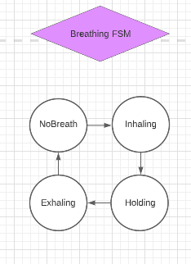
Haptic - Breathing
SysTick drives timing for motor
Parts of a breath broken up for expandability
Toggling transistor
LED was added for extra visuals

Slide 10
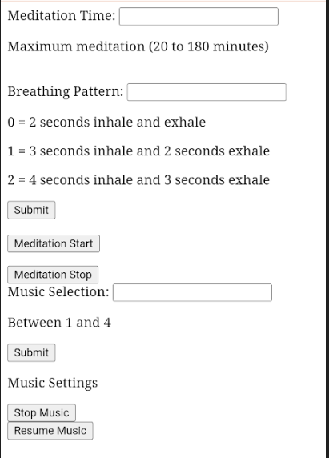
WiFi/Serial Communication
UART communication to KL25Z
Common web app used for data simulation
Simple 1 byte struct for data
First byte determines data type

Slide 11
SUMMARY
While simple. FSM’s allow for a robust system
More software than hardware
I would personally buy this product

Slide 12
Demo

Slide 13
Questions?

