Slide 1

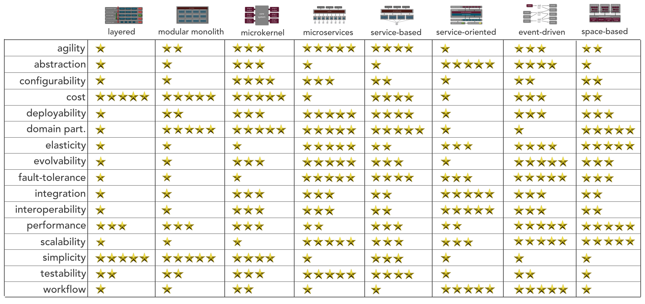
Architecture Styles Worksheet
System/Project:
MonitorMe
Architect/Team:
Design Dynamos
Date:
Selected Architecture(s):
X
X
Created by Mark Richards, DeveloperToArchitect.com

