Slide 1
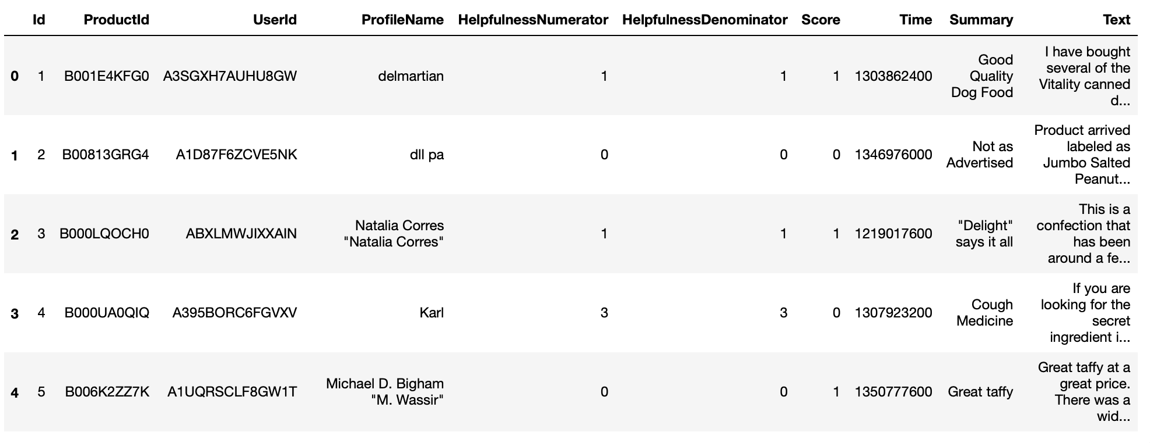
Data Profile
Number of reviews: 568,454 reviews；Number of Users : 256,059 users；
Number of products : 74,258 products；Time span of taking reviews: Oct 1999 - Oct 2012；
Number of attributes/column in Data: 10

Slide 2
Data Preprocessing
Replace the abbreviation with the full words.
Define the stopwords
Remove the stopwords
Remove the url content
Remove HTML tag
Convert captial to lowercase

Slide 3
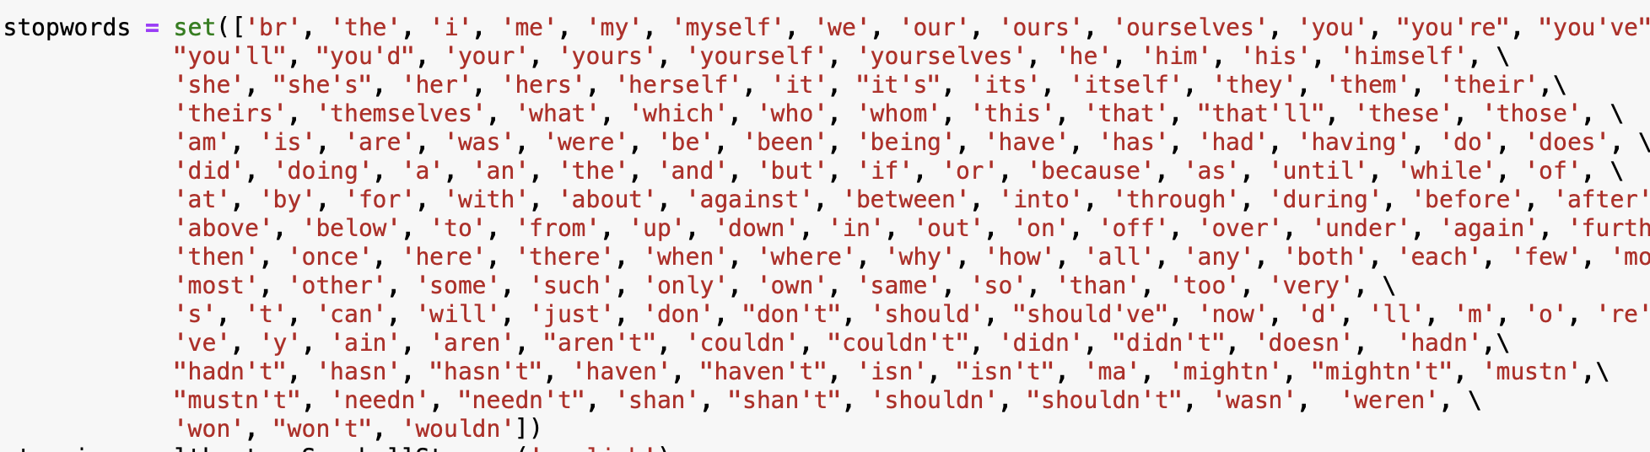
Data Preprocessing
The stopwords I defined as follows:

Slide 4
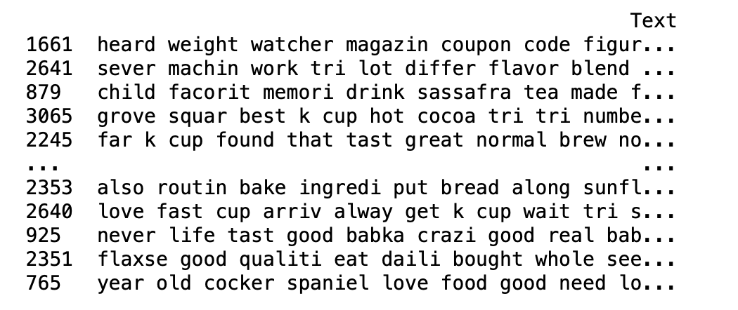
Data Preprocessing
After data preprocessing, part of the text of the dataset are shown as :

Slide 5
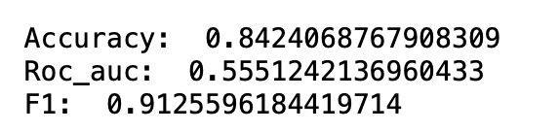
Experiment & Result
Put the data into the KNN of sklearn, and the result is shown as :

Slide 6
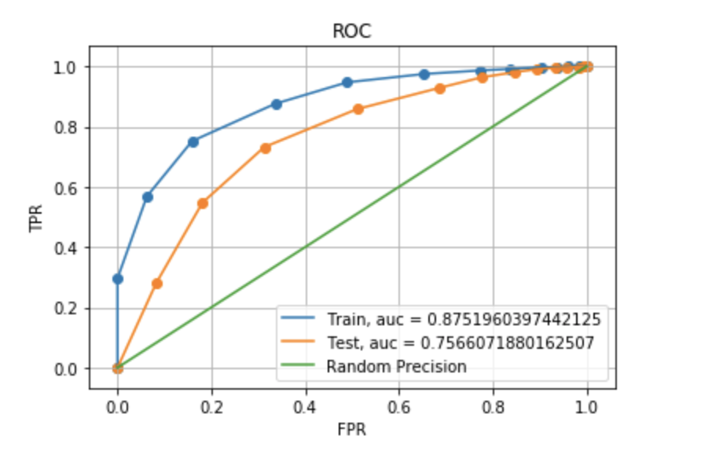
Experiment & Result
The ROC curve of the experiment result is shown as:

