Slide 1


Taking a page from functional programming: how to burn spaghetti and become 20% cooler, a case study
Michał Woźniczak

Slide 2
Let me tell you about...
Erlang
(wait, what?)

Slide 3
Some quirks are immediately useful:
L = [1,2,3,4,5]. [2 * X || X <- L].
% [2,4,6,8,10]

Slide 4
Some might take a moment to understand:
[H|T]
what even is this for?
sum(L) -> sum(L, 0).
sum([], N) -> N; sum([H|T], N) -> sum(T, H+N).

Slide 5
And some will straight up bend your mind
What is up with these variables?
1> A = 3.
3
2> A = 4.
** exited: {{badmatch,4},[{erl_eval,expr,3}]} ** 3> A = A + 4.
** exited: {{badmatch,7},[{erl_eval,expr,3}]} **

Slide 6
Consider the classic Python gotcha:
def list_appender(*args, outputs=[]): outputs += args
return outputs
>>> some_function(1, 2, 3) [1, 2, 3]
>>> some_function(4) [1, 2, 3, 4]
>>> some_function() [1, 2, 3, 4]
oh no

Slide 7
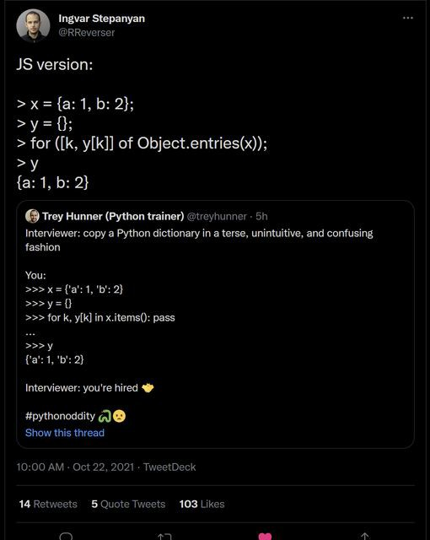
Consider... uh, this:

Slide 8
The setup

Slide 9
def process_elements(elements: List[Elements]) -> List[Elements]:
...
Return value is a list of elements that went through the ENTIRE process successfully.
What can possibly go wrong, right?

Slide 10
The problem(s)

Slide 11
The main processing function at a glance
def process_elements(elements): for element in elements:
if not passes_eligibility_check(element): elements.pop(element)
if not elements: return []
do_something(elements)
for element in elements: # Abbreviated; we’ll get there in a moment! ExternalAPI.process_an_element(element)
SomeOtherExternalThing.process(elements)

Slide 12
Changing the whole elements list with .pop()
if some_heavy_duty_library.somefunction(element):
elements.pop(element)

Slide 13
Changing the elements list with... whatever this is
...
for (i, element) in enumerate(elements.copy()): try:
ExternalAPI.process_an_element(element) except Exception:
elements[i:i+1] = []
...

Slide 14
Spooky action at a distance
...
SomeOtherExternalThing.process(elements)
...
...meanwhile, in SomeOtherExternalThing:
def process(elements):
for element in elements: try:
process_one(element) except Exception:
elements.pop(element)

Slide 15
Summary of problems
Can't speed things up with parallelization: The elements list keeps changing
especially with that trick
elements[i:i+1] = []
Keeping track of what the current status is would make debugging much easier
...But right now several functions in other modules are playing keepaway with it
Feedback we've gathered indicates need for better status indication

Slide 16
Working towards a solution

Slide 17
The main processing function: bird’s eye view
def process_elements(elements): # discriminator:
if not any_processable(elements): return []
# actual processing: do_something(elements) do_something_else(elements) do_some_other_stuff(elements)

Slide 18
Enter the ProcessingStatus object:
class ProcessingStatus(NamedTuple):
processables: Set permanent_failures: Set
# These are basically # just regular
transient_failures: Set # set()s
def | fail_transiently(self, item): ...
def def | fail_permanently(self, item): ... freeze(self) -> ProcessingStatus: # | lock down | the final results
@staticmethod
def integrate(statuses: Iterable[ProcessingStatus]) -> ProcessingStatus: ...

Slide 19
Functions in detail: fail_transiently and fail_permanently
Purpose:
Remove the item from processables (obviously)
fail_transiently indicates temporary failure; if an element didn't already fail
permanently, add it to our set of
transient_failures
3. fail_permanently indicates a failure we really want to report on. So, add it to permanent_failures , and remove it from transient_failures to remove the noise.

Slide 20
Functions in detail:
freeze
Converts all the sets: processables , data_failures , and transient_failures into frozensets, so they can no longer be modified. This is done when a processing function function has completed its tasks.

Slide 21
Functions in detail: integrate
Creates a new, pre-frozen following logic:
ProcessingStatus
object from the ones provided, using the
all sets are intersected ( & operation) all
processables
transient _ and permanent_failures are union'd ( | operation)
resulting transient_failures has the overlap with permanent_failures cut out ( - operation), since permanents trump transients

Slide 22
The solution(s)

Slide 23
The main processing function: once more, with feeling
def process_elements(elements): status = discriminate(elements) if not status.processables:
return status
return ProcessingStatus.integrate( f(status.processables) for f in (
do_something, do_something_else, do_some_other_stuff
)
)

Slide 24
Gotta go fast
from multiprocessing.dummy import Pool pool = Pool(some_number_of_processes)
and then:
def process_elements(elements, pool):
... # discrimination happens here results = pool.map(
lambda x: x(status.processables), ( do_something, do_something_else, do_some_other_stuff
)
)
return ProcessingStatus.integrate(results)

Slide 25

Outcomes:
Increased readability Modularization of processing functions
Introduced plug-ins can be snapped in (or out!)
Parallelization is now much easier
Major speed boosts (20% increase just by using Pool )

Slide 26
Q & A

Slide 27
Thank you
This slide deck will be available on http://mwozniczak.github.io/kds2021.html .pptx file also available here

