Slide 1
Orchestration > Automation
Overcome automation challenges with vRealize Orchestrator

Slide 2

Mike Preston
Writer
Leader
Twitter
Day(Night) Job
Author
Certs
@ blog.mwpreston.net
@ Toronto VMUG
@ mwpreston
@ Rubrik
Troubleshooting vSphere Storage
VCP/VCAP/Other Randoms

Slide 3



Slide 4


Slide 5




Slide 6
Agenda
Give away maple syrup
Talk about hockey
Automation vs Orchestration
Talk about vRO
Demo

Slide 7
Automation vs Orchestration
Automation
Orchestration
Set of instructions used to create a repeatable process that usually replaces manual labor.
Multiple sets of instructions used to create a repeatable process that usually replaces manual labor.
Single task oriented
Solves a specific problem
Workflow oriented
Solves a business process
Limited to a single tool
Utilizes multiple automation tools
Benefits
Provides Reliability
Time Savings
Consistency
Increased Availability

Slide 8


Slide 9
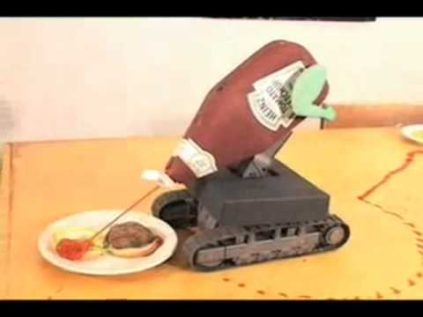
By removing the human element, we remove the human element
rm –fr /*
Get-VM * | Remove-VM -Force

Slide 10








Which tool to use?

Slide 11



Automation Sprawl

Slide 12
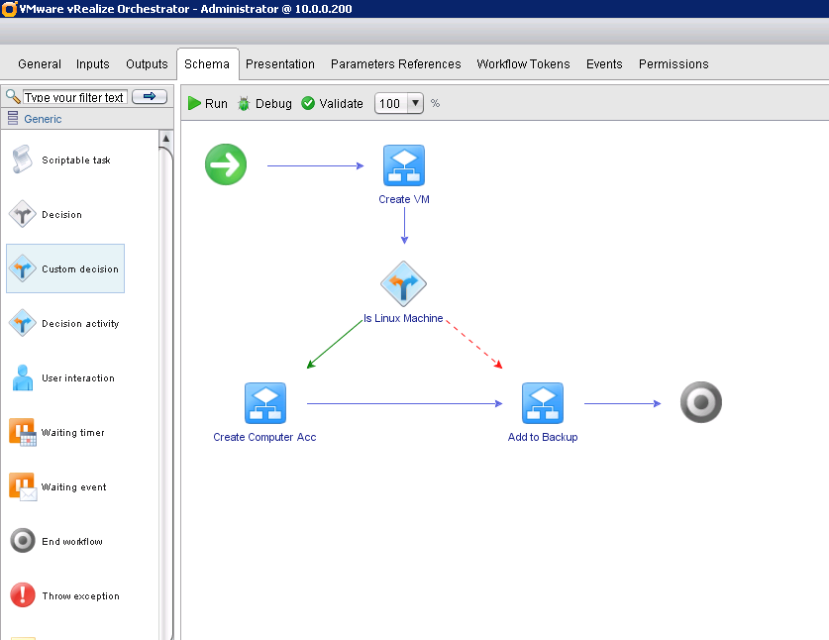
Introducing vRealize Orchestrator (Its not just for vRA)
An Orchestration Platform
Robust Workflow Automation
GUI Based Drag & Drop UI
Open & Flexible Architecture
You may already own it!

Slide 13
vRO Architecture
vRO Client
vSphere Web Client
REST API
vRO Platform
Workflow Engine
Workflow Library
vCenter
Active Directory
SSH
SQL
REST
3rd-party plugin

Slide 14

Demo Time

Slide 15
Did we solve our challenges?
Human element
Still technically a script – but with robust user interaction features.
Which tool?
Use them all!
Automation Sprawl
All actions are wrapped into highly visible workflows.

Slide 16
Want to get started?
Tips
Do more with less!
CodeCapture(Onyx) is your friend.
System.log();
Resources
VMware Marketplace (marketplace.vmware.com)
vRealize Orchestrator landing page (vmware.com/ca/products/vrealize-orchestrator.html)
code.vmware.com
theithollow.com (Eric Shanks)
github.com/mwpreston

Slide 17
Thank you
Questions?
Mike Preston | E: mike.preston@rubrik.com | T: @mwpreston

