Slide 1



Your Link to the Global VMware Community

Slide 2



Who am I?
Mike Preston
Tweets
Codes
Works
Does
Likes
mwpreston
mwpreston
Developer Advocate @ Rubrik
Coding, Writing, Talking
Maple Syrup & Hockey

Slide 3
What is VMUG?
The VMware User Group (VMUG) is an independent, global, customer-led organization, created to maximize members’ use of VMware and partner solutions through knowledge sharing, training, collaboration, and events.

Slide 4

Aim to meet ~5 times per year
Quarterly meetings featuring sponsors and community members
Content geared towards YOU – let us know what you want!
@TorontoVMUG | #TorontoVMUG | @MyVMUG

Slide 5


VMware User Group (VMUG) Member Benefits
200+ Local Groups (online & in-person!)
Free Membership
VMUG eLearning
VMUG Virtual Events
Customer Spotlight
VMUG Voice and VMUG Compass
VMUG Advantage
UserCons
Notes:
Here is an overview that shows all of the components that play a part in VMUG as an independent, global, and customer-led organization. As you can see, we have 100,000 plus members globally with 200 plus local groups.
We have many exciting things going on throughout the year, and lots to look forward to with your leadership role. We will talk through some of these things in more depth throughout this training.

Slide 6

VMUG Advantage

Slide 7

Benefits
Education & Certifications
20% off all VMware Instructor-led courses
35% off VMware Learning Zone
Events
$100 off VMworld registration – the only stackable discount available anywhere!
EVALExperience
Exclusive access to 365-day evaluation licenses for a selection of VMware solutions, for personal use in a non-production environment
20% off all VMware Certification exams
35% off VMware Lab Connect

Slide 8
EVALExperience – 365-day EVAL
VMware NSX – Enterprise Edition NEW
VMware vCenter Server v6.x Standard
VMware vSphere® with Operations Management™ Enterprise Plus v6.5
VMware vCloud Suite® Standard
VMware Virtual SAN™
VMware vRealize Orchestrator
VMware vRealize Operations™ 6 Enterprise
VMware vRealize Log Insight™
VMware vRealize Operations for Horizon®
VMware Horizon® Advanced Edition
VMware Fusion 8.5 Pro
VMware Workstation 12.5 Pro
Enjoy exclusive access to 365-day evaluation licenses for a selection of VMware solutions for personal use in a non-production environment.
For more information, please visit: https://www.vmug.com/Advantage

Slide 9
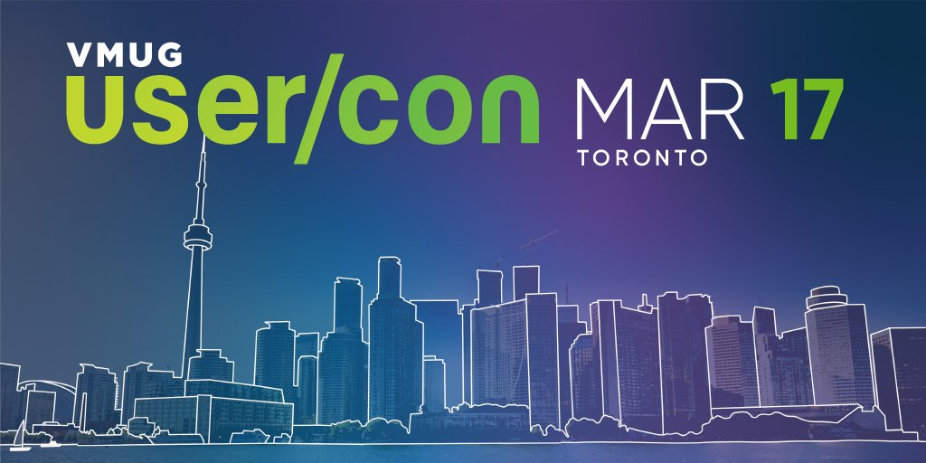
The Big One!
North Building | Metro Toronto Convention Centre 255 Front Street West

