Slide 1
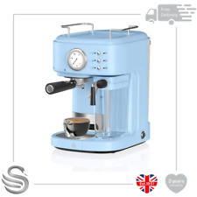

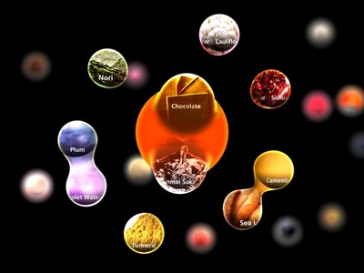
Advanced Coffee Macker
Anna Tumanova
Project description Coffee machine with additional new technology features. People would be able to scan a code in the app and get a coffee and what is more important create a coffee with unique recipe. Tasty coffee by New Generation Coffee machine | Objective/Approach Most of coffee lovers like to experiment with coffee recipes. That’s why our machine will make their experience unforgettable. First user needs to load the application if want to use recipe creating option and also they would be able to gather the bonuses and in future get some discounts. with the feature of creating the recipes user able to interact with machine and play with different flavours.
Schedule: Develop mobile application till 30/01 Make testing 15/02 Improve and develop user-friendly design till 17/04 Demo testing 01/05 | Miscellaneous support data Benefits: User should not touch machine everything can be managed by application as well as scheduled making a coffee User data will help to modify and create unique recipes with really interesting and bizarre flavours It can give new unique experience to the user With the help of saving the bonuses user will have discounts and additional benefits Also in future we are planning to integrate smart coffee consumption that will limit the amount of caffeine during the day

