Slide 1
The New Coffee Maker
Svitlana Bilan
Vitalii Upir
Dmytro Kravchenko
Sebastian Babushkin

Slide 2
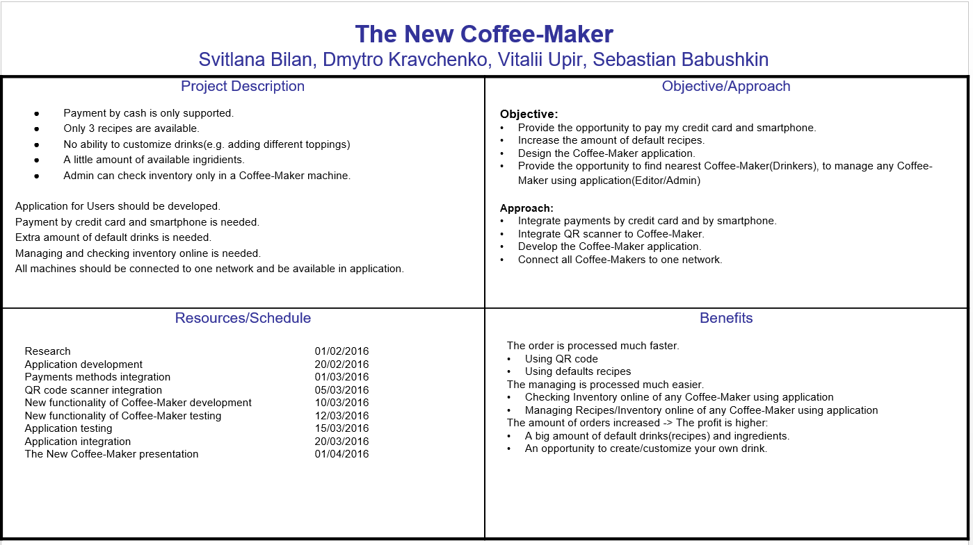
Planowane:

Slide 3
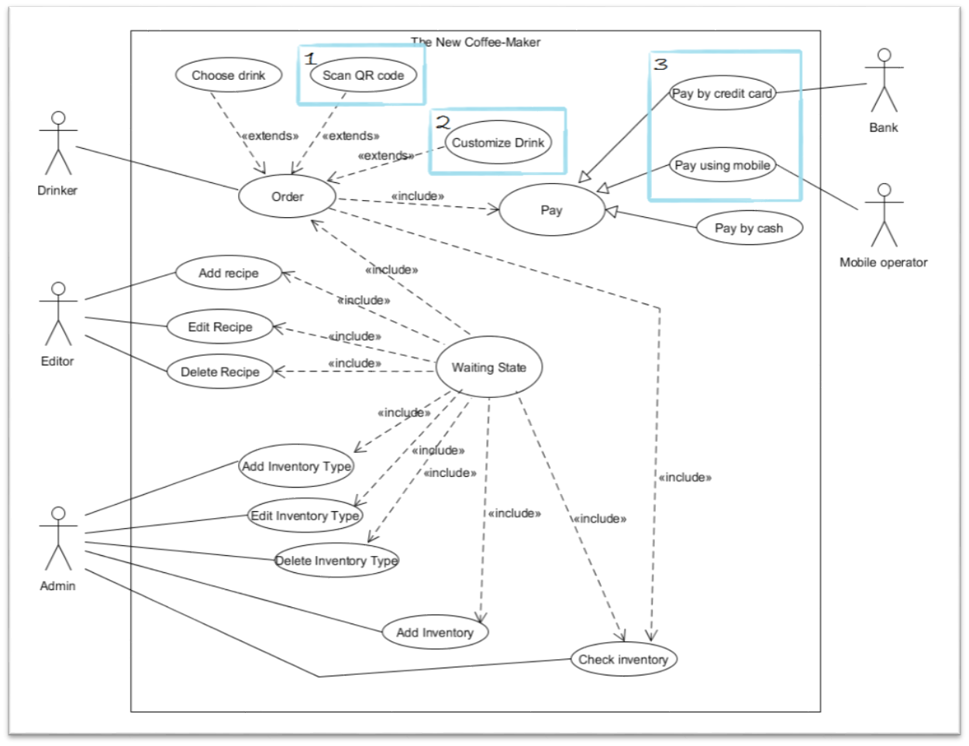
Planowane:
Scan QR code(with already created order);
Customize drink;
Payment by mobile and credit card.

Slide 4
Udało się realizować:
Serwis Scanner za pomocą którego możemy odczytać kod z przepisem i następnie wywołać serwis Coffee.
@Override
public Context scan(Context context) throws RemoteException, ContextException {
logger.info("SCANNER", "Started");
PositionalContext cxt = (PositionalContext) context;
List<String> inputs = cxt.getInValues();
logger.info("inputs: " + inputs);
List<String> outputs = cxt.getOutPaths();
logger.info("outputs: " + outputs);
// update the service context
if (provider != null)
cxt.putValue("scanner/provider", provider.getProviderName());
else
cxt.putValue("scanner/provider", getClass().getName());
if (isRecipeCodeExist(inputs.get(0))) {
Recipe recipe = decode(inputs.get(0));
cxt.putValue(RESULT_STATUS, true);
if (cxt.getReturnPath() != null) {
cxt.setReturnValue(getRecipeContext(recipe));
} else if (outputs.size() == 1) {
// put the result in the existing output path
cxt.putValue(outputs.get(0), getRecipeContext(recipe));
} else {
cxt.putValue(RESULT_PATH, getRecipeContext(recipe));
}
} else {
cxt.putValue(RESULT_STATUS, false);
cxt.putValue(RESULT_PATH, "Sorry, you sent incorrect code!!!");
}
return cxt;
}
public static Context getRecipeContext(Recipe recipe) throws ContextException {
return context( ent("name", recipe.getName()),
ent("price", recipe.getPrice()),
ent("amtCoffee", recipe.getAmtCoffee()),
ent("amtMilk", recipe.getAmtMilk()),
ent("amtSugar", recipe.getAmtSugar()),
ent("amtChocolate", recipe.getAmtChocolate())):
}
protected Recipe decode(String code) {
Recipe recipe = new Recipe();
String codes[] = code.split("[,]");
recipe.setAmtCoffee(Integer.parseInt(codes[0].split("c")[1]));
recipe.setAmtMilk(Integer.parseInt(codes[1].split("m")[1]));
recipe.setAmtSugar(Integer.parseInt(codes[2].split("s")[1]));
recipe.setAmtChocolate(Integer.parseInt(codes[3].split("ch")[1]));
recipe.setPrice(Integer.parseInt(codes[4].split("p")[1]));
recipe.setName(codes[5]);
return recipe;
}

Slide 5
Udało się realizować(Netlet):
#!/usr/bin/env nsh
@Codebase(group='org.sorcer', module='coffeemaker', version='${sorcer.version}', classifier='dl')
import edu.pjatk.inn.coffeemaker.Delivery
import edu.pjatk.inn.coffeemaker.Scanner
import edu.pjatk.inn.coffeemaker.CoffeeService
import static sorcer.co.operator.inEnt
import static sorcer.eo.operator.*
String codeRecipe = "c1,m1,s2,ch0,p123,latte";
int paid = 200;
Task scanner = task("hello scanner", sig("scan", Scanner.class), context("scanner", inEnt("code", codeRecipe)));
Task coffee = task("coffee", sig("makeCoffee", CoffeeService.class), context(
ent("recipe/name", "latte"),
ent("coffee/paid", paid),
ent("coffee/change"),
ent("recipe")));
Task delivery = task("delivery", sig("deliver", Delivery.class), context(
ent("location", "PJATK"),
ent("delivery/paid"),
ent("room", "Duza alua")));
if(get(exert(scanner),"result/status")){
job(scanner, coffee, delivery,
pipe(outPoint(scanner, "result/value"), inPoint(coffee, "recipe")),
pipe(outPoint(coffee, "coffee/change"), inPoint(delivery, "delivery/paid"))
);
} else{
scanner:
}

Slide 6
Udało się realizować(Netlet -> Output):
Context name: job-85
subject: job/data/context:job-85
Context name: unknown83
coffee/change = 77
coffee/paid = 200
price = 123
recipe = Context name: unknown23
amtChocolate = 0
amtCoffee = 1
amtMilk = 1
amtSugar = 2
name = latte
price = 123
recipe/added = false
recipe/name = latte
task/provider = CoffeeMaker-vital@172.23.66.83:172.23.66.83
job-85/coffee/coffee/change = 77
job-85/coffee/coffee/paid = 200
job-85/coffee/price = 123
job-85/coffee/recipe = Context name: unknown23
amtChocolate = 0
amtCoffee = 1
amtMilk = 1
amtSugar = 2
name = latte
price = 123
recipe/added = false
job-85/coffee/recipe/name = latte
job-85/coffee/task/provider = CoffeeMaker-vital@172.23.66.83:172.23.66.83
6.83:172.23.66.83
Context name: unknown84
deliver/change = 17
delivery/cost = 60
delivery/paid = 77
location = PJATK
room = Duza alua
task/provider = Coffee Delivery-vital@172.23.66.83:172.23.66.83
job-85/delivery/deliver/change = 17
job-85/delivery/delivery/cost = 60
job-85/delivery/delivery/paid = 77
job-85/delivery/location = PJATK
job-85/delivery/room = Duza alua
job-85/delivery/task/provider = Coffee Delivery-vital@172.23.66.83:172.23.66.83
Context name: scanner
code = c1,m1,s2,ch0,p123,latte
result/status = true
result/value = Context name: unknown23
amtChocolate = 0
amtCoffee = 1
amtMilk = 1
amtSugar = 2
name = latte
price = 123
scanner/provider = Scanner-vital
task/provider = Scanner-vital@172.23.66.83:172.23.66.83
job-85/hello scanner/code = c1,m1,s2,ch0,p123,latte
job-85/hello scanner/result/status = true
job-85/hello scanner/result/value = Context name: unknown23
amtChocolate = 0
amtCoffee = 1
amtMilk = 1
amtSugar = 2
name = latte
price = 123
job-85/hello scanner/scanner/provider = Scanner-vital
job-85/hello scanner/task/provider = Scanner-vital@172.23.66.83:172.23.66.83

Slide 7
DEMO

Slide 8
Pytania?

Slide 9
Dziękujemy!

