Slide 1
Methods for handling missing data
Types of Missingness
Simple Methods for handling missing data
Expectation-Maximization Algorithm
Multiple Imputation & Rubin’s Rules
Imputation methods for Monotone Missing data
Sample SAS Code

Slide 2
Missing data Mechanism
Missing at random (MAR): Missing data on a variable Y is related to some other measured variable
Missing Completely at random (MCAR): Probability of missing data on variable Y is unrelated to other measured variable and values of Y itself
Missing not at random (MNAR): Probability of missing data is related to values of Y itself

Slide 3
Missing Data Pattern
Univariate Pattern
Unit nonresponsive Pattern
Monotone Pattern
General Pattern
Planned missing Pattern
Latent variable Pattern

Slide 4
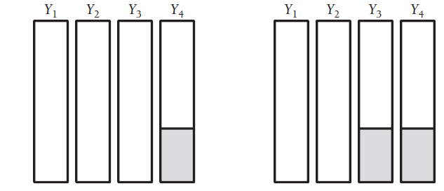
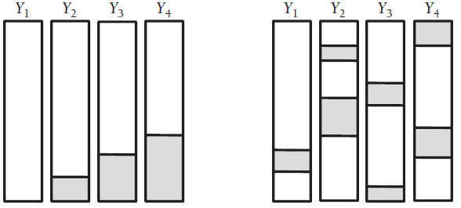
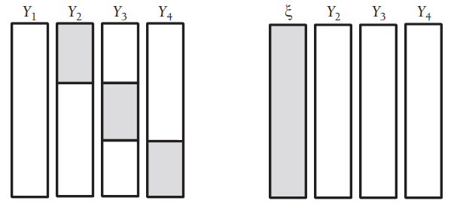
Patterns

Slide 5
Traditional Methods of Dealing With Missing Data
Deletion Methods:
List-wise deletion: deleting list of variable having missing value
Pairwise deletion: selecting pair of missing variables and deleting, attempts to mitigate the loss of data by eliminating the cases on an analysis-by-analysis basis

Slide 6
Traditional methods
Imputation methods:
- Arithmetic mean imputation
- Regression imputation method
- Stochastic regression imputation
- Hoc-deck imputation
- Similar response pattern imputation
- Averaging the available items

Slide 7
Expectation Maximization (EM)
Two-step iterative optimization procedure (E and M)
Iteration starts with initial estimate of mean vector and covariance matrix
E-step uses elements in mean vector and covariance matrix to build a set of regression equations that predicts incomplete variables from observed
E-step is used to fill in the missing value ( similar idea of stochastic regression imputation)

Slide 8
EM……
M-step uses complete data formula to the filled in data to generate updated estimates of mean vector and covariance matrices
Algorithm carries the updated parameter estimates forward to the next E-step, which builds the new set of regression lines to predict missing values
M-step re-estimates the mean and covariance
Process ends when there is no longer change in values of mean and covariance in subsequent steps (we say algorithm converged to MLE)

Slide 9
Validity of EM
EM is an iterative optimization algorithm, so it uses Maximum likelihood estimation process
Since MLE yields unbiased estimates with MAR data it is also regarded as a state-of-art missing data technique
Accompanied with process of MLE, EM algorithm also yields unbiased estimates for MAR data
Also for MCAR data MLE is superior than traditional methods but not for MNAR data

Slide 10
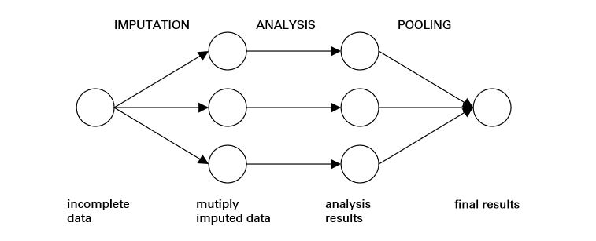
Multiple Imputation

Slide 11
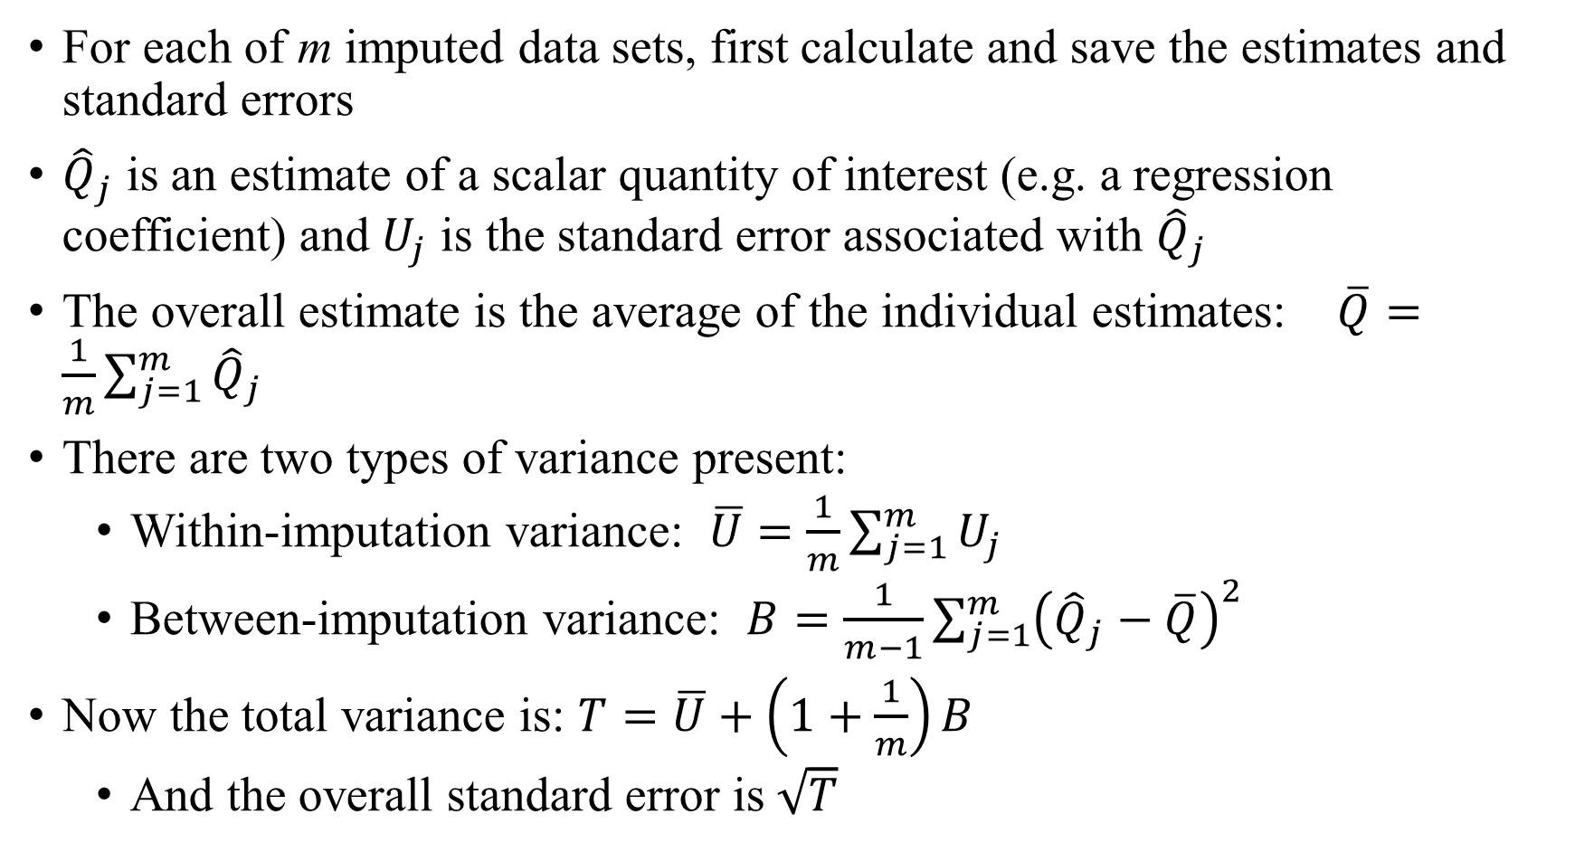
Rubin’s Rules
For each of m imputed data sets, first calculate and save the estimates and standard errors
${\hat{Q}}_{j}$ is an estimate of a scalar quantity of interest (e.g. a regression coefficient) and $U_{j}$ is the standard error associated with ${\hat{Q}}_{j}$
The overall estimate is the average of the individual estimates: $\overline{Q}=\frac{1}{m}\sum_{j=1}^{m}{{\hat{Q}}_{j}}$
There are two types of variance present:
Within-imputation variance: $\overline{U}=\frac{1}{m}\sum_{j=1}^{m}{U_{j}}$
Between-imputation variance: $B=\frac{1}{m−1}{\sum_{j=1}^{m}{\left({\hat{Q}}_{j}−\overline{Q}\right)}}^{2}$
Now the total variance is: $T=\overline{U}+\left(1+\frac{1}{m}\right)B$
And the overall standard error is $\sqrt{T}$

Slide 12
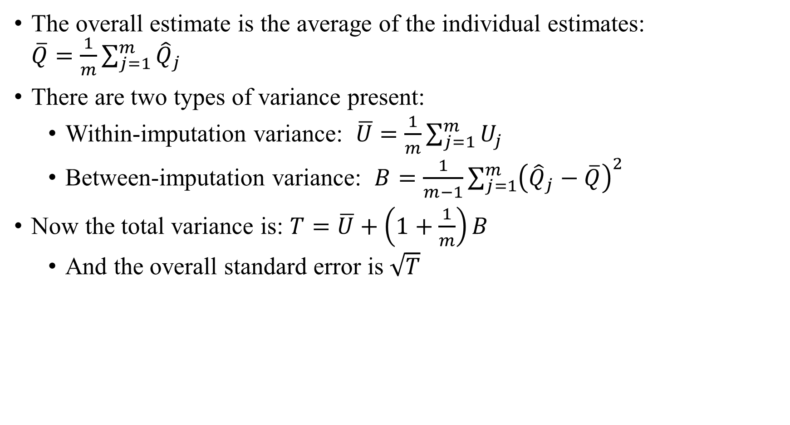
Rubin’s Rules (cont.)
The overall estimate is the average of the individual estimates: $\overline{Q}=\frac{1}{m}\sum_{j=1}^{m}{{\hat{Q}}_{j}}$
There are two types of variance present:
Within-imputation variance: $\overline{U}=\frac{1}{m}\sum_{j=1}^{m}{U_{j}}$
Between-imputation variance: $B=\frac{1}{m−1}{\sum_{j=1}^{m}{\left({\hat{Q}}_{j}−\overline{Q}\right)}}^{2}$
Now the total variance is: $T=\overline{U}+\left(1+\frac{1}{m}\right)B$
And the overall standard error is $\sqrt{T}$

Slide 13
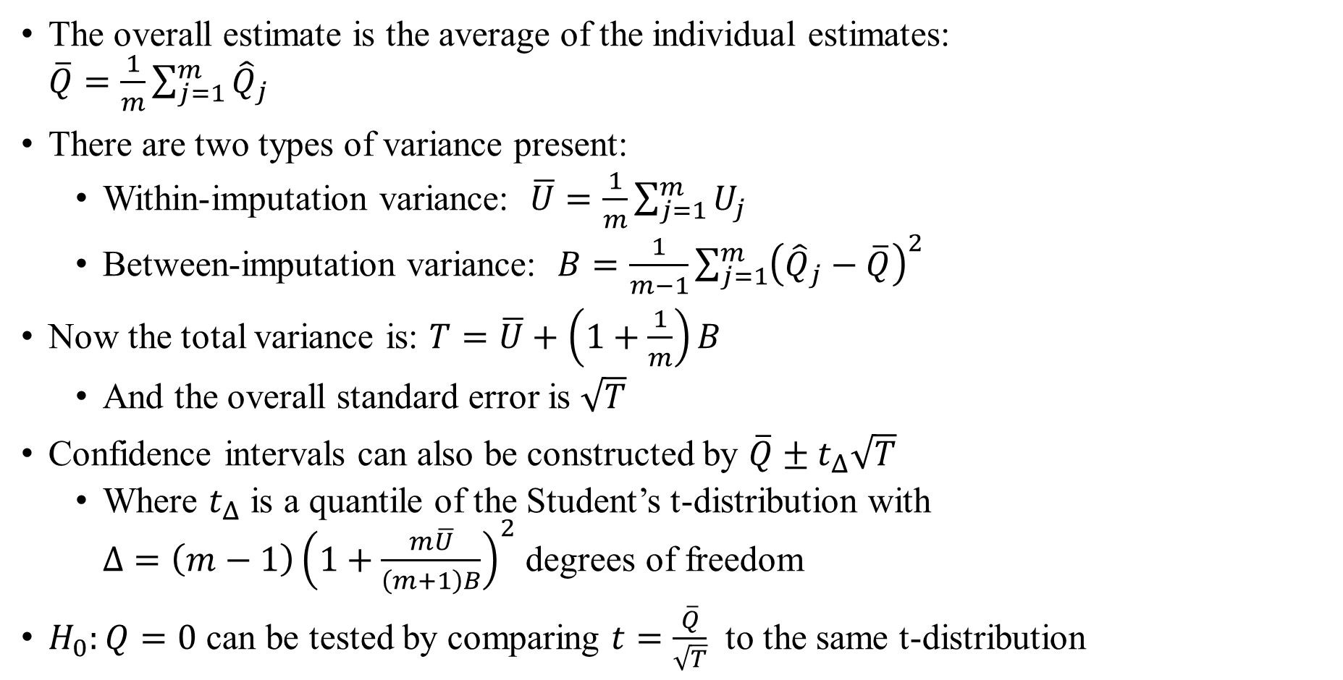
Rubin’s Rules (cont.)
The overall estimate is the average of the individual estimates: $\overline{Q}=\frac{1}{m}\sum_{j=1}^{m}{{\hat{Q}}_{j}}$
There are two types of variance present:
Within-imputation variance: $\overline{U}=\frac{1}{m}\sum_{j=1}^{m}{U_{j}}$
Between-imputation variance: $B=\frac{1}{m−1}{\sum_{j=1}^{m}{\left({\hat{Q}}_{j}−\overline{Q}\right)}}^{2}$
Now the total variance is: $T=\overline{U}+\left(1+\frac{1}{m}\right)B$
And the overall standard error is $\sqrt{T}$
Confidence intervals can also be constructed by $\overline{Q}±t_{Δ}\sqrt{T}$
Where $t_{Δ}$ is a quantile of the Student’s t-distribution with $Δ=\left(m−1\right){\left(1+\frac{m\overline{U}}{\left(m+1\right)B}\right)}^{2}$ degrees of freedom
$H_{0}:Q=0$ can be tested by comparing $t=\frac{\overline{Q}}{\sqrt{T}}$ to the same t-distribution

Slide 14
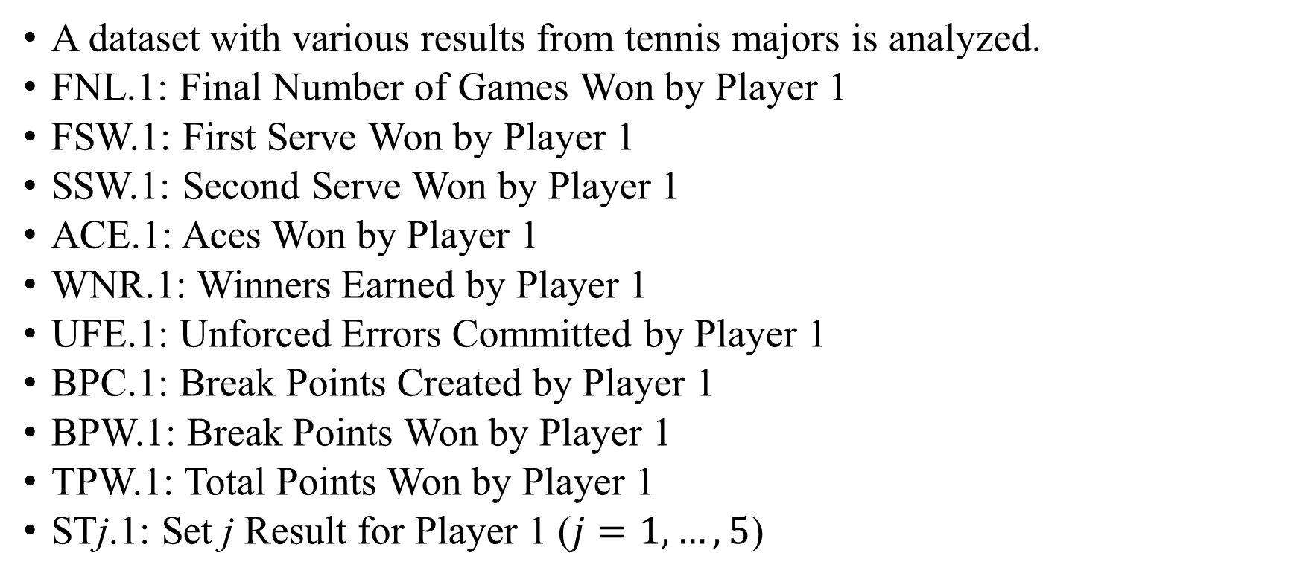
UCI Tennis Dataset
A dataset with various results from tennis majors is analyzed.
FNL.1: Final Number of Games Won by Player 1
FSW.1: First Serve Won by Player 1
SSW.1: Second Serve Won by Player 1
ACE.1: Aces Won by Player 1
WNR.1: Winners Earned by Player 1
UFE.1: Unforced Errors Committed by Player 1
BPC.1: Break Points Created by Player 1
BPW.1: Break Points Won by Player 1
TPW.1: Total Points Won by Player 1
STj.1: Set j Result for Player 1 ($j=1,…,5$)

Slide 15
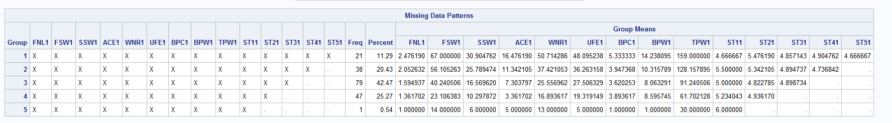
The Missing Data Patterns for Tennis Dataset

Slide 16
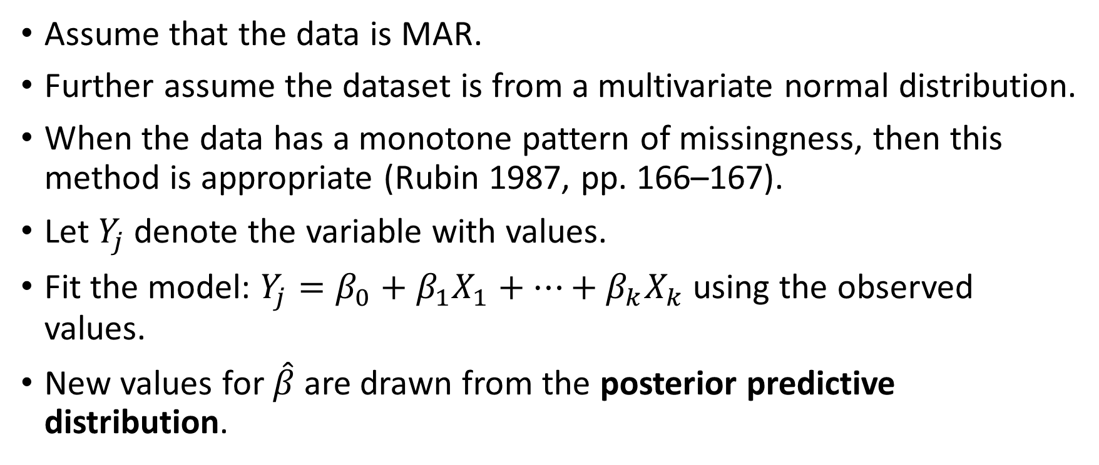
Monotone Regression Imputation
Assume that the data is MAR.
Further assume the dataset is from a multivariate normal distribution.
When the data has a monotone pattern of missingness, then this method is appropriate (Rubin 1987, pp. 166–167).
Let $Y_{j}$ denote the variable with values.
Fit the model: $Y_{j}=β_{0}+β_{1}X_{1}+…+β_{k}X_{k}$ using the observed values.
New values for $\hat{β}$ are drawn from the posterior predictive distribution.

Slide 17
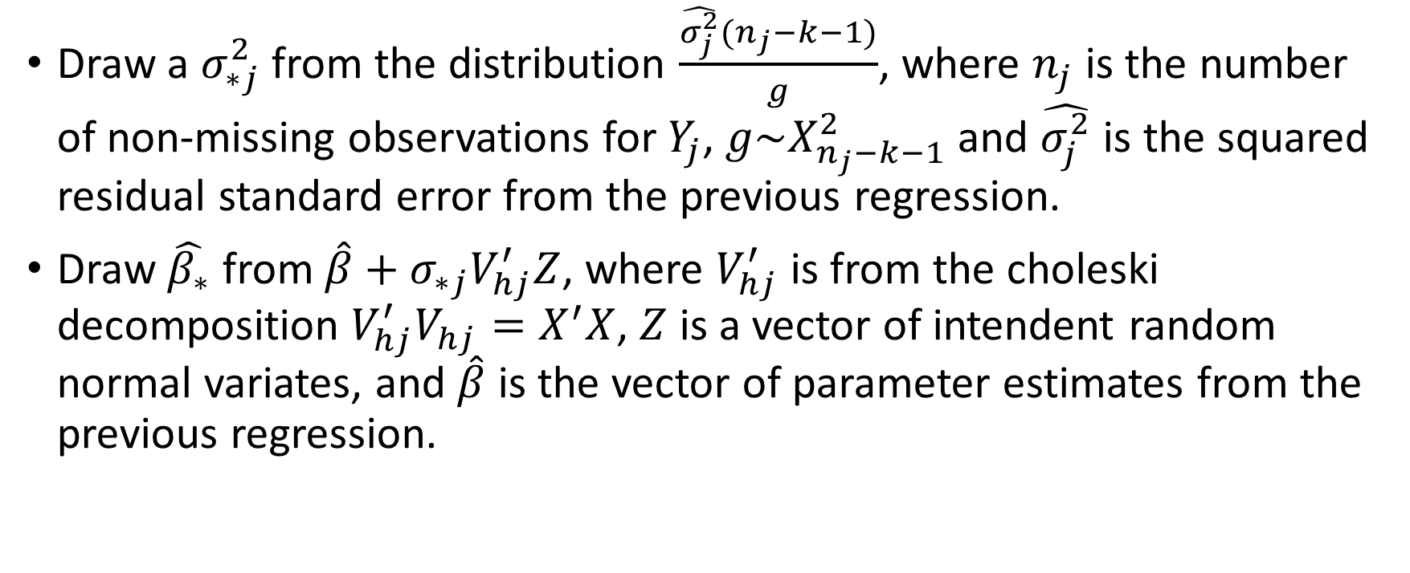
The Posterior Predictive Distribution
Draw a $σ_{∗j}^{2}$ from the distribution $\frac{\hat{σ_{j}^{2}}(n_{j}−k−1)}{g}$, where $n_{j}$ is the number of non-missing observations for $Y_{j}$, $g\sim X_{n_{j}−k−1}^{2}$ and $\hat{σ_{j}^{2}}$ is the squared residual standard error from the previous regression.
Draw $\hat{β_{∗}}$ from $\hat{β}+σ_{∗j}V_{hj}^{′}Z$, where $V_{hj}^{′}$ is from the choleski decomposition $V_{hj}^{′}V_{hj}=X^{′}X$, $Z$ is a vector of intendent random normal variates, and $\hat{β}$ is the vector of parameter estimates from the previous regression.

Slide 18
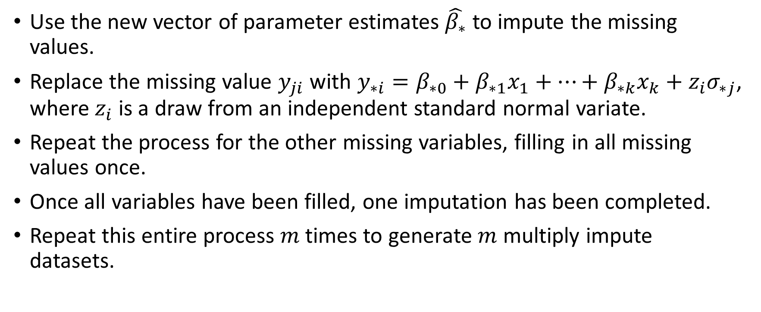
The Imputed Values
Use the new vector of parameter estimates $\hat{β_{∗}}$ to impute the missing values.
Replace the missing value $y_{ji}$ with ${y_{∗i}=β}_{∗0}+β_{∗1}x_{1}+…+β_{∗k}x_{k}+z_{i}σ_{∗j}$, where $z_{i}$ is a draw from an independent standard normal variate.
Repeat the process for the other missing variables, filling in all missing values once.
Once all variables have been filled, one imputation has been completed.
Repeat this entire process $m$ times to generate $m$ multiply impute datasets.

Slide 19
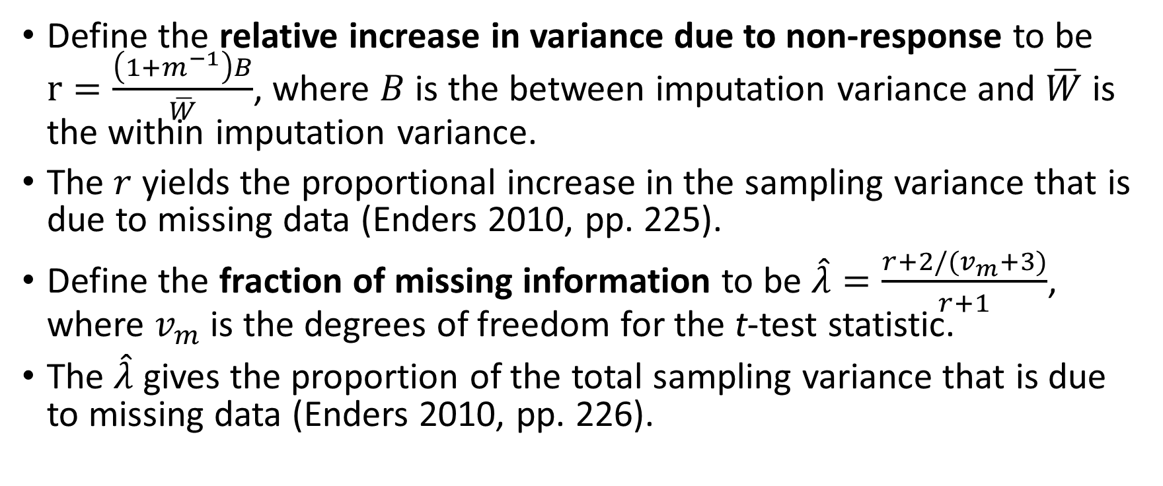
Some quick definitions
Define the relative increase in variance due to non-response to be $r=\frac{\left(1+m^{−1}\right)B}{\overline{W}}$, where $B$ is the between imputation variance and $\overline{W}$ is the within imputation variance.
The $r$ yields the proportional increase in the sampling variance that is due to missing data (Enders 2010, pp. 225).
Define the fraction of missing information to be $\hat{λ}=\frac{r+2/(v_{m}+3)}{r+1}$, where $v_{m}$ is the degrees of freedom for the t-test statistic.
The $\hat{λ}$ gives the proportion of the total sampling variance that is due to missing data (Enders 2010, pp. 226).

Slide 20
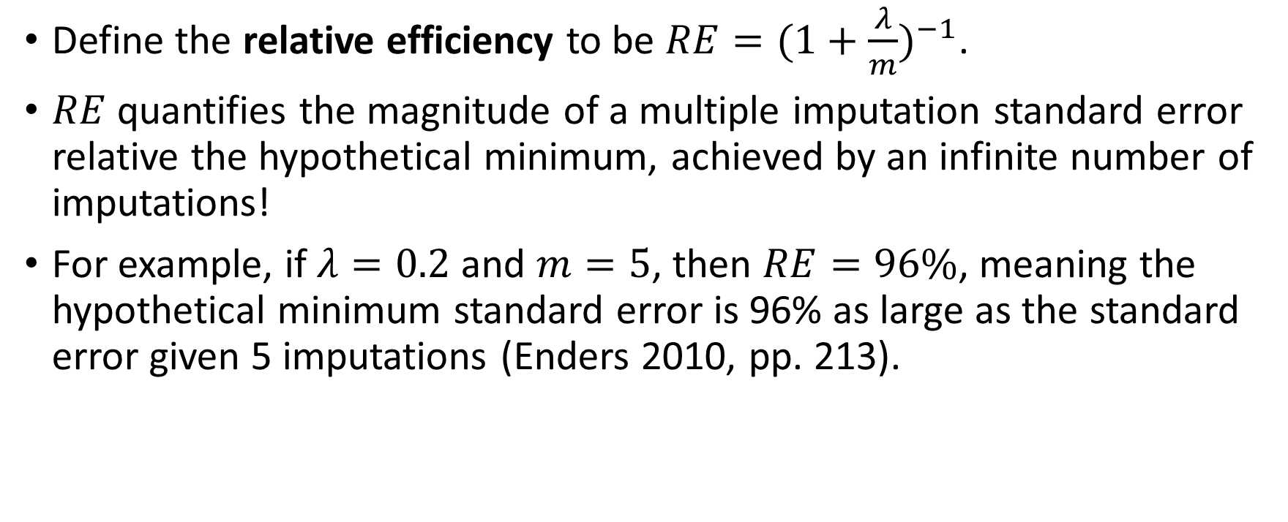
How many imputations are necessary?
Define the relative efficiency to be $RE={(1+\frac{λ}{m})}^{−1}$.
$RE$ quantifies the magnitude of a multiple imputation standard error relative the hypothetical minimum, achieved by an infinite number of imputations!
For example, if $λ=0.2$ and $m=5$, then $RE=96\%$, meaning the hypothetical minimum standard error is 96% as large as the standard error given 5 imputations (Enders 2010, pp. 213).

Slide 21
SAS Code for Monotone Regression
title'Imputation via Monotone Regression Method';
proc mi data=work.tennis0
seed=123456 out=outex1;
monotone reg(ST21 = FSW1 SSW1 ACE1 WNR1 UFE1 BPC1 BPW1 TPW1 ST11);
monotone reg(ST31 = FSW1 SSW1 ACE1 WNR1 UFE1 BPC1 BPW1 TPW1 ST11 ST21);
monotone reg(ST41 = FSW1 SSW1 ACE1 WNR1 UFE1 BPC1 BPW1 TPW1 ST11 ST21 ST31);
monotone reg(ST51 = FSW1 SSW1 ACE1 WNR1 UFE1 BPC1 BPW1 TPW1 ST11 ST21 ST31 ST41);
var FNL1 FSW1 SSW1 ACE1 WNR1 UFE1 BPC1 BPW1
TPW1 ST11 ST21 ST31 ST41 ST51;
run;

Slide 22
SAS Code for Pooling Regression Estimates
proc reg data=outex1 outest=outreg1 covout noprint;
model FNL1= FSW1 SSW1 ACE1 WNR1 UFE1 BPC1 BPW1
TPW1 ST11 ST21 ST31 ST41 ST51;
by _Imputation_;
run;
title'Pooling the Parameter Estimates';
proc mianalyze data=outreg1 edf=422;
modeleffects Intercept FSW1 SSW1 ACE1 WNR1 UFE1 BPC1 BPW1
TPW1 ST11 ST21 ST31 ST41 ST51;
run;

Slide 23
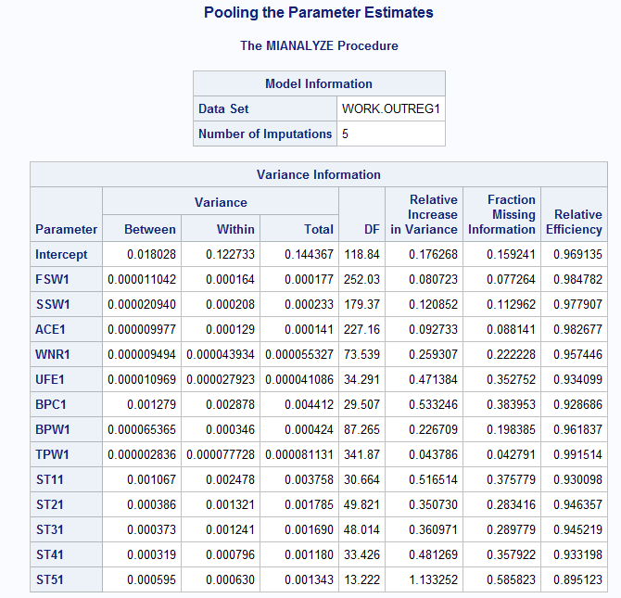

Slide 24
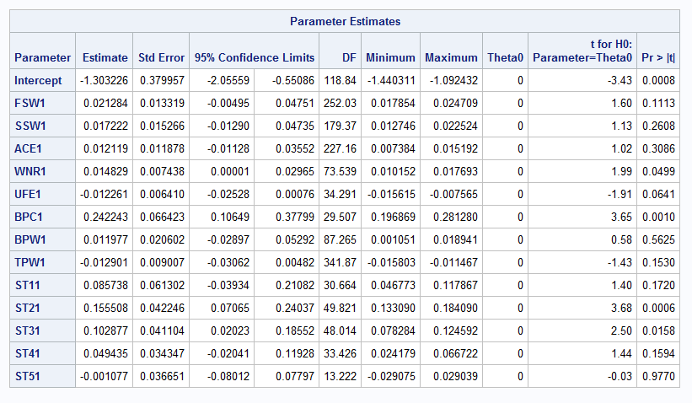

Slide 25
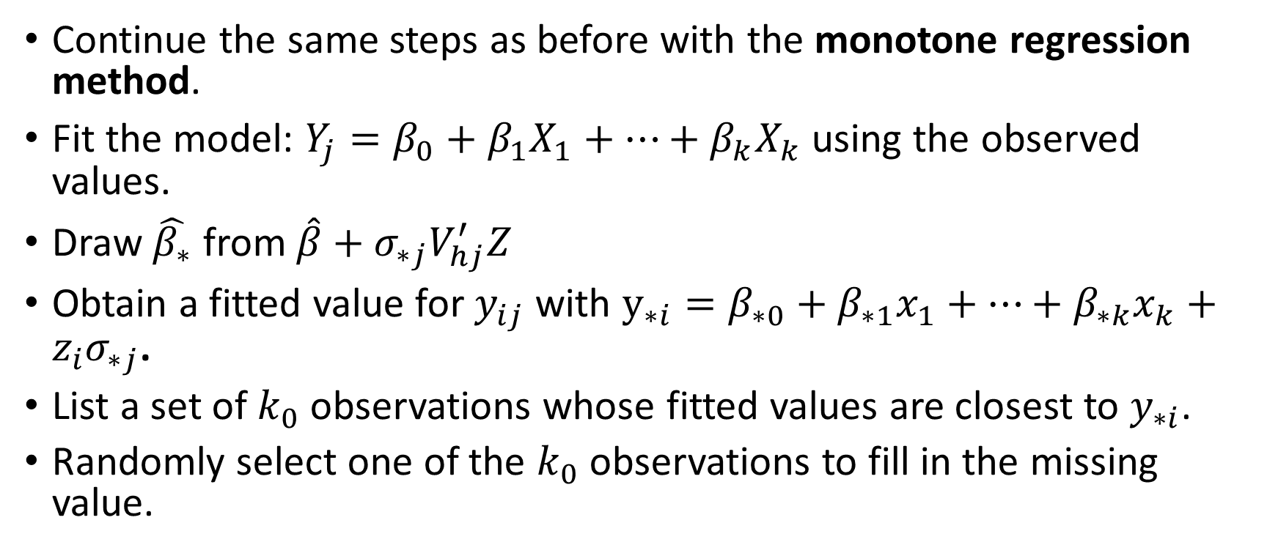
Monotone Regression Predictive Mean Matching method
Continue the same steps as before with the monotone regression method.
Fit the model: $Y_{j}=β_{0}+β_{1}X_{1}+…+β_{k}X_{k}$ using the observed values.
Draw $\hat{β_{∗}}$ from $\hat{β}+σ_{∗j}V_{hj}^{′}Z$
Obtain a fitted value for $y_{ij}$ with $y_{∗i}=β_{∗0}+β_{∗1}x_{1}+…+β_{∗k}x_{k}+z_{i}σ_{∗j}$.
List a set of $k_{0}$ observations whose fitted values are closest to $y_{∗i}$.
Randomly select one of the $k_{0}$ observations to fill in the missing value.

Slide 26
SAS Code for Regression PMM Method
title'Imputation via Monotone Predictive Mean Matching Method';
proc mi data=work.tennis0
seed=123456 out=outex2;
monotone regpmm(ST21 = FSW1 SSW1 ACE1 WNR1 UFE1 BPC1 BPW1 TPW1 ST11);
monotone regpmm(ST31 = FSW1 SSW1 ACE1 WNR1 UFE1 BPC1 BPW1 TPW1 ST11 ST21);
monotone regpmm(ST41 = FSW1 SSW1 ACE1 WNR1 UFE1 BPC1 BPW1 TPW1 ST11 ST21 ST31);
monotone regpmm(ST51 = FSW1 SSW1 ACE1 WNR1 UFE1 BPC1 BPW1 TPW1 ST11 ST21 ST31 ST41);
var FNL1 FSW1 SSW1 ACE1 WNR1 UFE1 BPC1 BPW1
TPW1 ST11 ST21 ST31 ST41 ST51;
run;

Slide 27
SAS Code for Pooling Regression Estimates
proc reg data=outex2 outest=outreg2 covout noprint;
model FNL1= FSW1 SSW1 ACE1 WNR1 UFE1 BPC1 BPW1
TPW1 ST11 ST21 ST31 ST41 ST51;
by _Imputation_;
run;
title'Pooling the Parameter Estimates';
proc mianalyze data=outreg2 edf=422;
modeleffects Intercept FSW1 SSW1 ACE1 WNR1 UFE1 BPC1 BPW1
TPW1 ST11 ST21 ST31 ST41 ST51;
run;

Slide 28
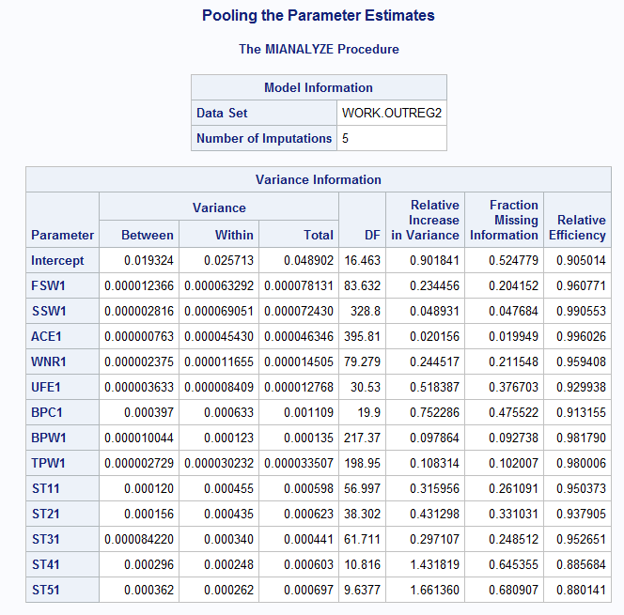

Slide 29
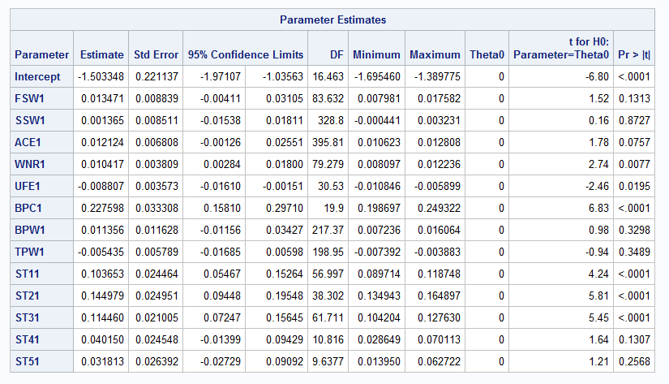

Slide 30
SAS Code for the EM Algorithm
title'Using the E-M Alg';
proc mi data=tennis0 nimpute=0;
em outem=tennisem;
var FNL1 FSW1 SSW1 ACE1 WNR1 UFE1 BPC1 BPW1
TPW1 ST11 ST21 ST31 ST41 ST51;
run;
proc reg data=tennisem outest=outreg2 covout;
model FNL1= FSW1 SSW1 ACE1 WNR1 UFE1 BPC1 BPW1
TPW1 ST11 ST21 ST31 ST41 ST51;
run;

Slide 31
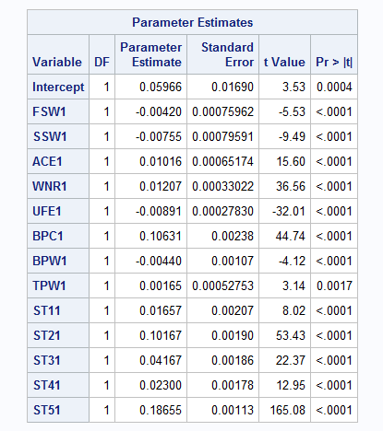

Slide 32
Were those p-values accurate?

Slide 33
References
http://hsta559s12.pbworks.com/w/file/fetch/52112520/enders.applied
http://www.gbv.de/dms/ilmenau/toc/33682193X.PDF
https://archive.ics.uci.edu/ml/datasets/Tennis+Major+Tournament+Match+Statistics
http://support.sas.com/documentation/cdl/en/statug/63962/HTML/default/viewer.htm#mi_toc.htm
http://support.sas.com/documentation/cdl/en/statug/63962/HTML/default/viewer.htm#mianalyze_toc.htm

Slide 34


