Slide 1
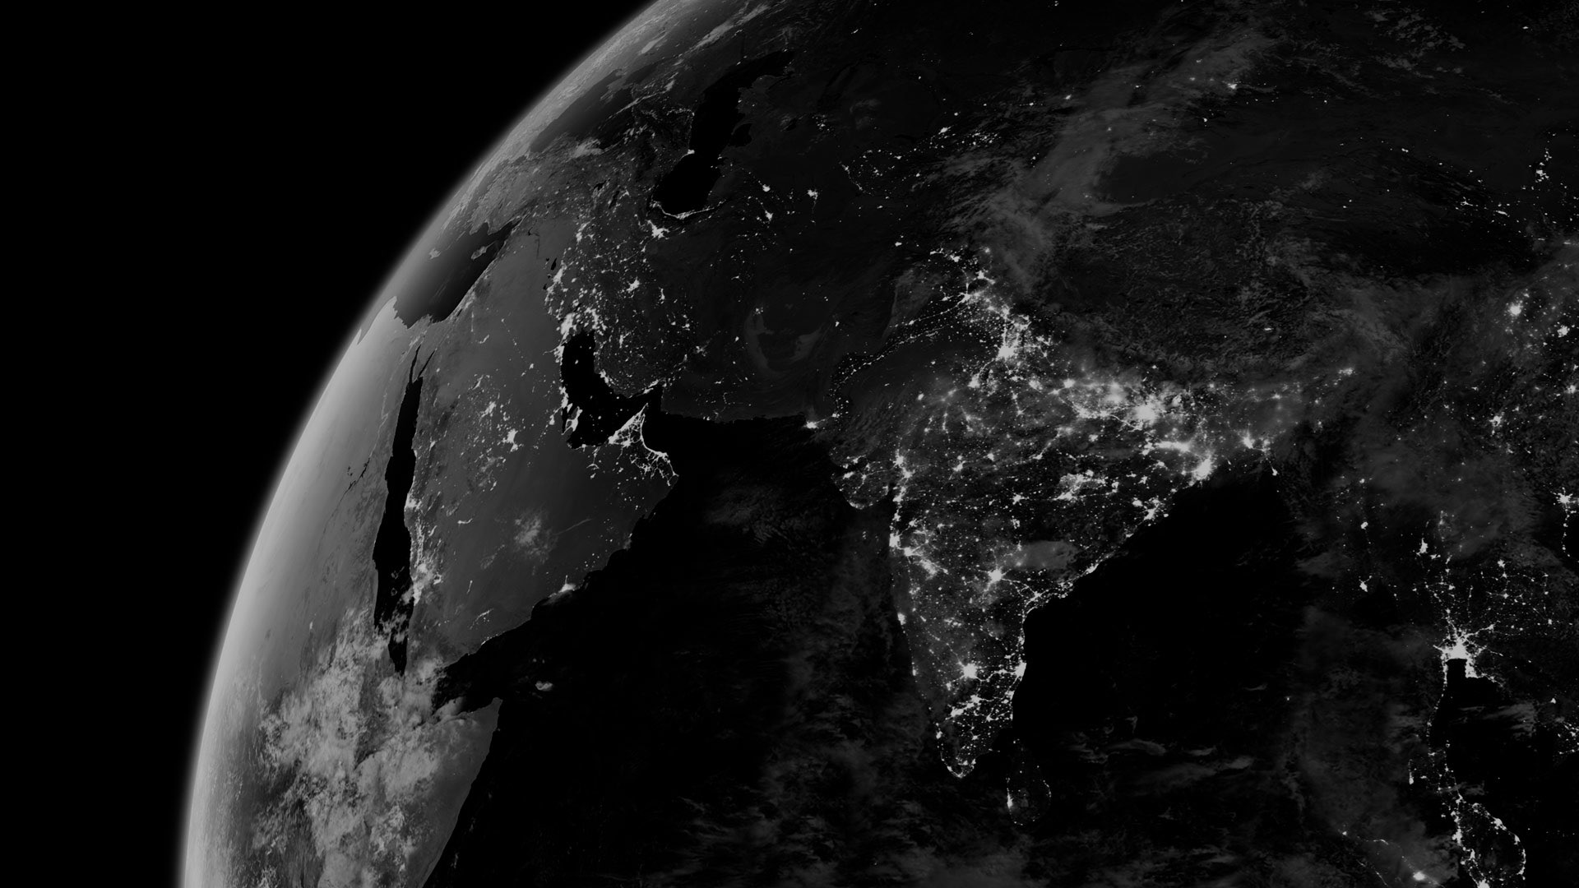
A Study of Meteorite Impact Data
Matthew W. Younce
National Geospatial-Intelligence Agency
Candidate for Masters of Science in Data Science University of Missouri
July 1, 2021

Slide 2
Acknowledgements
PSDS Program at NGA and the University of Missouri
Dr. Grant Scott, Academic advisor
Mr. John Gutraj, Agency mentor
Mrs. Amy Younce, for her moral support and inspiration
Thank you all!

Slide 3
Contents
Questions and Goals
Data Suitability and Preparation
Analysis and Results
Conclusions

Slide 4
Questions and Goals
Entered this study with five questions to answer:
Are the numbers of meteorite falls consistent over history or are they changing?
Are there trends between meteorites that have been observed hitting the ground and the ones that are found?
Is there any correlation between impacts and human population?
Do meteorites fall at random, or are there patterns to their impact locations?
Can predictions be made about future meteorite impacts by studying past impact events?

Slide 5
Data Suitability and Preparation
Began with a single dataset, from data.gov
Comprehensive meteorite landing data set from The Meteoritical Society
Consists of data of 34,513 meteorites, including year, location, mass, and meteorite type and classification
Data Carpentry was my first priority.
Discovered several “meteorongs” including misidentified meteorites, over 6,000 without a geolocation, and almost 5,000 in the same location in Antarctica (at a site Google Maps marked with a photo of a stack of pancakes.
After completion, left with 9,781 valid meteorite impacts.

Slide 6
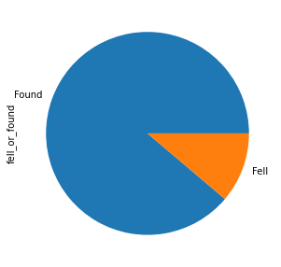
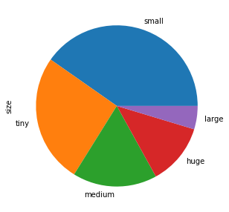
Data Suitability and Preparation
mass between 100g - 1000 g
(3937)
Found on Earth
(8686)
mass < 100g
(2533)
mass between
5kg - 10 kg
(458)
Observed Falling
(1095)
mass > 10 kg
(1202)
mass between
1 kg - 5 kg
(1651)
Two graphs to demonstrate the distribution
of meteorites in the dataset.

Slide 7
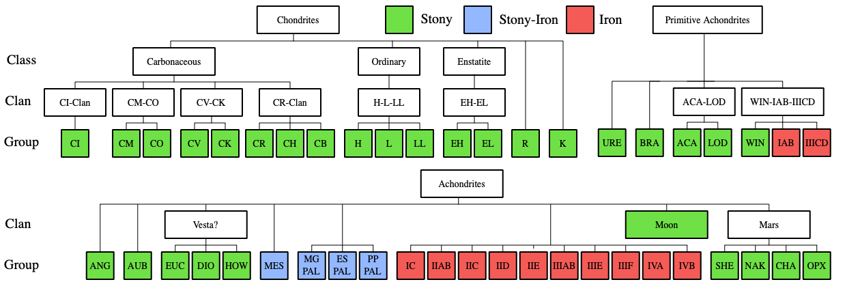
Data Suitability and Preparation
Additional datasets were needed:
Meteorite Classification System
I created a CSV from a “traditional classification scheme” listed on Wikipedia
Historical Land Cover
A raster dataset showing the changes in landcover from the preindustrial age (1700), followed by 50 year increments to 1950, then 1970 and 1990.
Historical Urban Population
Population of cities and urban areas between 3700 BC and AD 2000.
Historical Global Population Density
Rasters of global population density for 1990 and 1995.

Slide 8
Data Suitability and Preparation
Meteorite Classification System
I joined a table to the meteorite data to give more information on the type of meteorite at that location.
Historical Land Cover
I used this data to determine the land type at every impact site.
Historical Urban Population
This allowed me to find urban areas near impacts, as the number of people increases, so too is the likelyhood of someone seeing a meteorite impact or finding one on the ground.
Historical Global Population Density
This dataset was found not to be useful.

Slide 9
Analysis and Results
Are the numbers of meteorite falls consistent over history or are they changing?
The number of meteorites observed falling has dramatically risen, even when population growth is taken into consideration.
Histogram of meteorites observed falling by year
Line graph of meteorites observed falling per 1 million peole on Earth.

Slide 10
Analysis and Results
Are there trends between meteorites that have been observed falling to the ground and meteorites that are found in situ?
This analysis was accomplished by creating a 1° x 1° grid and counting whether meteorites had fallen and/or had been found. Only 181 grid squares had both, while 712 only had falls, and 1063 only had finds.
Grid squares with found only
Grid squares with both
Grid squares with falls only

Slide 11
Analysis and Results
Is there any correlation between impacts and human population?
“If a meteorite falls in the forest, and there’s no one there to see it, does it get recorded in the dataset?”
Large unpopulated areas of Earth, such as the Amazon rain forest, have no reported impacts.
However, only 239 of the impacts were within 0.25 degrees (~ 20 miles) of an urban area

Slide 12
Analysis and Results
Do meteorites fall at random, or are there patterns to their impact locations?
There were some correlations found:
Latitude + longitude ~ Found or Fall
mass ~ land covers 0 (water bodies) and 2 (pasture land)
Land cover PDF analysis: Different masses are more common with different land covers.
Probability Density
The least massive are more likely in tropical woodlands.
The most massive are more common in:
Savanna, Temperate mixed forest, and Grasslands.
Mass

Slide 13
Analysis and Results
Can predictions be made about future meteorite impacts by studying past impact events?
Ultimately, I was unable to find a correlation or method to allow me to predict future meteorite impact locations from past locations.
However, the other trends discussed in this report should theoretically continue for the foreseeable future.

Slide 14
Conclusions
This was a very interesting project to work on and discover how to use Data Science techniques in a “real life” problem set, rather than manufactured problems for Data Science classes
It was hoped that this study could lead to application in the classified environment. While the material itself did not lead to any definitive conclusions or predictions, the techniques and skills I learned will be useful as I apply them to my account.
All data and jupyter notebooks, containing my Python and R coding, are available at : https://www.github.com/mwy912/capstone

