Slide 1
PSDS Capstone: Data Analysis of Meteorite Impact Locations
Matthew W. Younce
9 August 2021

Slide 2
Agenda
Introduction/About Me
Background and Context
Data Discussion and Methodology
Analysis, Visualization, and Results
Questions?

Slide 3
About Me
Matthew W. Younce
Hybrid Geospatial/Imagery Analyst
GA Team Lead/SGA, Time-Dominant Operations Center (AOWE)
14+ years at NGA
Project Mentor: John Gutraj, SGO for Time-Dominant Operations

Slide 4

Background and Context
Looking for an unclassified data set to analyze, especially one with applicability to a classified, Time-Dominant environment
Located a set of all known meteorite falls and finds from NASA
These are random events (or are they?)
The ability to predict when and where a meteorite will strike the Earth could be used to predict other natural or human-induced events worldwide.
After locating this data source, I developed my analytic goals for this study.
Barringer Meteor Crater, Arizona
Canyon Diablo Meteorite
(no audio)

Slide 5
Goals
I set out to answer these questions:
Do meteorites fall at random or are there patterns to their impact locations?
Either as a whole, by class of meteorite, or some other parameter?
Are the numbers of meteorite falls consistent over history or are they changing?
Is there any connection to population?
Are there more falls recorded because more people to see it and more finds because people are in the area?
Are there trends between meteorites that have been observed hitting the ground and ones that are found?
Can predictions be made about future meteorite impacts by studying past impact events?

Slide 6
Data Discussion
Began with a dataset of over 45,000 meteorite impacts and witnessed falls through history, compiled by the Meteoritical Society and released by NASA
This dataset includes every meteorite known to be observed falling or later found.
Has geolocation, name, class/description of meteorite, and whether it was a fall or a find.
In order to answer my questions, I would need to additional data:
Meteorite classification guide
Present and historical Land use/land cover data
Historical urban areas

Slide 7
Data Discussion: Data Hygiene & Synthesis
Filtered out suspect data and other “meteorongs”
Some meteorites had questionable coordinates
Some were marked as “relict” – previously thought to be meteorites, but discovered not to be.
Others were missing attributes that were or were not able to be replicated or replaced.

Slide 8
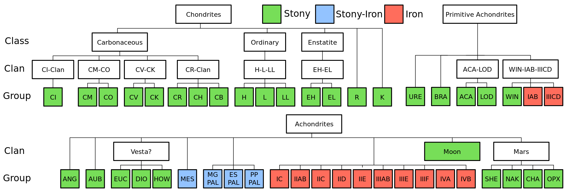
Data Discussion: Data Hygiene & Synthesis
Aggregated the extremely specific groups/subgroups of meteorites in the dataset to more general ones to simplify analysis
e.g. a meteorite defined in the dataset as an “H5-6” can also be placed into the H Group, H-L-LL clan, Ordinary Class, Chondrites, and Stony type.

Slide 9
Data Discussion: Preliminary Spatio-temporal Analysis
Historical Urban Population Data
Buffered each meteorite site to find what urbanized areas were within 0.25 degrees (approximately 25-30 km) of the site
Filtered to select only populations around the time the meteorite fell or was found
Determined only 2% of the meteorites were near an urban area.
Historical Land Cover Data
Determined the land cover in the 0.5° x 0.5° grid square where the meteorite fell/was found.
Used the most appropriate land cover based on the date
Considered assigning a weight to each category, to account for areas where no falls were observed, but determined this would bias my data

Slide 10
Analysis, Visualization, and Results
Data analysis was performed in Jupyter Notebook, and has been uploaded to a GIT repository:
https://github.com/mwy912/capstone/
The visualization of my results are in this R Shiny web app:
https://shiny.sgn.missouri.edu/students/ymw.0780/Capstone/meteoriteanalysis/
I performed various analyses to answer the goal questions, which will be demonstrated through the visualization screen shots on the following slides.

Slide 11
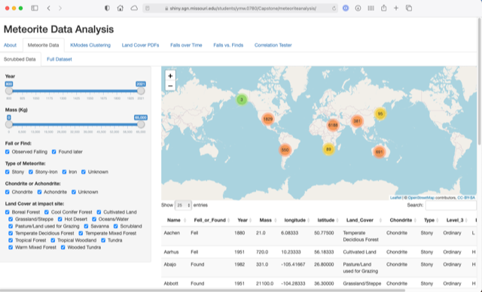
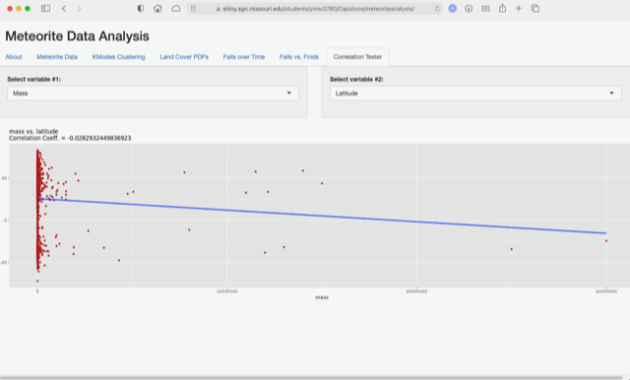
Shiny Web App Visualization

Slide 12
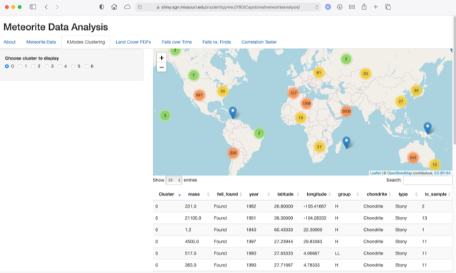
Analysis, Visualization, and Results: Goal 1
Do meteorites fall at random or are there patterns to their impact locations?
Used a Machine Learning technique to create K-Modes Clusters.
Unsupervised method that grouped meteorite impacts into 7 clusters
Found most meteorites were lumped into a “Catch All” cluster, while the other 6 were more specific, either on date, mass, or location.

Slide 13
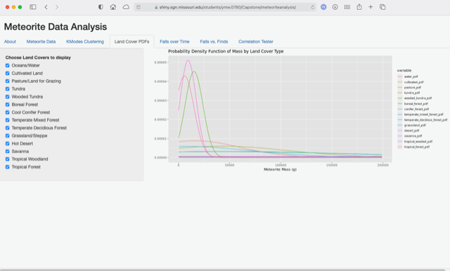
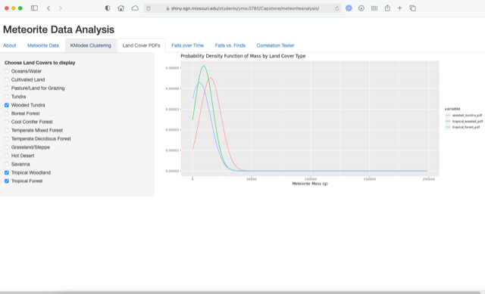
Analysis, Visualization, and Results: Goal 1
Do meteorites fall at random or are there patterns to their impact locations?
Probability Density Function comparing mass to land cover
Wooded Tundra, Tropical Woodland and Tropical Forest are most likely to have low mass meteorites.

Slide 14
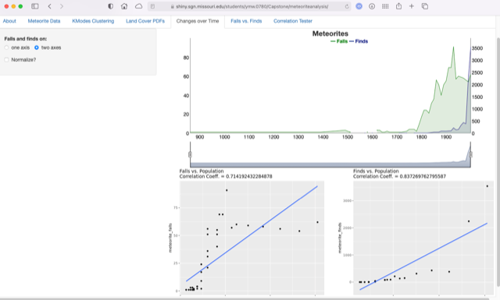
Analysis, Visualization, and Results: Goal 2 & 3
Are the numbers of meteorite falls consistent over history or are they changing?
Is there any connection to population? Are there more falls recorded because more people to see it and more finds because people are in the area?
The numbers are increasing, and have since the 1700s, even when normalized against population.
Spurious correlation?
Better record keeping?
Par for the course for 2020? Meteorite bombardment comes right after murder hornets, right?

Slide 15
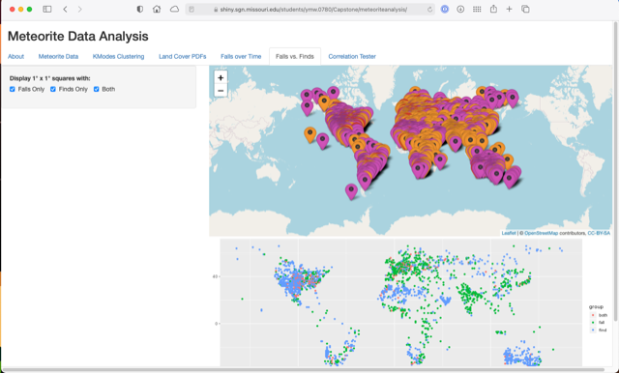
Analysis, Visualization, and Results: Goal 4
Are there trends between meteorites that have been observed hitting the ground and ones that are found?
Analyzed where meteorites were observed falling and were found. Do not see a correlation between the two.

Slide 16

Analysis, Visualization, and Results: Goal 5, and the Future…
“God does not play dice with the Universe” – Albert Einstein
Can predictions be made about future meteorite impacts by studying past impact events?
My research found that while correlations may exist, predicting is a long way off.
With information on orbital shape and meteoroid velocity, more precise calculations can be made about specific meteorite impacts.
Similarly, for time-dominant analysis, while a record of past events gives a clue of future events, much more data is needed to make specific predictions.
“However, He does play the occasional game of billiards.” – Dr. Bruce Dod, meteoriticist

Slide 17
Comments? Questions?

