Slide 1
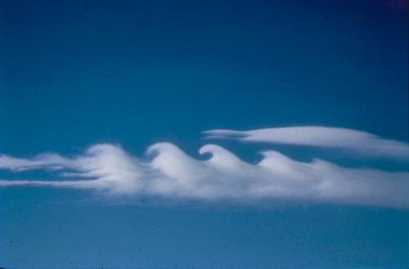
Generation of internal gravity waves by shear
(New results on an old problem!)
Alexandros Alexakis
National Center for Atmospheric Research

Slide 2
Outline
The set up of the problem
An incomplete, short, historical review of shear flow instabilities in stratified layers
The Hazel model: varying the stratification length scale
Some new results

Slide 3
Motivation & Reasoning
Holmboe instability is a shear instability in stratified flows with small stratification length scale
It is present for arbitrarily large values of stratification
In nature appears in small Prandtl number flows

Slide 4
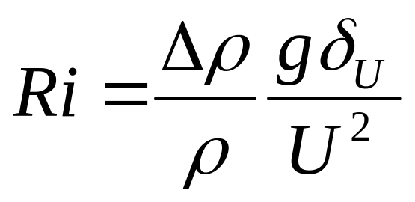
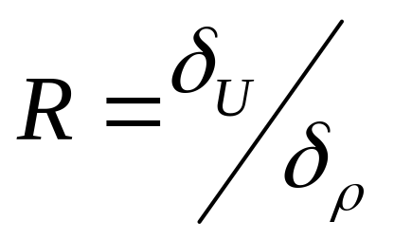
Setting up the problem
Non-dimensional
Numbers
ρ
δ_{U}
δ_{ρ}

Slide 5
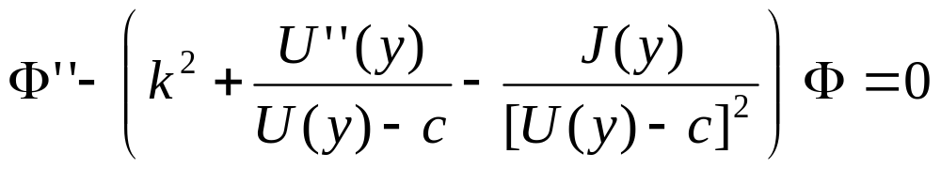
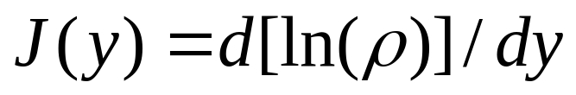
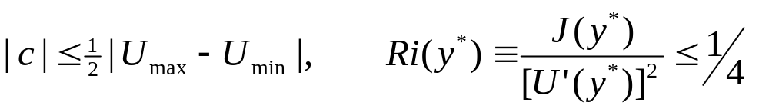
Linear stability equations
(In Bousinesq Approximation)
Taylor Goldstein Equation
Two theorems:
Howard’s semi-circle & Richardson Criterion

Slide 6
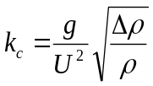






Overview of Models
Kelvin 1889
Taylor 1932 & Goldstein 1932
J
J
Ri
ρ
ρ
Math
Holmboe 1962
Miles 1969
J
J
Ri
Ri
ρ
ρ
U=tanh(y) ρ=ρ₀exp[-Ri tanh(y)]

Slide 7
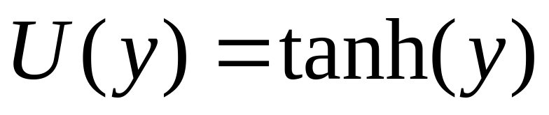
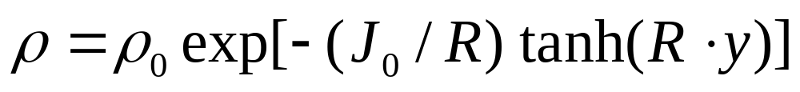
The Hazel 1972 Model
velocity length scale
R =
density length scale

Slide 8
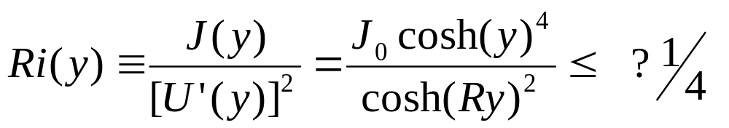
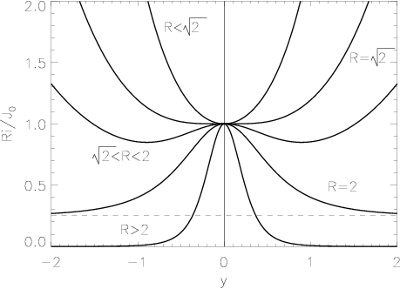
The Richardson function

Slide 9
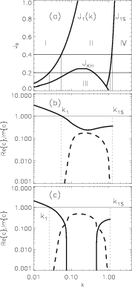
Stability Boundaries
Hazel 1972, Smyth & Peltier 1989
I) Stable gravity waves II) Unstable Holmboe Waves
III) Unstable Kelvin-Helmholtz IV) Stable singular modes
However instability regions were determined by a “brute force”
numerical solution of the eigenvalue problem

Slide 10
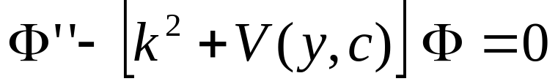
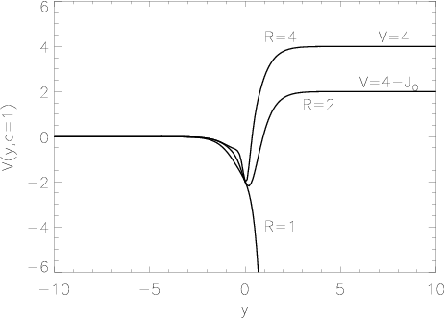
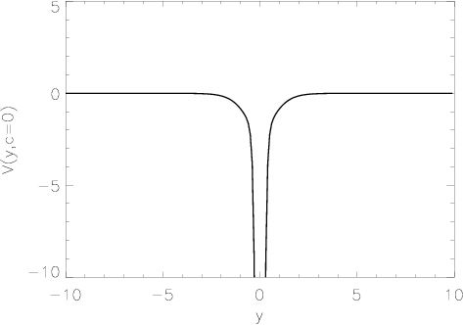
The Schrödinger Problem
Instead of looking for c, fix c and look for k²
c=1
c≠1

Slide 11
Stability & instability
The modes with c=1 provide the left stability boundary for the unstable traveling modes
Singular neutral modes with U_{max}>c≠0 provide the right stability boundary.
Singular neutral modes with c=0 provide the stability boundary for non-traveling unstable modes

Slide 12
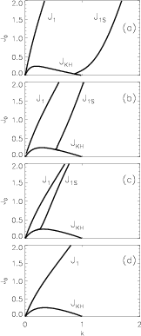
The parameter R
Holmboe 1962
R=4
R=2.5
R=2.2
R=2
J
Ri
ρ
Miles 1969
J
Ri
ρ

Slide 13
Higher Harmonics
For the c=1 modes what happens if the Schröndiger potential is deep enough that more than one bounded eigen-state exists?

Slide 14
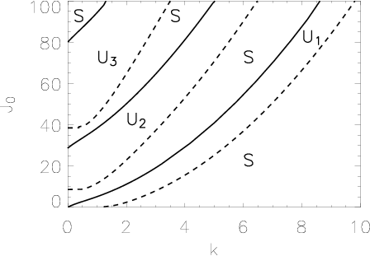
New instability stripes!
First Harmonic
Second Harmonic
Third Harmonic
R=4

Slide 15
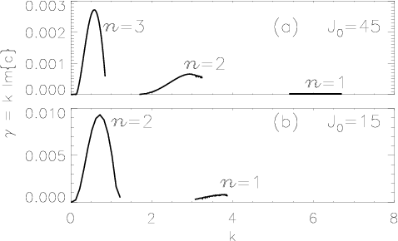
Higher Harmonics Growth Rate
R=4
J₀=45
J₀=20

Slide 16
Conclusions
We were able to determine modes that provide the stability boundaries
This led to the discovery of a series of unstable subharmonics that follow the already known Holmboe instability

Slide 17
References
H. Helmholtz Wissenschaftliche Abhandlungen 3 146 (1868)
Lord Kelvin Mathematical and physical papers iv 76 (1910)
G. Taylor Proc. Roy. Soc. A 157 546 (1932)
S. Goldstein Proc. Roy. Soc. A 132 524 (1931)
J. Holmboe Geophys. Publ. 24 67 (1962)
J. Miles JFM 16 209 (1963)
S.P. Hazel JFM 51 3261 (1972)
W. Smyth W. Peltier J. Atmos. Sci. 46 3698 (1989)
Alexakis Phys. of Fluids (to appear) (2005)

