Slide 1

Large-Eddy simulation of Pollutant Plume Dispersion over 2D Idealized Street Canyons
Colman C.C. Wong & Chun-Ho Liu
Department of Mechanical Engineering
The University of Hong Kong
March 3, 2011

Slide 2
Outline
Introduction
Methodology
Results & Discussion
Pollutant transport below and around roof level
Pollutant dispersion in the urban boundary layer (UBL)
Notes:
In this presentation, I will first introduce the topic. And then I will briefly explain the methodology. The results and discussion has two sections, the first one is the pollutant transport below and around roof level. The other one is the pollutant dispersion in the urban boundary layer.

Slide 3
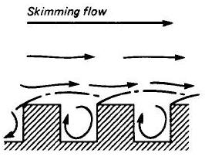
Introduction
In a developed city like Hong Kong, the building-height-to-street-width ratio (aspect ratio, AR) is large. In case the wind is flowing perpendicular to the street canyon (worst case), the flow falls into skimming flow regime in which flesh air cannot entrain into the street canyons by mean flow.
Source: Oke, T. R. "Street Design and Urban Canopy Layer Climate." Energy and Buildings, 11 (1988)
Notes:
In a developed city like Hong Kong, the building height to street width ratio, I call it aspect ratio, is large. In case the wind is flowing perpendicular to the street canyon. The flow will fall into skimming flow regime which the flesh air could not entrain into the street canyons by mean flow.

Slide 4
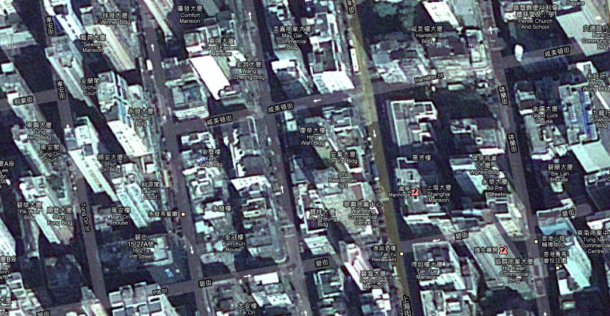
A satellite photo of Mong Kok, Hong Kong
Any methods to remove/dilute the pollutants better?
Source: Google map
Notes:
Here is a satellite photo of Monk Kok.
The street canyons in Mong Kok resemble the 2D street canyons. The building height to canyon width ratio is large so that when the wind is this “ direction, the flow will fall into the skimming flow regime. On the ground level, there are a lot of pollutant emitted by vehicles, by the exhaust gas of restaurant, by cigarette…etc. If the pollutant accumulated within the canyons. It is obviously harmful to pedestrians’ health. So that we need to find a way to remove the pollutant better in such case.
Here is an Engineering question. Is there any method to removal the pollutant better?

Slide 5
Objectives
The core objectives of this study are:
Develop a platform to calculate pollutant dispersion over idealized 2D street canyons using LES.
Examine how 2D urban roughness affects the flow structure and the pollutant dispersion in the urban boundary layer (UBL).
Elucidate the pollutant removal mechanism when the prevailing flow is perpendicular to the street canyons.
Notes:
Here is my core objective of my current study. My first objective is to Develop a platform to calculate pollutant dispersion over idealized 2D street canyons using LES.
My second objective is to Examine how 2D urban roughness affects the flow structure and the pollutant dispersion in the urban boundary layer (UBL).
My third objective is to find out the pollutant removal mechanism when the prevailing flow is perpendicular to the street canyons.

Slide 6
Introduction to CFD
Currently, three types of models are commonly used for resolving/modeling fluid turbulence.
k-ε model (RANS based)
Large-eddy simulation (LES)
Direct numerical simulation (DNS)
Model
k-ε model
LES
DNS
Accuracy
Lower
Higher
Computational cost
Relatively
cheap
Expensive
Very expensive
Notes:
Here is a short introduction to CFD. Currently, there are three popular models for resolving/modeling fluid turbulence. They are k-w model, large eddy simulation and direct numerical simulation. Amount these 3 models, K-e model is fastest one. Models using k-e model should be finished within a months. LES require a much long time but have higher accuracy. In my case, a single model could take half a year. The last one, DNS could generate the best result, but it take too long to generate the results so that it is not suitable in engineering practice.

Slide 7
The reason of using LES
Pollutant dispersion is strongly correlated with atmospheric turbulence
k-ε model assumes isotropic turbulent kinetic energy (TKE) but the turbulence structure over 2D roughness is highly anisotropic
Study of turbulence structure of individual components (i.e.: stream-wise fluctuation component) could not be achieved using k-ε turbulence model.
Notes:
k-e model is much faster, but why I have use LES? There are two major reason. The pollutant dispersion is strongly correlated with atmospheric turbulence, LES could definitely give me a more accuracy results. The isotropic assumption used in k-e model would over estimate the pollutant dispersion. In addition, the study of turbulence structure could not be achieved by using k-e model due to the model nature.

Slide 8
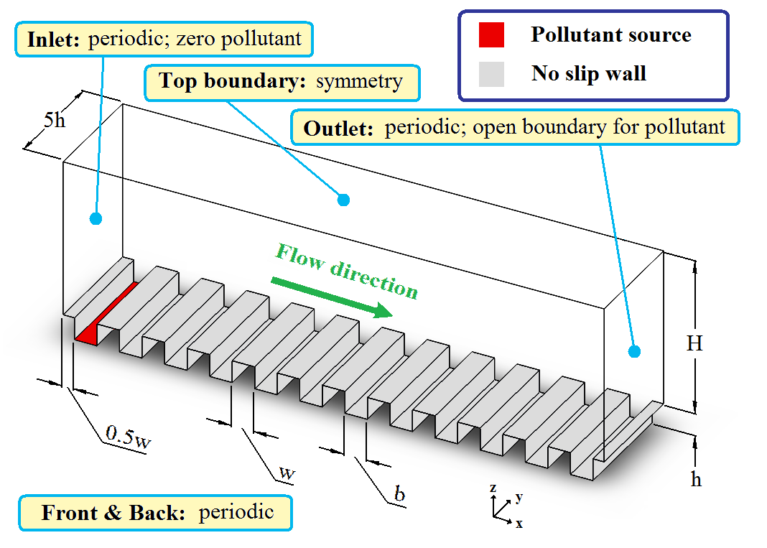
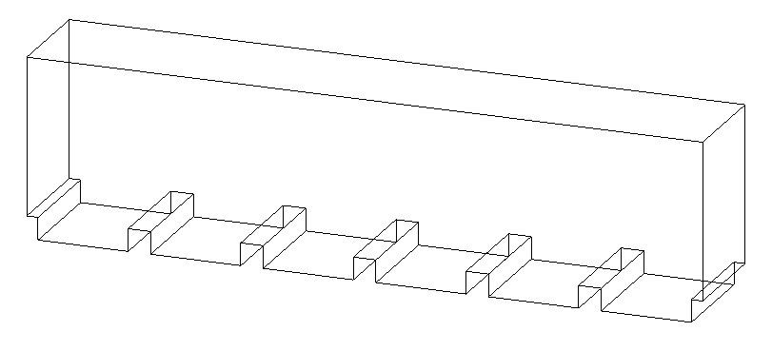
Methodology
Computational domain and boundary conditions
AR=0.25
AR (Aspect ratio) = h/b
AR=1.0
Notes:
Here is my computational domain. The bottom boundaries of the computational domain represent the grounds and building surfaces. The region above the buildings roof top represent the Urban boundary layer.
For the flow field, a no-slip condition is applied on the grounds and building surfaces. A free slip condition is applied at the top boundary. Periodic boundary conditions are applied in the horizontal direction to simulate the flow over an infinity large urban roughness. The flow is driven by a large scale pressure gradient in the Urban boundary layer only.
For the pollutant, a constant concentration source is applied on the ground of the first street canyon. Zero pollutant concentration is applied at the inlet to eliminate the background pollutant. An open boundary condition is applied to the outlet to prevent reflection.
On the right hand side, it is my another model. The computational domain and the boundary conditions are very similar. The only different between these two model are the aspect ratio and the number of street canyons.

Slide 9
Model Details
CFD code used: OpenFOAM 1.7.0
Turbulence model: Large-eddy simulation
With One-equation TKE subgrid-scale (SGS) model
Velocity-pressure coupling: PISO
Reynolds number: ~10,000
Pollutant source: Constant concentration source
Notes:
An Open source CDF code OpenFOAM is used in this study.
The LES of OpenFOAM use one-equation TKE sgs model to handle the sgs turbulence. The velocity-pressure coupling is iterated by PISO loop .
The Reynolds number based on the building height is around 10,000 for the current LESs.

Slide 10
List of completed computations
Model | AR = 1 | AR = 1 (Coarse) | AR = 0.25
No. of canyons | 12 | 12 | 6
No. of grids in each canyon (x,y,z) | 32×160×32 | 16×80×16 | 128×160×32
No. of grids in UBL (x,y,z) | 768×160×280 | 384×80×140 | 960×160×280
Total No. of grids | ~36M | ~4.5M | ~47M
Computation time | 5 months | 2 months | 6 months
Notes:
This table shows the grid density of my computation. My current models consist of more than 30M elements and each model required 5-6 months to complete.

Slide 11
Results & Discussion
Pollutant transport below & around roof level

Slide 12
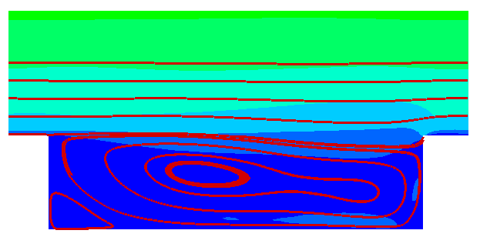
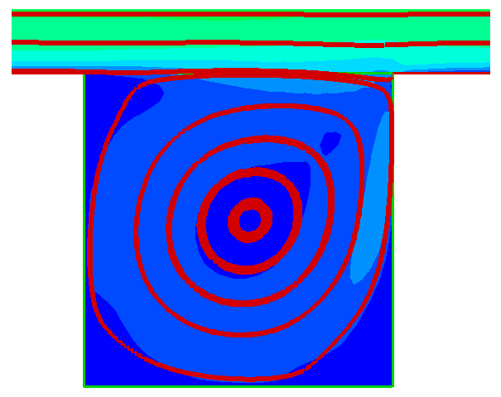
Streamlines
Primary recirculation is formed within each street canyon.
The mean wind in the UBL do not go into the street canyons.
AR = 0.25
AR = 1.0
Roof level
Notes:
The graphs here show the streamlines of the mean flow. Both of the current models fall into the skimming flow regime which means the mean flow from the UBL to not go into the canyon. The mean flows above the roof level are almost parallel to the streamwise direction and do not touch the ground level of the street canyon. A primary recirculation is formed within the canyons which could carry the pollutant from the ground level to the roof level and also dilute and mixing the pollutant within the canyon.

Slide 13
Cheng et al. (2008) pointed out that:
In skimming flow regime, the pollutant removal is mainly governed by turbulent transport instead of the mean wind using RANS k-ε turbulence model.
Notes:
Cheng have found that, in skimming flow regime, the pollutant removal is mainly governed by turbulence transport but not the mean wind speed. However, he use the less accuracy k-w model to demonstrate his finding. We would like to know is it the same in LES?

Slide 14
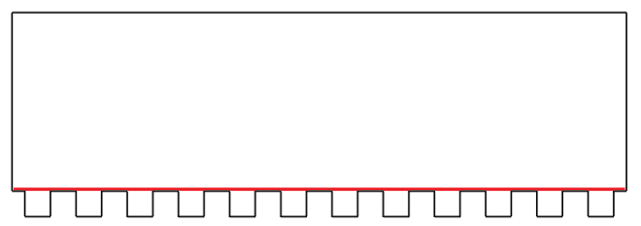
Pollutant removal
The following slides show the vertical pollutant flux along the roof level. Here, the three types of flux are:
Notes:
In order to examine cheng’s result, I decompose the vertical pollutant flux across the roof level into the mean and turbulence components. The mean flux represent the pollutant transported by the mean flow. The turbulence flux represent the pollutant transported by the turbulence. The red line in the graph on the right hand side shows the sampling location of the pollutant flux.

Slide 15
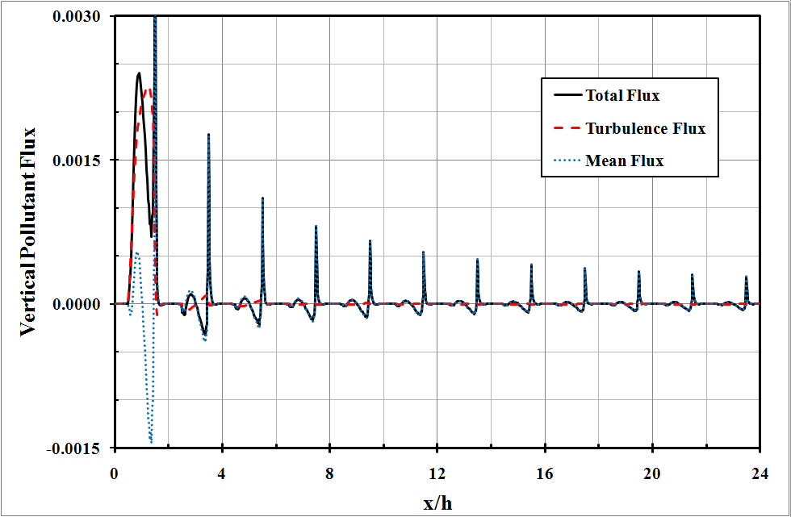
Mean flux vs turbulent flux across roof level (ar=1)
Pollutant removal is dominated by turbulent flux
Vertical Pollutant Flux
Pollutant transport is dominated by mean flux
x/h
Notes:
This graph show the vertical pollutant flux across the roof level for AR = 1. The vertical axis is the pollutant flux and x-axis is the streamwise location. Here, the red dash line represents the turbulence flux, the blue dotted line represents the mean flux, and the black solid line represents the total flux. A positive value of pollutant flux represent pollutant is removed from the street canyon and negative value represents pollutant entrainment. The result shows that, the mean wind remove and carry back the pollutant simultaneously which result in an insignificant net pollutant transport. Unlike the mean flux, the turbulence flux of the first canyon has a great pollutant removal effect. However, the turbulence flux for other street canyons drop to an insignificant value which make the mean flux govern the pollutant transport over there.

Slide 16
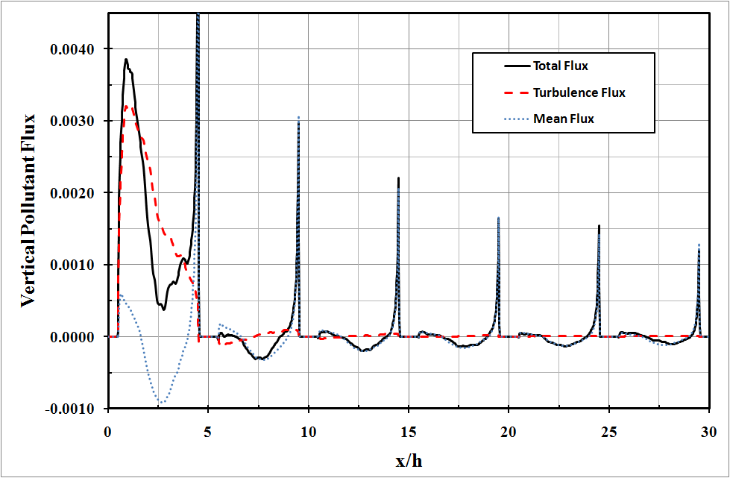
Mean flux vs turbulence flux across roof level (ar=0.25)
Notes:
This graph show the vertical pollutant flux for AR= 0.25. The overall trend here is similar to AR =1. The major different here is the location of maximum vertical turbulence flux is shifted to leeward side which should be due to the uneven distribution of pollutant within the first canyon. By these two graphs, we could conclude that the pollutant removal is governed by turbulence when the source is present.

Slide 17
Question
How is the pollutant removed from the street canyons to the UBL?
Notes:
Now we know that the turbulence transport govern the pollutant removal. But how the pollutant in the street canyon removed to the UBL?

Slide 18
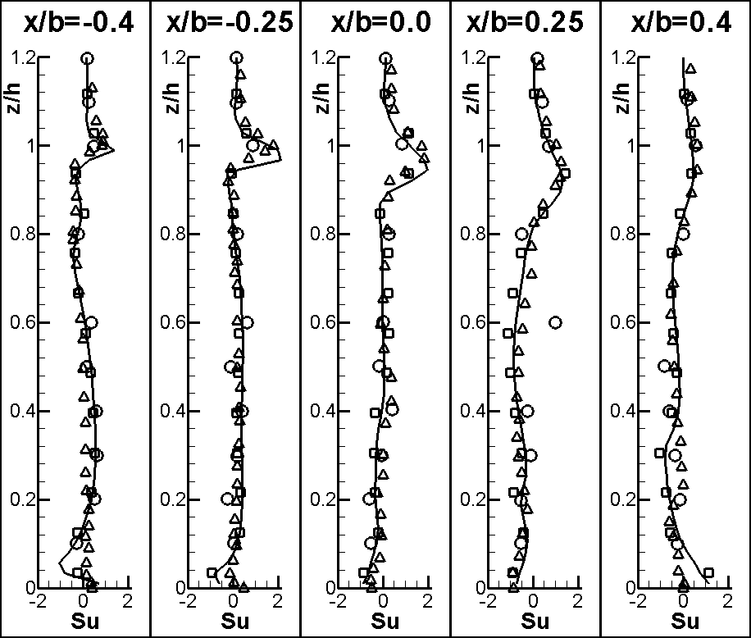
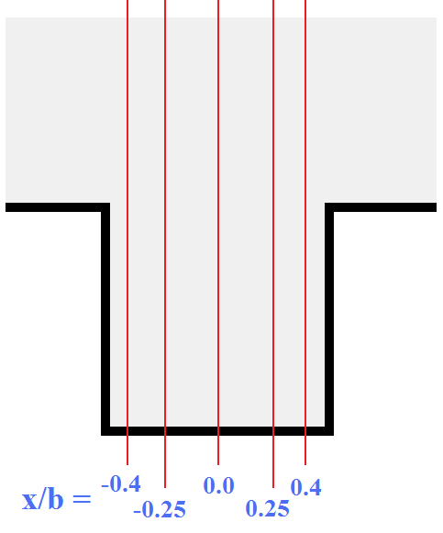
Skewness of u (AR=1)
Some air masses accelerate
while
Most of the air masses decelerate
Notes:
Let first have a look to the flow structure along the roof level. This chart shows the skewness of streamwise velocity at five vertical segments for AR=1, as shown in the picture on the right. The vertical axis is the vertical location; the horizontal axis is the skewness of streamwise velocity. The solid line is the data of the current LES. The symbols are the data from other people’s CFD and wind tunnel experiments. From the chart, a layer of positive skewness has been found along the roof level. Here, the positive skewness reveals that some air masses are travelling much faster than the majority. It imply some air masses there are undergoing rapid acceleration and most of the air masses are decelerating along this layer.

Slide 19
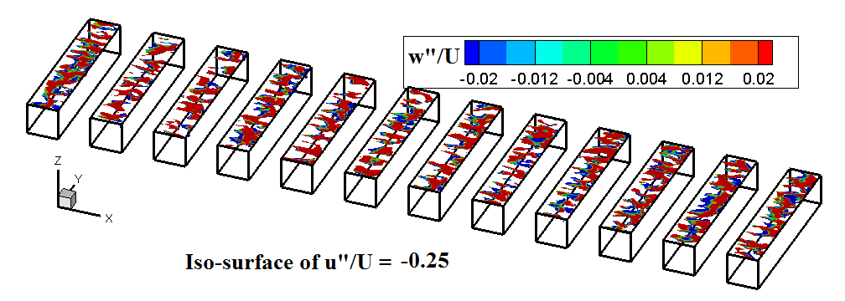
Snap shot of iso-surfaces of streamwise fluctuation velocity at roof level
Large amount of decelerating, up-rising air masses are located along the roof level.
u" < 0 represents deceleration
w” ≈ w at roof level
Notes:
Now move to the instantaneous information. This graph shows the instantaneous coherence structure between streamwise fluctuating velocity and vertical fluctuating velocity. In the graph, only the isosurfaces of a specific negative streamwise fluctuating velocity are shown. The color contour represent the vertical fluctuating velocity.
It is found that, when the streamwise fluctuating velocity is negative, the vertical fluctuating velocity is mostly positive.
Here, a negative streamwise fluctuating velocity means the air masses are travelling slower than the mean wind speed in streamwise direction . It imply there are some drag force decelerating those air masses. A positive vertical fluctuating velocity mean those air masses are going upward. Because the mean vertical velocity is almost 0 at roof level. The conclusion found from this graph is that when the air masses are decelerating, those air mass would travel upward and carry the pollutant always from the street canyon.

Slide 20
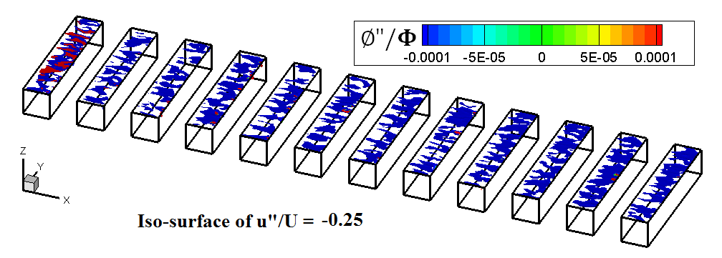
coherent structure at roof level
φ" < 0 occurs in the street canyons without pollutant source.
Notes:
Here is the same isosurface as the previous graph. Now, the color contour become the fluctuating pollutant concentration. For the street canyons without pollutant source, the pollutant concentration of those decelerating, up going air masses are mainly negative. It represent the up going mass could only carry a small amount of pollutant out of the street canyon. Since the mean vertical flow velocity is 0 at roof level, if there are some air masses going up, there must have air masses going down to make a mean of 0. Since the amount of pollutant removed by the up going air masses is small, the pollutant carried by the down going air masses could cancel the net pollutant removal effect. It explain why the turbulence transport is not significant when the pollutant source is absent.

Slide 21
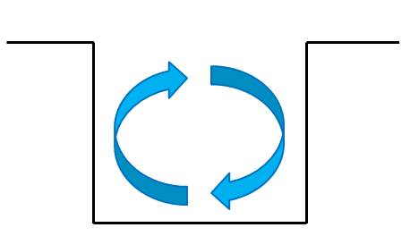
Removal mechanism
The accelerating air masses (u˝ > 0) carry the background pollutant into the street canyon by sweeps.
The decelerating air masses (u˝ < 0) remove the ground-level pollutant to the UBL by ejections.
The primary re-circulation mixes the pollutant within the street canyon.
Notes:
By summarizing the information in the last few slides, here is a proposed pollutant removal mechanism. In the street canyon with pollutant source, the primary recirculation carry the pollutant from the ground to the roof level. At the roof level, the accelerating air masses carry the background pollutant into the street canyon by strong sweeps. At the same time, the decelerating air masses remove the pollutant in street canyons by ejections. Since the background pollutant concentration is low in compare with the street canyon with pollutant source, the amount of pollutant removed by ejections is much greater than the amount of pollutant carried back by sweeps.

Slide 22
Removal mechanism
With pollutant sources
>>
Pollutant removal by ejections
Pollutant entrainment by sweeps
≈
Without pollutant source
Notes:
On the other hand, for the street canyon without pollutant source, the background pollutant concentration is similar to the concentration in the street canyons so that the effect of sweeps and ejections on pollutant transport is similar generating an insignificant net pollutant transport.

Slide 23
Question
Where does the turbulence come from?
Notes:
Just now I proved that turbulence transport is the major mean of pollutant removal. So, if we want to have better removal effect, we should promote turbulence instead of mean wind speed. Before we find a way to promote the turbulence, we first need to find out where does the turbulence come from.

Slide 24
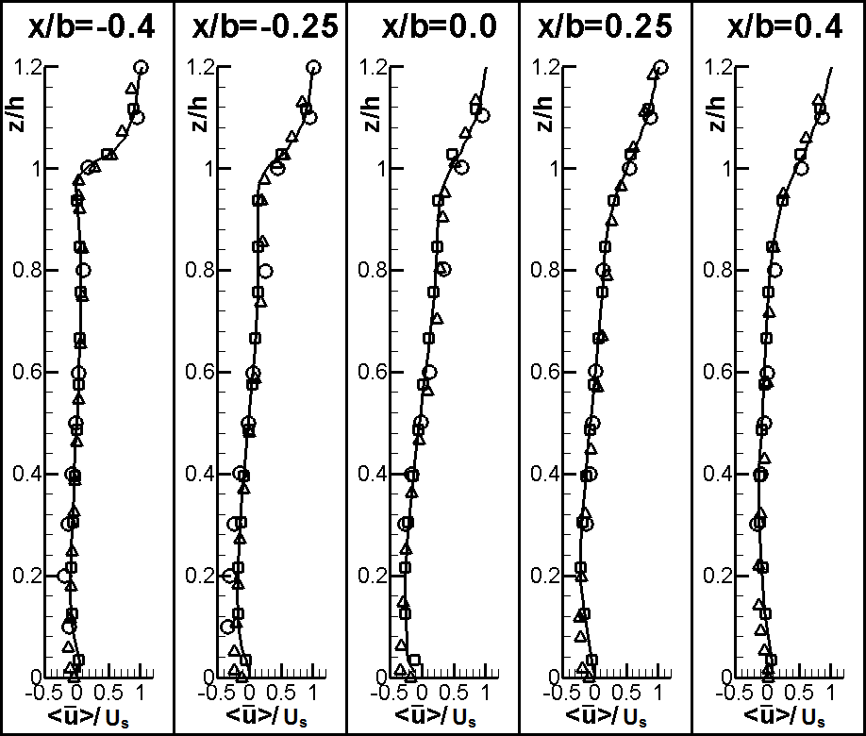
Mean flow velocity (AR=1)
The production term of TKE
Maximum gradient
Notes:
Go back to the flow structure along the roof level. This chart shows the mean streamwise velocity at five vertical segments for AR=1. The vertical axis is the vertical location; the horizontal axis is the mean flow velocity in streamwise direction. The black solid line is data from my model. The maximum vertical gradient of streamwise flow velocity occurs near the leeward side. The velocity gradient becomes gentler when approaching the windward side. On the right hand side, it is the production term of TKE. According to this equation, TKE production would be increase with the velocity gradient. So the TKE should peak at the same location as the maximum velocity gradient.

Slide 25
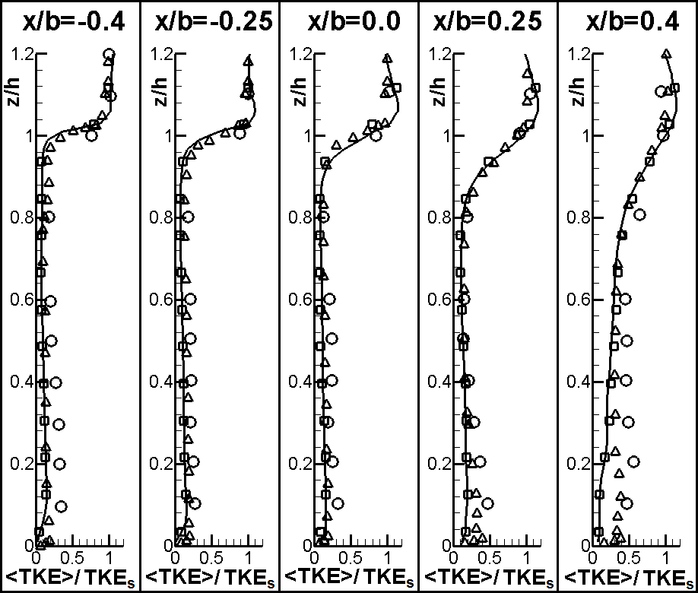
Resolved-scale TKE (AR=1)
Maximum TKE
Notes:
This graph shows the vertical profile of the resolved scale TKE. The horizontal axis is the Normalized TKE. The black solid line is data from my model.
WE expected the maximum TKE should peaked at the leeward side, since the local turbulence generated velocity gradient there is highest.
According to this graphs, the maximum TKE located at the windward side, where the velocity gradient is low. It contradict with the production of TKE.

Slide 26
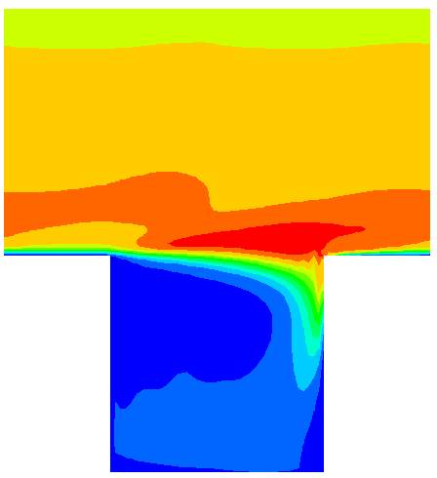
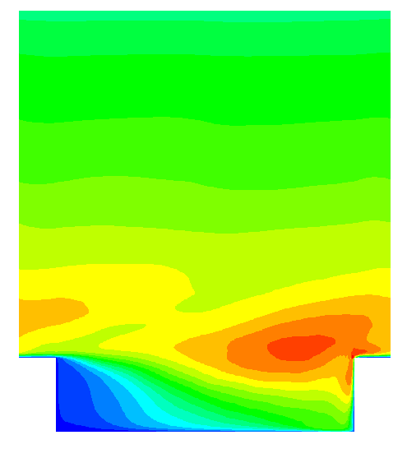
RS-TKE contours
Maximum TKE
Local turbulence production is not the major source of roof-level TKE for pollutant removal.
AR=1
AR=0.25
Maximum shear
Notes:
Here shows the contour of Resolved-scale turbulence kinetic energy. The left one is the model with AR 1. The one on the right is the model with AR 0.25. Here, red color represents high TKE and blue color represents low TKE. For both of my models, the maximum location of the TKE is near the windward corner of the roof top. Over there the velocity gradient is not high so that the turbulence production should be small. This finding implies the turbulence produced by local shear is not the main source of the turbulence at roof level for pollutant removal.

Slide 27
Cui et al. (2004) found that sweeps (u">0, w"<0) dominate the total momentum flux at roof level using LES with street canyon of AR=1.
Christen et al. (2007, pp.1962) figured out that under neutral stratification, sweeps dominate the exchange of vertical momentum at z ≤ 2.5h, employing quadrant analysis on the data measured from street canyons in Basel, Switzerland.
Notes:
We find that the local turbulence production is not the major source of roof-level TKE. but where does the turbulence come from? We may be able to find the result here. Cui have found out that sweeps dominate the total momentum flux at the roof level using his LES with AR=1. Another study by Christen, using quadrant analysis, have found that in real street canyons, the sweeps dominate the vertical momentum below a certain height. This finding imply the momentum as well as the turbulence kinetic energy is traveled from the UBL to the roof level. It is turn suggest the turbulence along the roof level is mainly come from the atmosphere turbulence from the UBL but not the local shear.

Slide 28
Section summary
The re-circulating flows carry the pollutant to the roof level and also mix/dilute the pollutant within the street canyon.
The aged air (carrying pollutant) is removed by ejections while fresh air is entrained by sweeps.
The TKE required for pollutant removal is mainly attributed to the (downward moving) atmospheric turbulence in the UBL.
Notes:
Here is the summary for the pollutant transport below & around roof level. The re-circulating flows carry the pollutant to the roof level and also mix/dilute the pollutant within the street canyon. The aged air (carrying pollutant) is removed by ejections while fresh air is entrained by sweeps. The TKE required for pollutant removal is mainly attributed to the (downward moving) atmospheric turbulence in the UBL.

Slide 29
Results & Discussion
Pollutant dispersion in the UBL

Slide 30
Necessary domain size
In the LES of open-channel flows over a flat, smooth surface, the domain-length-to-domain-height ratio is often greater than 4π in order to resolve the turbulence correctly. (e.g. Enstad et al. 2006)
Its computational cost is too high, if roughness are explicitly resolved.
Notes:
Before looking into the pollutant dispersion in the UBL, let first confirm the current computational domain is large enough to handle the atmospheric turbulence in the UBL. In the simulation of open channel flow over smooth surface, the domain length to domain height ratio is often greater than 4π in order to resolve the turbulence correctly. However, if roughness are explicitly resolved the computational cost is too high.

Slide 31
Two-point Correlation
Two-point correlations are commonly used to determine the necessary (minimum) domain size for resolving the turbulence. Ideally, the correlation of flow velocity drops to zero at certain horizontal separation, which is then used to determine the length scale of turbulence.
where
Notes:
Two-point correlations are commonly used to determine the necessary domain size for resolving the turbulence. Ideally, the correlation of flow velocity drops to zero at certain horizontal separation. And the intercept is the length scale of turbulence.

Slide 32
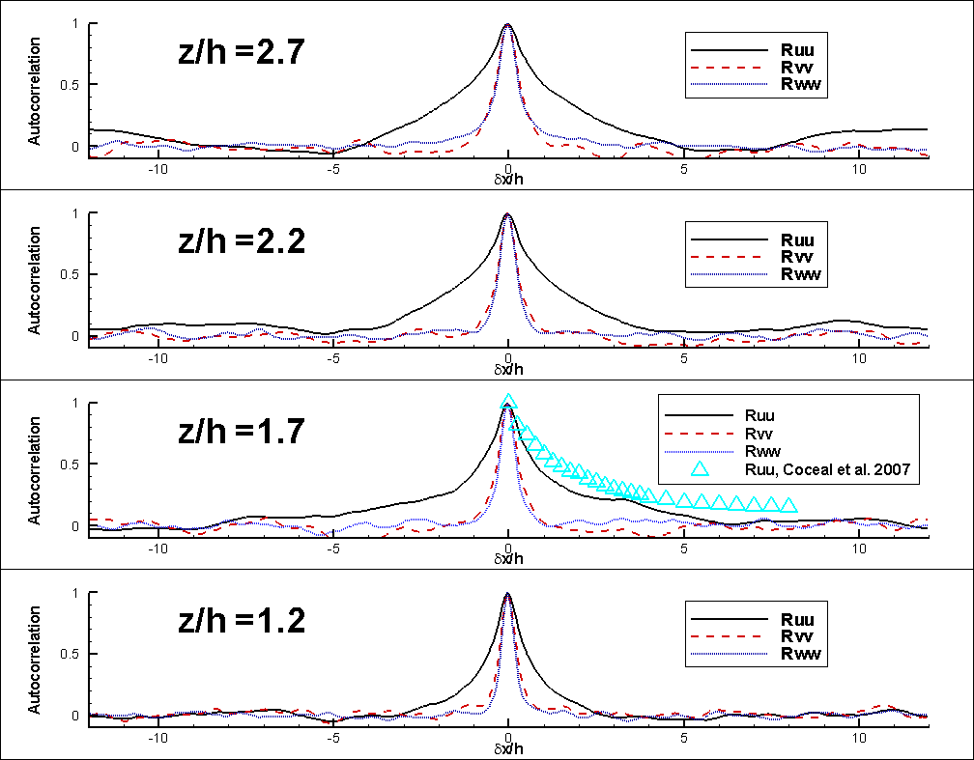
Two-point correlation (Ar =1)
The autocorrelation reaches 0 at any elevations.
Notes:
Here shows the two-point correlation at 4 different elevation of the model AR =1. The vertical axis is the two-point correlation; the horizontal axis is the streamwise separation. The black solid lines represent the two point correlation of streamwise velocity. The red dash lines are for the spanwise velocity. And the blue lines are for the vertical velocity. The triangle symbols are the data from DNS over 3D roughness, done by Coceal. The two point correlation of spanwise and vertical velocity reaches 0 at a short separation. The only troublesome parameter is the streamwise velocity. In this model, the two point correlation of streamwise velocity could reach 0 at a separation around 5h-10h. Which mean this model is large enough to handle the turbulence in the UBL.

Slide 33
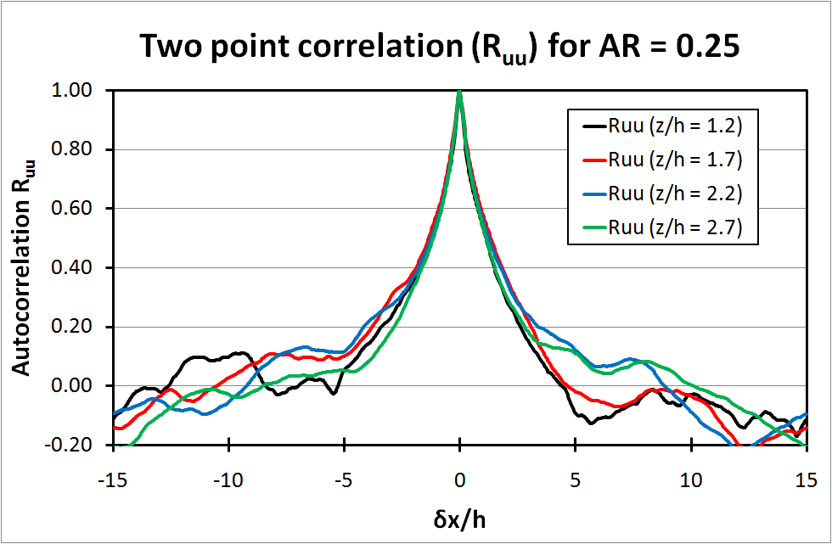
Two-point correlation (Ar =0.25)
Notes:
Here show the two point correlation of streamwise velocity of my another model. The spanwise and vertical compontents are not shown since they should not have any problem. This graph show the two point correlation reach 0 at horizontal separation of 5h-10h. Implying this model is also large enough handle the atmospheric turbulence.

Slide 34
Streamlines
The streamlines in the UBL are almost parallel to the streamwise direction.
AR = 0.25
AR = 1.0
Roof level
Notes:
Let’s remind that in the urban boundary layer, the mean flow is parallel to the streamwise direction so that the vertical transport of the pollutant is also governed by turbulence.

Slide 35
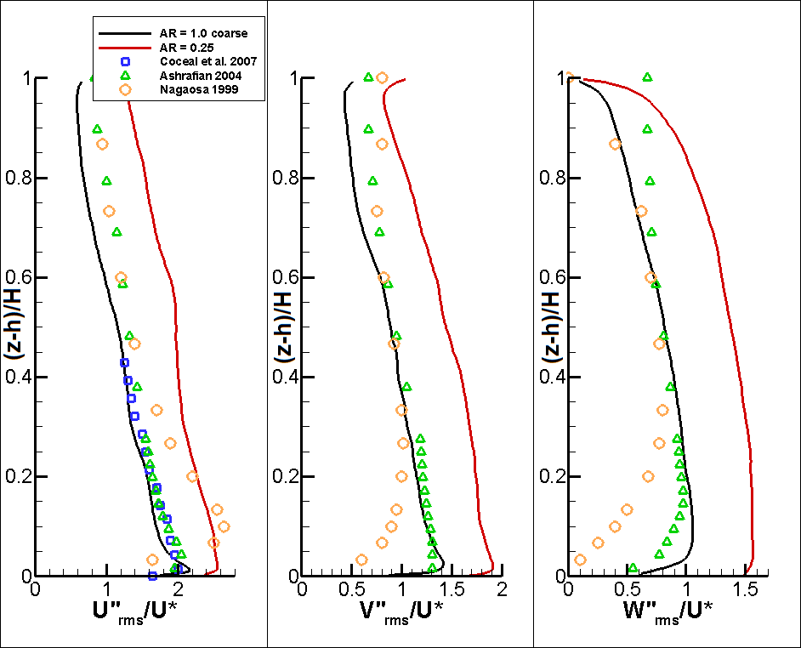
Flow fluctuation
Notes:
This graph show the individual components of velocity fluctuation in the UBL. The black line is for AR =1, red line is for the AR = 0.25. The symbols are data of others CFD for comparison.
Here the u” rms, v” rms and w” rms represent the flow fluctuation in streamwise, spanwise and vertical direction. It is found that the flow fluctuation for AR = 0.25 is much greater than that of AR = 1. Here, we only interested in the vertical component of the turbulence that govern the vertical pollutant transport. In the graphs, the w” rms of AR = 0.25 is much higher than that of AR = 1. Meaning that the canyons with AR = 0.25 could transport the pollutant vertically better than the canyon with AR =1.

Slide 36
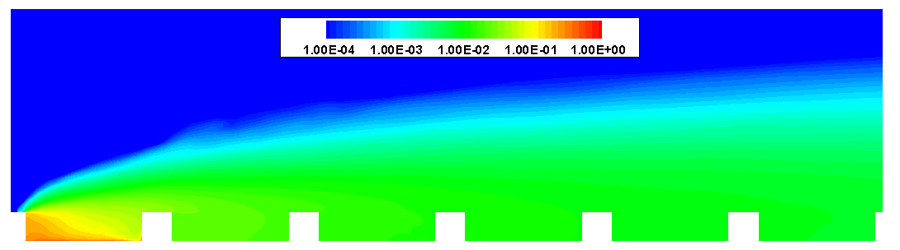
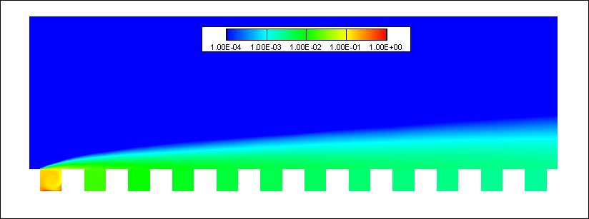
Pollutant plume
AR = 0.25
AR = 1
Notes:
Here is the pollutant concentration contours for both model. The red color represent high concentration and blue color represent low concentration. It is clear that the model with AR =0.25 could transport the pollutant to a higher place so that the pollutant concentration near the ground level should be lower. Note that the pollutant source here a constant concentration source, so that the wider canyon would have more pollutant, so that this graph may be misleading.

Slide 37
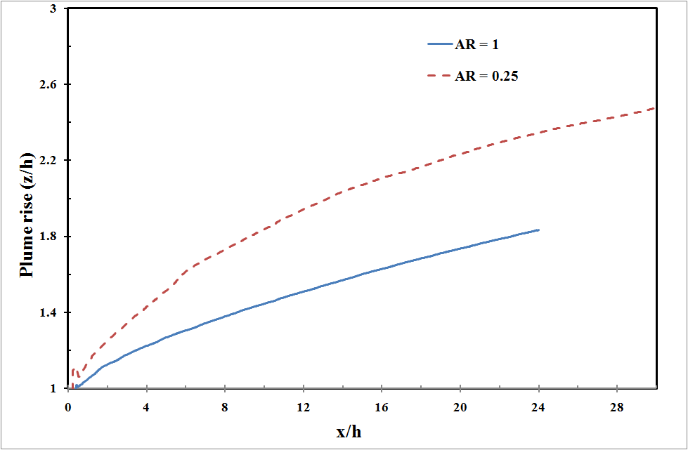
Plume rise
Notes:
In order to have a fair comparison, the plume rise, which is the mean plume height, are compared. The blue solid line is for the Ar 1 and the red dash line is for AR 0.25. With the same horizontal distant, the plume mean of the model AR = 0.25 rise to a much higher place in compare with the model with AR=1. Which mean the pollutant over street canyon with AR 0.25 could spread to higher place in compare with AR 1 so that the ground level air quality is better.

Slide 38
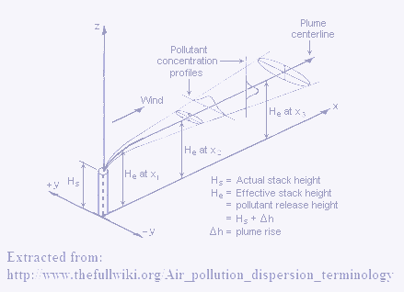
Plume profiles
Gaussian pollutant plume model has been widely used in the last 5 decades.
It was originally designed for rural areas (open terrain).
The re-circulating flows below the UBL are not considered
Davidson et al. (1996), using wind tunnel experiments, showed that the pollutant plume over an obstacle array exhibits a Gaussian form.
Notes:
Gaussian pollutant plume model has been widely used in the last 5 decades. It was originally designed for rural areas (open terrain), so that the re-circulating flows below the UCL are not considered. The idea of Gaussian plume model is that, with the distance from pollutant source, the mean wind speed, the stratification state, and the dispersion coefficient. The pollutant concentration at a specific location could be estimated by a simple equation.
Davidson et al. (1996) have discovered that the pollutant plume over an obstacle array has a Gaussian form by wind tunnel experiment. So that the analytical method adopted in my study is based on Gaussian plume pollutant model.

Slide 39
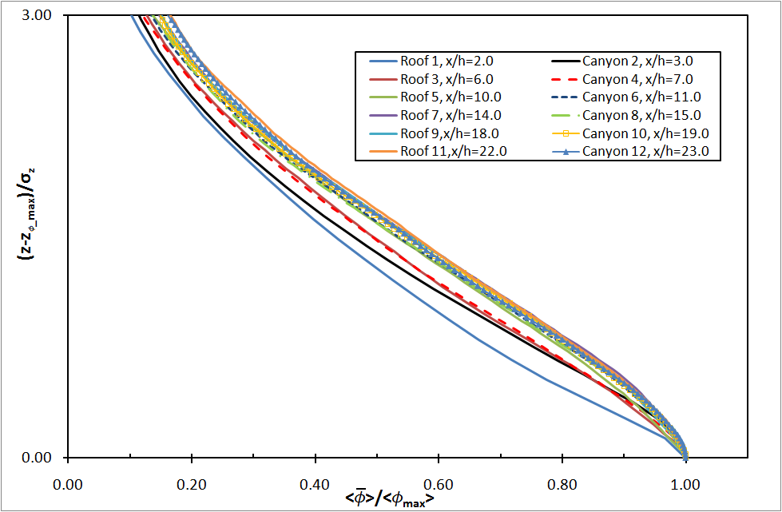

Vertical Plume profile (AR=1)
Notes:
This graph show the normalized vertical profile of pollutant concentration at different vertical sections for the model with AR 1.
Here the vertical axis is the normalized vertical location. The horizontal axis is the normalized pollutant concentration. The phi_max here is the maximum pollutant concentration of the same sections. The z_phi_max is the vertical location where the maximum pollutant concentration occur. The sigma_z is the vertical pollutant dispersion coefficient defined as this equation.
The vertical plume shape of the current AR = 1 model is closely resemble the Gaussian plume shape.
The results also show that after a certain distance away from the pollutant source, the normalized vertical plume profiles are converged to certain profile. It mean self-similarity profiles are achieve.
Besides, the plume profiles above the roof top and the plume profiles above the street canyons do not have much deviation, implying that the street canyons without pollutant source do not affect too much the plume shape aloft.

Slide 40
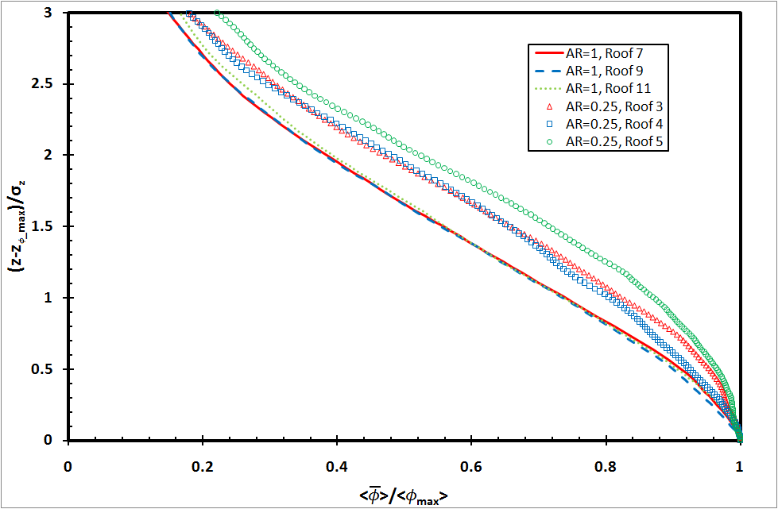
Vertical Plume
Obvious difference between AR=1 and AR = 0.25
Notes:
This graph compares the normalized vertical plume profiles of AR = 1.0 with AR = 0.25. The line are data of AR 1 and the symbols are data of AR 0.25. Unlike the AR =1, the plume profile of AR 0.25 could not achieve self-similarity. The reason is that the current domain length is not long enough for the pollutant plume to achieve self-similarity. Although the model with AR = 0.25 not yet achieve the self-similarity. However, the currently available plume profiles is sufficient to shows that the plume profiles for those two AR are different. Which imply the plume profile is a function of AR.

Slide 41
Section summary
The current computational domain is large enough handling the atmospheric turbulence in the UBL over idealized 2D urban roughness.
The street canyons of AR = 0.25 would have better air quality compared with AR = 1 counterparts.
The vertical plume profiles are functions of ARs.

Slide 42
Acknowledgment
This study was jointly supported by the Strategic Research Areas and Themes, Computational Sciences, and the University Research Committee Seed Funding Programme of Basic Research 200910159028 of the University of Hong Kong. The computation is supported in part by a Hong Kong UGC Special Equipment Grant (SEG HKU09). The technical support from Lillian Y.L. Chan, Frankie F.T. Cheung, and W.K. Kwan with HKUCC is appreciated.

Slide 43
References
Ashrafian A, Andersson H, Manhart M. 2004. DNS of turbulent flow in rod-roughened channel. Int. J. Heat and Fluid Flow 25: 373–383.
Bady M, Kato S, Huang H. 2008. Towards the application of indoor ventilation efficiency indices to evaluate the air quality of urban areas. Build. Environ. 43: 1991–2004.
Bentham T, Britter R. 2003. Spatially averaged flow within obstacle arrays. Atmos. Environ. 37: 2037–2043.
Barlow JF, Belcher SE. 2002. A wind tunnel model for quantifying fluxes in the urban boundary layer. Boundary-Layer Meteorol. 104:131–150.
Coceal O, Dobre A, Thomas TG, Belcher SE. 2007. Structure of turbulence flow over regular arrys of cubical roughness. J. Fluid Mech. 589:375-409.
Cheng WC, Liu CH, Leung DYC. 2008. Computational formulation for the evaluation of street canyon ventilation and pollutant removal performance. Atmoshperic Environment. 42:9041-9051
Cheng WC, Liu CH. 2010. Large-eddy simulation of flow and pollutant transport in and above two-dimensional idealized street canyons. Manuscript submitted to Boundary-Layer Meteorol.

Slide 44
References
Cui ZQ, Cai XM, Baker CJ. 2004. Large-eddy simulation of turbulent flow in a street canyon. Quarterly Journal of the Royal Meteorological Society 130: 1373–1394.
Davidson MJ, Snyder WH, Lawson RE, Hunt JCR. 1996. Wind tunnel simulations of plume dispersion through groups of obstacle, Atmospheric Environment. 30: 3715-3731.
Liu CH, Leung DYC, Barth MC. 2005. On the prediction of air and pollutant exchange rates in street canyons of different aspect ratio using large-eddy simulation. Atmos. Environ. 39: 1567–1574.
Macdonald RW, Griffiths RF, Hall DJ. 1998. A comparison of results from scaled field and wind tunnel modeling of dispersion in arrays of obstacles. Atmospheric Environment. 32: 3845-3862.
Michioka T, Sato A, Takimoto H, Kanda M, 2010. Large-Eddy Simulation for the Mechanism of Pollutant Removal from a Two-Dimensional Street Canyon. Boundary-Layer Meteorol. DOI 10.1007/s10546-010-9556-2
OpenFOAM. 2011. OpenFOAM: The open source CFD toolbox. Http://www.openfoam.com/.
Smagorinsky J. 1963. General circulation experiments with the primative equations I: The basic experiment. Month. Weath. Rev. 91: 99–165.

Slide 45
End

Slide 46
Q & A

Slide 48
Results & Discussions
Model validation

Slide 49
Flow structure within canyon
The vertical profiles of the following parameters on the vertical plane of the model with AR =1 were investigated:
Mean flow velocity, u and w
Turbulence Kinetic Energy, TKE
Skewness of u and w
Kurtosis of u and w
The results are compared with LES model by Cheng 2010 (represented by squares), Cui et al. 2004 (represented by triangles) & wind tunnel experiment by Brown 2000 (represented by circles).

Slide 50
Mean flow velocity, U
Max gradient
Notes:
Brown 2000 is wind tunnel experiment. Cui et al. 2004 use LES with different SGS model.

Slide 51
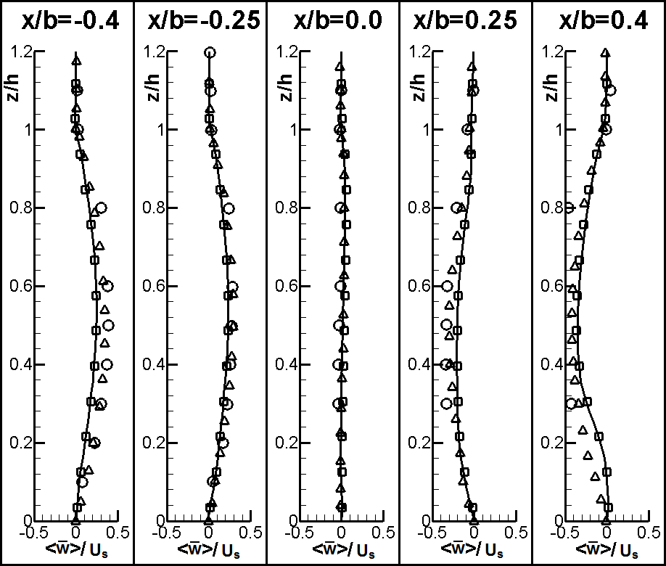
Mean flow velocity, W
The flow on the leeward side is going up and the flow on the windward side is going down forming a primary recirculation.
Notes:
Brown 2000 is wind tunnel experiment. Cui et al. 2004 use LES with different SGS model.

Slide 52
TKE
Max TKE

Slide 53
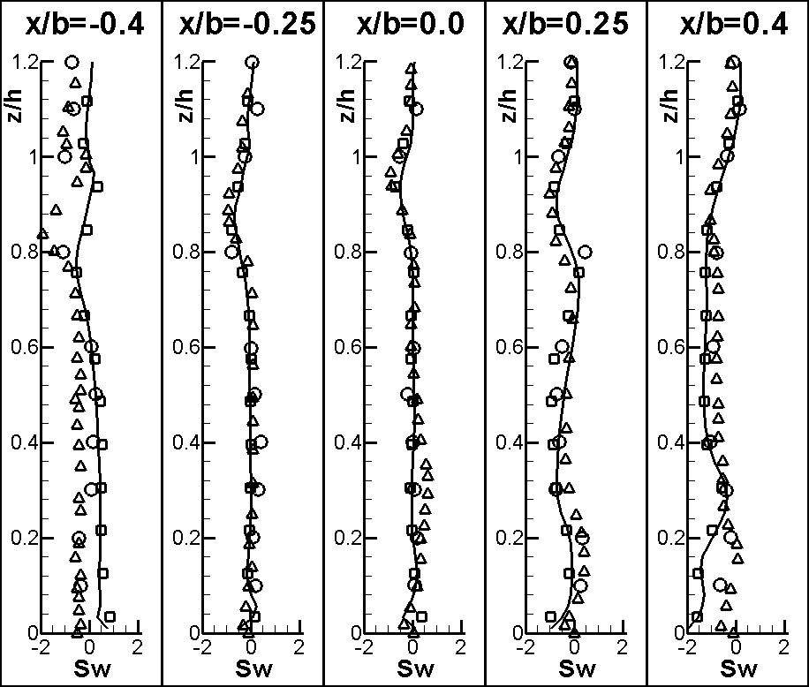
Skewness of w

Slide 54
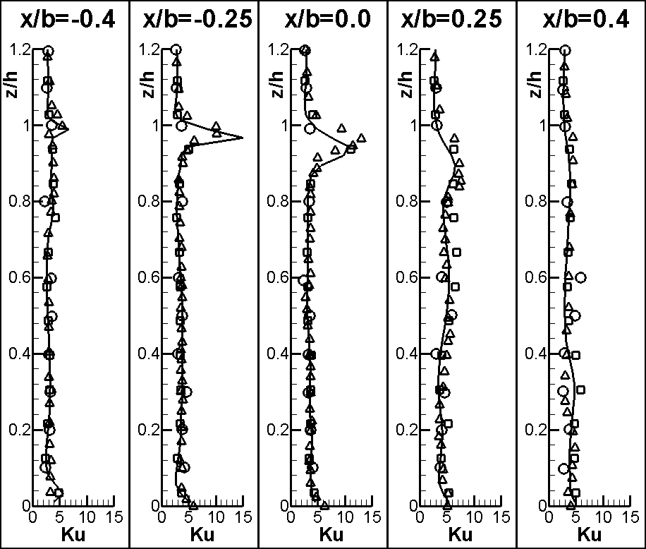
Kurtosis of u
Extreme values of streamwise velocity occur frequently at roof-level

Slide 55
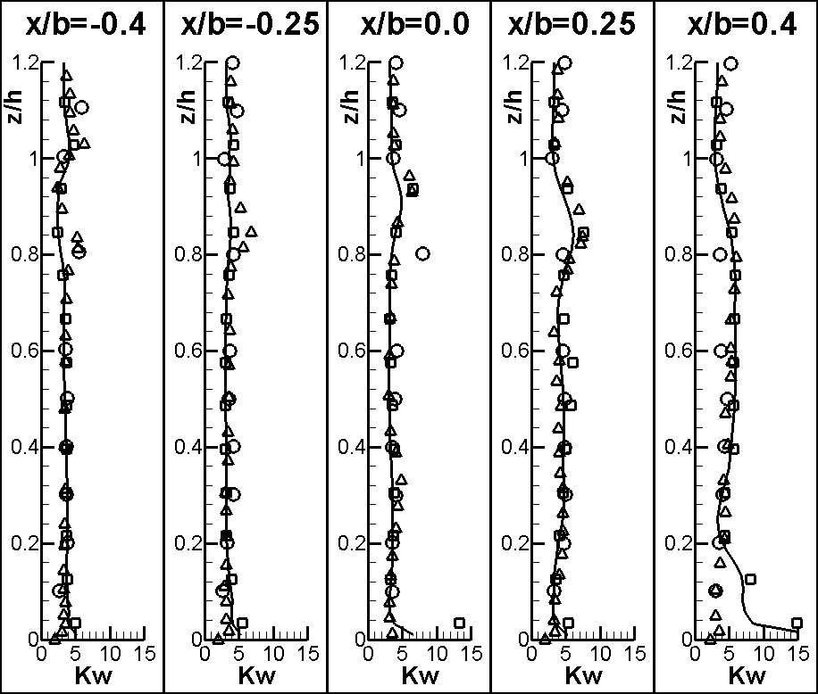
Kurtosis of w

Slide 56
Results & Discussions
Mathematic equations

Slide 57
Numeric method
Time derivative
Implicit second-order accurate backward differencing
Spatial derivative (gradient, divergence, and laplacian terms)
Second-order accurate Gaussian finite volume integration scheme
Interpolation scheme (cell surfaces’ value)
Central differencing using values from cell center

Slide 58
Mathematical Equations
Mass conservation equation:
Momentum conservation equation:
Resolved scale modified pressure

Slide 59
Mathematical Equations
The SGS Reynolds stresses (Smagorinsky, 1963)
SGS turbulence viscosity
filter width
modeling constant

Slide 60
Mathematical Equations
One-equation SGS model (Schumann, 1975)
modeling constant

Slide 61
Mathematical Equations
Scalar transport equation
Schmidt number
SGS pollutant flux

