Slide 1
Towards a Virtual Cluster Over Multiple Physical Clusters Using Overlay Network
PRAGMA20
2-4 March 2011
Kei Kokubo, Yuki Fujiwara
Kohei Ichikawa, Susumu Date
Osaka University
Adrian Ho, Jason Haga
University of California, San Diego
Notes:
I’m a student at graduate school of Osaka university, Japan.
Today, I will talk about our virtual cluster solution which we propose.
We aim to build a virtual cluster system to be used on a wide-area network like the PRAGMA Grid test-bed.
So we hope this presentation leads to new collaboration among PRAGMA members.

Slide 2
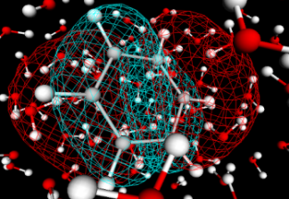

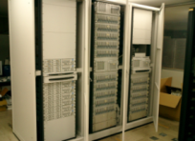
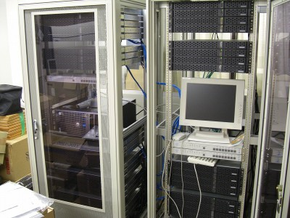
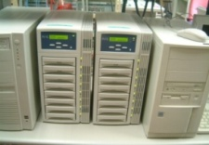
Background
PRAGMA Grid test-bed：
Shares clusters which managed by multiple sites
Realizes a large-scale computational environment.
Expects as a platform of computational intensive applications.
Highly independent processes which can be distributed.
Ex) Docking simulation.
Grid Environment
Large-scale
Environment
OS: Redhat
lib: glibc3.0
OS:Debian
lib: glibc2.0
OS: Redhat
lib: glibc2.0
Site A
Site C
http://www.rocksclusters.org/rocks-register/
Site B
2
Notes:
In PRAGMA grid test-bed, 26 institutions participate and 22 clusters are shared.
This grid environment have a possibility to realize a large-scale computational environment.
We believe that computational intensive applications such as docking simulation are suitable for submitting in grid environment especially. This is because their processes are highly independent and can be distributed respectively, so the effect of the latency and narrow bandwidth in grid environment is insignificant for such applications.
So grid is strongly expected by such applications.

Slide 3
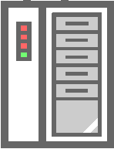

Virtual cluster
Virtualized cluster which is composed of virtual machines (VMs).
build a private computational environment that can be customize for users.
relatively easy to deploy on a single physical cluster by utilizing cluster building tools.
lib: glibc3.0
lib: glibc2.0
OS: Redhat
lib: glibc3.0
OS:Debian
lib: glibc2.0
Virtual machines (VMs)
Virtual machines (VMs)
Virtual local network
Local network (LAN)
Computers at a Site
Notes:
On the other hands, Virtual Cluster is promoting technology for efficient utilization of computational resources at one site.
Virtual cluster is composed of some of virtual machines and can build a private computational environment that can be customize for users.
And it is becoming relatively easy to deploy such virtual clusters on a single physical cluster by utilizing cluster building tools.

Slide 4

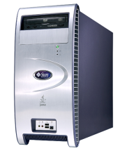
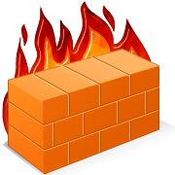
Rocks
Developed by UCSD
Rocks is installed on clusters at Sites in PRAGMA test-bed.
Rocks virtual cluster :
A virtual cluster is allocated a VLAN ID and network
Virtual compute nodes are automatically installed via network boot technology (PXE boot)
Compute nodes
Rocks
Virtual
Compute node
Virtual
Compute node
Virtual
Frontend
node
VLAN
Construction
eth0
eth0
PXE booting
Frontend node
eth1
eth0
VLAN 2
VLAN 2
VLAN 2
Layer 2 communication is needed
（LAN）
WAN
Physical NIC
Physical NIC
Physical NIC
Physical NIC
Issue ：It is difficult to build a virtual cluster over multiple clusters at Grid site with Rocks.
Notes:
Rocks is one of such cluster building tool.
As you all already know, Rocks is developed by UCSD and is composed of one Frontend node and some of Compute nodes.
On building a virtual cluster with Rocks, site administrators request a virtual cluster on the Frontend node via rocks commands.
After that, a virtual cluster is allocated a VLAN ID and VLAN network individually. Then, VLAN virtual network interface is set up on each physical node before administrators launch virtual machines.
And Rocks realize easy virtual cluster deployment with automatic installation of virtual compute nodes via network boot technology, or PXE boot. Virtual compute nodes boot via PXE and find a PXE server on a virtual frontend node through layer 2 communications and start automatic installation.
This automatic install mechanism needs layer 2 networks on which virtual machines can communicate directly like local network.
In WAN environment, it is difficult to set such local network. So with default setting Rocks, it is difficult to build a virtual cluster over multiple clusters at Grid sites which is expected by computational intensive applications.
＊ネットワークブートに仕組みを使って管理者の負担が小さいということを強調する。

Slide 5

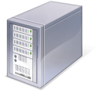
Our Goal
Develop a system which can build a virtual cluster over multiple clusters at Grid sites for computational intensive applications.
Our Approach
Focus on Rocks
Seamlessly integrate N2N overlay network with Rocks
N2N Overlay Network
Rocks virtual cluster
Rocks cluster A
Rocks cluster B
Site A
Physical Network
Site B
Notes:
From the background and the issue, now we have worked on developing a virtual cluster over multiple clusters at Grid sites easily for computational intensive applications.
In our research, we focus on Rocks and we propose and design a virtual cluster system which extends the functionality of Rocks to facilitate the creation of a virtual cluster to be able to build a virtual cluster over multiple Rocks-based clusters. Specifically, we seamlessly integrate functionalities of N2N overlay network with the functionality of Rocks.

Slide 6
N2N : Overlay network technology
Developed by ntop project in Italy
Creates an encrypted layer 2 overlay network using P2P protocol.
Can establishes layer 2 network spanned on multiple sites.
Utilize TAP virtual network interface (VNIC)
Divides overlay networks in similar manner to VLAN ID
Community name
Site A
MAC address
Site B
MAC address
13:14:15:16:18:26
11:22:33:44:55:66
N2N
VNIC
N2N
VNIC
N2N Overlay network
Community name （network ID）
Physical
NIC
Physical NIC
LAN
WAN
LAN
Notes:
N2N is one of overlay network technologies and developed by ntop project in Italy.
N2N creates an encrypted layer 2 overlay network using P2P protocol and can establish layer 2 network spanned on multiple site by utilizing TAP virtual network interfaces even if the physical machines are behind NAT and cannot communicate with each other directly.
And N2N overlay network has a unique community mane which is conceptually similar to the VLAN ID.
We integrate these N2N functionalities with Rocks.

Slide 7
Virtual cluster construction (1/3)
MVC Controller (MVC : Multi-site Virtual Cluster)
Resource Manager
1.
Resource Manager
rocks add mvc Site A:Site b
2.
Overlay network Constructor
3.
VM Manager
Registers multiple Rocks cluster as resources for a virtual cluster.
Compute nodes
Compute nodes
MVC
Databese
Databese
Rocks
Rocks
Frontend
node
Databese
Physical NIC
Physical NIC
Physical NIC
Physical NIC
Physical NIC
Physical NIC
LAN
LAN
WAN
Site A
Site B
Notes:
From this slide, I’d like to talk about our solution concretely.
In our solution, we have designed and been prototyping MVC Controller. MVC stands for Multi-site Virtual Cluster.
The Controller is composed of these three components, Resource Manager, Overlay Constructor and VM Manager.
From now, I explain how administrators deploy a virtual cluster over multiple Rocks clusters with MVC Controller.
When administrators request a virtual cluster to MVC Controller, at first, Resource Manager registers multiple Rocks cluster as resources for a virtual cluster to manage these resources as one unified resources.

Slide 8
Virtual cluster construction (2/3)
MVC Controller (MVC : Multi-site Virtual Cluster)
1.
Resource Manager
Overlay network Constructor
2.
Overlay network Constructor
3.
VM Manager
Compute nodes
Compute nodes
MVC
Databese
Rocks
Rocks
Frontend
node
N2N
VNIC
N2N
VNIC
Builds a Layer 2 overlay network for each virtual cluster.
N2N
VNIC
N2N Overlay network
Cluster name （Cluster ID）
Physical NIC
Physical NIC
Physical NIC
Physical NIC
Physical NIC
Physical NIC
LAN
LAN
WAN
Site A
Site B
Notes:
Second, based on information of resources stored in Resource Manager, Overlay network Constructor builds a N2N layer 2 Overlay network over physical nodes at multiple sites.

Slide 9
Virtual cluster construction (2/3)
MVC Controller (MVC : Multi-site Virtual Cluster)
1.
Resource Manager
Overlay network Constructor
2.
Overlay network Constructor
3.
VM Manager
Compute nodes
Compute nodes
MVC
Databese
Rocks
Rocks
Frontend
node
N2N
VNIC
Builds a Layer 2 overlay network for each virtual cluster.
N2N
VNIC
N2N
VNIC
N2N
VNIC
N2N
VNIC
N2N
VNIC
N2N Overlay network
Cluster name （Cluster ID）
Physical NIC
Physical NIC
Physical NIC
Physical NIC
Physical NIC
Physical NIC
LAN
LAN
WAN
Site A
Site B
Notes:
Next, Overlay network Constructor changes N2N virtual network interfaces’ configuration to connect to virtual machines, Lastly, Overlay network Constructor resisters information of each N2N virtual network interfaces to Resource Manager.

Slide 10
Virtual cluster construction (3/3)
MVC Controller (MVC : Multi-site Virtual Cluster)
Resource Manager
rocks start host vm overlay frontend
1.
rocks start host vm overlay compute nodeA Site =A
2.
Overlay network Constructor
VM Manager
3.
VM Manager
Compute nodes
Compute nodes
MVC
Databese
Virtual
Compute node
Rocks
Frontend
node
Rocks
Virtual
Frontend
node
Seamlessly connects virtual Frontend node and virtual Compute nodes to N2N overlay network.
eth0
eth0
eth1
N2N
VNIC
N2N
VNIC
WAN
N2N
VNIC
PXEブート
N2N Overlay network
Cluster name （Cluster ID）
Physical NIC
Physical NIC
Physical NIC
Physical NIC
Physical NIC
Physical NIC
LAN
LAN
WAN
Site A
Site B
Notes:
Then, administrators launch a virtual frontend node comprising of a virtual cluster with connecting it to N2N Overlay network via VM Manager.
Next and administrators launch virtual compute nodes comprising of a virtual cluster, as well as virtual frontend node via VM Manager.
Virtual compute nodes boot via PXE on N2N Overlay network, find virtual frontend node and start automatic installation.

Slide 11
Virtual cluster construction (3/3)
MVC Controller (MVC : Multi-site Virtual Cluster)
1.
Resource Manager
rocks start host vm overlay compute nodeB Site =B
2.
Overlay network Constructor
3.
VM Manager
Compute nodes
Compute nodes
MVC
Databese
Virtual
Compute node
Rocks
Frontend
node
Rocks
Virtual
Compute node
Virtual
Frontend
node
eth0
eth0
eth1
eth0
N2N
VNIC
N2N
VNIC
WAN
N2N
VNIC
PXEブート
N2N Overlay network
Cluster name （Cluster ID）
Physical NIC
Physical NIC
Physical NIC
Physical NIC
Physical NIC
Physical NIC
LAN
LAN
WAN
Site A
Site B
Notes:
Virtual compute nodes at remote sites from virtual frontend node can also be installed via PXE boot with VM Manager.

Slide 12
Feather of our virtual cluster solution
Can use as well as a Rocks virtual cluster at local site.
$ qsub -np $NSLOTS app.sh
$ mpirun -np 2 app.mpi
Compute nodes
Compute nodes
MVC
Databese
Virtual
Compute node
Rocks
Frontend
node
Rocks
Virtual
Compute node
Virtual
Frontend
node
eth0
eth0
eth1
eth0
WAN
N2N
VNIC
Virtual LAN
N2N
VNIC
N2N
VNIC
N2N Overlay network
Cluster name （Cluster ID）
Physical NIC
Physical NIC
Physical NIC
Physical NIC
Physical NIC
Physical NIC
LAN
LAN
WAN
Site A
Site B
Notes:
The feature of our virtual cluster solution is that seamlessly integration of N2N layer 2 overlay network with Rocks enables users to use multi-site virtual cluster as well as a Rocks virtual cluster at local site.
Virtual machines comprising of multi-site virtual clusters can communicate with each other directly via eth0.

Slide 13


Experiment
Verify the possibility of building virtual cluster over multiple Rocks clusters.
Evaluate calculation performance for a computational intensive application.
Environment
WAN emulator
Frontend node of
Rocks cluster A
Frontend node of
Rocks cluster B
OS: CentOS 5.4
(Rocks 5.4)
CPU: Intel Xeon 2.27G HZ * 2 (16core)
Memory: 12GB
Network: 1Gbps
4 of compute nodes:
4 compute nodes of cluster A
4 compute nodes of cluster B
…
…
Site A
Site B
Switch(1Gbps)
Notes:
Now we have been prototyping implementation of our virtual cluster solution.
To show the feasibility and the practicality of our solution we performed preliminary experiments.
First is to Verify the possibility of building virtual cluster over multiple Rocks clusters.
Second is to evaluate calculation performance for distributed application.
Figure illustrates the overview of our experimental environment. We used two Rocks clusters which are composed of one frontend node and 4 of compute nodes. Cluster A is the master cluster here and the frontend node of cluster A hosts a virtual frontend node. Cluster B is the worker cluster which hosts virtual compute nodes installed with PXE boot from the virtual frontend node. To evaluate our solution in WAN environment, we arrange a dummynet node which can emulate WAN environment in terms of the latency and bandwidth and set it between the two clusters.

Slide 14
Experiment (Possibility of Building)
Verified a virtual cluster over cluster A and B can be built through N2N overlay network
Verified possibility of building a virtual cluster in WAN environment.
Change the latency at WAN emulator
0ms, 20ms, 60ms, 100ms, 140ms
Calculate install time for 4 of virtual compute nodes
About 1.0GB packages to install
3521
3099
2628
1365
692
A virtual cluster over multiple Rocks clusters can be built even if Rocks clusters are in WAN environment.
Verified virtual compute nodes can be installed in WAN
Notes:
まず，2つのクラスタ横断的に仮想クラスタを構築可能であることを確認しました．
次に，本研究の
提案手法によるネットワークオーバヘッドによりWAN環境では仮想クラスタを構築できなくなる懸念があったことから、疑似的なWAN環境において仮想クラスタを構築可能か評価を行いました．
結果、図のように遅延を増大させるとパッケージのダウンロードに時間がかかるようになるものの、高遅延環境においても提案手法を用いて仮想クラスタを正常に構築可能であることが確認しました。このことから、広域分散計算環境においても性能要件をクリアしていることが判明しました。

Slide 15
Experiment (Calculation Performance)
Measure execution time of a computational intensive application.
DOCK 6.2 (sample program)
30 pieces of compounds for a protein divided by 8 processes.
There are few communication between 8 processes
Change the latency and bandwidth at WAN emulator
20ms, 60ms, 100ms, 140ms / 500Mbps, 100Mbps, 30Mbps
The effect of the performance is small
even if latency is high and bandwidth is narrow

Slide 16
Conclusion and Future work
Conclusion
have designed and been prototyping a virtual cluster
solution over multiple cluster at Grid sites.
Integrate N2N with Rocks seamlessly.
Verify the calculation performance for distributed
application will be scale even if in WAN. Environment.
Future work
Manage multiple virtual clusters deployed by multiple users.
Make the install time of virtual compute nodes short.
Improve the performance of N2N overlay network.
Set a cache repository per site.

Slide 17
Requirements for our Virtual cluster solution
Rocks with Xen Roll
N2N
RPM package installation.
Open some port for N2N
For edge nodes and a supernode
Install MVC Controller
Composed of Some new python scripts
Provide original rocks commands.
(we still have been developing.)
Notes:
This is the requirement for our virtual cluster solution.

Slide 18
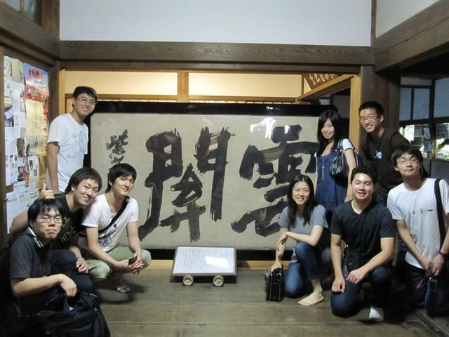
Thank you for your attention!
Fin

Slide 20
Calculate install time when change the number of virtual compute nodes.
1.0G for 3000 sec => around 300Kbps per node.
The limited bandwidth of N2N Overlay network is 40Mbps.
Install time won’t change when we install over 100 virtual compute nodes

Slide 21
Network overhead
Verify the network overhead of our virtual cluster.
Change the latency and bandwidth at WAN emulator.
20ms, 60ms, 100ms, 140ms / 500Mbps, 100Mbps, 30Mbps
Limited bandwidth

Slide 22
Administrator
MVC：Multi-site Virtual Cluster
Request virtual cluster
Frontend node of site A
Frontend node of site B
Provide virtual
cluster
MVC
Controller
MVC
Controller
MVC
DB
MVC
DB
Resource
Manager
Aggregate resource information from Rocks DBs
Resource
Manager
Database (DB)
Database (DB)
Rocks
Rocks
VM
Manipulator
Manipulate Virtual
Machine for MVC
VM
Manipulator
VM
Installer
VM
Installer
VLAN
Constructor
Overlay network
Constructor
Overlay network
Constructor
VLAN
Constructor
Build a overlay network over multiple sites

Slide 23
Supernode drops Ethernet flames
if the MAC address of source host is not registered at Supernode.
VM1
domain U
VM2
domain U
node | MAC address | Community
EdgeA | 11:22:33:44:55:66 | Osaka
EdgeB | 13:14:15:16:18:26 | Osaka
eth0
14:25:36:47:58
eth0
41:52:63:74:85
Supernode
drop
Domain 0
Domain 0
N2N
through
N2N
Edge A
11:22:33:44:55:66
Edge B
13:14:15:16:18:26

Slide 24
MAC Address Synchronization.
Can Connect to N2N overlay network.
VM container
13:14:15:16:18:26
VM
domainU
eth0
Supernode
MAC address
Synchronization
domain 0
N2N
TAP
Virtual network interface
node | MAC address | Community
EdgeA | 11:22:33:44:55:66 | Osaka
EdgeB | 13:14:15:16:18:26 | Osaka
eth0
xenbr.eth0
(bridge)
xenbr.edge1
(bridge)
13:14:15:16:18:26
peth0

Slide 25
Resource Manager
(ID)
(node name)
(site ID)
(Membership, cpus etc..)
Site
nodes for MVC
(ID)
(fqdn) (IP or DNS name)
(headnode name)
(user)
(SSHpubkey) (text)
(Site ID)
(Node ID)
(ID)
(Node id)
(Physical Node id)
(Memory, Slice etc..)
vm_nodes for MVC
(Node ID)
(ID)
(Supernode IP)
(Supernode Port)
(Community)
(Key)
(Edge port)
Networks for MVC
Overlay
(ID)
(Node ID)
(MAC)
(Virtual Device name)
(Overlay ID)
(overlay ID)

