Slide 1


Summary of PRAGMA SC Meeting
Planning for PRAGMA’s Future
PRAGMA 20
2-4 March2011
University of Hong Kong

Slide 2
PRAGMA 20
Wonderful organization
Opportunity we need to build on – with concrete ways to interact
Who will come to PRAGMA 21?

Slide 3
PRAGMA 21 Extending GEOGrid to other countries
GEOGrid Workshop, PRAGMA 21 Workshop
17 – 19 October 2011
Sapporo, Japan
Hosts
AIST - GEOGrid
AIST, Osaka U, U Tsukuba, NICT, Titech – PRAGMA 21

Slide 4
Products and Marketing Ideas for Action
Virtual Image Repository and Member Software Links
Publishing our work for ourselves and others
Special Edition of Journal
Accomplishments
Lessons Learned
Future
Applications Portal, or Demonstration Gallery
Help prospective users know about applications
Organize sessions at major meetings
Notes:
Moving beyond wiki

Slide 5
Longer Term Thinking
Vision into the future: PRAGMA is
Forum for people, applications, technologies integration
Conduit of ideas, people, products
Open experimentation, allowing people to use PRAGMA framework
Applications
Strategic review for missing areas, potential impact of PRAGMA, persistent interest
Communities; virtualization for way to provision resource
Building future leaders and participants
Encourage others to organize and lead workshops
Make others more aware of PRAGMA
Enable students to have a stronger role in workshop planning

Slide 6
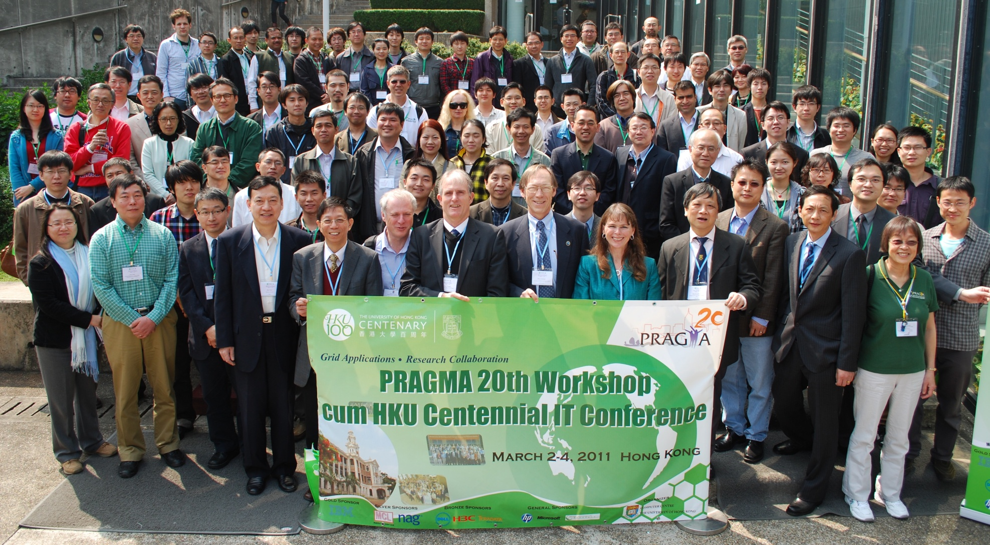
Congratulations to all of us

