Slide 1
PRAGMA Virtual Machine Sharing Demo
AIST, NCHC, UCSD

Slide 2
Our Goals
Run each others virtual machines each others sites, e.g.
Authored at UCSD – Run at AIST, NCHC
Authored at NCHC – Run at AIST, UCSD
Authored at AIST – Run at UCSD, NCHC
Can it work with Multi-OS, Different Hosting Environments?
Xen at UCSD, AIST
KVM at NCHC
Run actual Code in distributed (private) infrastructure
Started end of Jan 2011 (1 month ago)

Slide 3



Demo 1 – UCSD → PRAGMA
EC2
AIST
UCSD
Landphil.rocksclusters.org
NCHC
All nodes running a uniform Rocks-defined image
Run at AIST, NCHC, UCSD and EC2
Submit Locally, Run Globally
Autodock2 Demo
BLAST Demo

Slide 4
From our viewpoint
We (UCSD) have full control of software on all VMs that we want to run
Use Rocks to define VM images
Frontend (landphil.rocksclusters.org) is yum repository for all nodes
Root @ landphil has root @ ALL NODES
Single Condor Pool, Single Submit point
Just need permissions to boot my VMs
Pay $$ to boot in EC2

Slide 5
Not Quite a Complete Cluster Extension
Private Network
Cloud/Public Net
Frontend + Condor Collector
c0
c1
n0
n1
n2
n3
Condor runs jobs on two pools – cluster, cloud
No Direct Messaging: Cloud nodes ←→ Clusters nodes
Large group of existing tools do not work in this topology
Can it be fixed (w/o rewriting all tools)?

Slide 6
(Experimental) More Complete Extension
Private Network
Cloud/Public Net
Frontend + Condor Collector
tun0
c0
c1
tun1
n0
n1
Use Frontend as a Router
IP tunnels from each c<n> to frontend
Direct cloud/cluster communication
Rocks EC2 Roll Automates tunnel, routing, firewall configuration
User home areas show up in cloud
Not fast, but very convenient
n2
n3
Direct Messaging Domain

Slide 7

The ONE thing I wish I had in EC2
Console!

Slide 8
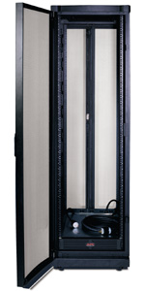
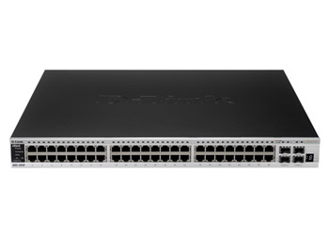
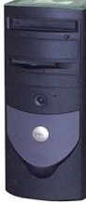
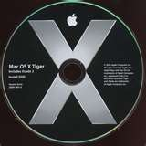
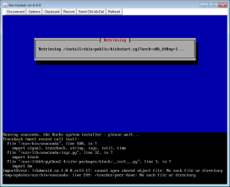

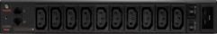

User-Level Cloud Combat Maneuvers The Rocks Pilot (in 5.4)
Frontend
OS Native Requires Root. Airboss gives limited access to users (Public Key Crypto)
AirBoss
Vi-1.rocksclusters.org
SSH tunnel
My Virtual Cluster
Power and Console to ANY of my VMs in my Virtual Cluster
Pilot
Physical Hosting Cluster
“Build-x86-64.rocksclusters.org”

