Slide 1
MGrid-PLSI
Suntae Hwang
Daeyoung Heo
PRAGMA 20, 2011.03
Kookmin University, Korea.

Slide 2
Contents
Introduce PLSI
MGrid on PLSI
Collaboration Model by MGrid
MGrid Improvement
MGrid Tutorial
MGrid Data Management

Slide 3
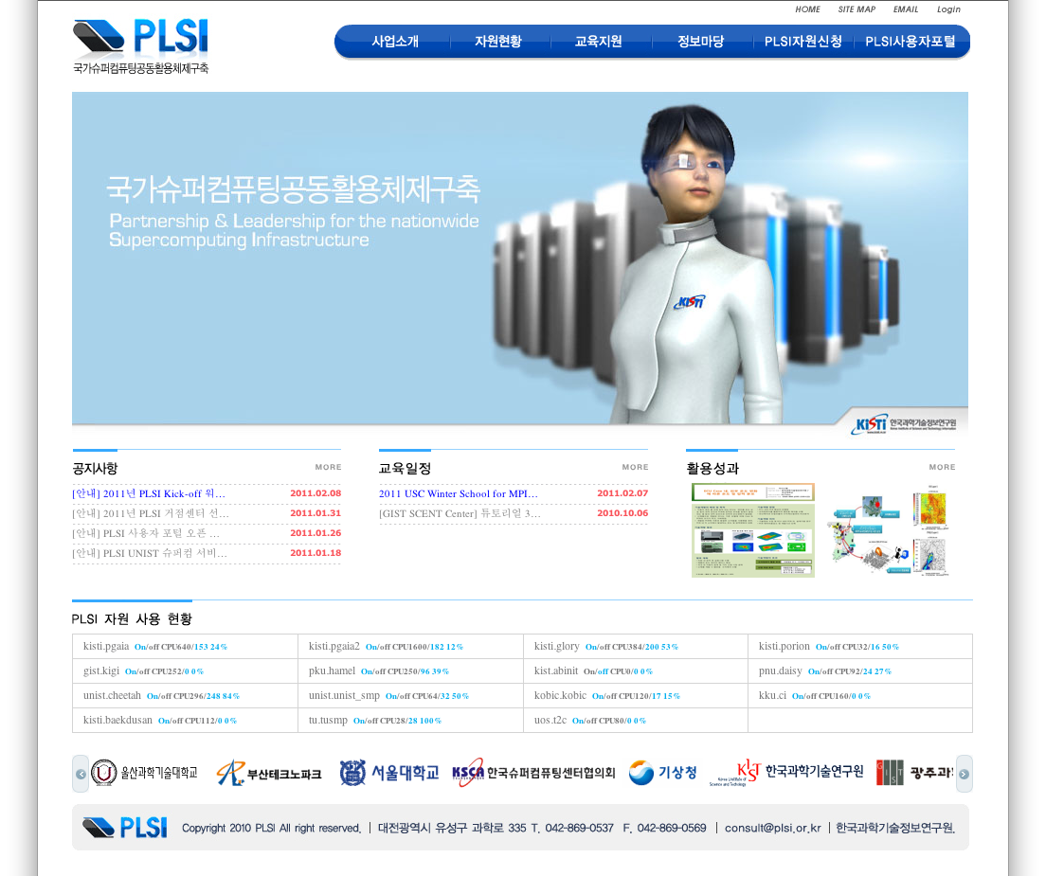
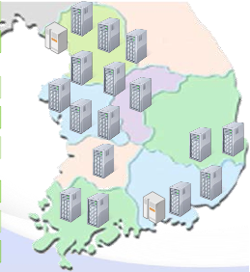
PLSI
Partnership and Leadership for the nationwide Supercomputing Infrastructure
A nationwide supercomputing infrastructure in Korea.
7 Korean supercomputing centers
Interconnected by dedicated high performance network
KREONET
The National Research Networks
Total 1,180 TFlops
By KISTI, 2010.11
http://www.plsi.or.kr

Slide 4

Goal of PLSI
Integrated System Management
Assist supercomputing site by professional work experience.
System Monitoring.
System Operation.
Improve System Availability
Uniform System Interface and
Unified Service
Improve Usability.
Unified Service
Uniform System Interface
PLSI
Integrated System
Management

Slide 5
Problem #1: User still feel difficult to use PLSI via Terminal
Why?
Don’t have experience of linux or unix.
Don’t want to know that systems.
Difficult
Users feel about PLSI

Slide 6
Example of Problem #1
Users are not happy to understand what they don’t need.
Just feels “It is very difficult”
#! /bin/ksh
# Loadleveler Job command file
# @cluster_list = gist.kigi
# @job_type = MPICH
# @wall_clock_limit = 48:00:00
# @class = normal
# @resources = ConsumableCpus(1) ConsumableMemory(1gb)
# @tasks_per_node = 2
# @environment = 1
module load intel/intel_9.1.052
module load vasp/vasp
mpirun –np $LOADL_TOTAL_TASKS \
–machinefile $LOADL_HOSTFILE \
/home01/applic/vasp/vasp4.6/vasp
What is this?
module?
$LOADL_TOTAL_TASKS?
What do these statements mean?
Where is executable of ‘VASP’?

Slide 7
Problem #2, Unnecessary Education
System Details
Policy of each supercomputing centers
Wall-clock time limits.
CPU count limits.
Memory size limits.
Etc.
Execution methods
By system architecture
Single or parallel
Execution System Software
like SGE, Loadleveler
Syntaxes
Some condition or combinations of execution methods
Users don’t want to know about system details. However they cannot execute then application without that knowledge
Education
Too much to learn

Slide 8
Example of Problem #2.
In ‘VASP’ case
Major
Interesting
What is ‘VASP’?
What can I do using ‘VASP’?
How to make to input data(s)?
How to analyze the results?
How to visualize the data?
Minor or Not
Interesting
module load intel/intel_9.1.052
module load vasp/vasp
mpirun –np $LOADL_TOTAL_TASKS \
–machinefile $LOADL_HOSTFILE \
/home01/applic/vasp/vasp4.6/vasp

Slide 9
Problem #3: Security
Anxiety of Administrator
Password management.
Don’t allow easy password.
Terminal access
Don’t allow terminal being open to the unknowns.
Restrictions for Security
Users can access from registration IP only.
Strongly password system
Must change in the periods.
Should be use complex combination of letter.
Administrator can’t trust user’s behavior on security.
“Users always make a mistake to manage their accounts”
Security

Slide 10
MGrid on PLSI
MGrid can be a solution!

Slide 11
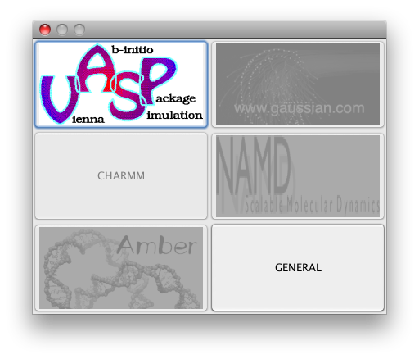
Plain PLSI vs. MGrid
PLSI
MGrid
PLSI
Uniform System Interface
Integrated System Management
LoadLeveler
LoadLeveler

Slide 12
What MGrid can do.
Portal Service
Integrated technically into web.
Anywhere can be access.
Independence for security issue of terminal access.
Authentication via GSI Infra.
Provide GUI Toolset.
Logical Resource Information
Access uniform information.
➔Hide followings:
Complex of software execution,
Policy of supercomputing centers,
And anything not interesting.
Improve
Usability
MGrid
PLSI
LoadLeveler

Slide 13
MGrid solve…
In ‘VASP’ case
Major
Interesting
What is ‘VASP’?
What can I do using ‘VASP’?
How to make to input data(s)?
How to analyze the results?
How to visualize the data?
Minor or Not
Interesting
module load intel/intel_9.1.052
module load vasp/vasp
mpirun –np $LOADL_TOTAL_TASKS \
–machinefile $LOADL_HOSTFILE \
/home01/applic/vasp/vasp4.6/vasp
Provide GUI Toolset

Slide 14
Collaboration Model by MGrid
Supercomputing
Centers
Collaboration Model
Software and Technology
( Kookmin Univ. )
Operation Center
( KISTI )

Slide 15
Collaboration Model by MGrid
MGrid
Centers
KMU
KISTI
MGrid provide toolset for users.
Indirect access PLSI resources.
Divide works.
System operation.
Support customers.
Tools
MGrid
PLSI
Resources
PLSI

Slide 16
Collaboration Model : Feedback Cycles
MGrid
Centers
KMU
KISTI
Feedback
notify
Feedback
Tools
MGrid
PLSI
Resources
work
work
PLSI
Feedback

Slide 17
MGrid Improvement
MGrid
Improvement!

Slide 18

Improve #1: IP free
IP free
Using HTTP Protocol only
Anywhere access to PLSI
Restricted IP
Port 2811,
45000 ~ 50000
Any IP
Port 80

Slide 19
Improve #2. Quick Launching
Quick Launching
Provide application specific dialog.
Software Packages
VASP
GAUSSIAN
CHARMM
NAMD
AMBER

Slide 20
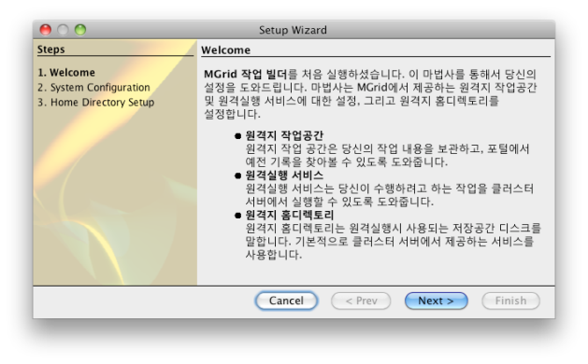
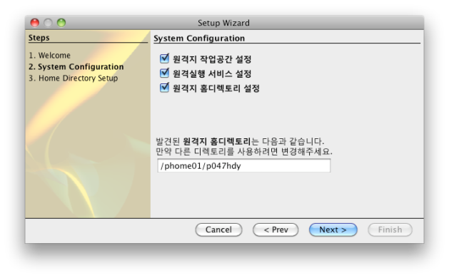
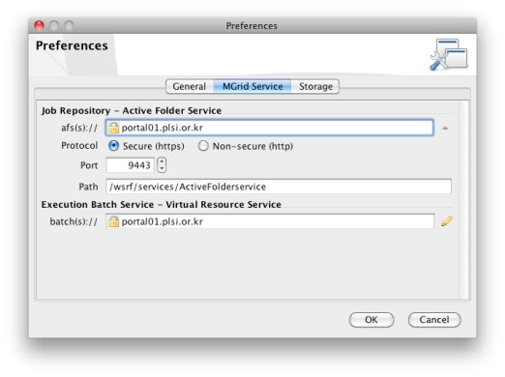
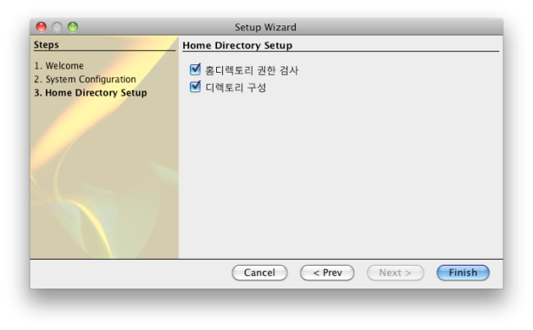
Improve #3. Automatic Tool Setup
Setup wizard
Manual ➔ Automatic
Set service’s URL
Check if services are running.
Retrieve and set path of user’s home

Slide 21
MGrid Tutorial
MGrid
Tutorial!

Slide 22
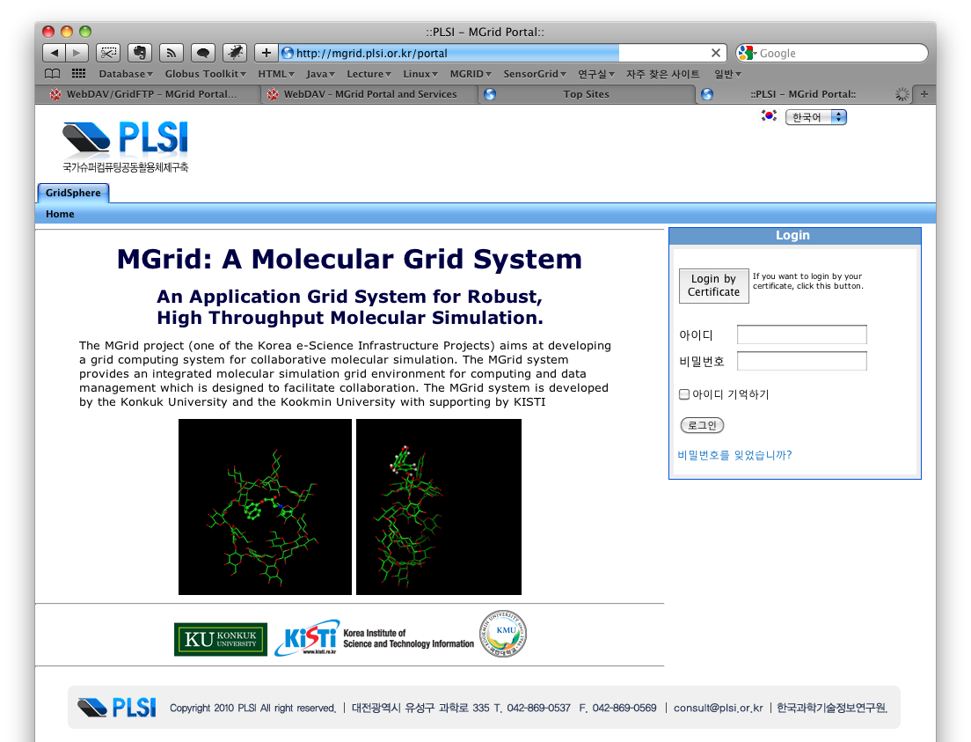
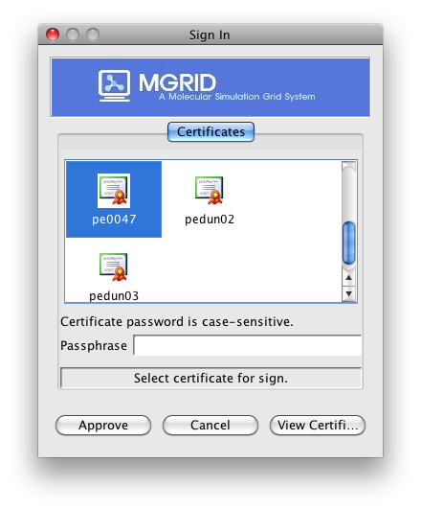
Step 1. Access MGrid-PLSI Portal
Visit http://mgrid.plsi.or.kr
Sign-in by ceritficate

Slide 23
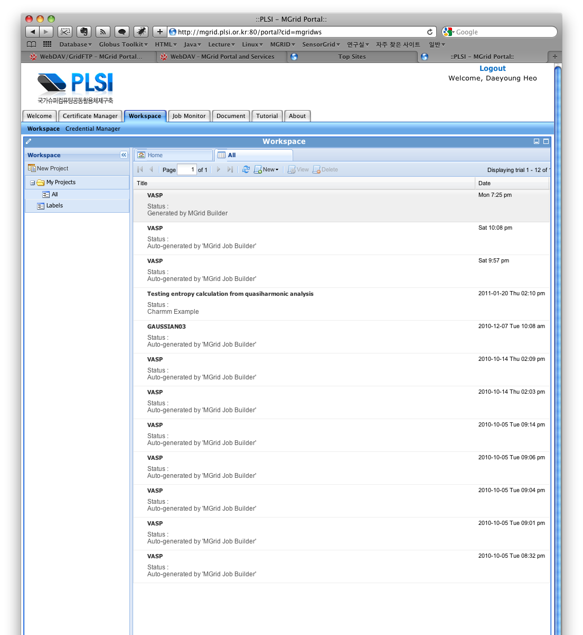
Step 3. Launch MGrid Builder
Move to ‘Workspace’ Tab
Click ‘New>MGrid Builder’ on the toolbar.

Slide 24
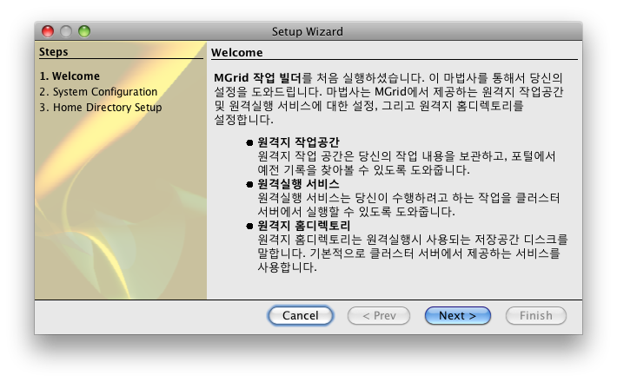
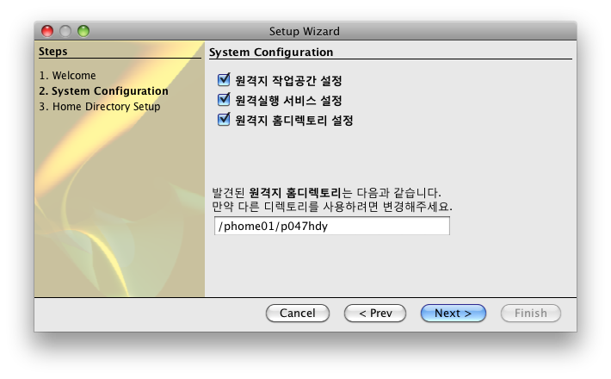
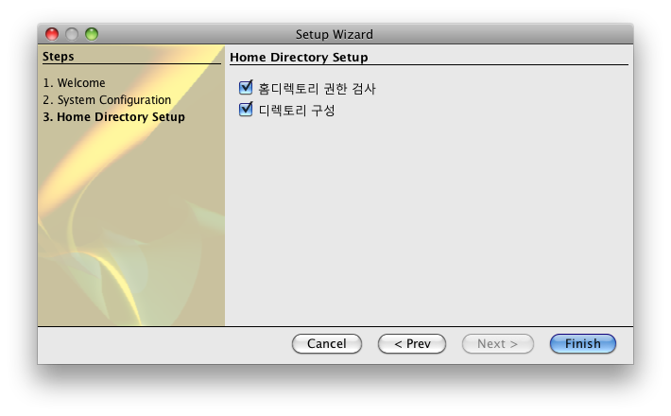
Step 4. Automatic setup wizard
Just click ‘Next’ and ‘Finish’

Slide 25
Step 5. Quick launching Menu
Click software on the menu.
VASP
GAUSSIAN (soon)
CHARMM (soon)
NAMD (soon)
AMBER (soon)
Or click ‘General’
General Job Builder.

Slide 26
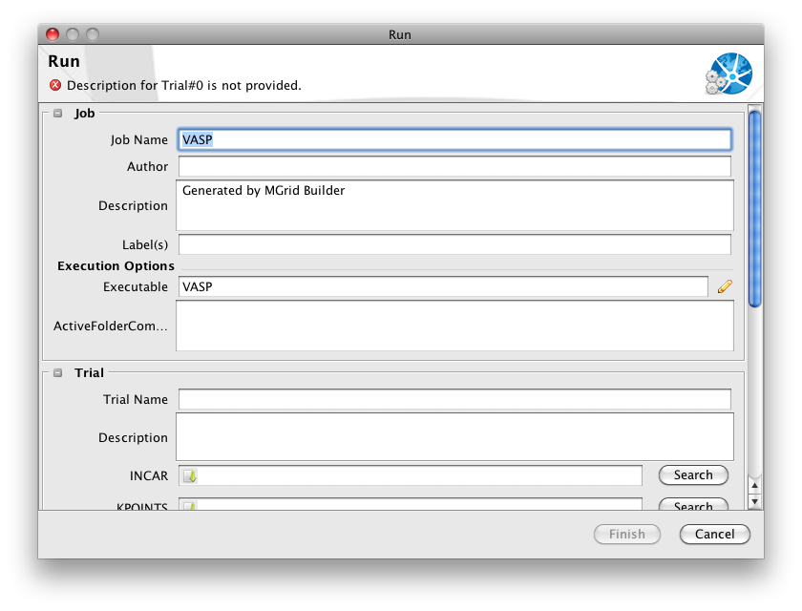
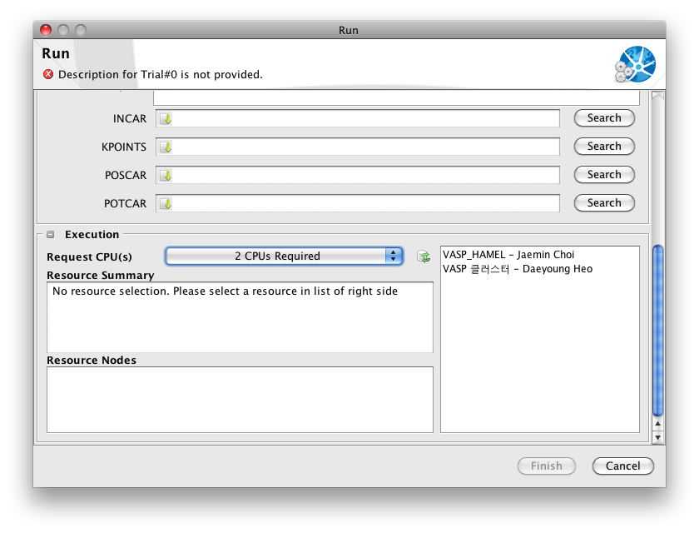
Step 6. Show ‘RUN’ wizard
These fields already
filled out.
Required fields
Trial Section
Trial Name
Description
Files
Execution Section
Scroll
down
Exploring
remote filesystem
Just click and than search.

Slide 27
MGrid DATA Management

Slide 28
Label(Tagging) or Project
Organize and Categorize jobs with label
All jobs belong to label “All”
Assign multiple labels to each jobs.

Slide 29

Job and Trial
It contains your input and result files
Two ways of organize your data
First way
Using only job.
Job is like ‘Folder’
.
Second way
Combination of job and trials.
Job can contains multiple trials

Slide 30
First way of organize data
Always create new job (“New>MGrid Builder”)

Slide 31
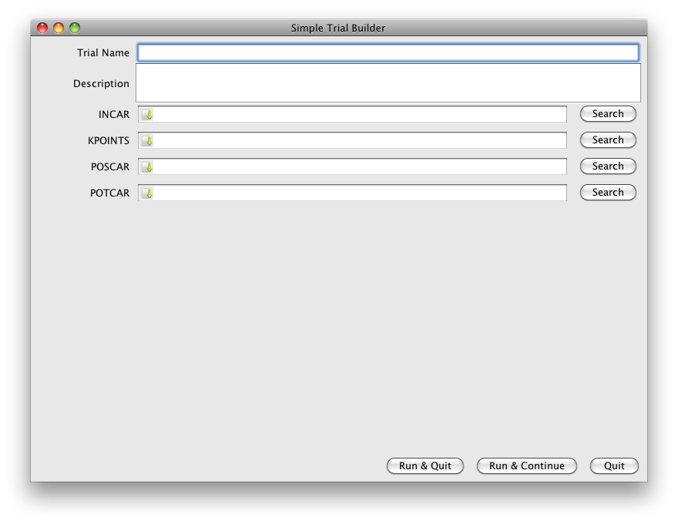
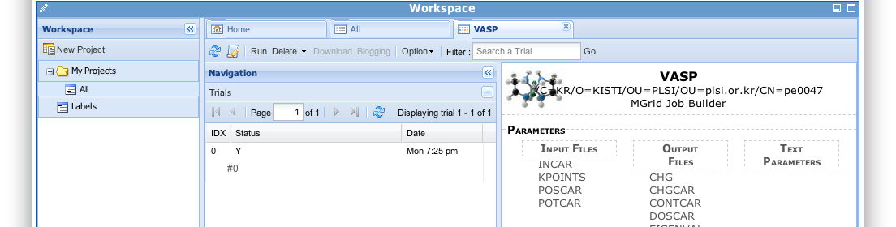
Second way of organize data
Using ‘Run Wizard’ with different parameters
Run Wizard

