Slide 1

Large-eddy simulation of flow and pollutant dispersion in urban street canyons under different thermal stratifications
W. C. Cheng and Chun-Ho Liu *
Department of Mechanical Engineering, The University of Hong Kong
Pokfulam Road, Hong Kong, China.
*Corresponding Author: liuchunho@graduate.hku.hk
3/3/2011

Slide 2
Content
Introduction
Methodology
Results and Discussions
Mean wind
Turbulence
Pollutant dispersion
Conclusions

Slide 3
Introduction
Urban street canyon is the canyon structure constructed by the buildings and streets geometry in urban area
Figure 1. Urban street canyon (Berkowicz 2000)

Slide 4
The air inside street canyon is mainly driven by (1) the shear force by the free stream wind and (2) the buoyancy due to heating by solar radiation
The relative contributions of buoyancy to the shear stress can be quantified by the dimensionless number Richardson number (Ri)
Keep the Reynolds number (Re) constant
Assume the flow and pollutant removal patterns are function of Ri only

Slide 5
Methodology
Large-eddy simulation (LES), one equation subgrid-scale (SGS) model for turbulent kinetic energy (TKE)
OpenFOAM 1.6
Wall function (Spalding 1962) for velocity
Boussinesq approximation for buoyancy
The simulations are performed in the HPCPOWER2 and GRIDPOINT Linux clusters of Computer Center of the University of Hong Kong

Slide 6
Computational Domain
Total number of mesh = 15 million
Finest grid near streets and buildings with height = 2.3×10⁻³h
5h
6h
5h
Free stream flow (U₀,θ₀)
h
b
w
Table 1. Number of element
Buildings and streets
Canyon | Shear-layer
100×200×100 | 450×200×100
heat source Θ
Figure 2. Computational domain

Slide 7
Re ∼10000
Rb = αgh(θ₀- Θ)/U_{f}²
5 sets of LESs with Rb = -0.11, -0.06, 0 , 0.18 and 0.35
The results are spatial and temporal averaged using 100s of data with 0.1s interval.

Slide 8
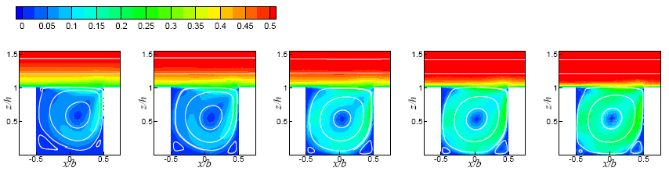
Results and Discussion
Wind contours and the comparison with wind tunnel experiment
Figure 3. Contour of mean velocity magnitude and streamlines in different thermal stabilities (a) Rb = 0.35, (b) Rb = 0.18, (c) Rb = 0, (d) Rb = -0.06 and (e) Rb = -0.11.
Figure 4. Vertical profiles of ⟨u⟩/U_{f} along the centerline of the street canyon.

Slide 9
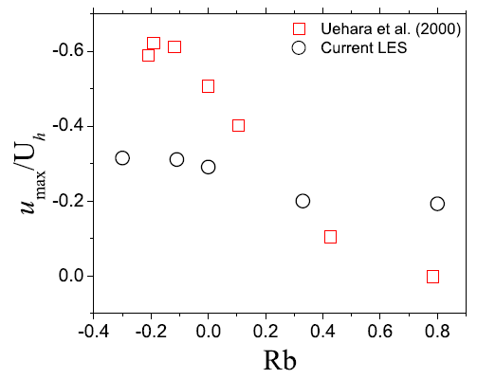
Maximum reverse wind speed and the locations
Table 2. Shift of the location of maximum reversespeed from the center of the street surface.
Rb | Locations (x/b, z/h)
0.35 | (0.126, 0.290)
0.18 | (0.095, 0.231)
0.00 | (0.027, 0.179)
-0.06 | (0.027, 0.179)
-0.11 | (0.027, 0.179)
Figure 5. Maximum reverse wind speed (u_{max}) in the street canyon. (a) Current LES and (b) Uehara et al. (2000).

Slide 10
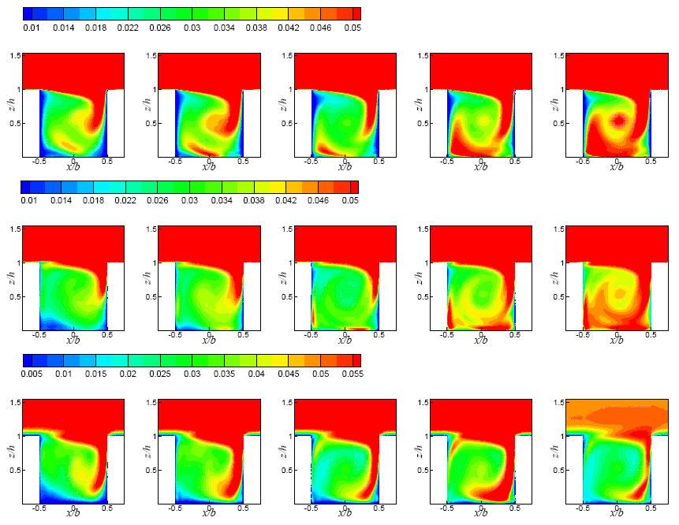
Streamwise, spanwise and vertical velocity variances
Figure 6. Contours of (i) ⟨u’u’⟩^{1/2}/U_{f}, (ii) ⟨v’v’⟩^{1/2}/U_{f} and (iii) ⟨w’w’⟩^{1/2}/U_{f} in different thermal stratifications: (a) Rb = 0.35, (b) Rb = 0.18, (c) Rb = 0, (d) Rb = -0.06 and (e) Rb = -0.11.

Slide 11
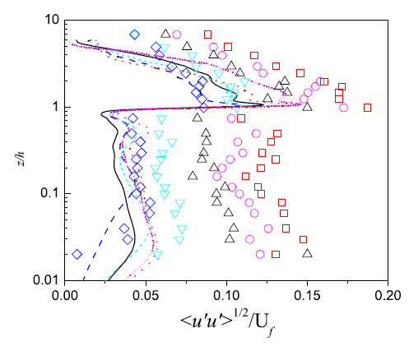
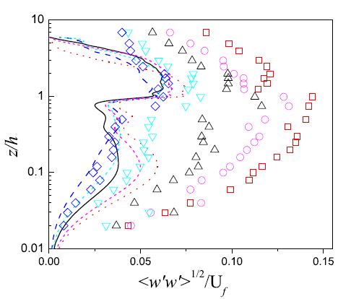
Velocity variances comparison
Figure 7. Vertical profiles of (a) ⟨u’u’⟩^{1/2}/U_{f} and (b) ⟨w’w’⟩^{1/2}/U_{f} along the centerline of the street canyon: (i) Current LES; (ii) Uehara et al. (2000). for the current LES results, Rb = 0.35: Deep blue dashed line, Rb = 0.18: Light blue dashed line, Rb = 0: Black solid line, Rb = -0.06: Pink short dotted line and Rb = -0.11: Red dotted line.

Slide 12
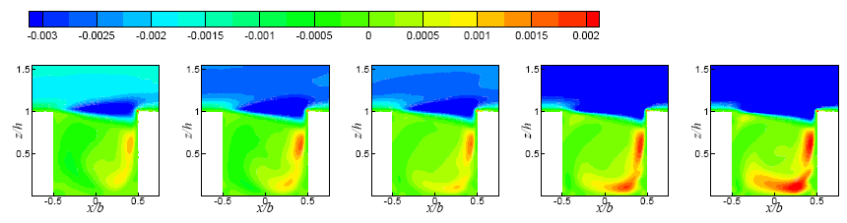
Shear stress contours
Figure 8. The contour ⟨u’w’⟩/U_{f}² in different thermal stabilities: (a) Rb = 0.35, (b) Rb = 0.18, (c) Rb =0, (d) Rb = -0.06 and (e) Rb =-0.11. For the current results, Rb = 0.35: Deep blue dashed line, Rb = 0.18: Light blue dashed line, Rb = 0: Black solid line, Rb = -0.06: Pink short dotted line and Rb = -0.11: Red dotted line.

Slide 13
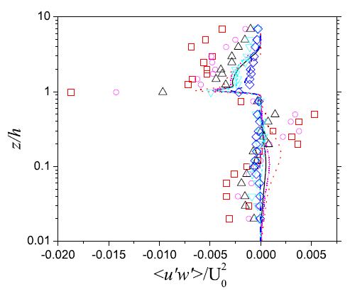
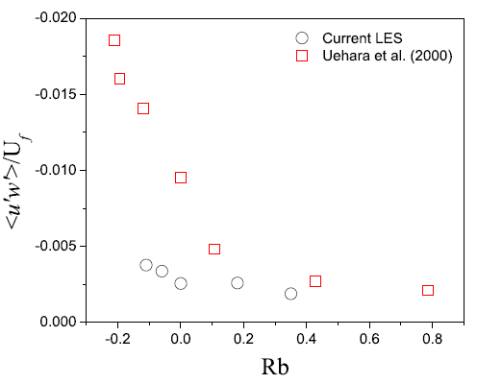
Shear stress comparison
Figure 9. Vertical profiles of ⟨u’w’⟩^{1/2}/U_{f} along the centerline of the street canyon: (i) Current LES; (ii) Uehara et al. (2000). For the current LES results, Rb = 0.35: Deep blue dashed line, Rb = 0.18: Light blue dashed line, Rb = 0: Black solid line, Rb = -0.06: Pink short dotted line and Rb = -0.11: Red dotted line.
Figure 10. Roof-level ⟨u’w’⟩/U_{f}² plotted against Rb. (a) Current LES and (b) Uehara et al. (2000).

Slide 14
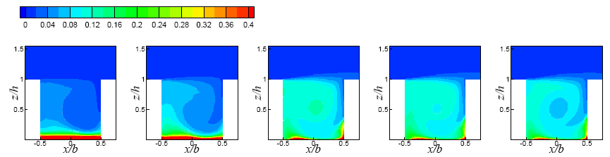
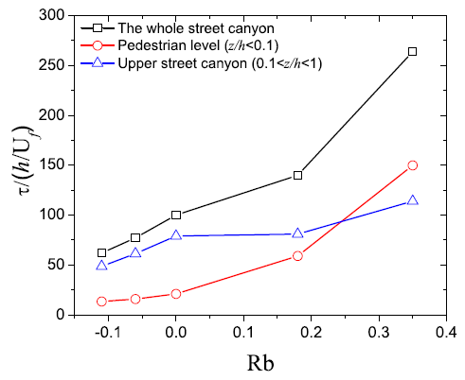
Pollutant concentration contours and the retention time
Figure 11. Contour of ⟨c⟩/C₀ in different thermal stabilities. (a) Rb = 0.35, (b) Rb = 0.18, (c) Rb = 0, (d) Rb = -0.06 and (e) Rb = -0.11.
Figure 12. Pollutant retention time ⟨τ⟩ plotted against Rb.

Slide 15
Conclusions
The flow patterns are similar for neutral and unstable results and changes in flow patterns are observed in stable conditions because of the strong depression of mean wind at the lower leeward corner
Turbulence generally increases with decreasing Rb except increases of TKE in the center region of street canyon is observed in stable conditions
The pollutant concentration show strong dependence on the thermal stratifications and serious accumulation of pollutant is observed in stable conditions

