Slide 1
High Throughput, Low Impedance e-Science on Microsoft Azure
Presenter:
Blair Bethwaite
Monash eScience and Grid Engineering Lab

Slide 2
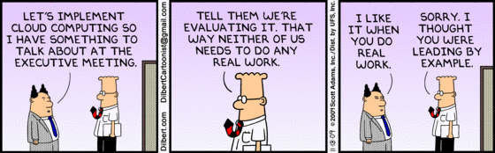
Acknowledgements
MeSsAGE Lab team:
Blair Bethwaite
Slavisa Garic
Notes:
Please ask questions during the talk if you have them.

Slide 3
Agenda
The Nimrod tool family
Integrating with IaaS and PaaS
Application drivers
Future directions
From Clusters, to Grids, to Clouds

Slide 4
The Nimrod tool family
Nimrod
Nimrod/G
Nimrod/O
Nimrod/E
Nimrod/K
cluster tool for parametric computing
extends Nimrod over the Grid
parameter space search through optimisation algorithms
experimental design and sensitivity analysis
scientific workflows with implicit parallelism

Slide 5
Parametric computing with the Nimrod tools
Vary parameters
Execute programs
Copy code/data in/out
X, Y, Z could be:
Basic data types; ints, floats, strings
Files
Random numbers to drive Monte Carlo modelling
X
Parameter
Space
Y
User Job
Solution
Space
Z
Notes:
Simple pleasingly-parallel computing for “legacy” (misnomer: just need existing app, Nimrod is the distributed glue that launches and contextualises each job) codes. On clusters, compute grids, and now clouds.
Also support computational economy via economic scheduling.

Slide 6
Parametric computing with the Nimrod tools - example
Example Nimrod/G experiment using the Monte-Carlo method
parameter run integer range from 1 to 1000 step 1;
parameter model files select anyof “*-model.xml”;
parameter model_seed float random from 0 to 1;
task nodestart
copy code_package.$OS.zip node:code_package.zip
endtask
task main
node:execute unzip code_package.zip
copy $model node:.
node:execute ./myapp –seed $model_seed –model $model
node:execute zip results.zip *.log output/
copy node:results.zip results/$model/results-$run.zip
endtask
Notes:
This to note here:
A sweep with these parameters will produce 1000 x #models jobs
The random parameter gives a different value for $model_seed in each job
The nodestart task stages the application code package in and uses the special $OS variable to get platform specific packages for the case of a heterogeneous testbed
For each parameter set the main task unpacks the code, copies in the model file, runs the app from the code package with Nimrod provided parameters, packs up the output (assume the app creates the output/ sub-folder) and copies it back to a sub-dir on the Nimrod server.

Slide 7
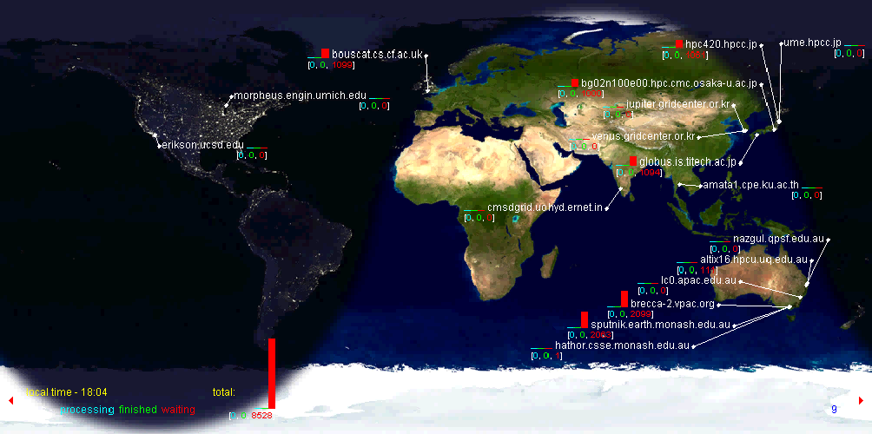
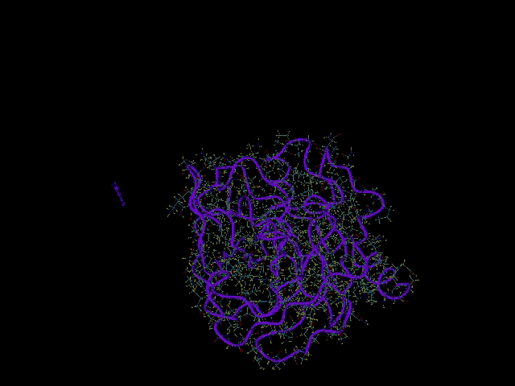
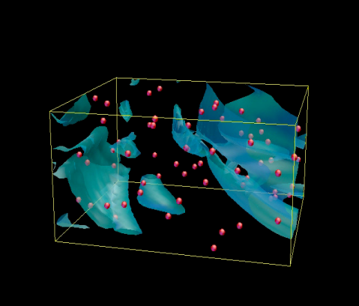
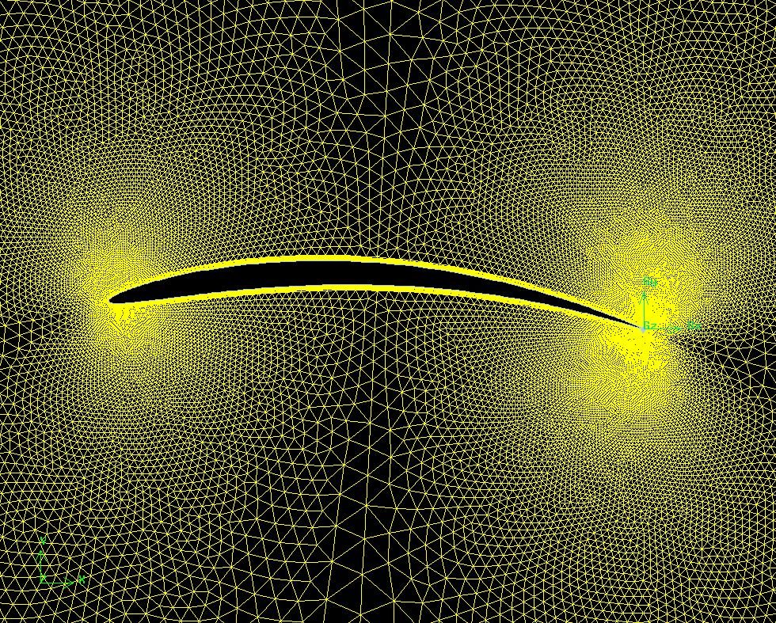
Nimrod Applications
messagelab.monash.edu.au/EScienceApplications
Notes:
Molecular docking in drug design
Engineering antennae for maximum gain
Airfoil optimising LD ratio

Slide 8
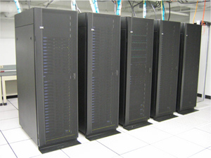
From Clusters, to Grids, to Clouds
Jobs / Nimrod experiment
Nimrod
Actuator, e.g., SGE, PBS, LSF, Condor
Local Batch System
Notes:
Original Nimrod acted as the cluster management system, commercial spin-off to Enfuzion.

Slide 9
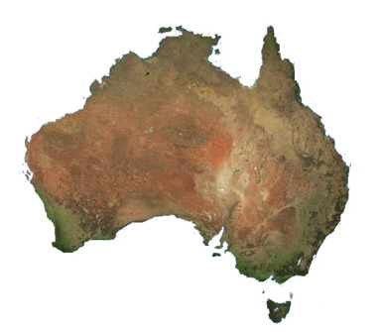
From Clusters, to Grids, to Clouds
Portal
Jobs / Nimrod experiment
Nimrod-O/E/K
Nimrod/G
Actuator, e.g., Globus
Servers
Upper middleware
Lower middleware
Pilot jobs / agents
Grid Middleware
Grid Middleware
Agents
Grid Middleware
Agents
Grid Middleware
Notes:
Nimrod/G – “G” originally stood for Globus but now more general supporting other lower level middleware, such as Condor.

Slide 10
From Clusters, to Grids, to Clouds
The Grid
Global utility computing mk.1
Somewhere in-between Infrastructure and Platform as-a-Service
For Nimrod
Increased computational scale – massively parallel
New scheduling and data challenges
Computational economy proposed
Move to a pilot-job model
Improved throughput
Supports meta-scheduling
Provide consistent interface to various middleware
Problems
Interoperability
Barriers to entry

Slide 11

From Clusters, to Grids, to Clouds
On demand
Self service
Pay as you go
Notes:
Then AWS came along... suddenly public utility computing became a reality
On demand: start and stop machines or services any time, with a lead time of minutes.
Self service: no lengthy email trail with your data centre admin, just make a web service call.
PAYG: pay for what you use, tear it down when not needed.
Think of it as a computational vending machine.

Slide 12
From Clusters, to Grids, to Clouds
Cloud opportunities for HTC
Virtualisation improves interoperability and scalability
Build once, run everywhere
Cloud bursting
Scale-out to supplement locally and nationally available resources
Computational economy, for real
Deadline driven
“I need this finished by Monday morning!”
Budget driven
“Here’s my credit card, do this as quickly and cheaply as possible.”

Slide 13
From Clusters, to Grids, to Clouds
But, the Cloud is an amorphous target
Cloud (noun):
A popular label for any technology delivered over the Internet
For the vendor; whatever the customer wants it to be!
IaaS is great but needs some scaffolding to use as a HTC platform
Grids provide useful services above IaaS
E.g., you can build a grid on or into EC2
Grids provide job and data handling
Like a PaaS where the platform is a command shell

Slide 14
Integrating Nimrod with IaaS
Portal
Jobs / Nimrod experiment
Nimrod-O/E/K
Nimrod/G
Actuator: Globus,...
Services
New actuators: EC2, Azure, IBM, OCCI?,...?
RESTful IaaS API
VM
Grid Middleware
Agents
Agents
VM
VM
Agents
Agents

Slide 15
Integrating Nimrod with IaaS
(+) Nimrod is already a meta-scheduler
Creates an ad-hoc grid dynamically overlaying the available resource pool
Don’t need all the Grid bells and whistles to stand-up a resource pool under Nimrod, just need to launch our code
(-) Requires explicit management of infrastructure
(-) Extra level of scheduling – when to initialise infrastructure?
Notes:
Actuator model makes this integration relatively painless compared to an app highly dependent on higher Grid middleware functions.

Slide 16
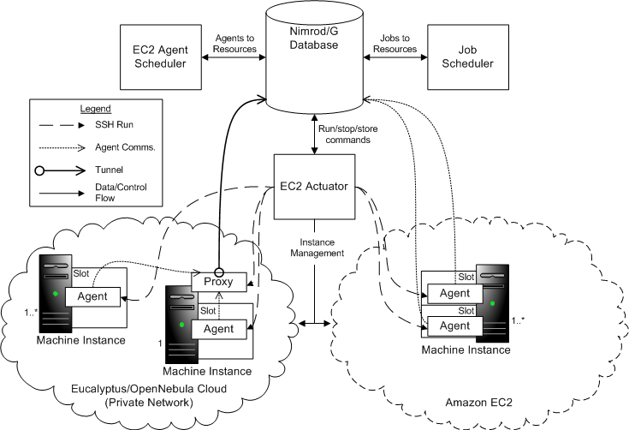
Integrating Nimrod with IaaS
2
1
3

Slide 17
Integrating Nimrod with PaaS
PaaS is trickier...
More variety (broader layer of the cloud stack), e.g., contrast Azure and AppEngine
Typically designed with web-app hosting in mind...
...but Nimrod tries to provide a generic execution framework
Higher level PaaS offerings are too prescriptive to work with Nimrod’s current model (i.e., user code is a black box for Nimrod)
AppEngine: Python and Java only (plus fine print)
Beanstalk: currently Java only
Trades-off generality (typically of the application platform or runtime) for implicit scalability
Notes:
AppEngine is referring to Google App Engine
Beanstalk is referring to Amazon Elastic Beanstalk, which is a fairly new PaaS offering from Amazon – it manages infrastructure for you (within your configured parameters) and hosts the service you give it targeted for particular Web Application Containers (e.g. Tomcat)

Slide 18
Integrating Nimrod with Azure
What about Azure?
Fortunately, Azure is flexible...
Provides a .NET app-hosting environment but has been built with legacy apps in mind
The Azure Worker Role essentially provides a Windows Server ‘08 VM with a .NET entry point
Nimrod-Azure mk.1
Can we treat Azure like a Windows IaaS and use it alongside other Cloud and Grid resources?
Yes! Well, more-or-less, need to define a basic Nimrod Worker Azure service and accept a few caveats...

Slide 19
Integrating Nimrod with Azure
Nimrod-Azure mk.1, the details...
The Nimrod server (currently) runs on a Linux box external to Azure
The Nimrod-Azure actuator module contains the code for getting Nimrod agents (pilot-job containers) started in Azure
This includes a pre-defined minimal NimrodWorkerService cspkg;
and, a lib (PyAzure) for speaking XML over HTTP with the Azure Storage and Management REST APIs
Notes:
cspkg = Azure term for Cloud Service Package – contains code, service definition file (csdef), and can include (static) dependencies
cscfg = Azure term for Cloud Service Configuration – defines dynamic service configuration, e.g., setting values, # of role instances

Slide 20
Integrating Nimrod with Azure
To stand-up an Azure compute resource under Nimrod, the actuator:
Copies the Nimrod agent package and encryption keys to an Azure Blob
Adds command line parameters for agents to an Azure Queue
Builds an initial cscfg for the deployment including relevant blob and queue URLs
Deploys the service to the Cloud
Notes:
cspkg = Azure term for Cloud Service Package – contains code, service definition file (csdef), and can include (static) dependencies
cscfg = Azure term for Cloud Service Configuration – defines dynamic service configuration, e.g., setting values, # of role instances

Slide 21
Integrating Nimrod with Azure
Azure
Blob
Blob
Blob
Queue
Agent
Create
cspkg
Azure Actuator
Nimrod Experiment
Nimrod Server

Slide 22
Integrating Nimrod with Azure
Once deployed, the NimrodWorkerService:
Pulls the Nimrod agent package from blobs referenced in cscfg settings
Unpacks and launches the agent with parameters from the queue referenced by cscfg
The agent connects out to the Nimrod server, pulling work and pushing results until: no work left, lifetime ends, exception
But, when the agent exits there is no way to de-provision the role instance... scaling without de-scaling?! An Azure ‘quirk’...

Slide 23
Integrating Nimrod with Azure
Azure
Blob
Blob
Worker
Worker
Workers
Worker
Worker
Agent
User app/s
Queue
Agent params
Deploy
Azure Actuator
Nimrod Server

Slide 24
Application Drivers
Cloud computing might be fashionable but there’s little point using it unless you have applications that can benefit and provide a litmus test
Markov Chain Monte Carlo methods
completed with EC2
Ash dispersion modelling
Pt.1 (NG-Tephra) completed with EC2
Pt.2 (Ceniza) to run on Azure
Energy economics of DG technology
to run on Azure

Slide 25
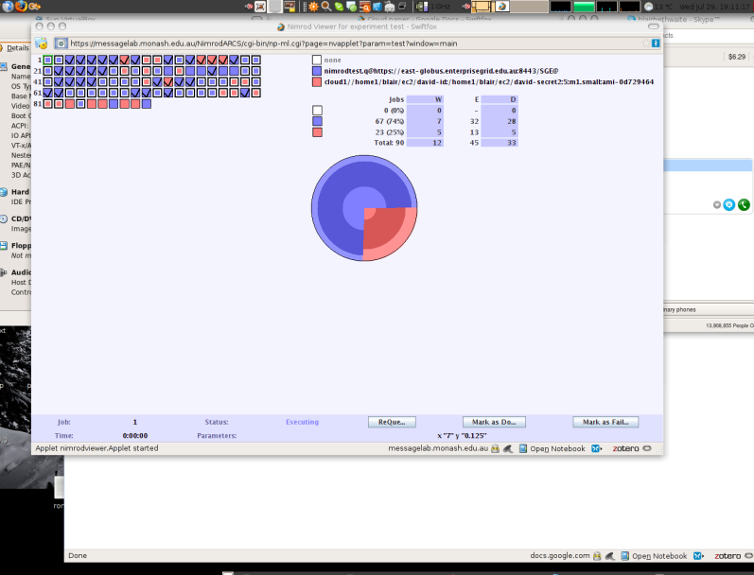
Application Drivers
A lot of existing grid based infrastructure
So, mix it together
“Mixing Grids and Clouds: High-Throughput Science Using the Nimrod Tool Family,” in Cloud Computing, vol. 0 (Springer London, 2010)
Markov Chain Monte Carlo methods for recommender systems
For better results, insert coins here...
Notes:
Clouds provide an interesting infrastructure to supplement the usual resources available for academic computing.
You can pay to get your results faster, or make them higher quality.

Slide 26
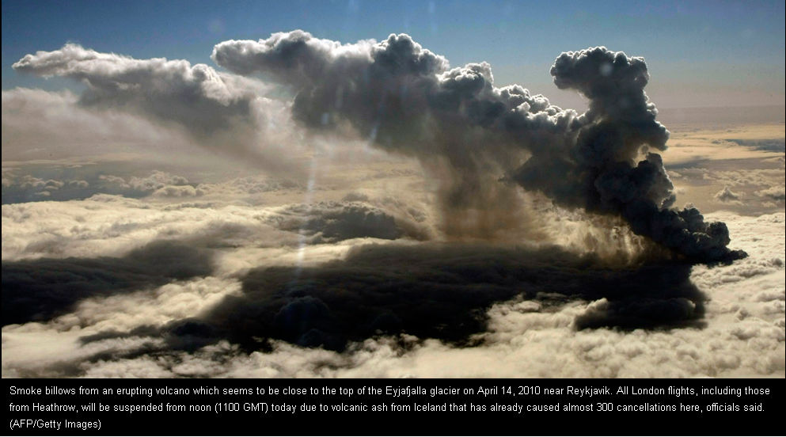
Application Drivers
NG-TEPHRA & Ceniza
Modelling volcanic ash (tephra) dispersion
Supplement local infrastructure for deadline sensitive analysis
Notes:
Probabilistic spatial and density distribution mapping of volcanic tephra, potentially useful in time sensitive scenarios, i.e., immediately preceding or following an eruption event.
Collaboration with Nunez et al., ITCR

Slide 27
Application Drivers
iGrid
Investigate potential of distributed generation (DG) technology in the context of the National Energy Market (NEM)
For different scenarios, e.g., business as usual (BAU), carbon pollution reduction scheme (CPRS) targeting 15% or 25% below 2000 level emissions, what is the:
Effect on emissions intensity?
Effect on wholesale price?
Effect on demand?
With and without DG.
Notes:
Collaboration with Wagner et al., UoQ.

Slide 28
Application Drivers
iGrid
UQ colleagues have modelled the NEM using PLEXOS for Power SystemsTM
PLEXOS is used by energy generators and market regulators worldwide
PLEXOS is .NET application – uncommon in the high-throughput computing domain
Very few Windows compute resources available (none on the Australian Grid)
Highly combinatorial model requires hundreds of thousands of CPU hours for relevant results
Cloud to the rescue!

Slide 29
Future Directions
Provide blob storage caching on Nimrod copy commands
Nimrod can cache data in the Cloud and avoid unnecessary ingress/egress for common data
Port Nimrod server into the Cloud

Slide 30

Thank you!
Presentation by:
Blair Bethwaite
Feedback/queries:
blair.bethwaite@monash.edu

