Slide 1
A Google Cloud Technology-based Sensor Data Management System for KLEON
Karpjoo Jeong (jeongk@konkuk.ac.kr)
Institute for Ubiquitous Information Technology and Applications
Konkuk University

Slide 2
Motivation: Why
Ecologists’ Mixed Feeling about IT
Indispensable to keep competitiveness
But difficult to understand
More difficult to make running
Even more difficult to make stable
Moreover, expensive to build
But often more expensive to scale up

Slide 3
KLEON
KLEON: Korea Lake Ecological Observatory Network
Korean Implementation of the GLEON model
led by Prof. Bomchul Kim at Kwangwon National University
Intended to use the GLEON technology as much as possible
Focused on automatic real time monitoring
Requirement for a number of lakes and reservoirs in Korea

Slide 4
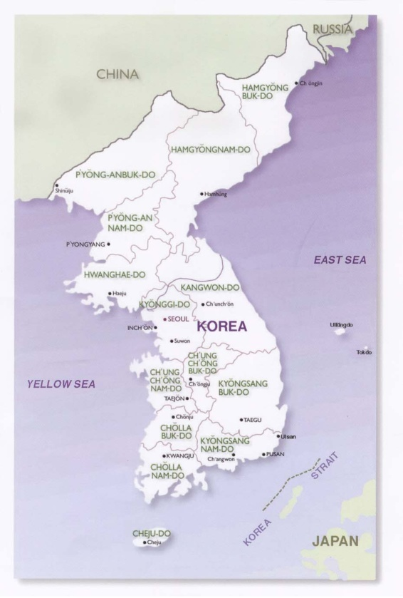
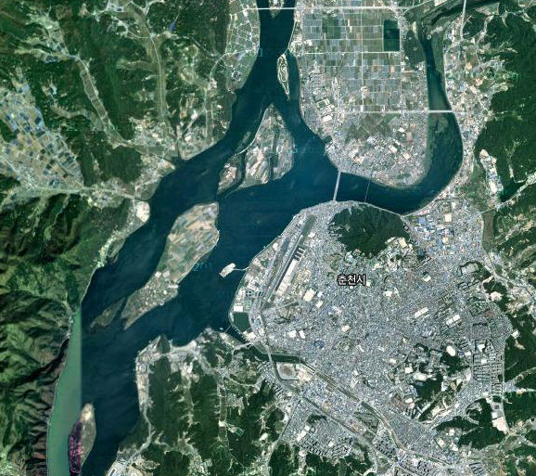
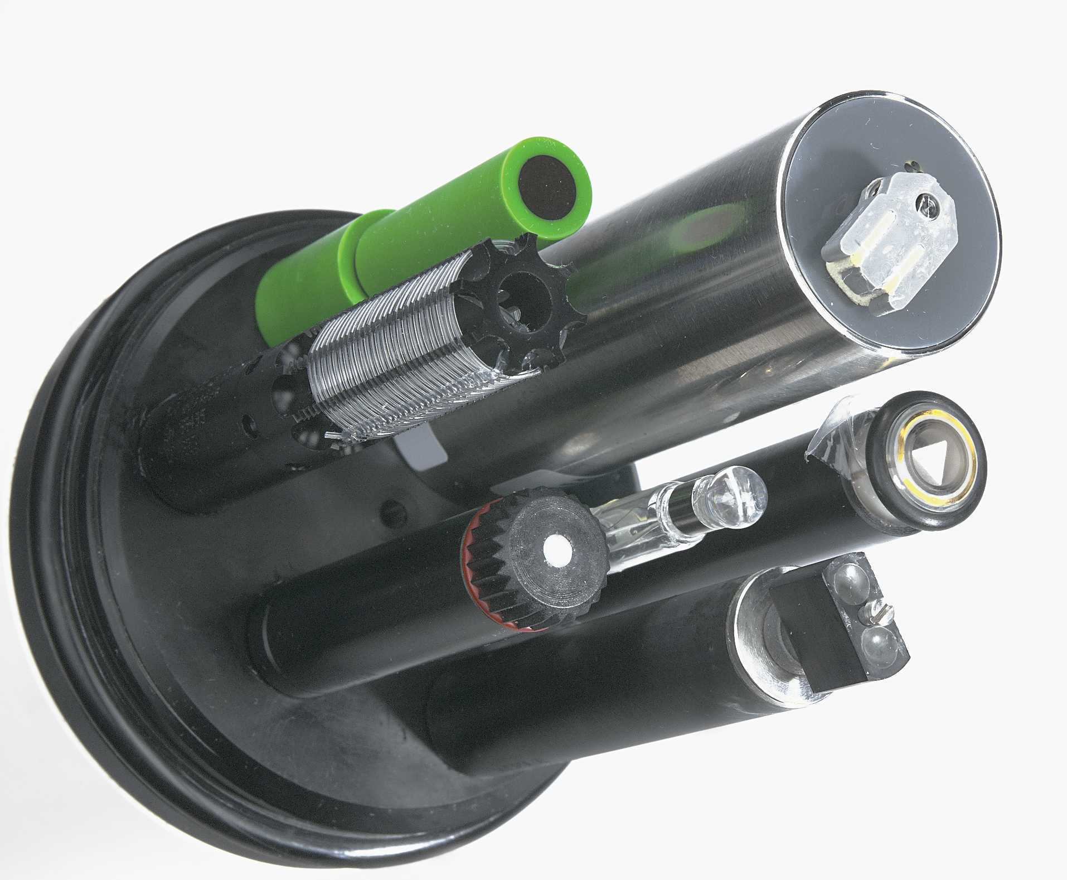

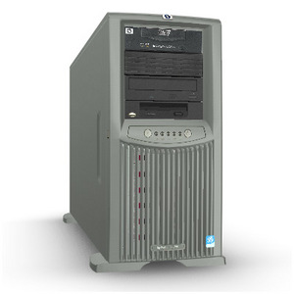
KLEON Monitoring Infrastructure
To be expanded
for national scale
M2M Service
(CDMA)

Slide 5
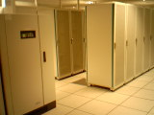

Major Challenging Tasks for Ecologists
Custom-built
Communication H/W
Management
Communication S/W
Maintenance
Server
Administration
Lake
Computer with Internet Access
Data Management
Server
Need to Free ecologists from Information Technology
as much as possible !

Slide 6
Our Approach
Free ecologists from IT as much as possible !!
Commercial M2M (Machine-To-Machine) service for Custom-built Communication System for lakes
Provided by SK Telecom
DataTurbine for Data Distribution (S/W communication system)
Cloud Service for Sensor Data Management

Slide 7


Goal: IT Infrastructure “Invisible” to Ecologists
IT Collaborators
Google
SK Telecom
DataTurbine
Server
Soyang Lake
M2M Service
M2M Modem
Google App Engine
Ecologists

Slide 8
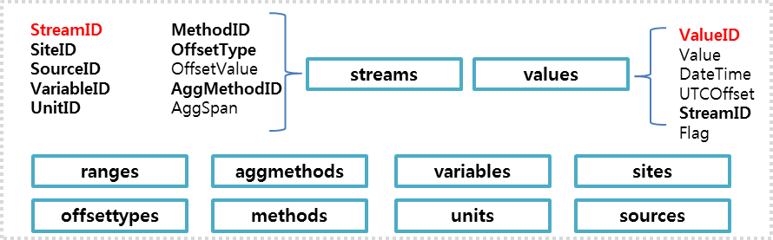
Google Cloud Technology-based Sensor Data Management System
Implement the GLEON Vega Data Model by using Google App Engine (GAE)
Integrate this into our M2M based monitoring system
Both GAE and Vega Data Models are similar and general enough for a variety of sensors

Slide 9
Google App Engine (GAE)
Virtual application-hosting environment
Python & Java
Scalable Database System: DataDatastore
Key-Property-Value Data Model
Scalable Infrastructure
Same infrastructure that Google applications use
Web Based Admin Console
Upload GAE applications
Monitor execution

Slide 10
Google App Engine
req/resp
stateless APIs
R/O FS
urlfech
Python
VM
process
stdlib
mail
app
images
datastore
stateful
APIs
memcache

Slide 11
Google App Engine
Advantages
Easy to start, little administration
Scale automatically
Reliable
Integrate with Google user service: get user nickname, request login…
Cost
Can set daily quota
CPU hour: 1.2 GHz Intel x86 processor
Resource | Unit | Unit cost | Free (daily)
Outgoing Bandwidth | gigabytes | $0.12 | 10GB
Incoming Bandwidth | gigabytes | $0.10 | 10GB
CPU Time | CPU hours | $0.10 | 46 hours
Stored Data | gigabytes per month | $0.15 | 1GB (all)
Notes:
Outgoing bandwidth: 1 GB with 56 MB/minute max
Incoming bandwidth: 1GB with 56 MB/minute max
Store data: 500mb
6.5 CPU hours with 15 CPU minutes/minute max

Slide 12
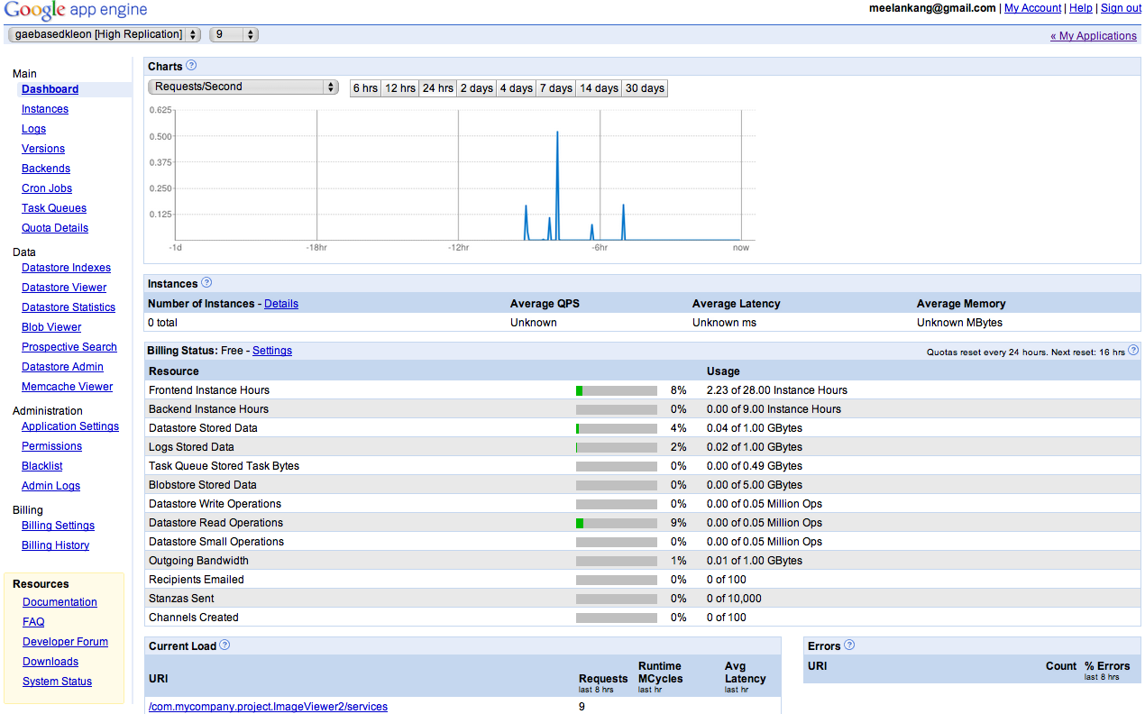
Web-based Admin Console

Slide 13
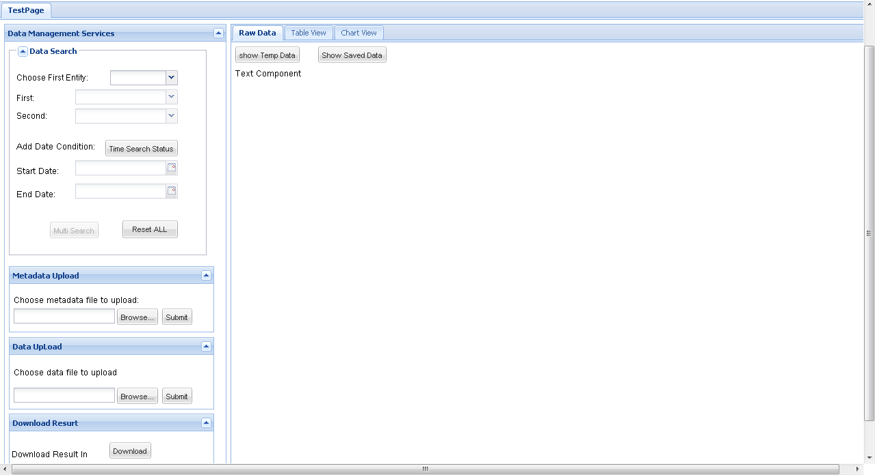
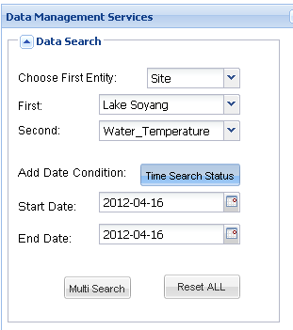
GAE-based Sensor Data Management System

Slide 14
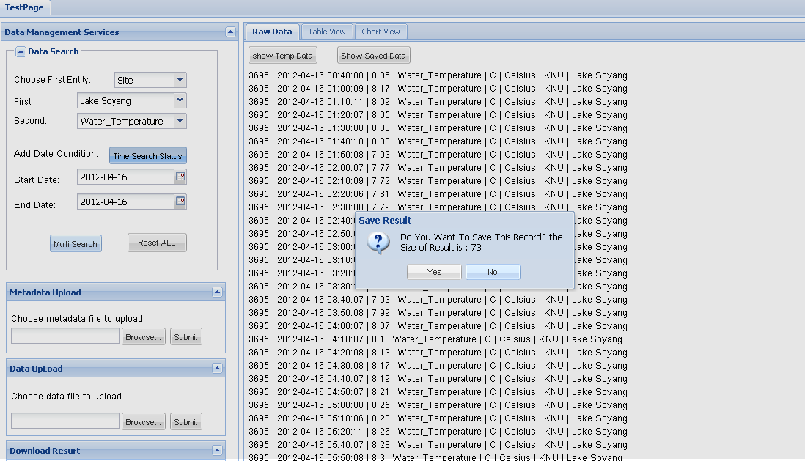
Data Search

Slide 15
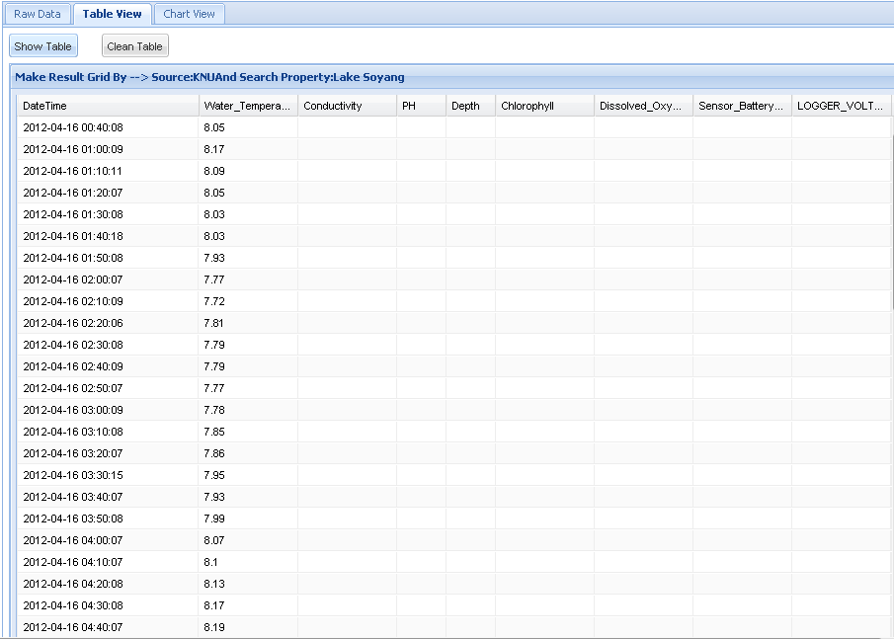

Slide 16
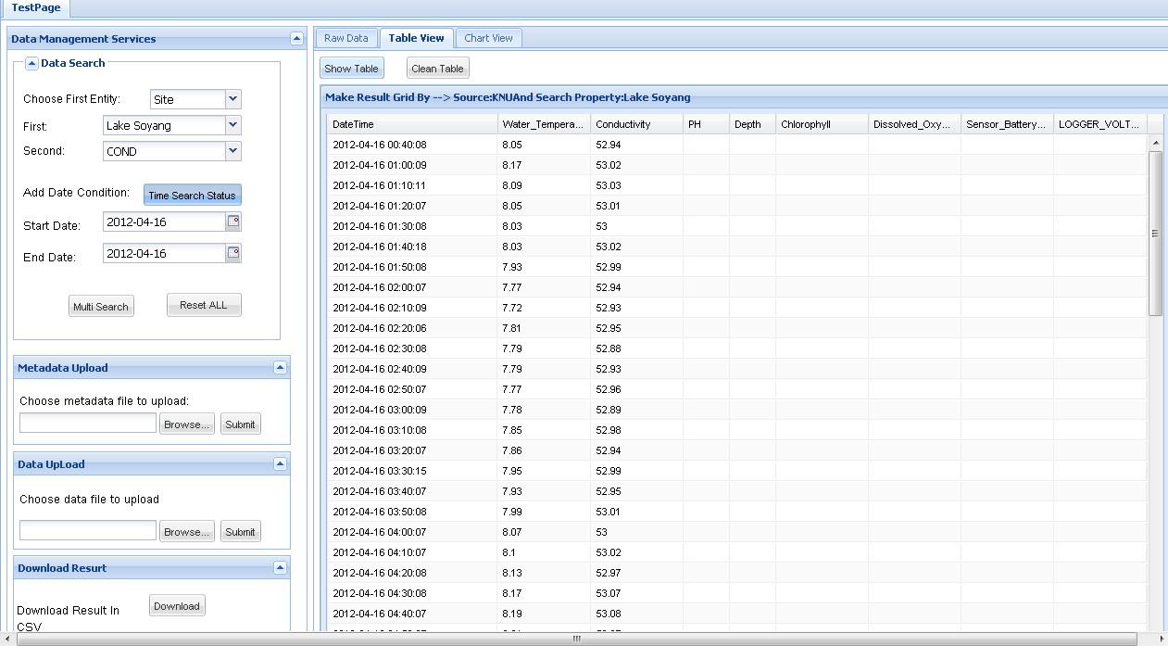

Slide 17
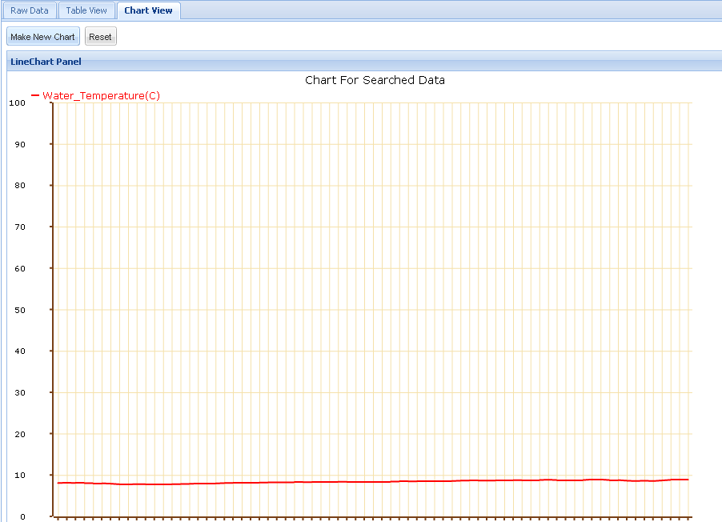

Slide 18
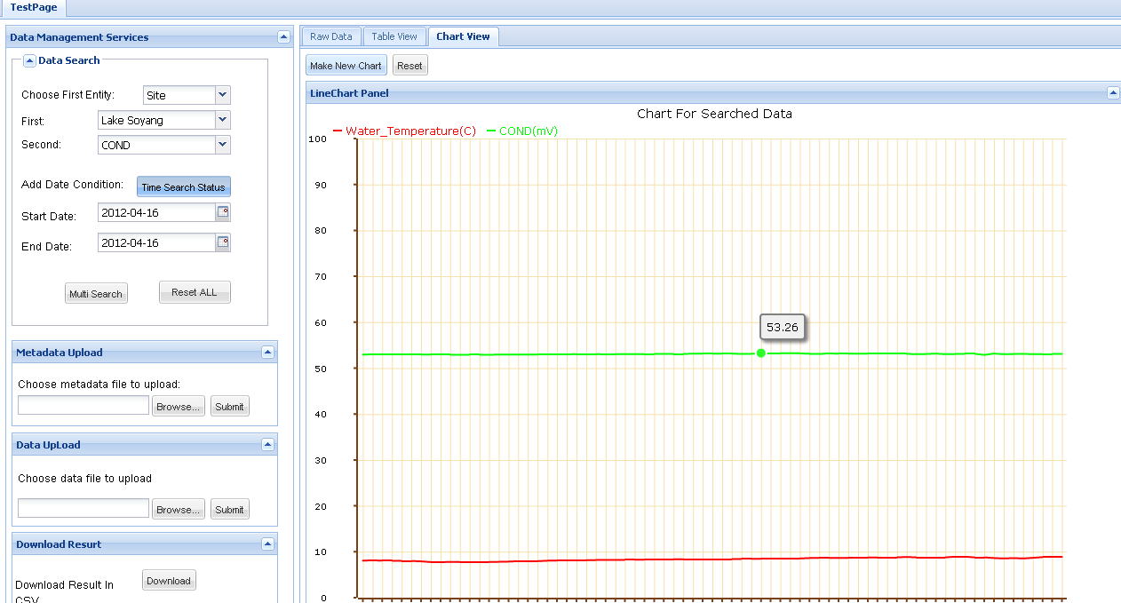

Slide 19
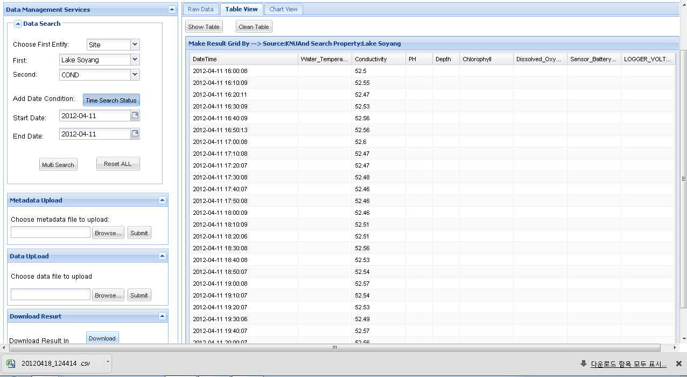
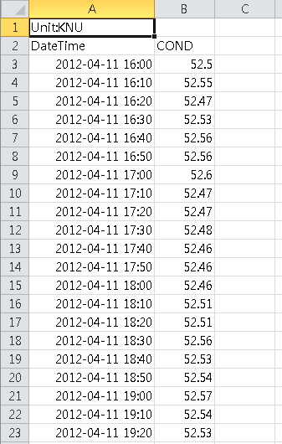

Slide 20
Discussions
Easy to develop, deploy and monitor
The current implementation is done by an undergraduate student for two month
Good tools available from Google such as GWT (Google Web Toolkits).
A very very small cost for each operation, but sequential processing could be really expensive !!
Risks
Cost in the future
Data ownership

