Slide 1
PRAGMA21 – PRAGMA 22 Collaborative Activities
Resources Working Group

Slide 2
Work set at PRAGMA 21
Expand PRAGMA Cloud and VM deployment
3 more sites deploy Gfarm and scripts
CNIC, IU, Osaka, LZU
Virtualization software development
Enable remote boot at NCHC
Boot multi VMs by a single script run (by PRAGMA 22)
More images
Other WGs (BIO)
Run MPI applications on our sites and EC2 (by PRAGMA 22)
Network overlay w/ GEO Grid VM
Osaka/NICT, UCSD, AIST
OpenFlow
What are needed in practical?

Slide 3

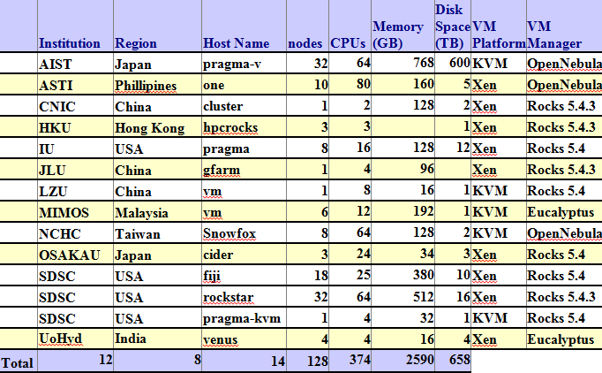
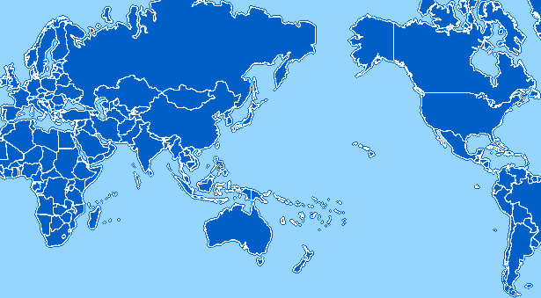
PRAGMA Grid/Clouds
UZH
Switzerland
UZH
Switzerland
CNIC
China
JLU
China
AIST
OsakaU
UTsukuba
Japan
KISTI
KMU
Korea
IndianaU
USA
LZU
China
SDSC
USA
LZU
China
ASGC
NCHC
Taiwan
HKU
HongKong
UoHyd
India
ASTI
Philippines
NECTEC
KU
Thailand
CeNAT-ITCR
Costa Rica
HCMUT
HUT
IOIT-Hanoi
IOIT-HCM
Vietnam
MIMOS
USM
Malaysia
UValle
Colombia
MU
Australia
BESTGrid
New Zealand
UChile
Chile
26 institutions in 17 countries/regions, 23 compute sites, 10VM sites

Slide 4
Accomplishments
Expanded PRAGMA Cloud and VM deployment
2 new cloud site – JLU, HKU
6 more sites deploy Gfarm and scripts
CNIC, IU, Osaka, LZU, JLU, HKU
SC11 demo AIST VM application on 7 sites
AIST, SDSC, NCHC, CNIC, IU, JLU, Osaka
Virtualization software development
On Rocks/Xen platform by SDSC:
Boot multiple VMs by a single script run
Boot local VM images with auto deploy script
On WebOS by NCHC:
Ezilla (VM image creator)
See demo today
On OpenNebula by AIST:
Boot multiple VMs by a single script run
Will be available on PRAGMA GOC Wiki soon.
More images
Bio application VM image – Nadya has mde it. See demo today.
Network overlay w/ GEO Grid VM
Setup Openvswitch network among 3 sites: Osaka/NICT, UCSD, AIST
Openswitch controller – Osaka
Tested with AIST Geogrid application VM
Deployed and run on all 3 sites. See demo today.

Slide 5
Openflow network environment
Virtual network slice A
VM
VM
VM
VM
VM
VM
VM
VM
Virtual network slice B
VM
VM
VM
VM
VM
GRE
VM
AIST
Open vSwitch
VM
VM
Open vSwitch
Open vSwitch
VM
GRE
VM
Open vSwitch
GRE
VM
GRE
UCSD
Open vSwitch
GRE
VM
VM
Open vSwitch
Open vSwitch
VM
GRE
VM
Openflow Controller Trema (Sliceable routing switch)
Open vSwitch
Open vSwitch
Osaka Univ.
Openflow network
VM

