Slide 1

The Atlas of Living Australia
Demo

Slide 2
Load 1. dashboard.ala.org.au 2. spatial.ala.org.au 3. spatial.ala.org.au/layers (all)
1

Slide 3
Add to Map | Species Elapidae (cobras) Opacity – Size Facet species Click on point
2

Slide 4
Add to Map | Areas Polygon Area report EE: Bio15 (precip seasonality) 20-22 Bio05 (temp warm period) 25-27
3

Slide 5
Add to Map | Layers Show spatial.ala.org.au/layers Distance to PERManent water Opacity Hover tool
4

Slide 6
Add to Map | Facet Lifeform = Fungi Facet on Collection
5

Slide 7
Tools | Scatterplot Tasmanian extent Eucalyptus gunnii (cider gum) Eucalyptus amygdalina (black peppermint) Bio01 vs Bio12 Select SE point Facet on bioregion
6

Slide 8
Tools | Tabulate States and Territories VS Collaborative Australian Protected Areas Database Species% 6.2% of the species in all Oz reserves occur in wilderness in NSW
7

Slide 9
Tools | Classify Tasmania Best 5 50 groups
8

Slide 10
Tools | Predict Tasmania Tasmanian Devil Best 5
9

Slide 11
Import | Points Demo_points.csv Facet
10

Slide 12
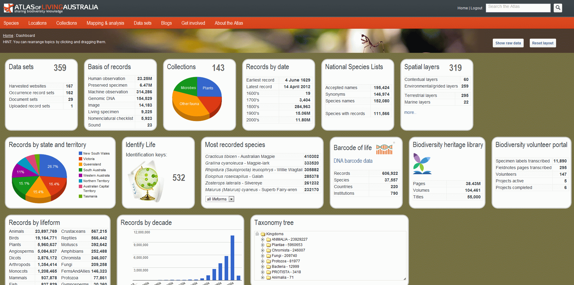

Slide 13
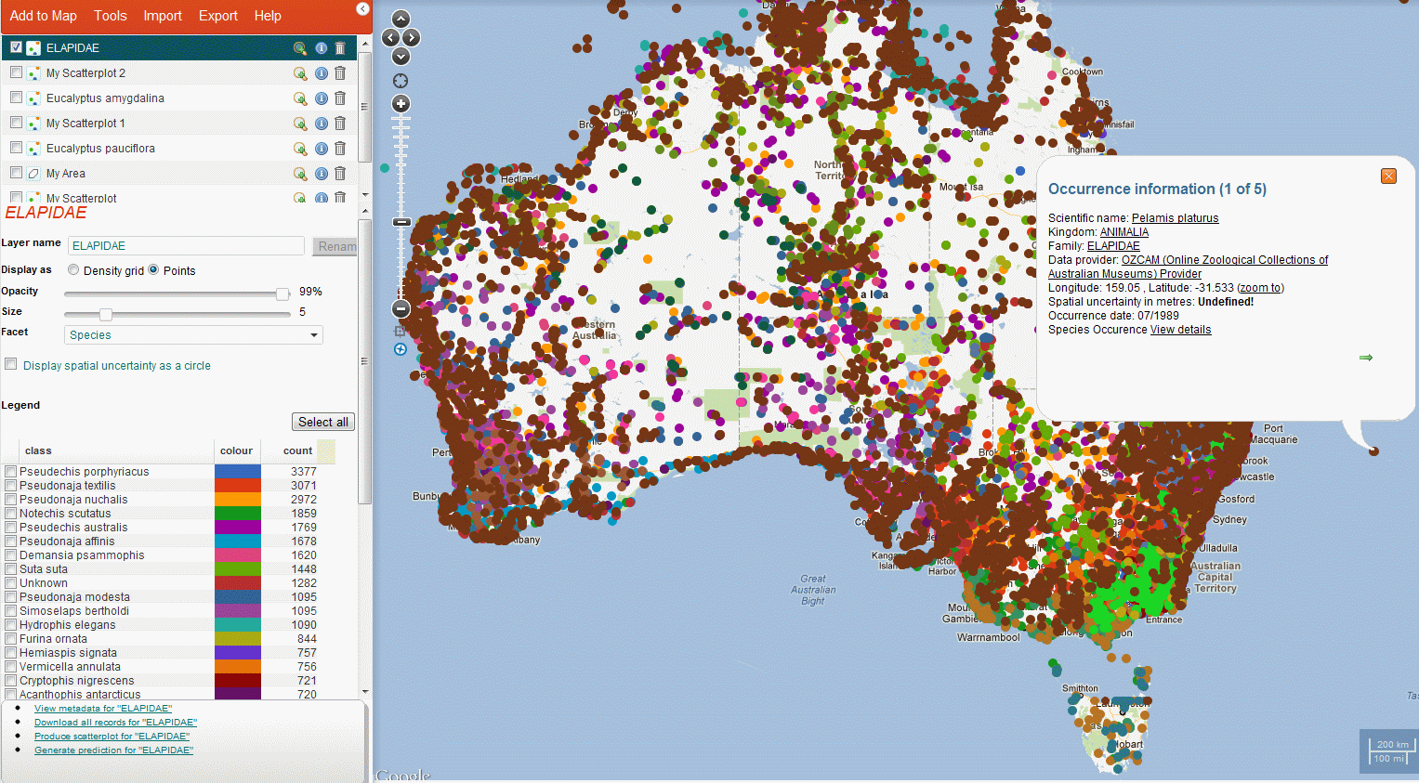

Slide 14
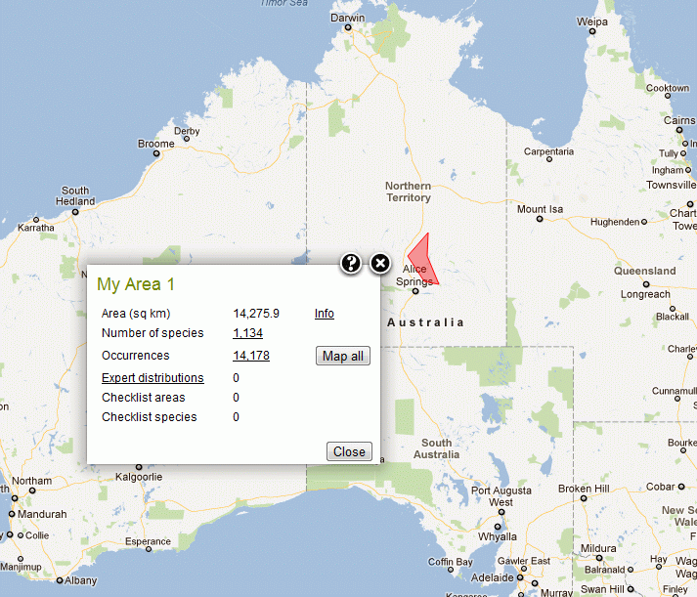

Slide 15
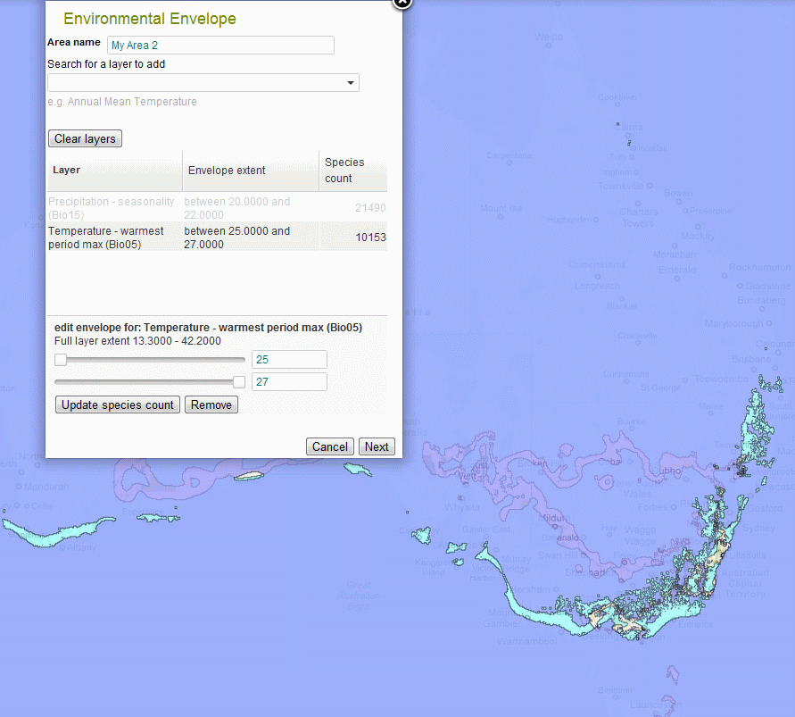

Slide 16
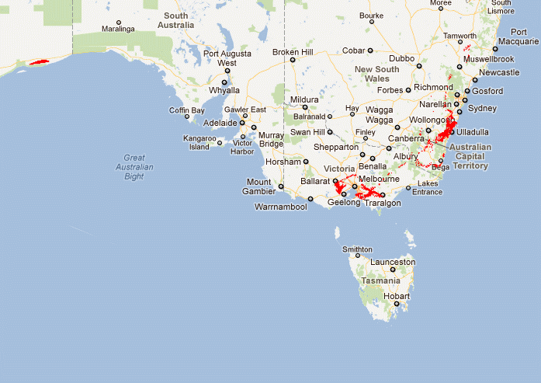

Slide 17
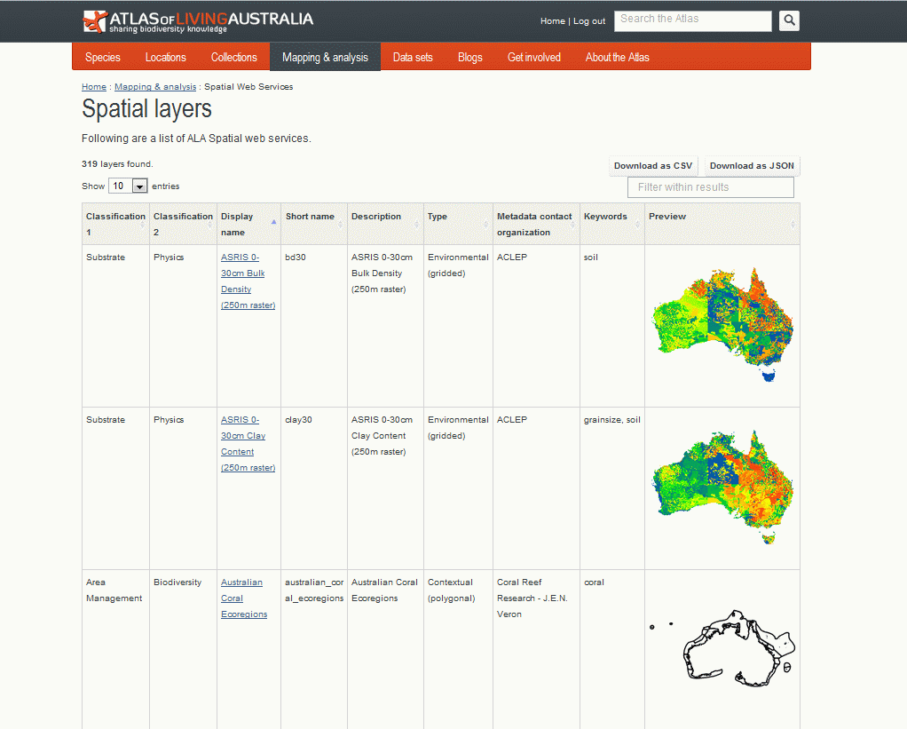

Slide 18
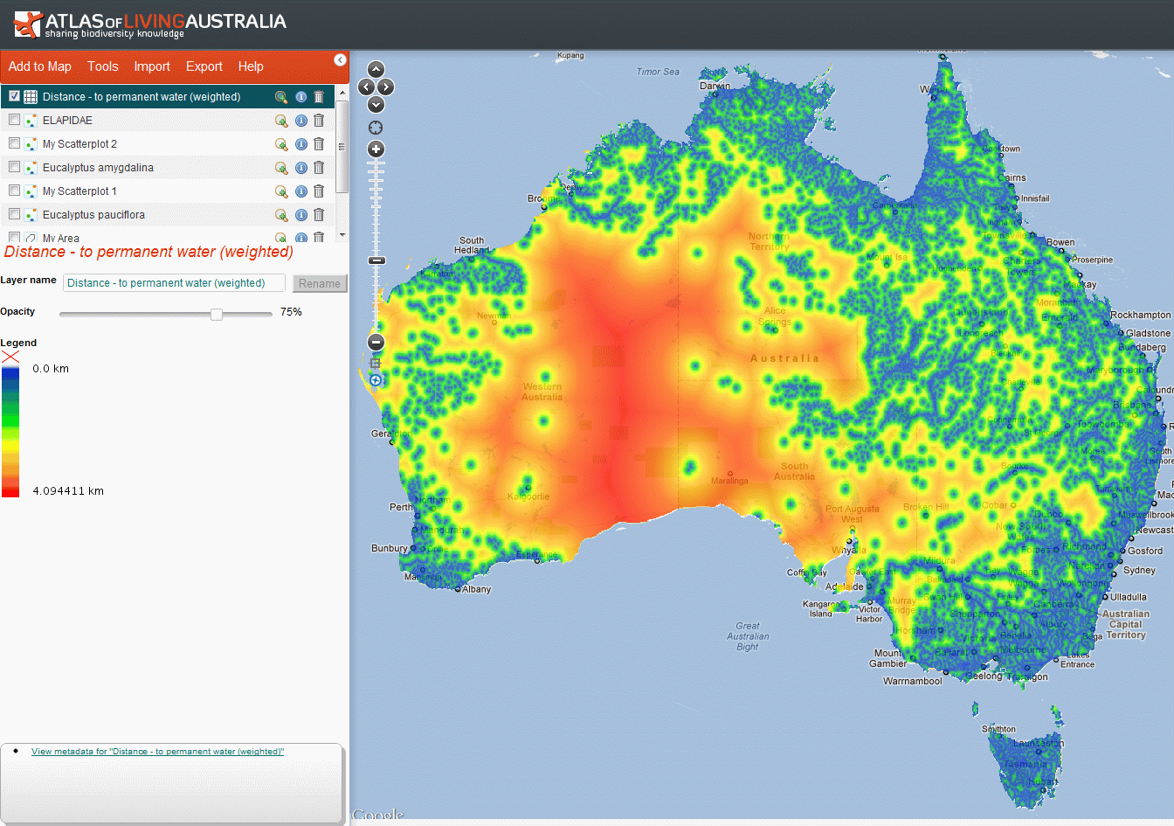

Slide 19
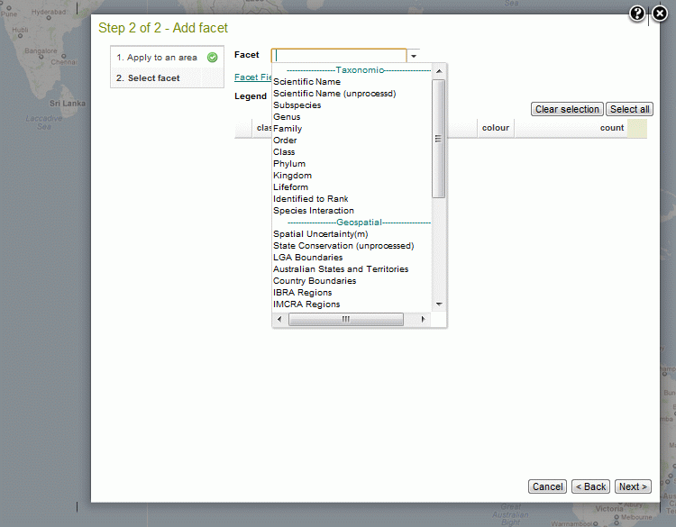

Slide 20
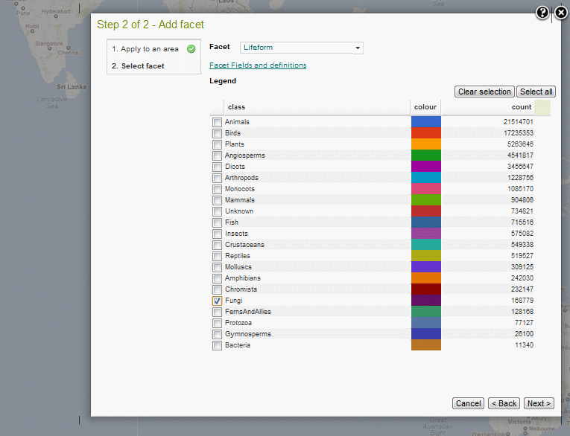

Slide 21
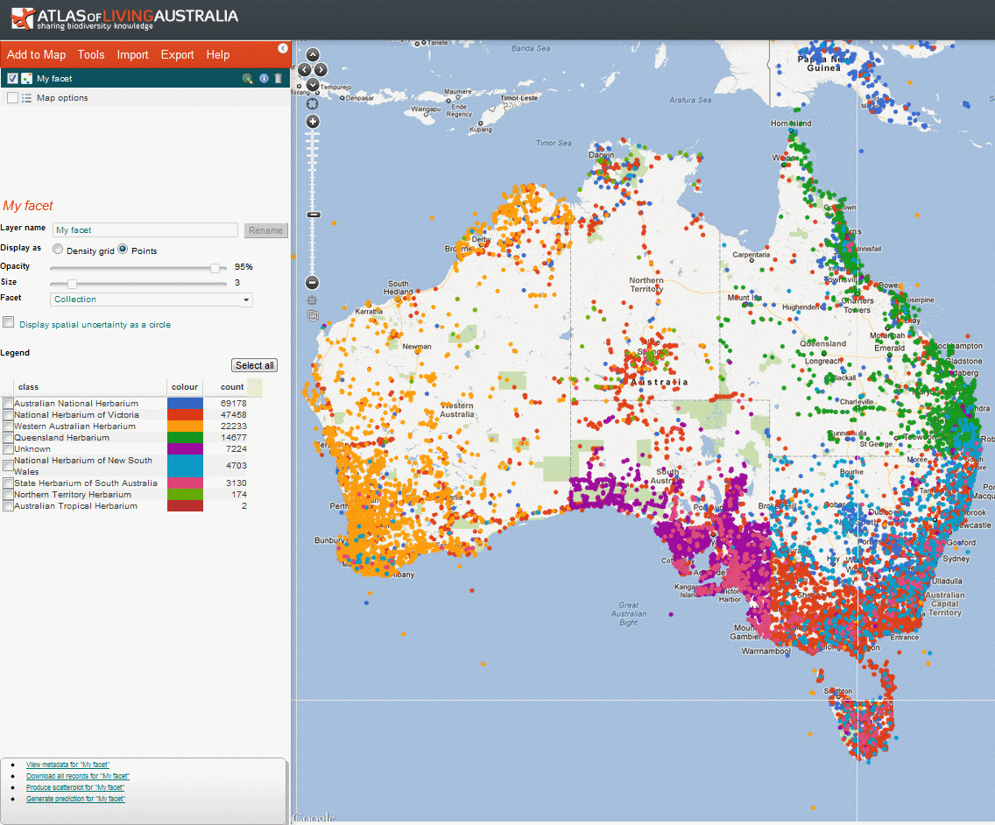

Slide 22
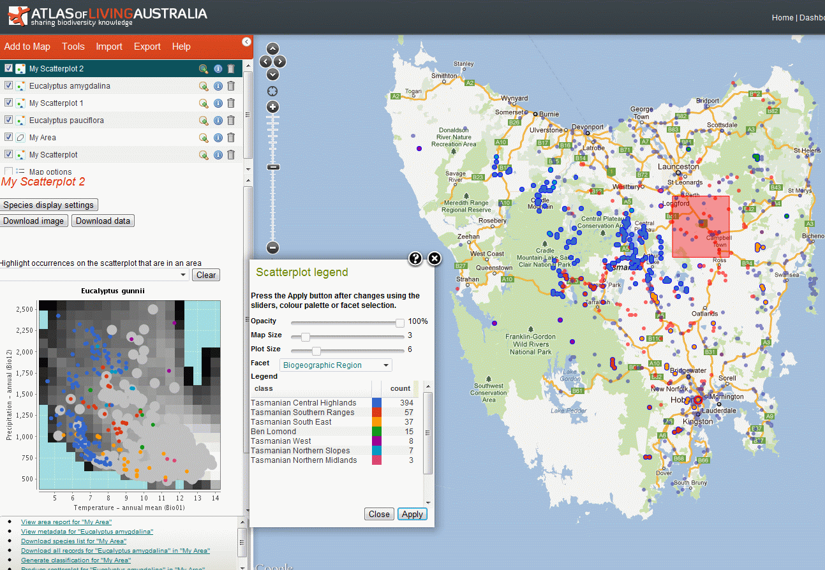

Slide 23
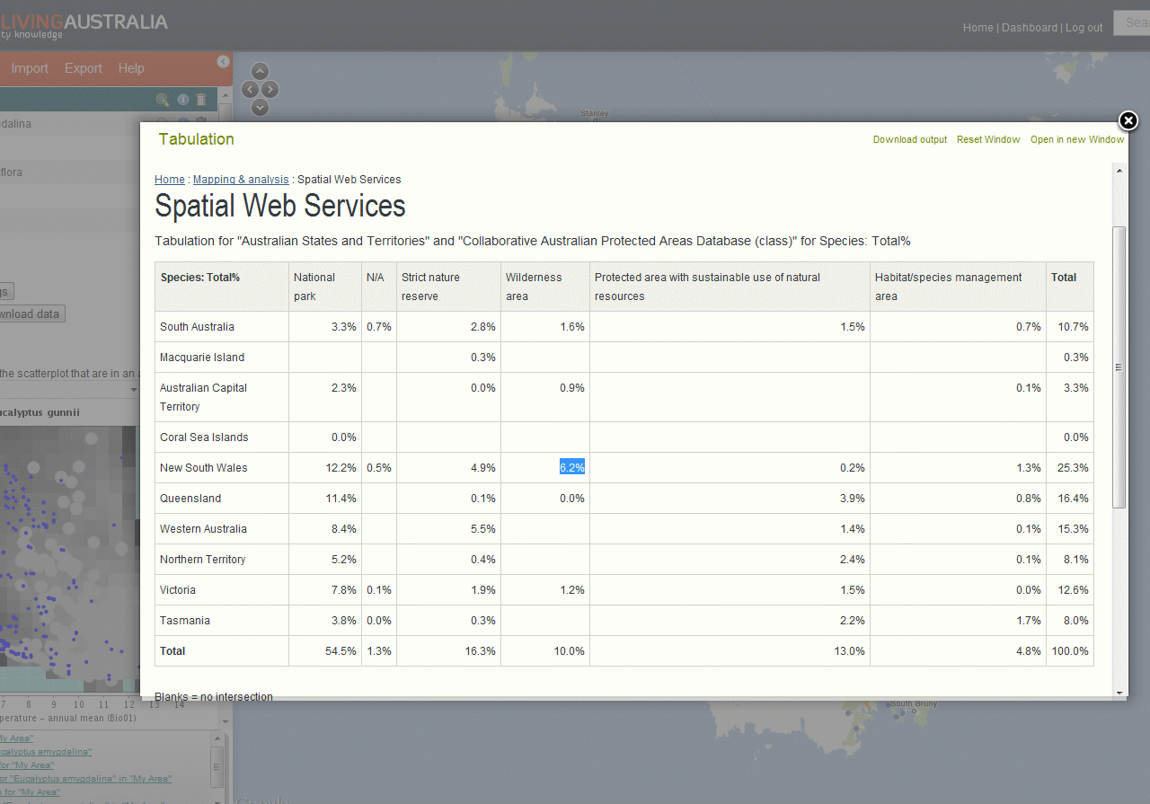

Slide 24
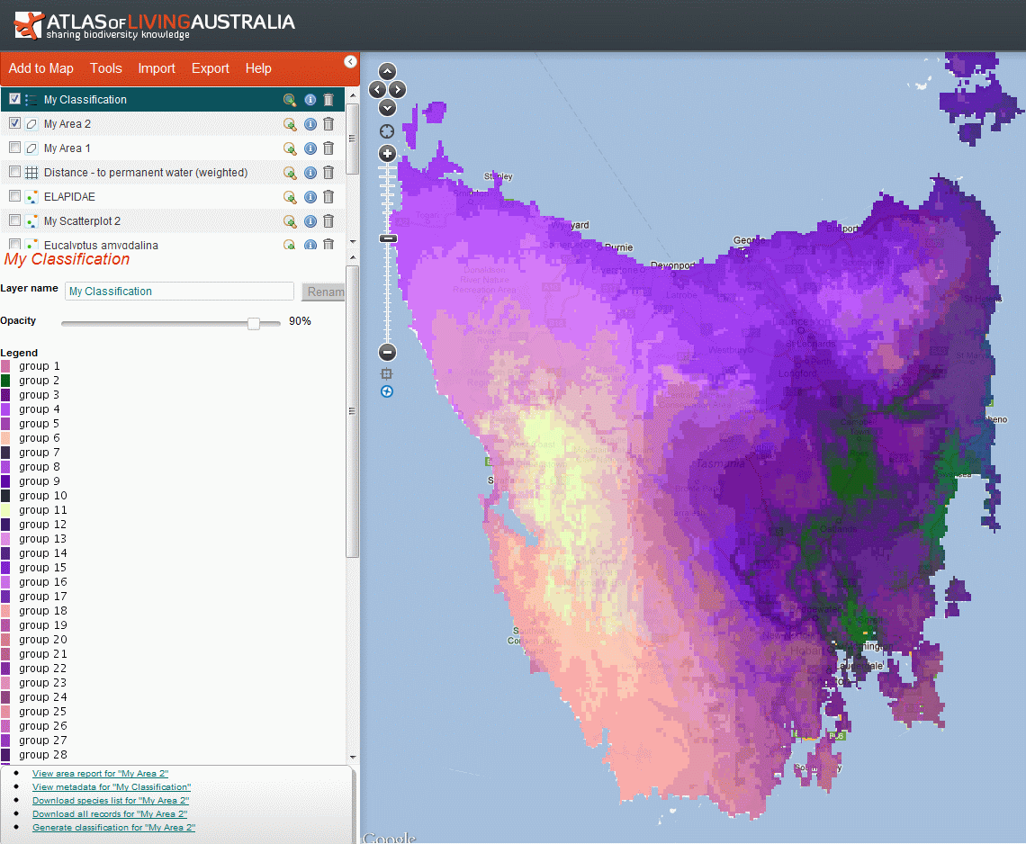

Slide 25
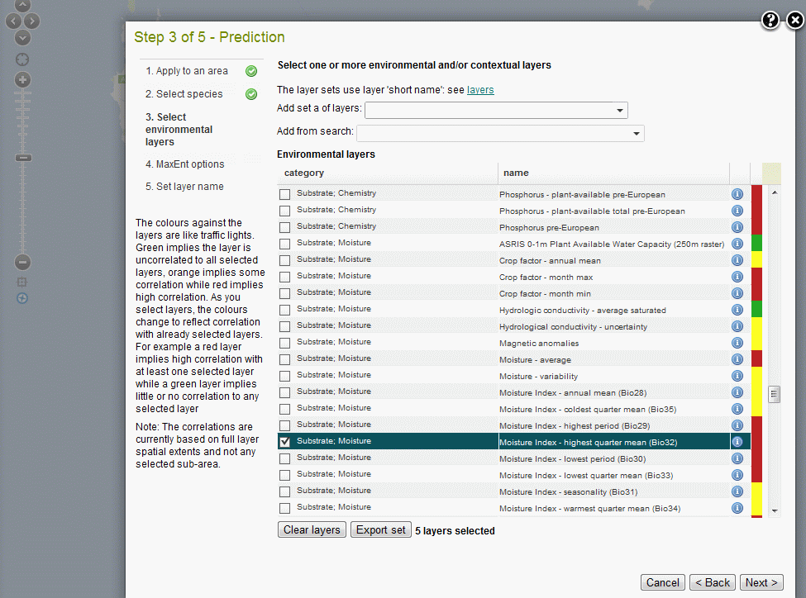

Slide 26
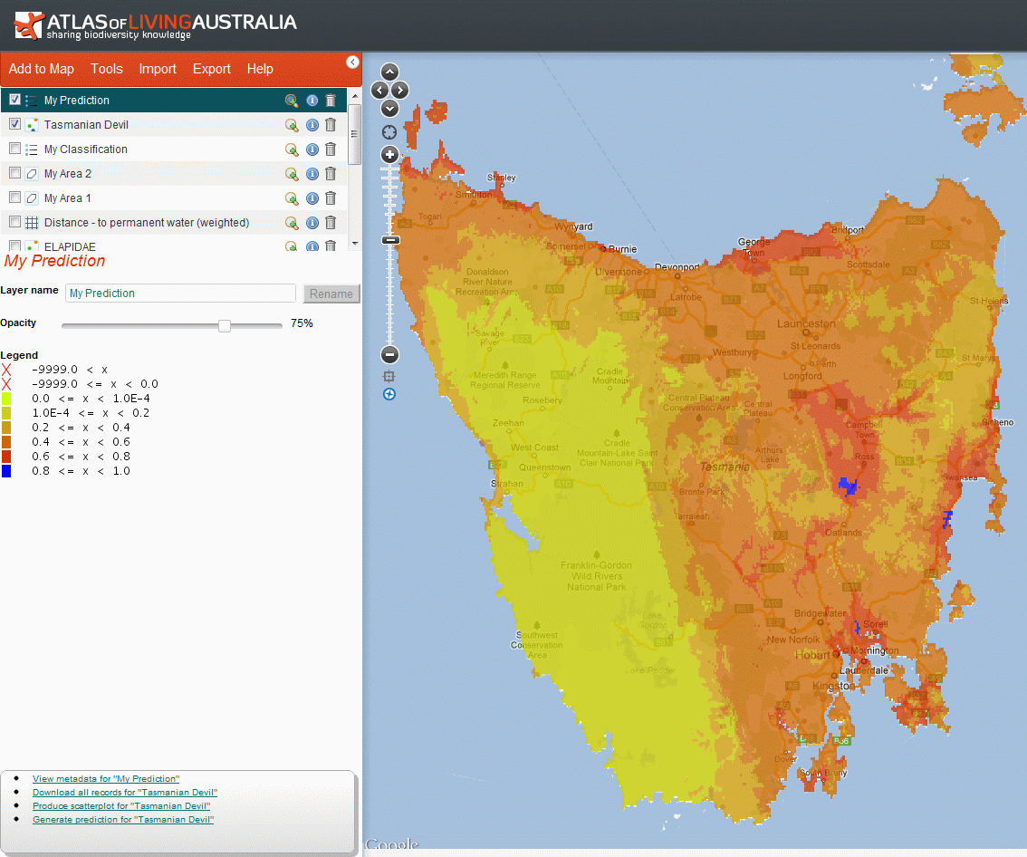

Slide 27
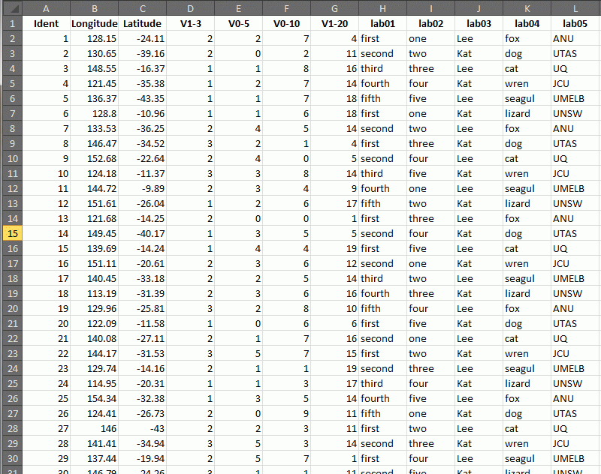

Slide 28
