Slide 1
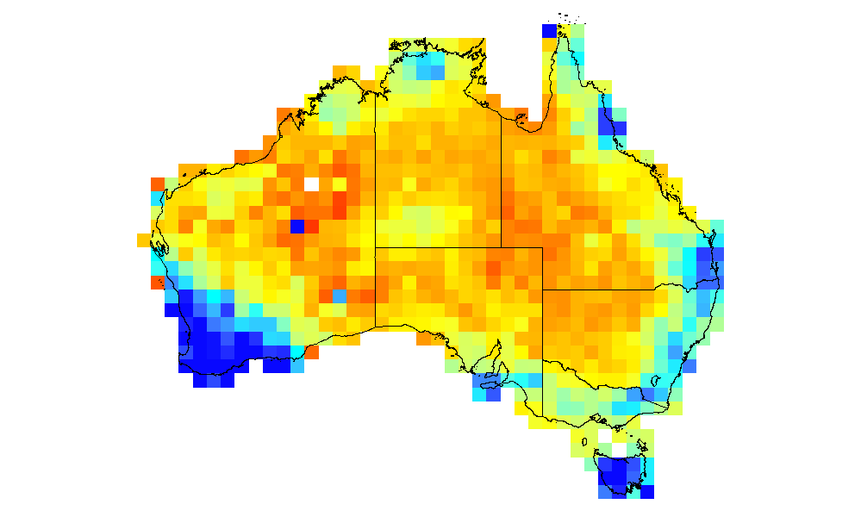
Biodiverse, a tool for the analysis of biological and other diversity
Shawn Laffan
BEES, UNSW

Slide 2
What does it do?
Linked visualisations
Spp list, geography, phylogeny, genetic
Moving window analyses
Cluster / region grower analyses
Randomisations
Matrix visualisation
Arbitrarily complex spatial windows

Slide 3
The software
It is free and open source
http://www.purl.org/biodiverse
~50k lines of Perl code
Discussion forum at
groups.google.com/group/biodiverse-users

Slide 4
The remainder of the talk was a demonstration of the software.

