Slide 1
Recent Development of Gfarm File System
PRAGMA Institute on Implementation: Avian Flu Grid with Gfarm, CSF4 and OPAL
Sep 13, 2010 at Jilin University, Changchun, China
Osamu Tatebe
University of Tsukuba

Slide 2

Gfarm File System
Open-source global file system http://sf.net/projects/gfarm/
File access performance can be scaled-out in wide area
By adding file servers and clients
Priority to local (near) disk, file replication
Fault tolerant for file server
Better NFS

Slide 3
Features
Files can be shared in wide area (multiple organizations)
Global users and groups are managed by Gfarm File System
Storage can be added during operations
Incremental installation possible
Automatic file replication
File access performance can be scaled-out
XML extended attribute (and extended attribute)
XPath search for XML extended attributes

Slide 4
Software component
Metadata Server (1 node, active-standby possible)
Plenty of file system nodes
Plenty of clients
Distributed Data Intensive Computing by using file system node as a client
Scaled out architecture
Metadata server only accessed at open and close
File system nodes directly accessed for file data access
Access performance can be scaled out unless the performance of metadata server is saturated

Slide 5
Performance Evaluation
Osamu Tatebe, Kohei Hiraga, Noriyuki Soda, "Gfarm Grid File System", New Generation Computing, Ohmsha, Ltd. and Springer, Vol. 28, No. 3, pp.257-275, 2010.

Slide 6
Large-scale platform
InTrigger Info-plosion Platform
Hakodate, Tohoku, Tsukuba, Chiba, Tokyo, Waseda, Keio, Tokyo Tech, Kyoto x 2, Kobe, Hiroshima, Kyushu, Kyushu Tech
Gfarm file system
Metadata Server: Tsukuba
239 nodes, 14 sites, 146 TBytes
RTT ~50 msec
Stable operation more than one year
% gfdf -a
1K-blocks Used Avail Capacity Files
119986913784 73851629568 46135284216 62% 802306

Slide 7
Metadata operation performance
Hakodate
6 nodes
Tsukuba
15 nodes
[Operations/sec]
Kyutech
16 nodes
Tohoku
10 nodes
Imade
2 nodes
Kobe
11 nodes
Kyoto
25 nodes
Hongo
13 nodes
Keio
11 nodes
Hiroshima
11 nodes
3,500 ops/sec
Chiba
16 nodes

Slide 8
Read/Write N Separate 1GiB Data
[MiByte/sec]
Tohoku
10 nodes
Kyutech
16 nodes
Read
Kyushu
9 nodes
Hakodate
6 nodes
Imade
2 nodes
Hongo
13 nodes
Hiroshima
11 nodes
Keio
11 nodes
Chiba
16 nodes
Write

Slide 9
Read Shared 1GiB Data
[MiByte/sec]
5,166 MiByte/sec
Kyutech
8 nodes
Hongo
8 nodes
Kyushu
8 nodes
Hiroshima
8 nodes
Keio
8 nodes
Tsukuba
8 nodes
Tohoku
8 nodes

Slide 10
Recent Features

Slide 11
Automatic File Replication
Supported by Gfarm2fs-1.2.0 or later
1.2.1 or later suggested
Automatic file replication at close time
% gfarm2fs –o ncopy=3 /mount/point
If there is no update, replication overhead can be hidden by asynchronous file replication
% gfarm2fs –o ncopy=3,copy_limit=10 /mount/point

Slide 12
Quota Management
Supported by Gfarm-2.3.1 or later
See doc/quota.en
Administrator (gfarmadm) can set up
For each user and/or each group
Maximum capacity, maximum number of files
Limit for files and physical limit for file replicas
Hard limit and soft limit with grace period
Quota checked at file open
Note that a new file cannot be created if exceeded, but the capacity can be exceeded by appending to an already opened file

Slide 13
XML Extended Attribute
Besides regular extended attribute, store XML document
% gfxattr -x -s -f value.xml filename xmlattr
XML extended attribute can be looked for by XPath query under a specified directory
% gffindxmlattr [-d depth] XPath path

Slide 14
Fault Tolerance
Reboot, failure and fail-over of Metadata Server
Applications transparently wait and continue except files to be written
Reboot and Failure of File System nodes
If there are available file replicas, available file system nodes, applications continue except it does not open files on the failed file system node
Failure of Applications
Opened file automatically closed

Slide 15
Coping with No Space
Minimum_free_disk_space
Lower bound of disk space to be scheduled (by default 128 MB)
Gfrep – file replica creation command
Available space dynamically checked at replication
Still, there is a case of no space
Multiple clients simultaneously create file replicas
Available space cannot be exactly obtained
Readonly mode
When available space is small, file system node can be read only mode to reduce risk of no space
Files stored in read-only file system node can be removed since it only pretend to be full

Slide 16
VOMS synchronization
Gfarm group membership can sync with VOMS membership management
Gfvoms-sync –s –v pragma –V pragma

Slide 17
Samba VFS for Gfarm
Samba VFS module to access Gfarm File System without gfarm2fs
Coming soon

Slide 18
Gfarm GridFTP DSI
Storage I/F of Globus GridFTP server to access Gfarm without gfarm2fs
GridFTP [GFD.20] is extension of FTP
GSI authentication, data connection authentication, parallel data transfer by EBLOCK mode
http://sf.net/projects/gfarm/
It is used in production by JLDG (Japan Lattice Data Grid)
No need to create local accounts due to GSI authentication
Anonymous and clear text authentication possible

Slide 19
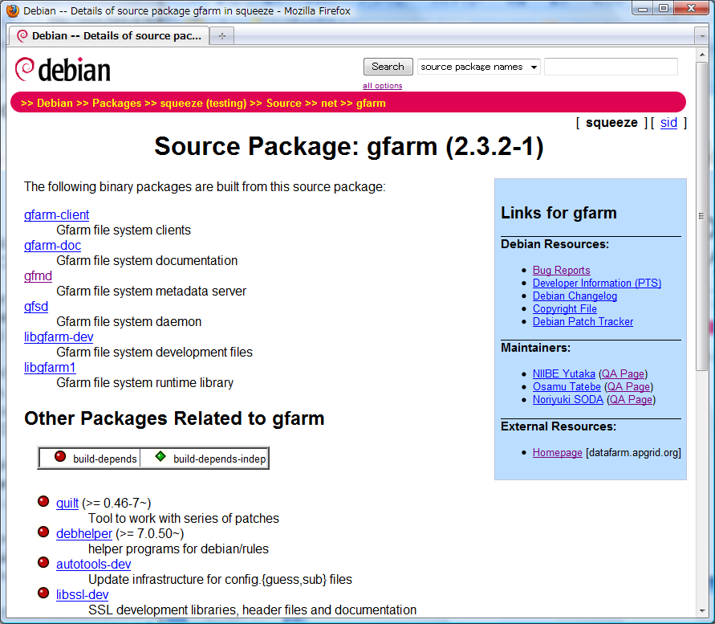
Debian packaging
Included in Squeeze package

Slide 20
Gfarm File System in Virtual Environment
Construct Gfarm File System in Eucalyptus Compute Cloud
Host OS in compute node provides functionality of file server
See Kenji’s poster presentation
Problem – Virtual Environment prevents to identify local system
Create physical configuration file dynamically

Slide 21
Distributed Data Intensive Computing

Slide 22
Pwrake Workflow Engine
Parallel Workflow Execution Extention of Rake
http://github.com/masa16/Pwrake/
Extension to Gfarm File System
Automatic mount and umount of Gfarm file system
Job scheduling considering the file locations
Masahiro Tanaka, Osamu Tatebe, "Pwrake: A parallel and distributed flexible workflow management tool for wide-area data intensive computing", Proceedings of ACM International Symposium on High Performance Distributed Computing (HPDC), pp.356-359, 2010

Slide 23
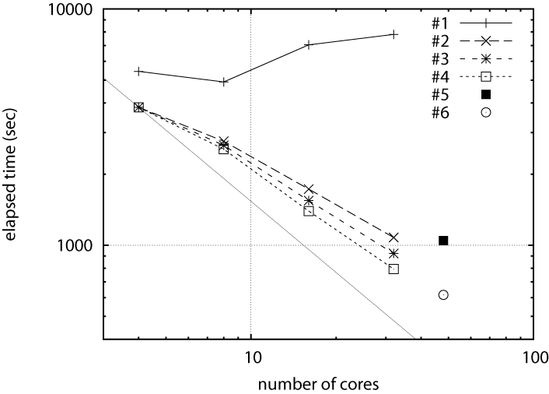
Evaluation Result of Montage Astronomic Data Analysis
NFS
Scalable Performance in 2 sites
1 node
4 cores
2 nodes
8 cores
4 nodes
16 cores
2 sites
16 nodes
48 cores
1-site
8 nodes
32 cores

Slide 24
Hadoop-Gfarm plug-in
Hadoop MapReduce applications
Hadoop File System Shell
Hadoop plug-in to access Gfarm file System by Gfarm URL
http://sf.net/projects/gfarm/
Hadoop apps can be scheduled by considering the file locations
File System API
HDFS client library
Hadoop-Gfarm plugin
Gfarm client library
HDFS servers
Gfarm servers

Slide 25
Performance Evaluation of Hadoop MapReduce
Read Performance
Write Performance
Better Write Performance than HDFS

Slide 26
Summary
Evolving
ACL, Master-Slave Metadata Server, Distributed Metadata Server
Multi Master Metadata Server
Large-Scale Data Intensive Computing in Wide Area
For e-Science (Data-Intensive Science Discovery) in various domain
MPI-IO
High Performance File System in Cloud

