Slide 1

Enabling parameter sweep jobs via scaling cluster-based computing services in the cloud
Nadya Williams nadya@sdsc.edu
Phil Papadopoulos philip.papadopoulos@gmail.com
Wilfred Li wilfredli01@gmail.com

Slide 2

Cloud Anatomy
Computing cloud
Large collection of CPU + Memory + Storage
Access to massive internet bandwidth
Physically located not at customer site
Easy access to computing power and bandwidth
Available to anyone and relatively inexpensive
Application instances load balancing
CPU and network bandwidth on demand
System storage capacity goes up/down
Costs Reduction:
local hardware via
more efficient handling of consolidated
remote clusters
telecommunication: printing, files transfer
Different tasks
use single or
multiple instances
From 1Byte to a few Tbyte
Notes:
- Service Level Agreement (SLA) to guarantee uptime availability %
- potentially reducing the need for office space, buying new furniture, disposing of old furniture, having your office cleaned with chemicals and trash disposed, and so on. They also reduce the need for driving to work and the resulting carbon dioxide emissions.

Slide 3
Cloud providers
July 15, 2010 04:46PM Network World Report
http://www.btclogic.com/pov/rankings.cfm
Contenders:
AT&T
Aylus Networks
Rackspace
Heavyweights:
Microsoft Google
Red Hat Salesforce
Symantec Vmware
Citrix EMC
Oracle Level 3
Cisco
Champions:
Amazon
IBM

Slide 4
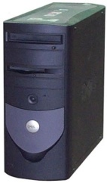


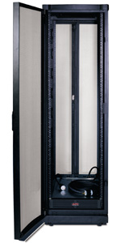
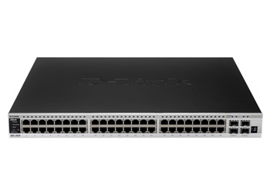
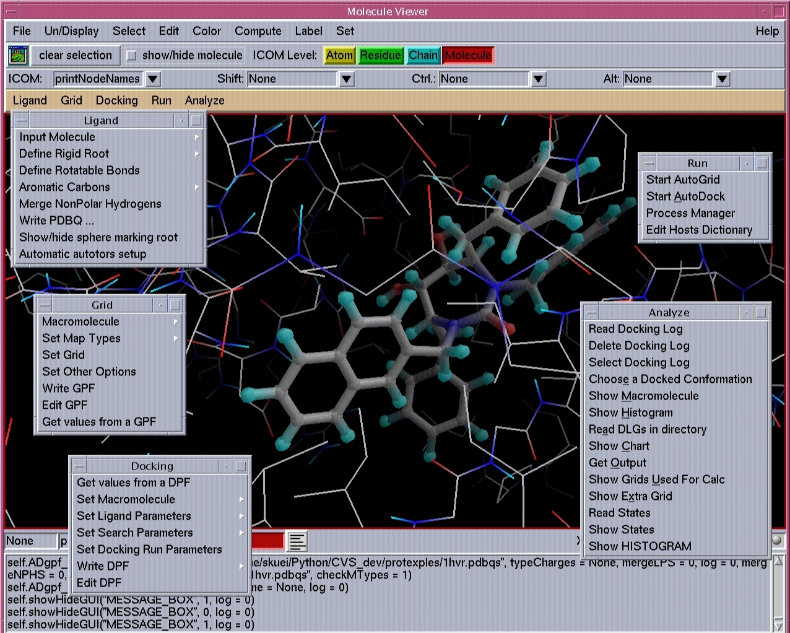
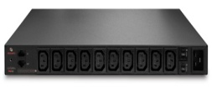
Scaling the cluster
Amazon Cloud Storage
Elastic Compute Cloud (EC2)
copy AMI & boot
Condor pool
Application services
EC2 condor
execute
machines

Slide 5
Step by step
Step #1: start development server
# rocks start host vm devel-server-0-0-2
# ssh devel-server-0-0-2
add application: binary, libs, DB, etc
# shutdown –h now
# export EC2_PRIVATE_KEY=/root/.ec2/pk.pem
# export EC2_CERT=/root/.ec2/cert.pem
# rocks create ec2 bundle devel-server-0-0-2 imagename=devel-server-0-0-2-pragma
# rocks upload ec2 bundle devel-server-0-0-2 pragma19 imagename=devel-server-0-0-2-pragma
# ec2-register pragma19/devel-server-0-0-2-pragma.manifest.xml
# ec2-run-instances -n 5 -t m1.large ami-5840aa31 -k si2010 -g si2010 –d "condor:rocce.ucsd.edu:40000:40050”
# ec2-describe-instances
Step #2: add to development server
Step #3: create AMI
Step #4: start AMI

Slide 6
Thank you!
Questions?

