Slide 1
Update of Development of Long Term Underwater Observatories at Taiwan and Plan for New Knowledge from CREON
Fang-Pang Lin,
Division Manager of Grid Applications
National Center for High-performance Computing
PRAGMA 18, San Diego, 04 March, 2010

Slide 2
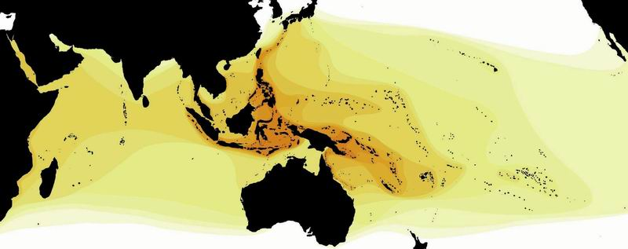
Coral Triangle and Biodiversity
world’s highest marine diversity region (East Indies) + Kuroshio current area
Diversified habitats (substratum and topography) ---
coral, rubbles, sand, estuary, sea grass, etc
2
By Dr. R.F. Myers
Notes:
2

Slide 3
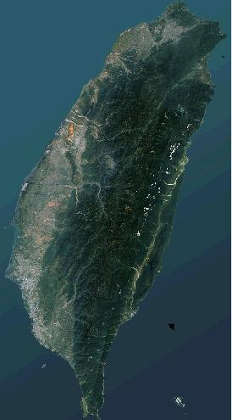
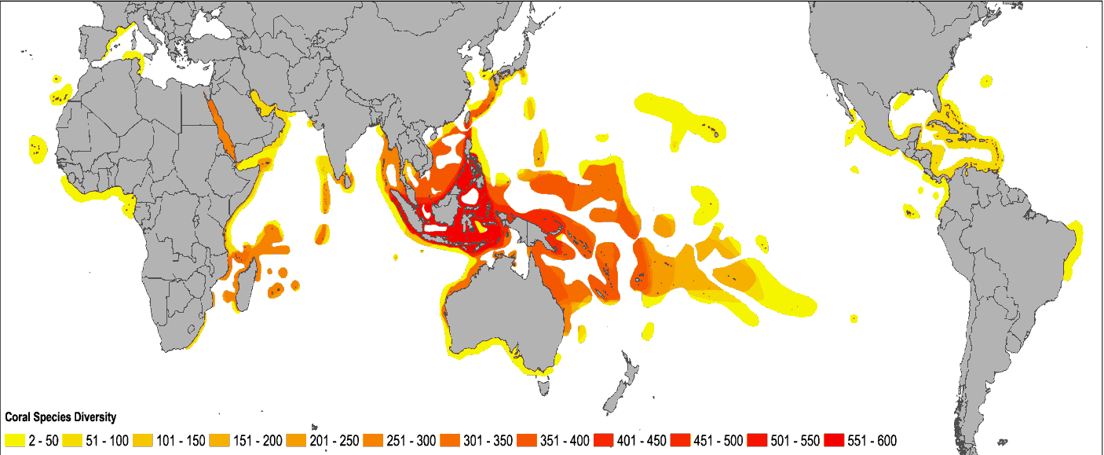
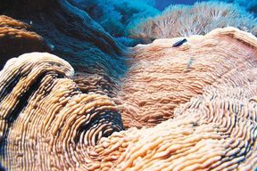
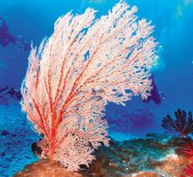
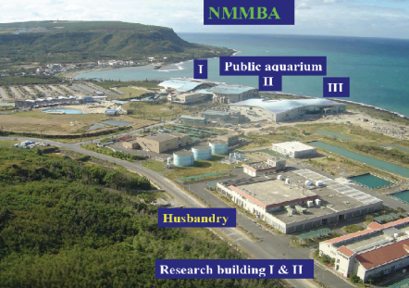
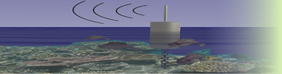
Coral Reef Environmental Observatory Network (CREON)
Jeju
Racha Yai islands
Kenting
Carrabian
Taichung Site
Green Island
Orchid Island
Ken-Ting
GBR
NSF Collaboration:
UCSB and AS/NMMBA
Moorea Island
Source: Stuart Kininmonth, AIMS
Source : Fang-Pang Lin, NCHC
http://www.coralreefeon.org/
Notes:
3

Slide 4
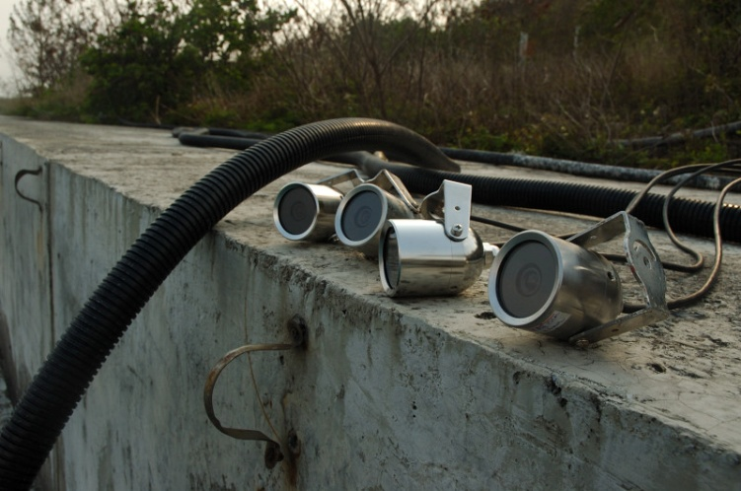
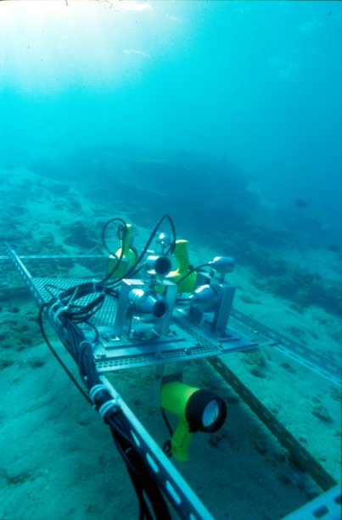
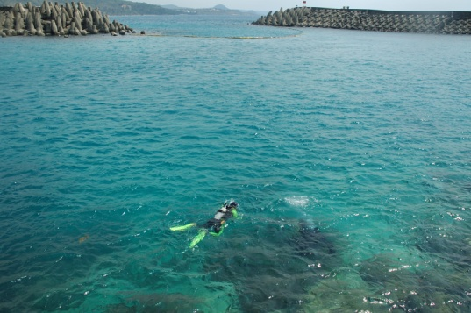
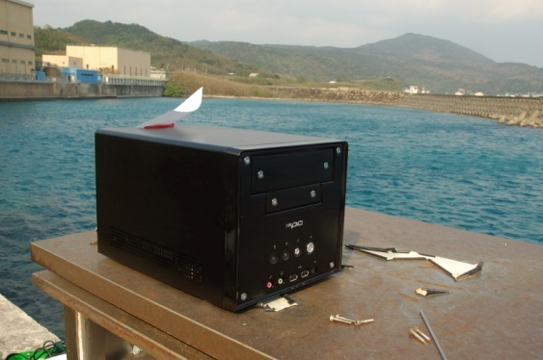
Kenting's Underwater Observatory
Deployed in 2004. Still the only system of its kind in the world. Has gained lots of interest from international communities.
Currently features 4 underwater video cameras.
Current effective output: 320x240, ~10 fps.
Used by researchers in NMMBA for coral reef studies and Academia Sinica for fish behavioural research.

Slide 5
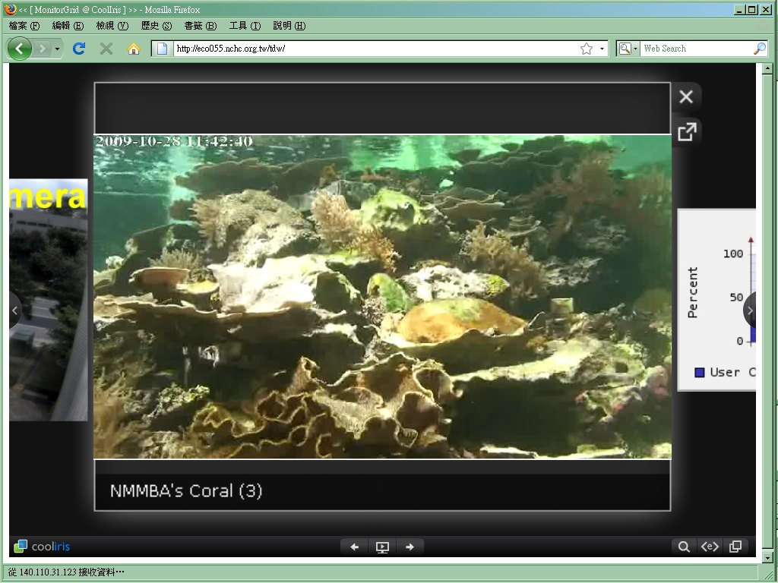
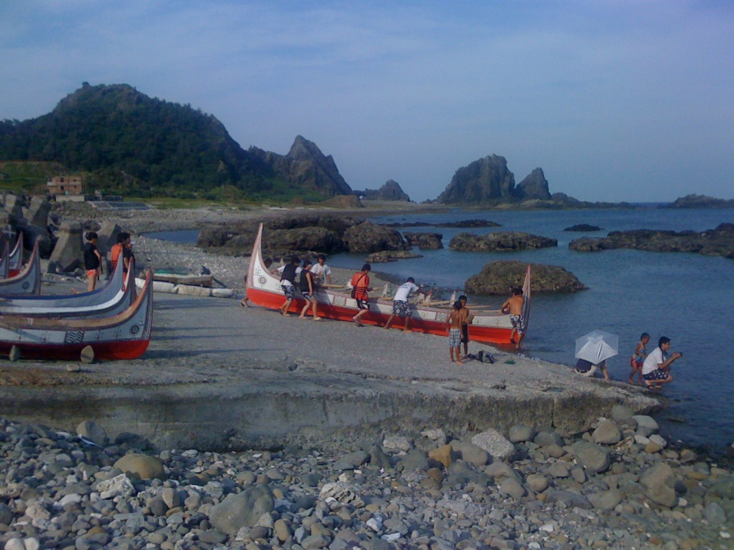
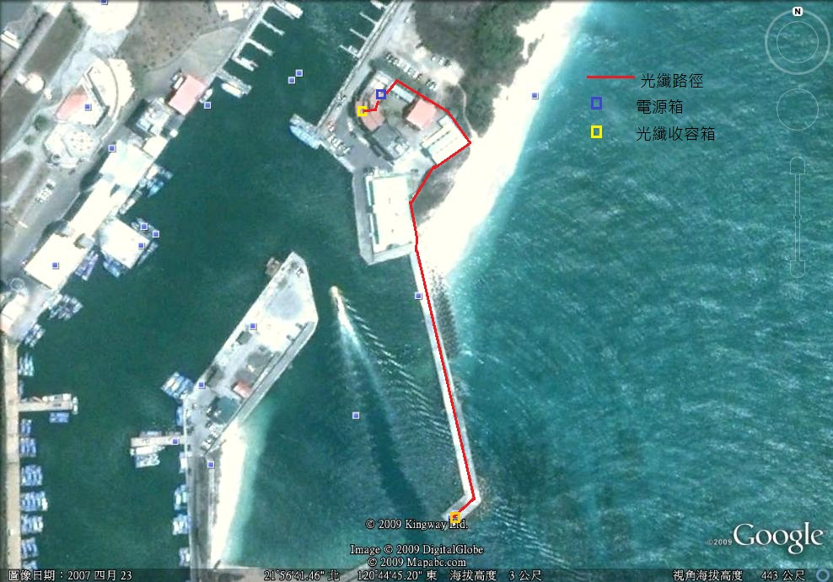
National Museum of Biology & Aquarium
Orchid Island (Lanyu)
Ho-Bi Harbor @ Kenting
(Digital Kenting)

Slide 6
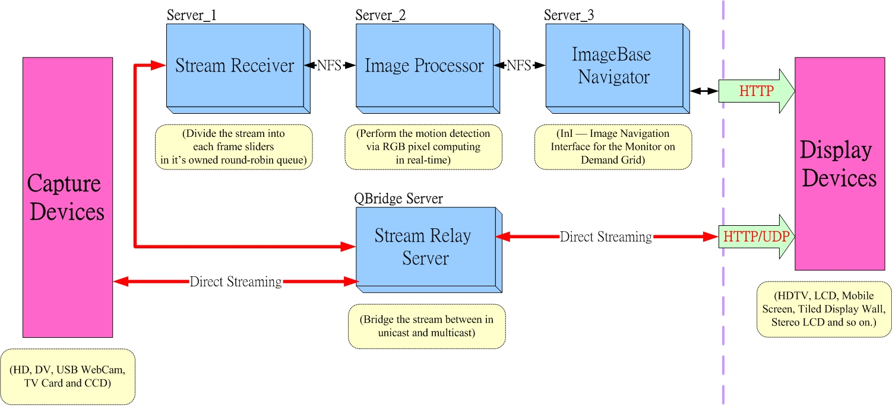
Three-tier Architecture
http://ecocam.nchc.org.tw/

Slide 7

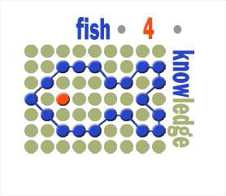



EU-FP 7 Collaboration
Supporting humans in knowledge gathering and question answering
w.r.t. marine and environmental monitoring through analysis of
multiple video streams
Participated Institutes
University of Edinburgh (UEDIN), United Kingdom
Centrum Wiskunde & Informatica (CWI), Netherlands
Universita’ di Catania (UCATANIA), Italy
National Center for High-Performance Computing (NCHC), Taiwan

Slide 8
