Slide 1
A Control Mechanism of Multiple Visualization Applications on SAGE-enabled TDW
Yuki Fujiwara
OSAKA Univ.
Notes:
Hi! I’m Yuki Fujiwara, from Osaka University.
I would like to introduce ”A Control Mechanism of Multiple Visualization Applications on SAGE-enabled TDW”.

Slide 2
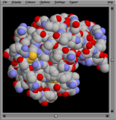
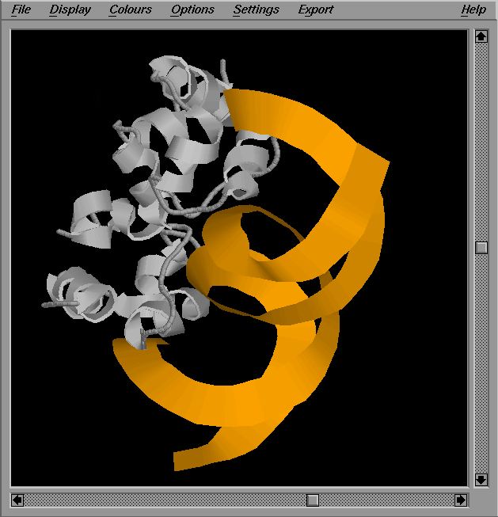
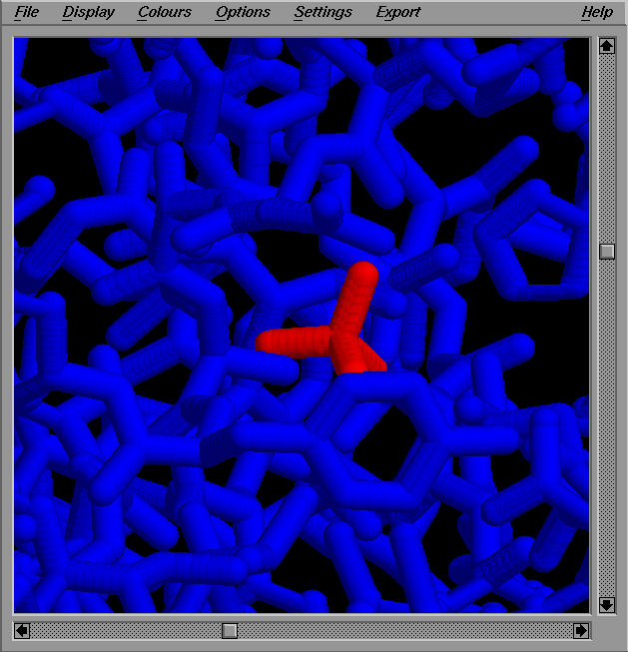
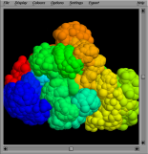
SAGE and Distributed Scientific Data
Streaming
Tiled Display Wall (TDW)
France
Japan
US
SAGE
(Scalable Adaptive
Graphics Environment)
India
China
2
Notes:
First, let me explain what SAGE is..
SAGE is a graphic streaming middleware to build a tiled display wall
composed of multiple LCDs and computers.
The tiled display wall can show high-resolution images or movies.
The most important feature of SAGE is network streaming.
SAGE allows a user to share data
stored or generated on local or remote computers
on a SAGE-enabled tiled display wall via networks.

Slide 3
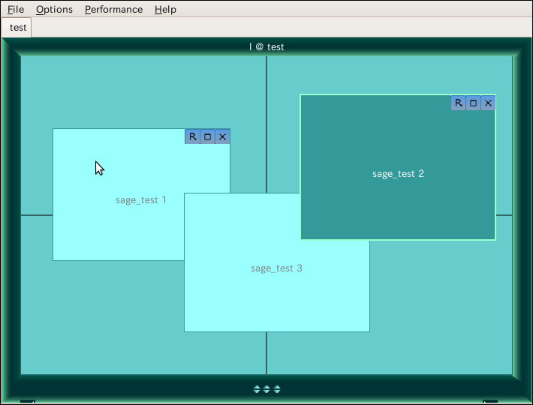
SAGE UI
Window control
on a Tiled Display Wall
zoom
move
maximize
Notes:
Next, let me explain SAGE UI.
SAGE UI is a component of SAGE that allows a user to control windows on the tiled display wall.
You can zoom, move or maximize the windows on the tiled display wall freely through this SAGE UI.

Slide 4
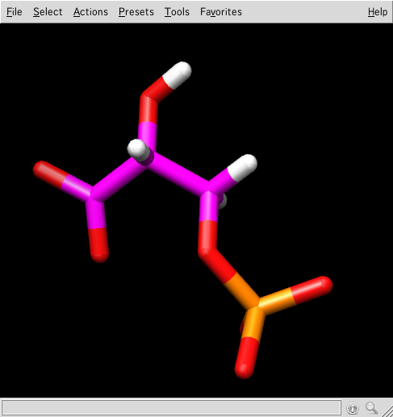
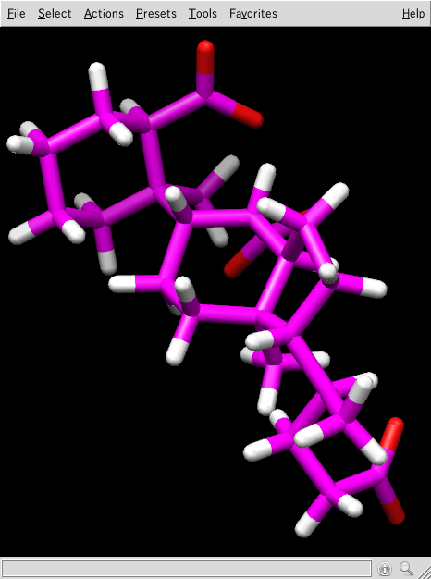
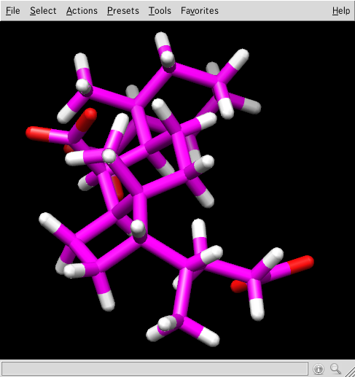
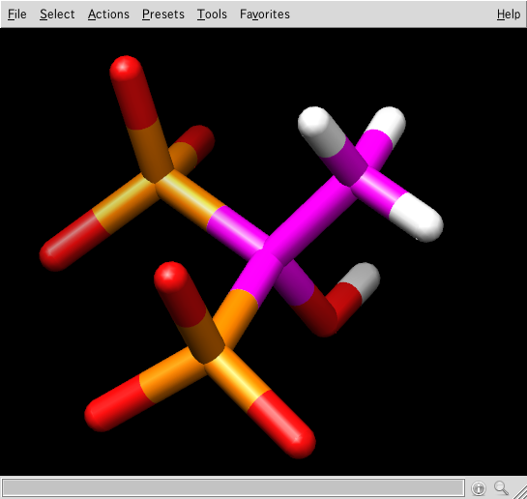
Problem
Lack of control function for
distributed visualization applications
Tiled Display Wall (TDW)
France
Japan
US
India
China
Control
Notes:
However the SAGE has no control function and interface that allows users to control visualization applications on the internet.
Technically speaking, SAGE users cannot send application events such as mouse click to applications on the internet.
Therefore, it is not practical to use SAGE-based tiled display wall for actual scientific research.
Furthermore, to analyze the difference and relation among the visualized scientific data,
it’s important to be able to control multiple visualization applications simultaneously.

Slide 5
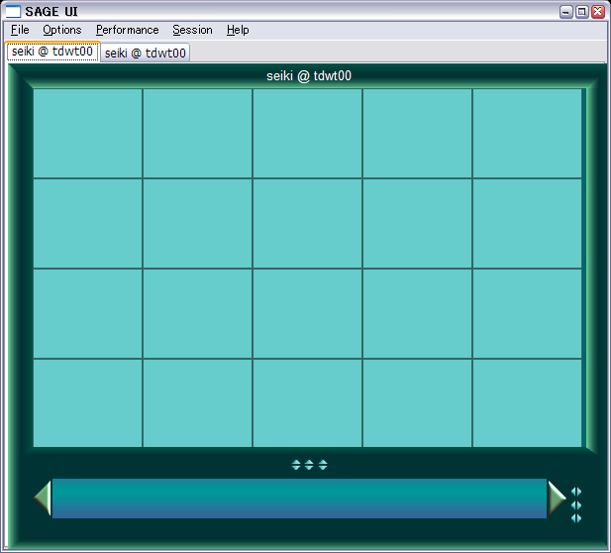
What is our work?
Create a mechanism
to control multiple visualization application
France
Japan
US
India
China
Application Control
via Event Message
SAGE UI
Notes:
So we aim to extend the original SAGE UI so that users can send application events to the applications distributed on the internet through the SAGE UI.

Slide 6




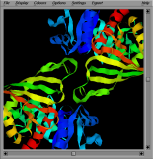
SAGE Architecture
Pixel stream
Tiled Display Wall
SAIL
SAIL
SAIL
SAGE Receiver
SAGE UI
SAIL
SAIL
A
B
C
D
F
SAIL:
SAGE Application
Interface Library
Free Space Manager
SAGE message
for window management
Notes:
To make the goal possible, we propose a built-in module based on SAGE architecture.
So let me explain the SAGE architecture.
To show a image of an application,
SAIL, SAGE Application Interface Library, makes an application enabled on SAGE,
and sends its image to SAGE Receivers. Then the image is displayed to a tiled display wall.
SAGE has a message passing system for window management.
When a SAGE user makes a window control command on a SAGE UI, for example move or zoom it,
the command gets packed in a SAGE message first.
Next, the message is sent to a management node named free space manager.
This node makes copies of the message and send them to SAILs.
Each SAIL analyzes the message and makes effect to the tiled display wall.
本研究では、この仕組みを利用しまして、ユーザがSAGE UIで操作する際に発生させるマウス操作などのEventを、
Event message としてそれぞれの可視化アプリケーションへ送ります。
これらのmessageがX Window SystemのEventとして解釈・実行されることで、アプリケーションの同時遠隔操作を実現します。

Slide 7
Proposed Module (single control)
Pixel stream
Tiled Display Wall
SAIL
SAIL
SAIL
Event message
analysis
SAGE Receiver
SAGE UI
SAIL
SAIL
A
B
C
D
F
Event detection
Event message transmission
Free Space Manager
Event
message
Notes:
We applied the message passing mechanism to application control.
We have developed a module to control single or multi applications based on a idea of SAGE message.
I’ll explain how the module works.
Like the window management,
when the SAGE UI gets a application control event like mouse click or dragging,
the event is detected and gets packed to a event message.
Next, the message is sent to Free Space Manager
and forwarded to a SAIL on the application that corresponds to the window on the SAGE UI where user’s event is generated.
The message is analyzed and executed as a X Window event on the application.

Slide 8
Proposed Module (multi control)
Pixel stream
Tiled Display Wall
SAIL
SAIL
SAIL
Event message
analysis
SAGE Receiver
SAGE UI
SAIL
SAIL
Event
message transmission
A
B
C
D
F
Proposed
Module
Event
Message
duplication
Event detection
Event
message
Free Space Manager
Notes:
Also , we have further extended the application control module so that it sends the application events to multiple applications distributed on the internet.

Slide 9

Notes:
Here, I would like to show how the developed module works using the example movie.
In this example, cube lattices visualized on remote applications are simultaneously displayed on a tiled display.
Also, through the SAGE UI enabled with our developed module built-in, we can control remote applications visualizing cube lattices like this.

Slide 10
Thank you for your attention!
Notes:
Thank you for your attention.
I hope that the developed module help SAGE to be used in actual scientific research.

Slide 11
Conclusion
Problem
Lack of control function for
distributed visualization applications
with SAGE
Approach
To create a module
with the application control mechanism using SAGE architecture
Conclusion
Usefulness of multi-data manipulation is confirmed
Future work
To improve the event message filter
To create a UI to select controllable applications
To create a function of application control synchronization
Notes:
本研究では、Tiled Display Wallを用いた複数データの比較における操作方法の欠如という問題に対し、
複数可視化アプリケーションの同時遠隔操作を行うモジュールを提案・実装しました。
その結果、被験者実験により、モジュールの同時操作機能の有用性を確認しました。
今後の課題としては、不要なEvent message の削減による応答性の改善、
などがあげられます。

Slide 12
Principle and approach
Principle
Minimum change to existing SAGE architecture
For compatibility with the SAGE running on facilities
For future change in SAGE architecture
Approach
A module for SAGE to realize the mechanism of application control
using existing message passing system on window control
Notes:
We decided a principle in creating a mechanism.
We thought minimum change to existing SAGE architecture is needed,
for compatibility with the SAGE running on facilities and future change in SAGE architecture.
With the principle, our approach is to create a module for SAGE to realize the mechanism of application control
using existing message passing system on window control.

Slide 13
Proposed Module
Pixel stream
Tiled Display Wall
SAIL
SAIL
SAIL
Event message
analysis
SAGE Receiver
SAGE UI
SAIL
SAIL
Event
message
filter
A
B
C
D
F
Event detection
Proposed
Module
Event
Message
duplication
Event message transmission
Event
message
Free Space Manager
Notes:
With the principles, we created the module that can control multiple applications.
Look at the picture.
(Event message filter?) ← ポスターでは、消すのを忘れました。
Event message duplication function duplicates the message which comes from the transmission function
and forward them to all or a part of SAIL-enabled application.
まず、Event message を複製し、操作対象となる全てのアプリケーションに対して
Event message をtransmissionする機構を構築しました。
この際、1つ目の課題である、アーキテクチャへの変更の最小化を考慮しました。
また、不要なEvent message を間引き、messageのtransmission量を削減する
Event message filter 機構を、プロトタイプとして構築しました。
これは、2つ目の課題である、応答性の保持について考慮したためです。
本発表ではこれらのうち、Event message 複製機構の設計について述べます。

Slide 14
Design: Event message duplication
How to duplicate a event message
In SAGE UI
In Free Space Manager
Good：Minimum change to SAGE architecture
Bad：Increase of
message traffic
Application 1
SAGE UI
Free Space Manager
Event
message
duplication
Message sort
Application 2
Event
detection
Application 3
Notes:
There is a issue to create the duplication function: How to duplicate a event message?
There are two way.
First way is to put the duplication function in SAGE UI.
When SAGE UI gets a event and make a event message, the function duplicates here
and pass the message to Free Space Manager.
After that, the processing of the message is the same as the previous module.
The advantage of the way is minimum change to SAGE architecture.
But the bad point is message traffic become more.
検討すべき項目は、messageの複製方法です。
複製方法は2つあり、1つ目の方法は、SAGE UIで、アプリケーションの数だけEvent message を複製し、
従来のアーキテクチャを利用してtransmissionする方法です。
この方法の利点は、アーキテクチャへの変更がSAGE UIのみの最小限で済むという利点があります。
ただし、欠点は、アプリケーションの増加によってSAGE UIと管理ノードの間で
通信量やmessage処理の負荷が増加するということです。

Slide 15
Design: Event message duplication
How to duplicate a event message
In SAGE UI
In Free Space Manager
Good：Less traffic
Bad：More change to SAGE architecture
SAGE UI
Application 1
Control: ID 1, 2, 3
Free Space Manager
Event
detection
Event
message
duplication
Application 2
Transmission of application specification
message
Application 3
Send to:
ID 1, 2, 3
Notes:
The another way is to put the duplication function in Free Space Manager.
In this way, application IDs needs to be set on the duplication function in the Free Space Manager.
SAGE UI sends only one event function by an event to the duplication function in Free Space Manager,
then the function duplicates the message an send them to each applications.
The advantage is less traffic between SAGE UI and Free Space Manager.
But the bad point is more change to SAGE architecture.
2つ目は、あらかじめtransmission先のアプリケーションIDを専用のmessageでFree Space Managerに指定する方法です。
SAGE UIからはEvent message 1つ送り、
指定されたアプリケーションに対してFree Space Managerでmessageを複製・transmissionします。
この方法の利点は、通信量が少ないという点ですが、欠点は大幅なアーキテクチャ変更が必要という点です。

Slide 16
Design: Event message duplication
How to duplicate a event message
In SAGE UI
In Free Space Manager
Because
Prior: Minimum change to architecture
Less effect: increase of message traffic
adopted
the same LAN
Application 1
SAGE UI
Free Space Manager
Event
message
duplication
Message sort
Application 2
Event
detection
Application 3
Notes:
We adopted the first way with consideration of changing SAGE architecture to be minimum.
We thought the bad point of message traffic is not a big problem because both SAGE UI and Free Space Manager
are usually supposed to be on the same LAN.

Slide 17
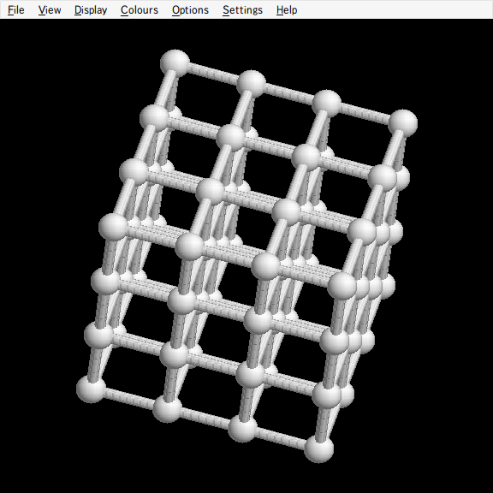
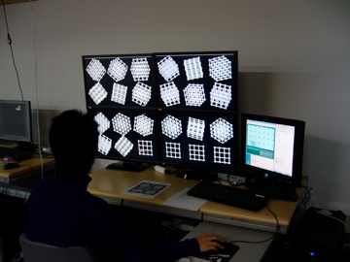
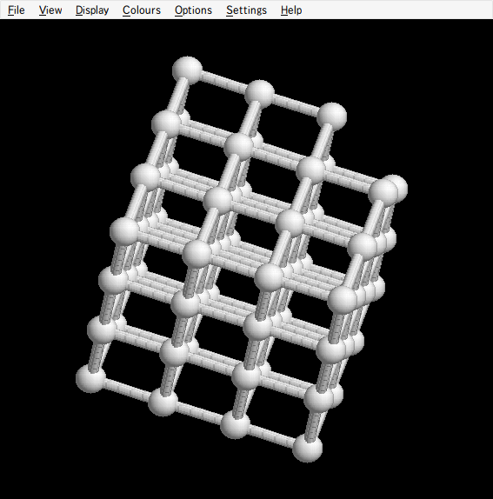
Evaluation
Target: usefulness of multi-data manipulation with proposed module
Subject test
Multiple Control vs. Single Control
Good
Tiled Display Wall
Bad
Cube lattices
Notes:
Finally, we prove the usefulness of multi-data manipulation with proposed module in a subject test.
We compared two condition: with multiple control or with single control.
Each subject was in front of the tiled display wall and
did a task to find a lacked cube lattice from many lattices.
We measured time to do it for each subjects.

Slide 18
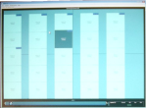
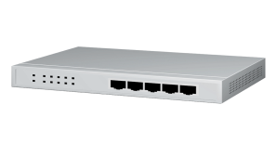



Environment for the Evaluation
SAGE Receiver
SAGE UI
Free Space Manager
LAN: 1Gbps
Suita
VLAN
control
find
2x2 TDW
(1920x1280 LCD*4)
SAIL
Toyonaka
about 10km
RasMol
Notes:
Each subject and tiled display wall was in Toyonaka campus of Osaka University.
The subject controlled applications in Suita campus via our module-enabled SAGE UI.
Distance between two campuses is about 10 km.

Slide 19
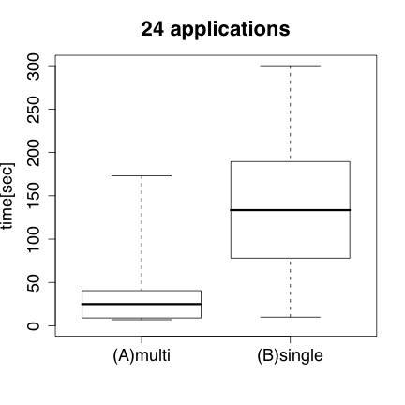
Result
Late
Usefulness of multi-data manipulation is confirmed
significant difference
10 subjects
2 times / person
Level of
significance: 5%
Fast
Notes:
The result of the experiment is here.
With showing 24 applications on the tiled display,
in the condition of multi-application control enabled was faster than single control.
We concluded the usefulness of multi-data manipulation is confirmed.
10人の被験者による実験の結果、
24個のアプリケーションを同時操作する場合に
複数同時操作と単一操作の2条件間で、統計的有意差がみられました。
この結果より、本研究で提案・実装した同時遠隔操作モジュールが有用であり、
多くの可視化画像を同時比較する作業の効率化が達成されていると結論づけました。

Slide 20
Conclusion
Problem
Lack of control function for
distributed visualization applications
with SAGE
Approach
To create a module
with the application control mechanism using SAGE architecture
Conclusion
Usefulness of multi-data manipulation is confirmed
Future work
To improve the event message filter
To create a UI to select controllable applications
To create a function of application control synchronization
Notes:
本研究では、Tiled Display Wallを用いた複数データの比較における操作方法の欠如という問題に対し、
複数可視化アプリケーションの同時遠隔操作を行うモジュールを提案・実装しました。
その結果、被験者実験により、モジュールの同時操作機能の有用性を確認しました。
今後の課題としては、不要なEvent message の削減による応答性の改善、
などがあげられます。

Slide 22
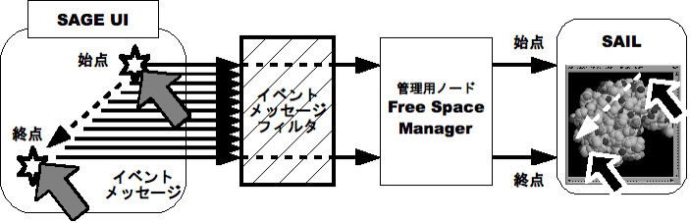
Event message filter
目的：応答性の向上
評価実験では有意差が見られない
目視では、応答性の向上を確認→評価の必要性
Notes:
本研究ではEvent message filter 機構も構築していた。
ドラッグ操作を対象としていた
ドラッグは始点・途中・終点がある
途中のmessagetransmissionによる、画像生成によるネットワークのオーバーヘッドが問題
プロトタイプでは、このドラッグ途中のmessagetransmissionを丸ごとカット
測定はしていないが、操作のタイムラグが目視で確認できるぐらい減少した
今後は、messageの間引き方について工夫を加えたい

Slide 23
実験用ネットワーク環境（レイテンシ）
測定方法：ping
豊中サイバー
吹田サイバー
画像出力
ノード
0.02 ms
管理用
ノード
0.29 ms
画像出力
ノード
画像生成用ノード

Slide 24
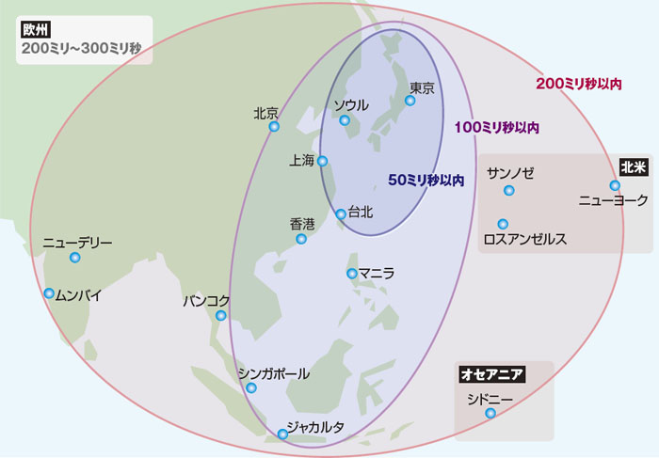
国際間のレイテンシ比較
“［4］いまさら聞けない国際ネットワークの基礎知識 -企業が作る国際ネットワーク最前線：ITpro”,
http://itpro.nikkeibp.co.jp/article/COLUMN/20100119/343461/

Slide 26
Proposed Module
Pixel stream
Tiled Display Wall
SAIL
SAIL
SAIL
Event message
analysis
SAGE Receiver
SAGE UI
SAIL
SAIL
Event
message
filter
A
B
C
D
F
Event detection
Proposed
Module
Event
Message
duplication
Event message transmission
Event
message
Free Space Manager
Notes:
With the principles, we created the module that can control multiple applications.
Look at the picture.
After the event message transmission,
まず、Event message を複製し、操作対象となる全てのアプリケーションに対して
Event message をtransmissionする機構を構築しました。
この際、1つ目の課題である、アーキテクチャへの変更の最小化を考慮しました。
また、不要なEvent message を間引き、messageのtransmission量を削減する
Event message filter 機構を、プロトタイプとして構築しました。
これは、2つ目の課題である、応答性の保持について考慮したためです。
本発表ではこれらのうち、Event message 複製機構の設計について述べます。

