Slide 1
Pwrake: An extensible parallel and distributed flexible workflow management tool
Masahiro Tanaka and Osamu Tatebe
University of Tsukuba

Slide 2
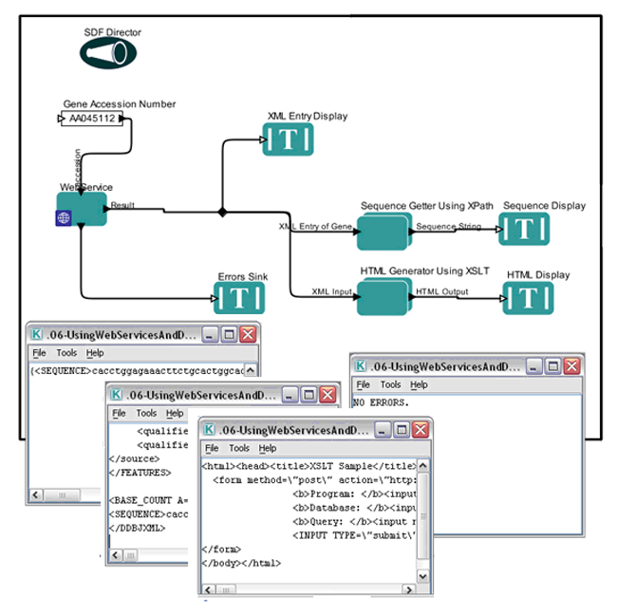
Workflow Systems
Visual Workflow Creation
Is EASY but
has many LIMITATIONS!

Slide 3
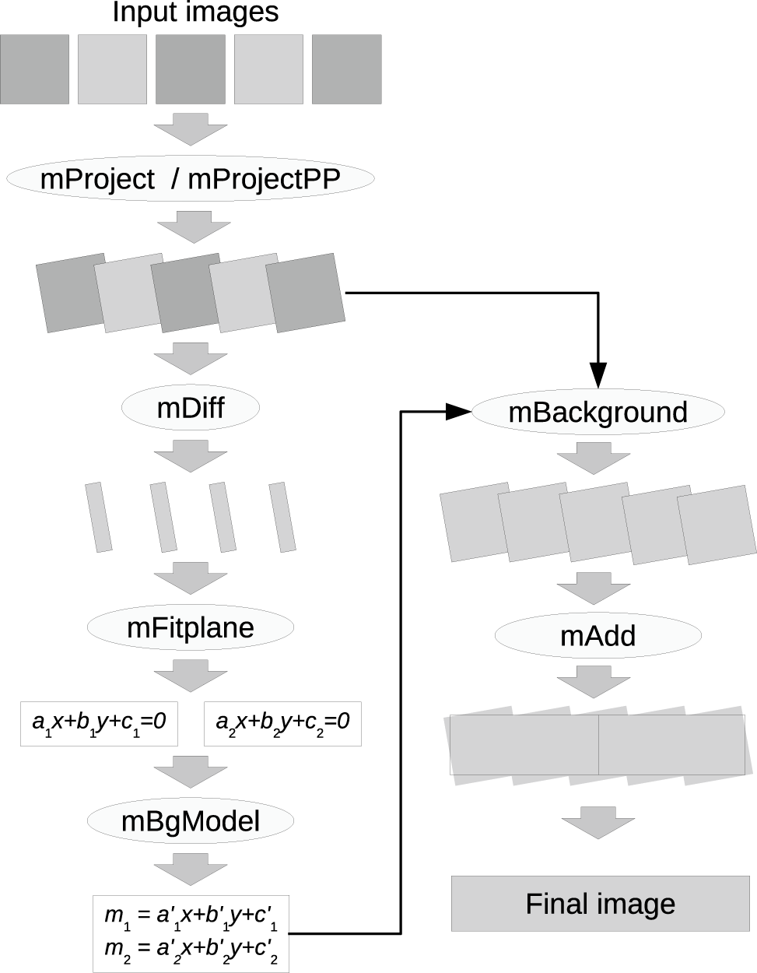
Montage Astrophysics workflow
Flexible Task dependency
Loop & Conditions
Parallel & Remote execution
availability from single host to Cluster & Grid

Slide 4
Pwrake
= Rake + Parallel Workflow extension
Rake
Ruby version of make
Much powerful description than Makefile
Just specify input files and output files, that it!
Pwrake
Parallel workflow extension
If execution fails, pwrake again
Extensible
Mounting Gfarm file system on the remote node
Gfarm file affinity scheduling

Slide 5
Rake syntax = Ruby syntax
Key-value argument to file method
task_name => prerequisites
Ruby method
defined in Rake
file “prog” => [“a.o”, “b.o”] do
sh “cc –o prog a.o b.o”
end
Ruby code block
enclosed by do … end or {…}.
not executed on task definition,
but passed to the file method and
executed as a task action

Slide 6
Pwrake implementation
PwMultitask class
SSH connection
Prerequisite
Tasks
Task Queue
Thread Queue for remote executions
enqueue
dequeue
Task1
remote host1
worker thread1
Task2
worker thread2
remote host2
Task3
worker thread3
remote host3
…
able to extend for
affinity scheduling

Slide 7
Benefit of Pwrake
Rakefile is evaluated as a Ruby script.
With Ruby’s scripting power,
ANY TASK and DEPENDENCY can be defined.

Slide 8
Example of Rake (1)
File Dependency:
Not suffix-based dependency
How do you define these tasks?
A00
A01
A02
A03
…
B00
B01
B02
…

Slide 9
Comparison of task definition
Make:
B00: A00 A01
prog A00 A01 > B00
B01: A01 A02
prog A01 A02 > B01
B02: A02 A03
prog A02 A03 > B02
……
Rake:
for i in "00".."10"
file “B#{i}" => [“A#{i}",“A#{i.succ}"] {|t|
sh "prog #{t.prerequisites.join(' ')} > #{t.name}"
}
end

Slide 10
Example of Rake (2)
File dependency is given as a list written in a file:
$ cat depend_list
dif_1_2.fits image1.fits image2.fits
dif_1_3.fits image1.fits image3.fits
dif_2_3.fits image2.fits image3.fits
...
How do you write this?
image1
image2
image3
…
dif_1_2
dif_1_3
dif_2_3
…

Slide 11
Dependency is given as a file list
Make:
Needs other script to convert file list to Makefile
Rake:
open("depend_list") { |f|
f.readlines.each { |line|
name, file1, file2 = line.split
file name => [file1,file2] do |t|
sh “prog #{t.prerequisites.join(' ')} #{t.name}"
end
}
}

Slide 12
Performance measurement
Workflow:
Montage
a tool to combine astronomical images.
Input data:
3.3 GB (1,580 files) of 2MASS All sky survey
Used cluster:
site | core | nodes | memory
Univ of Tsukuba | quad | 8 | 4GB
AIST | dual | 8 | 2GB

Slide 13
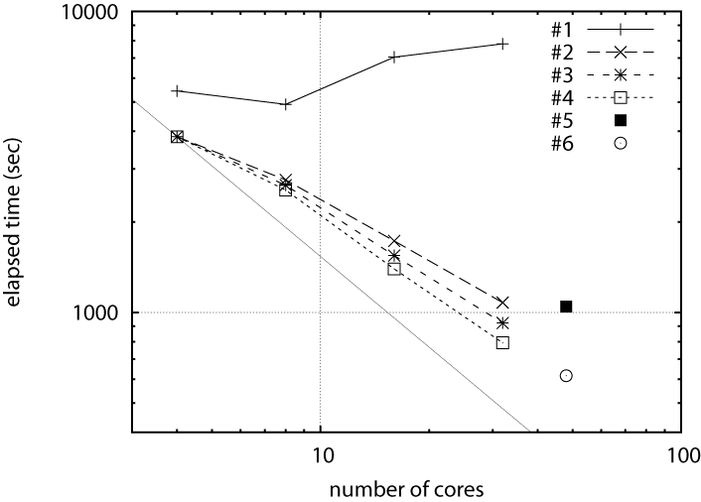
Performance of Montage workflow
1 node
4 cores
2 nodes
8 cores
4 nodes
16 cores
2 sites
16 nodes
48 cores
1-site
8 nodes
32 cores

Slide 14
Performance of Montage workflow
NFS
1 node
4 cores
2 nodes
8 cores
4 nodes
16 cores
2 sites
16 nodes
48 cores
1-site
8 nodes
32 cores

Slide 15
Performance of Montage workflow
Gfarm
without affinity scheduling,
initial files are not distributed
1 node
4 cores
2 nodes
8 cores
4 nodes
16 cores
2 sites
16 nodes
48 cores
1-site
8 nodes
32 cores

Slide 16
Performance of Montage workflow
Gfarm
with affinity scheduling,
initial files are not distributed
1 node
4 cores
14%
speedup
2 nodes
8 cores
4 nodes
16 cores
2 sites
16 nodes
48 cores
1-site
8 nodes
32 cores

Slide 17
Performance of Montage workflow
Gfarm
with affinity scheduling,
initial files are distributed
1 node
4 cores
20%
speedup
2 nodes
8 cores
4 nodes
16 cores
2 sites
16 nodes
48 cores
1-site
8 nodes
32 cores

Slide 18
Performance of Montage workflow
Gfarm
with affinity scheduling,
initial files are distributed
1 node
4 cores
2 nodes
8 cores
4 nodes
16 cores
2 sites
16 nodes
48 cores
1-site
8 nodes
32 cores

Slide 19
Performance of Montage workflow
Gfarm
with affinity scheduling,
initial files are optimally allocated
1 node
4 cores
2 nodes
8 cores
4 nodes
16 cores
2 sites
16 nodes
48 cores
1-site
8 nodes
32 cores

Slide 20
Conclusion
Pwrake, a parallel and distributed flexible workflow management tool, is proposed.
Pwrake is extensible, and has flexible and powerful workflow language to describe scientific workflow.
We demonstrate a practical e-Science data-intensive workflow in Astronomical data analysis on Gfarm file system in wide area environment.
Extending a scheduling algorithm to be aware of file locations, 20% of speed up was observed using 8 nodes (32 cores) in a PC cluster.
Using two PC clusters located at different sites, the file location aware scheduling and appropriate input data placement showed scalable speedup.

