Slide 1
More Nuts and Bolts in Virtualization

Slide 2

Amazon EC2
EC2 = Elastic Computing Cloud
Introduced (Beta) in Sept 2006
Uses Xen para-virtualization as underlying VM engine
Users rent Virtual Machines by the core/hour
32-bit = $.085/core/hour (0.12 for Windows)
64-bit, 4-cores minimum ($0.34/hour)
Have variations of larger memory, more cores, etc.
Cores are roughly 1.2 GHz equivalent
Standard instances have 1.7GB mem/core. Local Disk
You are charged for network in/out of Amazon

Slide 3
EC2 was THE Catalytic event for Cloud Computing
Q: Why?

Slide 4
A: Users could have (new) servers without owning any hardware
No Upfront Capital Cost
“0” time spent on Hardware Purchase

Slide 5
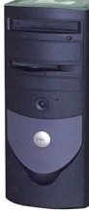


Basic EC2
Elastic Compute Cloud (EC2)
Amazon Cloud Storage
Copy AMI &
Boot
S3 – Simple Storage Service
EBS – Elastic Block Store
AMIs are copied from S3 and booted in EC2 to create a “running instance”
When instance is shutdown, all changes are lost
Can save as a new AMI
Amazon Machine Images (AMIs)

Slide 6
Basic EC2
AMI (Amazon Machine Image) is copied from S3 to EC2 for booting
Can boot multiple copies of an AMI as a “group”
Not a cluster, all running instances are independent
If you make changes to your AMI while running and want them saved
Must repack to make a new AMI
Or use Elastic Block Store (EBS) on a per-instance basis

Slide 7
Some Challenges in EC2
Defining the contents of your Virtual Machine (Software Stack)
Understanding limitations and execution model
Debugging when something goes wrong
Remembering to turn off your VM
Smallest 64-bit VM is ~$250/month running 7x24

Slide 8
What’s in the AMI?
Tar file of a / file system
Cryptographically signed so that Amazon can open it, but other users cannot
Split into 10MB chunks, stored in S3
Amazon boasts more than 2000 public machine images
What’s in a particular image?
How much work is it to get your software part of an existing image?
There are tools for booting and monitoring instances.
Defining the software contents is “an exercise left to the reader”

Slide 9
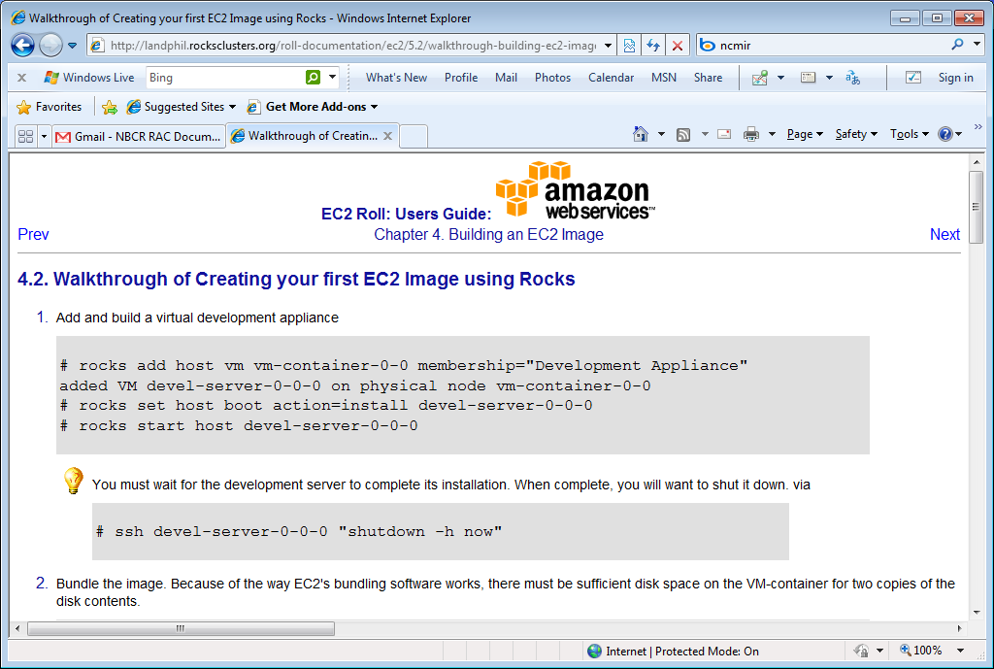
In the Rocks and NBCR Lab
EC2 Roll Development
We define our clusters using Rocks
Can build Virtual Machine Images that are Bootable in EC2
→ Practical publishing of complex software stacks
With complete reproducibility (and local testing/development)
Handcraft to Automation
Initial Development 4 months from vision to EC2 VM
2nd iteration --- Two Weeks from start to EC2 VM
Today – about 1 hour

Slide 10
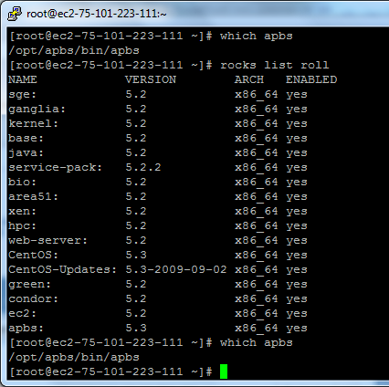
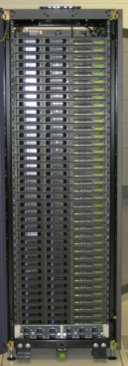

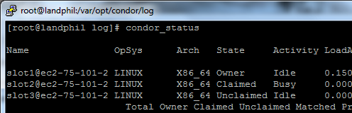
Proof of Concept Using Condor
APBS Roll (NBCR) → Amazon VM (Rocks)
< 24 Hours from SW Release (4 Feb ‘10) to VM (5 Feb ‘10)
Cluster extension into Amazon using Condor
Local Cluster
EC2 Cloud
Running in Amazon Cloud
NBCR VM
NBCR VM
NBCR VM
APBS + EC2 + Condor

Slide 11
The EC2 Roll
Take a Rocks appliance and make it compatible with EC2:
10GB disk partition (single)
DHCP for network
ssh key management
Other small adjustments
Create an AMI bundle on local cluster
rocks create ec2 bundle
Upload a bundled image into EC2
rocks upload ec2 bundle
Mini-tutorial on getting started with EC2 and Rocks

Slide 12
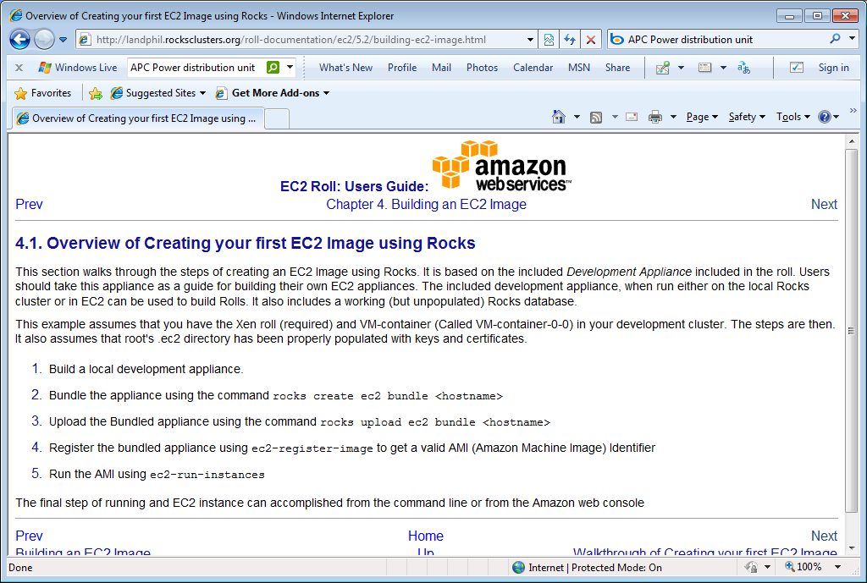
Overview of Image Creation

Slide 13
Why EC2 Roll?
Reliably creating AMIs from scratch is important for reproducibility
Rocks is a rich system definition structure want to leverage
Debugging is difficult in EC2. Can do many things more quickly when on local hardware
Pre-beta:
http://landphil.rocksclusters.org/roll-documentation/ec2/5.2/
- Not a durable website!

Slide 14
Some Quirks of EC2
Network performance is undefined
¼ GbE for a 32-bit instance
About 1 GbE for each physical host
When you turn off an instance you lose all changes made locally
Good: Booting from an AMI is a “frozen/known” image
Bad: Not the way your local “real” machine works
IP addressing is a bit weird
You contact your instance via a real public IP
“ifconfig eth0” is a non-routable 10.x.y.z address
Packaging of AMIs is pretty cryptic
API (command line tools) are very inconsistent.
Not always “quick” : Booting a complex AMI (1.5GB compressed image) took 22 minutes this morning

Slide 15

Rocks, Xen, and Virtual Clusters

Slide 16
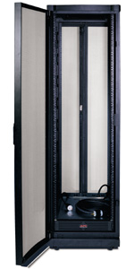
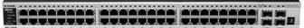
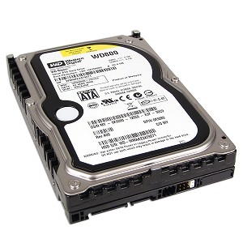
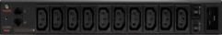
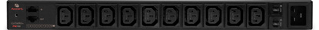
Taken for Granted in Real HW
Network
Physical world “automatically” defines a cluster by how the components are assembled
Disk
Power

Slide 17
Virtual Clusters
Virtual Cluster 1
Require:
Virtual Frontend
Nodes w/disk
Private Network
Power
Virtual Cluster 2
Virtual Clusters:
May overlap one another on physical HW
Need network isolation
May be larger or smaller than physical hosting cluster
Physical Hosting Cluster
“Cloud Provider”

Slide 18
How Rocks Treats Virtual Hardware
It’s just another piece of HW.
If CentOS supports it, so does Rocks
Allows mixture of real and virtual hardware in the same cluster
Because Rocks supports heterogeneous HW clusters
Re-use of all of the software configuration mechanics
E.g., a compute appliance is compute appliance
Virtual HW must meet minimum HW Specs
1GB memory
36GB Disk space
Private-network Ethernet
+ Public Network on Frontend

Slide 19
Network Isolation - VLANs
Need to isolate the private networks of (overlapping) virtual clusters
Broadcast traffic (e.g. DHCP) needs to be confined
IEEE 802.1Q VLAN Tagging
Mark (Tag) ethernet packets with a particular numeric ID ( 1 – 4095).
Packets with same tag are in the same LAN
Rocks defines nodes are in the same cluster if VLAN tag on the private interface is identical

Slide 20
List Clusters: VLAN Tag on Private Net
Need to configure Ethernet Switch for VLANs
Vendor-specific commands : SMC ≠ Cisco ≠ Extreme …
Virtual Cluster 1
VLAN ID = 4
[root@rocks-76 ~]# rocks list cluster
FRONTEND CLIENT NODES TYPE
afg.rocksclusters.org: ----------------- VM
: hosted-vm-0-5-0 VM
: hosted-vm-0-4-0 VM
: hosted-vm-0-3-1 VM
: hosted-vm-0-2-1 VM
rocks-178.sdsc.edu: ----------------- VM
: hosted-vm-0-0-2 VM
rocks-76.sdsc.edu: ----------------- physical
: vm-container-0-0 physical
: vm-container-0-1 physical
: vm-container-0-2 physical
#[root@rocks-76 ~]# rocks list host interface
HOST IFACE NAME VLAN
frontend-0-0-11: eth0 frontend-0-0-11 4
frontend-0-0-11: eth1 afg.rocksclusters.org 0
hosted-vm-0-2-0: eth0 hosted-vm-0-2-0 144
hosted-vm-0-2-1: eth0 hosted-vm-0-2-1 4
Virtual Cluster 2
VLAN ID = 144

Slide 21
Inside VM Hosting (Physical) Cluster must Provide Network Plumbing
Linux (and Solaris) supports explicit tagging
eth0 = Physical Network
eth0.144
Tag outgoing packets with VLAN ID 144
Receive only packets tagged with ID 144
Bridges (Software Ethernet Switches) utilized by Xen
Xen Dom0
VM1
VM-N
Physical Host
VM2
xenbr.eth0 (bridge)
xenbr.eth0.144
(bridge)
eth0 (untagged)
eth0.144 (VLAN 144)
Tag /
Un-tag
144
Here
physical interface
Switch must be configured to support native (untagged) VLAN and tagged VLAN (e.g. 144)

Slide 22
Assembly into Virtual Clusters: Overlay on Physical
Virtual Cluster
Rocks simplifies creation of all network interfaces
Real, virtual & bridges
VM’s are blind to the actual packet tag being used

Slide 23
Other Virtual Items
Disks
Xen has many choices for what types of “backing” store is used for virtual disk
Rocks supports files for backing store
If you really know Xen, you can specify other methods
CPU/Memory
Power – Commands to turn on/off VMs
rocks start host vm
rocks stop host vm

Slide 24
VM Host (Dom0) vs VM Guest (DomU)
VM Host (Dom0) AKA
“Cloud Provider”
Creates tagged Interfaces & associated xen bridges
Allocates Local Disk Space for each VM
Allocates Memory/CPU to each VM
Wires VM interface(s) to appropriate bridges
VM Guest DomU
Sees disk, CPU, Memory, and Network Interfaces, as if real HW
Generally, cannot tag with eth0.<id>

Slide 25
Some Realities of Virtual Clusters
When you start building Hosting Clusters, you build many clusters
Viewpoints:
Physical Cluster that Hosts Virtual Machines
Cloud Provider: Allocation of resources (disk, network, CPU, memory) to define a virtual cluster
Cluster Owner: Configuration of Software to define your environment
Your first virtual cluster requires you to define three clusters and build two
Rocks > 5.0 provides infrastructure for all of this
Share as much as possible

Slide 26
A Taste of the Command Line
Build Physical Hosting Cluster with Xen Roll and build vm-container appliances
Allocate resources for a virtual cluster
rocks create cluster <ip of virtual frontend> <fqdn of frontend> <# of nodes> vlan=<vlanid> [<options>]
Start and build virtual cluster frontend
rocks start host <vm fqdn of frontend>

Slide 27
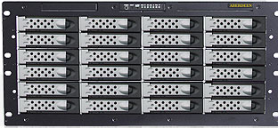
Building Hybrid/Mixed Clusters
Hybrid/Mixed
Base View: Same VLAN == Same Cluster
Some Examples:
Less Hardware: Virtual Frontend
Physical Storage
Testing
Virtual Compute
Real Frontend
Reduce HW costs for lightly loaded elements
Test new software configuration before rolling to production
Extending a cluster with cloud-based HW
Storage Cluster
Compute Cluster

Slide 28
Campus Cloud: Cluster Extension
VMs: Software/OS defined by the frontend:
Users, file system mount, queuing system, software versions, etc
Working on doing this with Commercial Clouds → VLAN abstraction does not work here!

