Slide 1
Development of OGC Framework for Estimating Near Real-time Air Temperature from MODIS LST and Sensor Network
Dr. Sarawut NINSAWAT
GEO Grid Research Group/ITRI/AIST
Notes:
Urbanization and Geo-environmental monitoring
Web-GIS for Geo-environmental monitoring
Geospatial interoperability
FOSS for Geoinformatics

Slide 2
Contents
Background
Our previous work
MODIS LST
Live E! project
Prototype system

Slide 3
Introduction
Environmental Study
Natural environments
Global Warming / Climate Change
Monitoring spatial-temporal dynamic changes
Sustainable development
Geo-environmental quality and management
Complex chain process
Diverse distributed data source
Huge of data for time-series data
Implementation of database and IT solutions for e-Science infrastructure

Slide 4
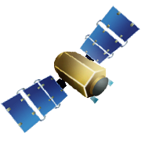



Geospatial Data Gathering
Satellite
Data Center
Field Survey
with Laboratory
Data Logger
Internet
Smart Sensor

Slide 5



OGC System Framework
PSS
SOS
WMS,WMS-T
PEN Observation System
52NorthSOS
Mapserver
???
“Any” Observation System
Overpass time
scene
MODIS MOD08
Daily image
GetObservation
[During MODIS overpass time from
start to end]
XML
GetFeatureInfo
[MODIS value
from start to end]
JSON
GetObservation
ADFC
WPS
Execute
[station,start,end,product]
PyWPS
Validation process
Least Square Fitting process
JSON
R
rpy2
simplejson
Etc..
Client

Slide 6
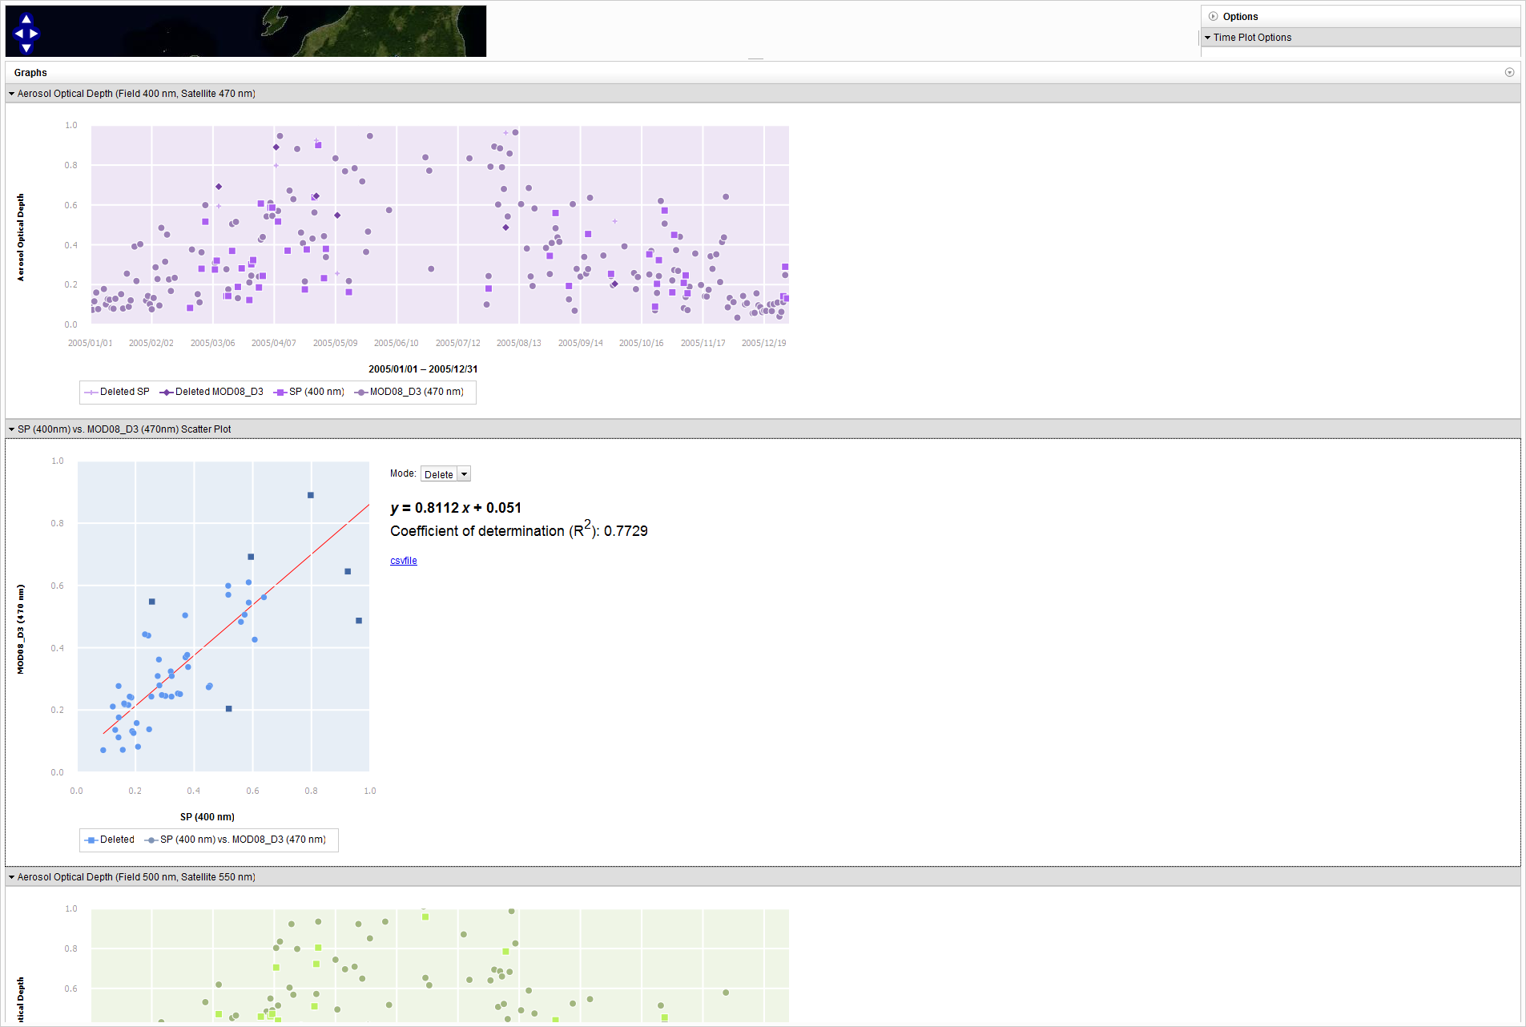
Prototype Application

Slide 7
Prototype Application

Slide 8
Validation satellite products
Basic Product
Top of the atmosphere
Surface Reflectance
Land Surface Temperature
Sea
Surface
Temperature
Higher Product
Gross Primary
Productivity
Chlorophyll A
Land Cover
Vegetation
Indices

Slide 9
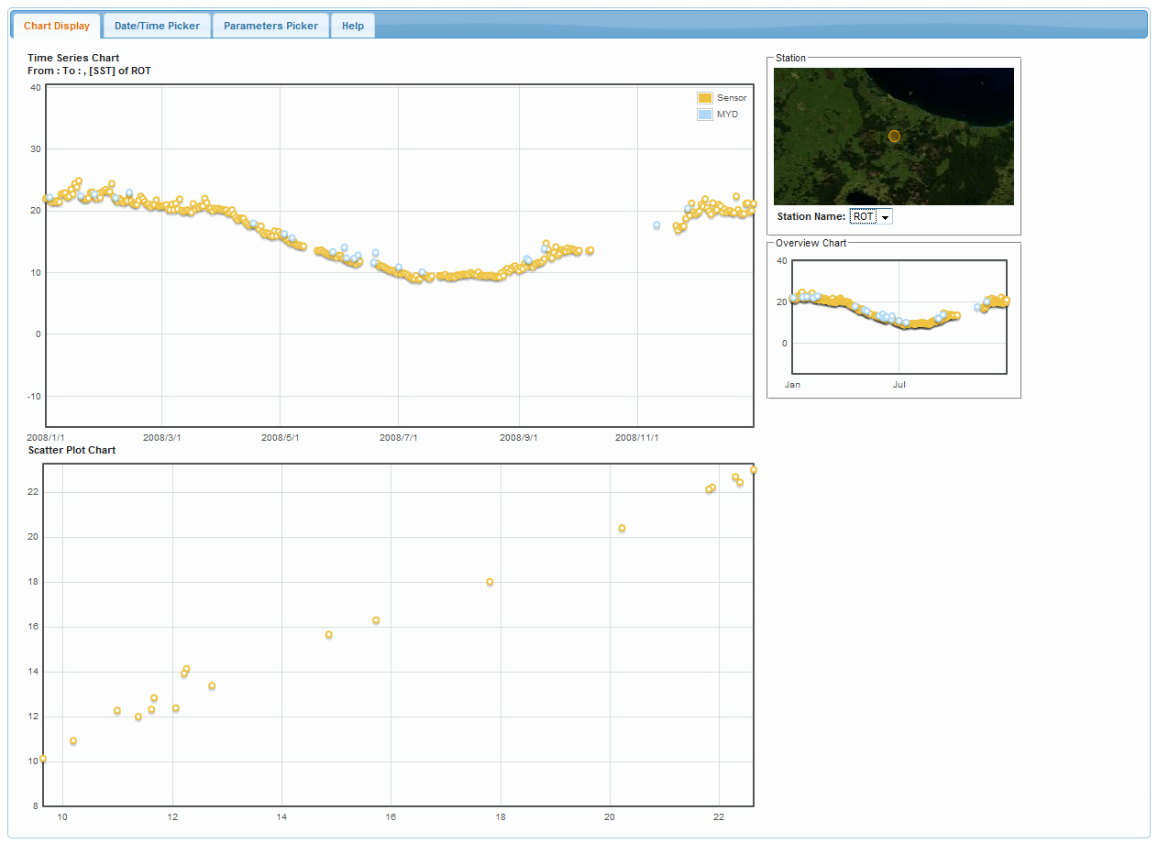
SST: Lake Rotorua vs Satellite data

Slide 10
SST: Lake Rotorua vs Satellite data

Slide 11
Weather Station : Live E! project
“Weather Station” is a the biggest available Sensor Network.
Live E! is a consortium that promotes the deployment of new infrastructure
Generate, collect, process and share “Environmental Information”
Accessible for Near/Real-time observation via Internet Connection
Air temperature, Humidity, Wind Speed, Wind Direction, Pressure, Rainfall

Slide 12
Air Temperature
Air temperature near the Earth’s surface
Key variable for several environmental models.
Agriculture, Weather forecast, Climate Change, Epidemic
Commonly measure at 2 meter above ground
Spatial interpolation from sample point of meteorological station is carried out.
Uncertainly spatial information available of air temperature is often present.
Limited density of meteorological station
Rarely design to cover the range of climate variability with in region

Slide 13
MODIS LST
MODIS Land Surface Temperature
Day/Night observation
Target accuracy ±1 K.
Derived from Two Thermal infrared band channel
Band 31 (10.78 - 11.28 µm)
Band 32 (11.77 – 12.27 µm)
Using split-window algorithm for correcting atmospheric effect
Indication of emitted long-wave radiation
Not a true indication of ambient air temperature
However, there is a strong correlation between LST and air temperature

Slide 14
Prototype System
High temporal measured air temperature by Live E! Project sensor network
High spatial density measured Land Surface Temperature by MODIS Satellite.
Coupling both of data set will provides as a comprehensive data source for estimating air temperature
A prototype distributed OGC Framework offer
Product of regional scale estimated near real-time air temperature from MODIS LST evaluated with Live E! Project sensor network.

Slide 15
OGC System Framework
Node
SOS
WMS, WCS
Live E! Sensor Node
52NorthSOS
Mapserver
???
“Any” Observation System
Overpass time
scene
MODIS MOD11
Daily image
GetObservation
[During MODIS overpass time from
start to end]
GetFeatureInfo
[MODIS value
from start to end]
GetCoverage
GetObservation
ADFC
WPS
Execute
[station,start,end,product]
PyWPS
Validation process
Least Square Fitting process
Image Processing process
JSON
Execute
Client
R
rpy2
simplejson
GRASS,
GDAL
GeoTiff

Slide 16
Conclusion
Prototype system is still developing.
Assimilation of sensor observation data and satellite image
Wider area, More accuracy, Reasonable cost
More information from estimated air temperature
Growing Degree Days (Insect, Disease vector development)
Pollen forecast
Data sharing via standard web services
Information vs Data Storage available (Peter)
On-demand accessing
Reduce data redundancy

Slide 17









