Slide 1
insilicoCell: an integrated platform for biological model development and analysis
Thai Quang Tung
Korea Institute of Science and Technology Information (KISTI)

Slide 2
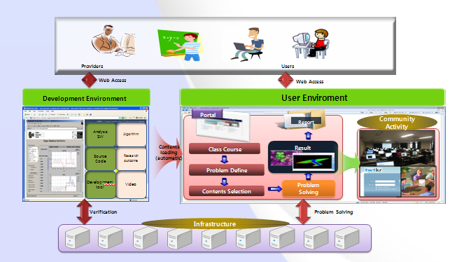
Dept. of Cyber environment, KISTI
Development of Next-Generation Cyber Research Environment
Development of an Advanced Science Education Hub
Development of Science Cloud Technology

Slide 3
System biology
System biology aims at a (sub)system level understanding of biological process and networks

Slide 4
System biology
Target systems: organisms, organs, tissues, signaling networks (molecular level)

Slide 5
Why modeling?
Comprehend information
Reduce complexity, help understanding real systems
Explain biological phenomena
Virtual laboratory
Generating new hypotheses
Design new experiments

Slide 6
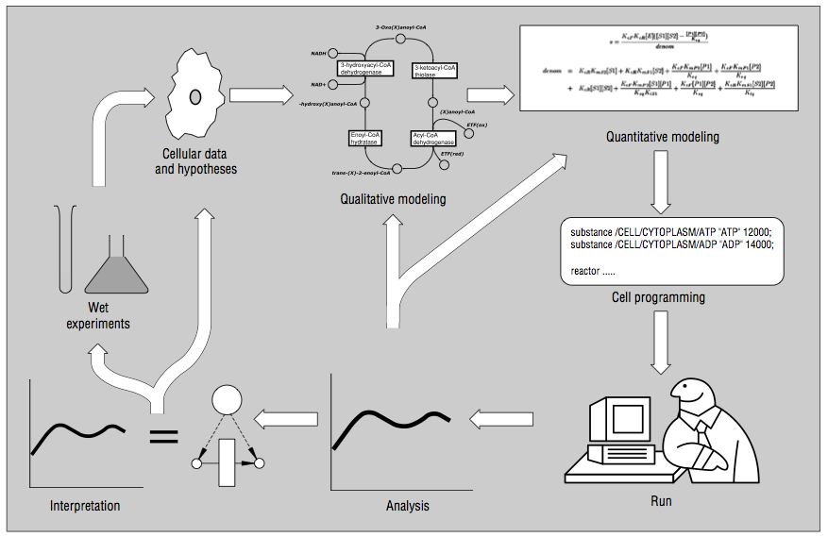
Modeling process

Slide 7
What computer can help?
Knowledge management
Search literature database (PubMed) for system interactions
Search gene/protein database for specific gene/protein functions
Computer simulation tools
Validate the model
Edit/create models
Dynamical analysis tools
Parameter estimation
Sensitivity analysis
Bifurcation analysis

Slide 8
insilicoCell
System biologists need:
multiple tools, some are complex to used (command line)
literature, database searching
Tools are developed for desktop environment
Interaction, reaction database
Systems biology workbench
Kinetic parameter database
insilicoCell brings:
Integration
Intuitive GUI
High performance computing
Biological model database
SBML editor
Model converter
Time-course simulation
Local sensitivity analysis
Parameter estimation
Biological system modelers
Global sensitivity analysis, robustness analysis
Bifurcation analysis

Slide 9
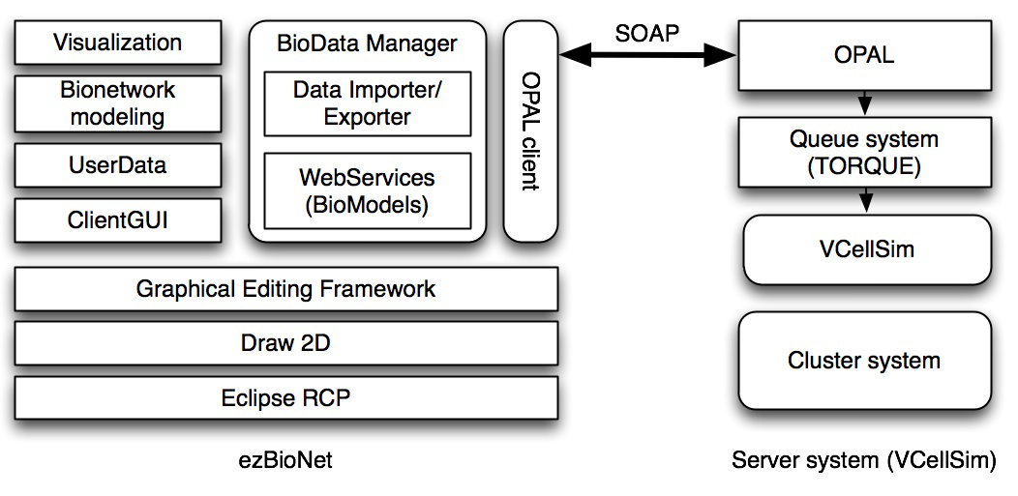
System architecture

Slide 10
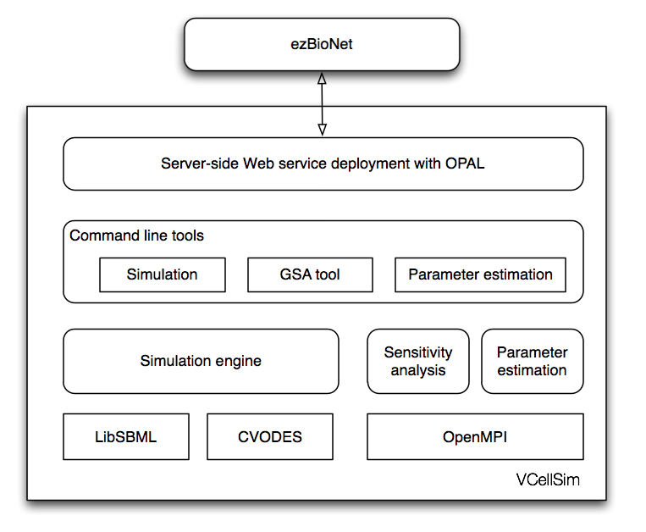
Computational engine

Slide 11
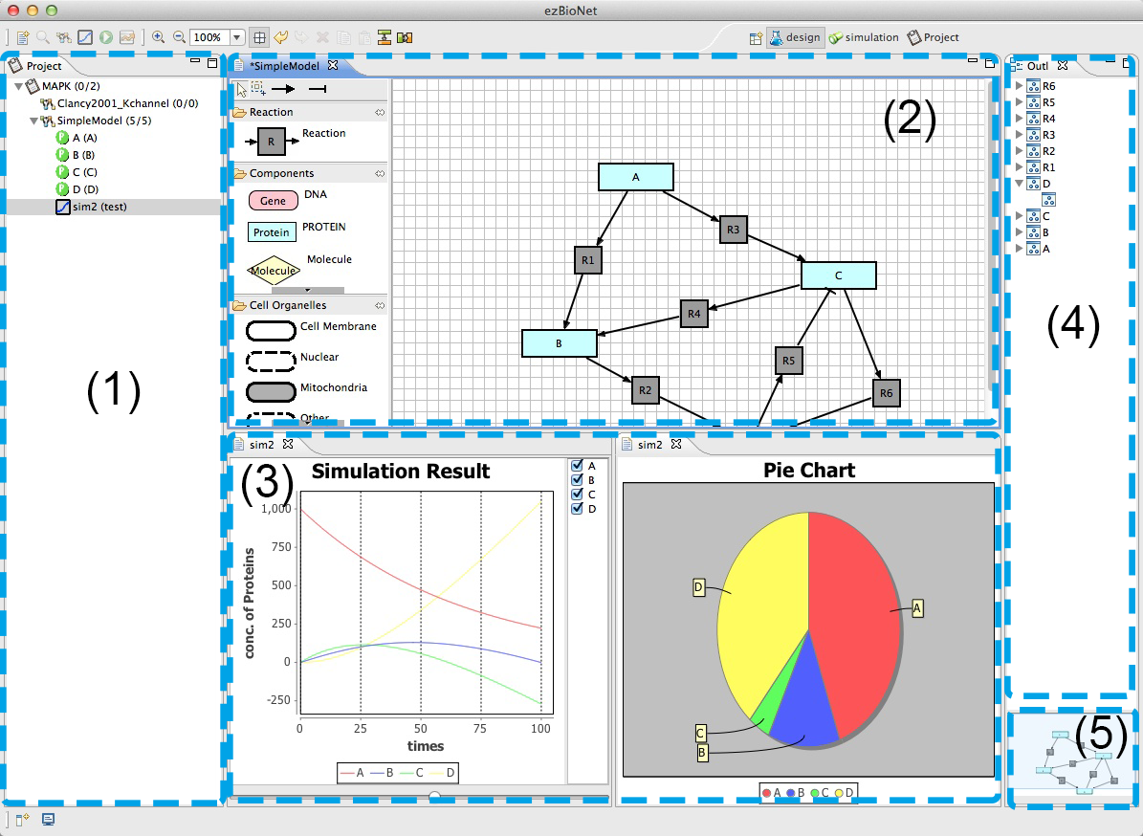
ezBioNet GUI

Slide 12
Demo

