Slide 1
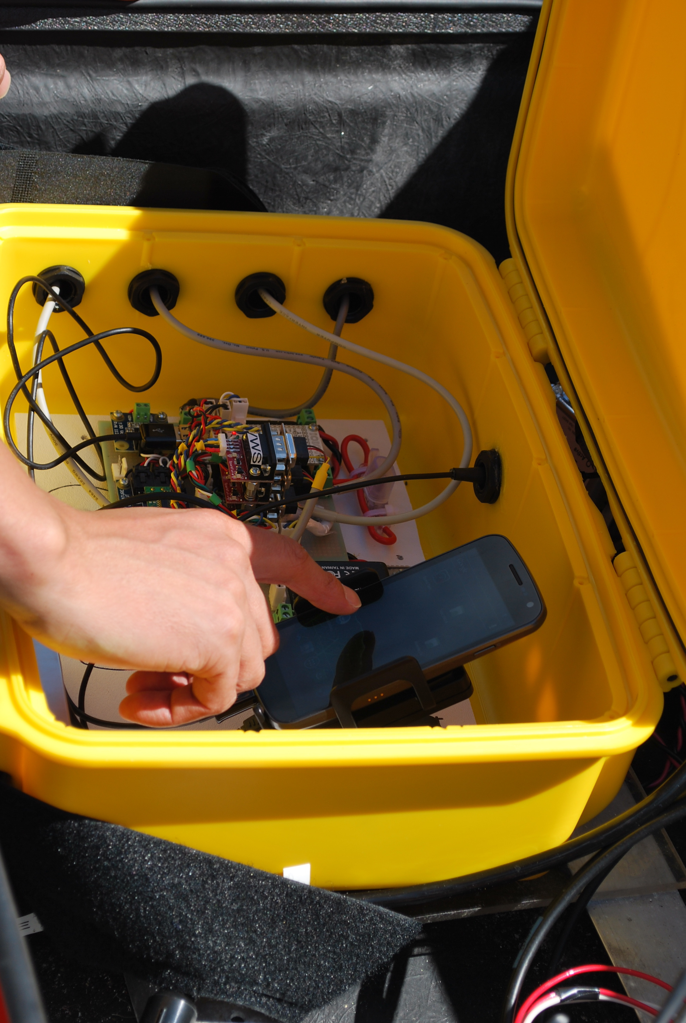


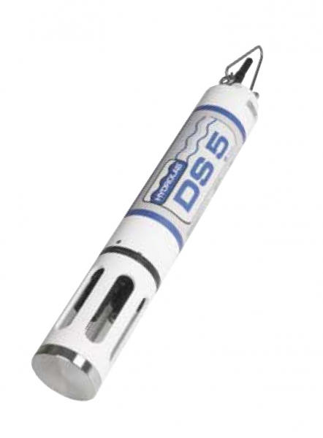
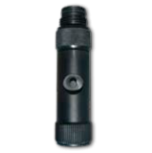
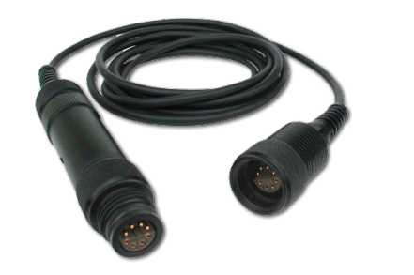
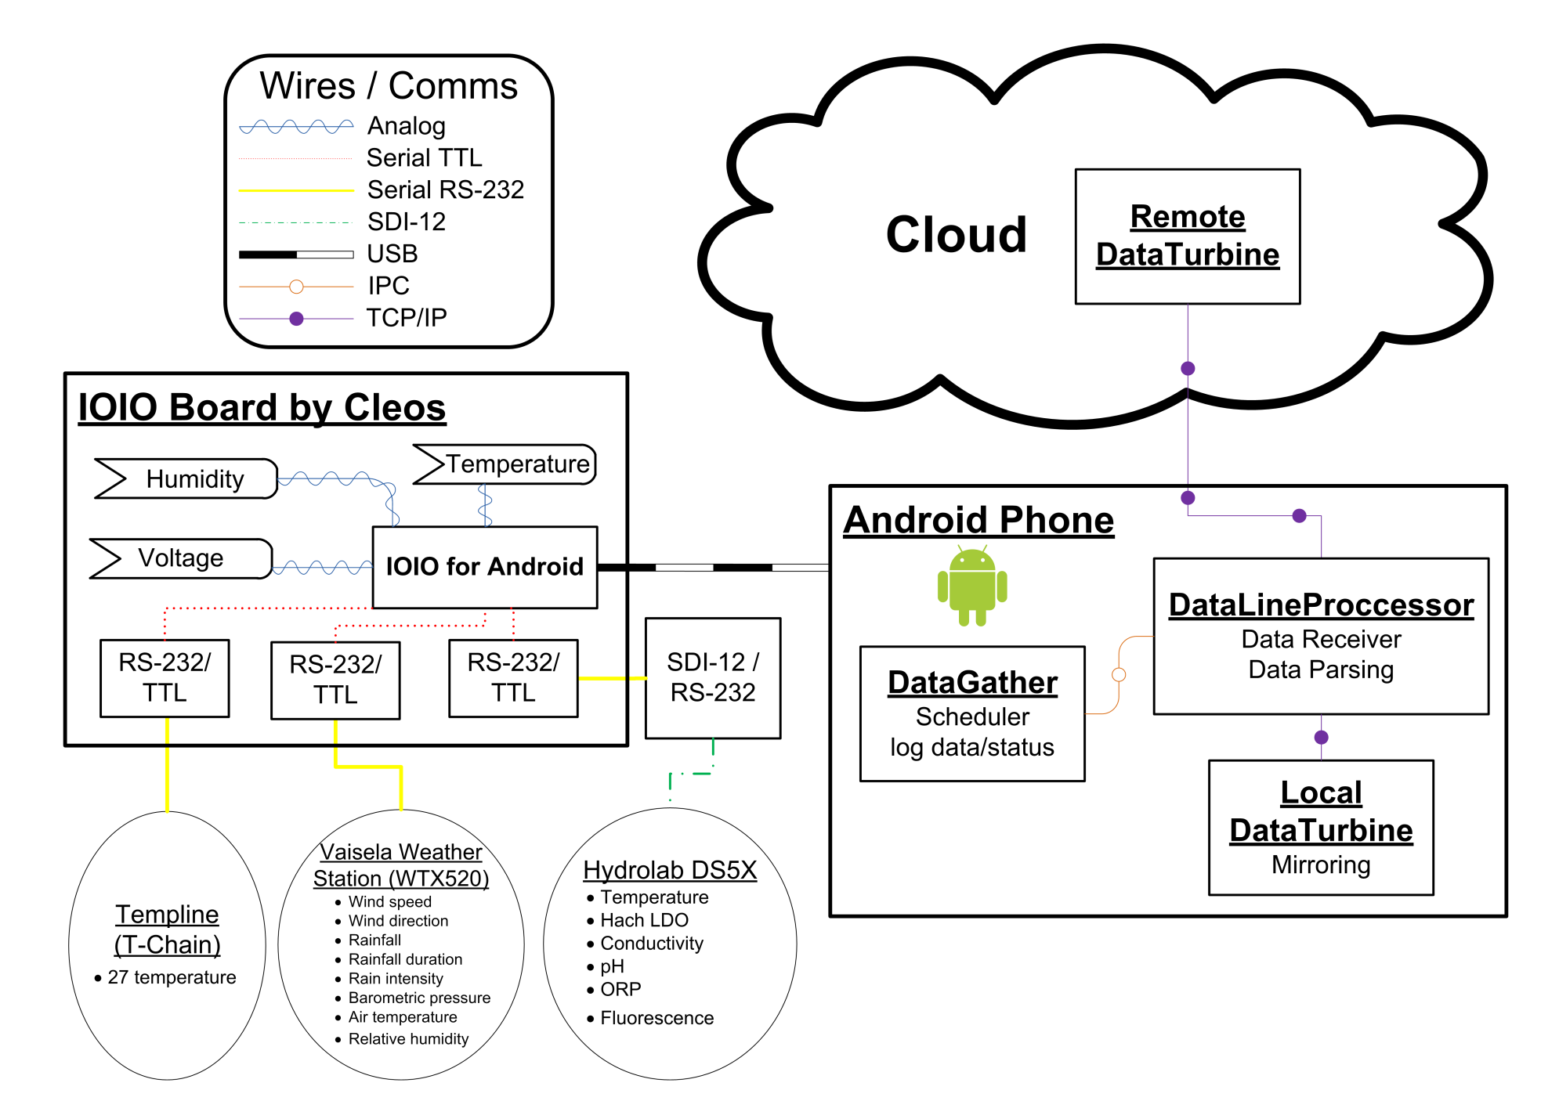
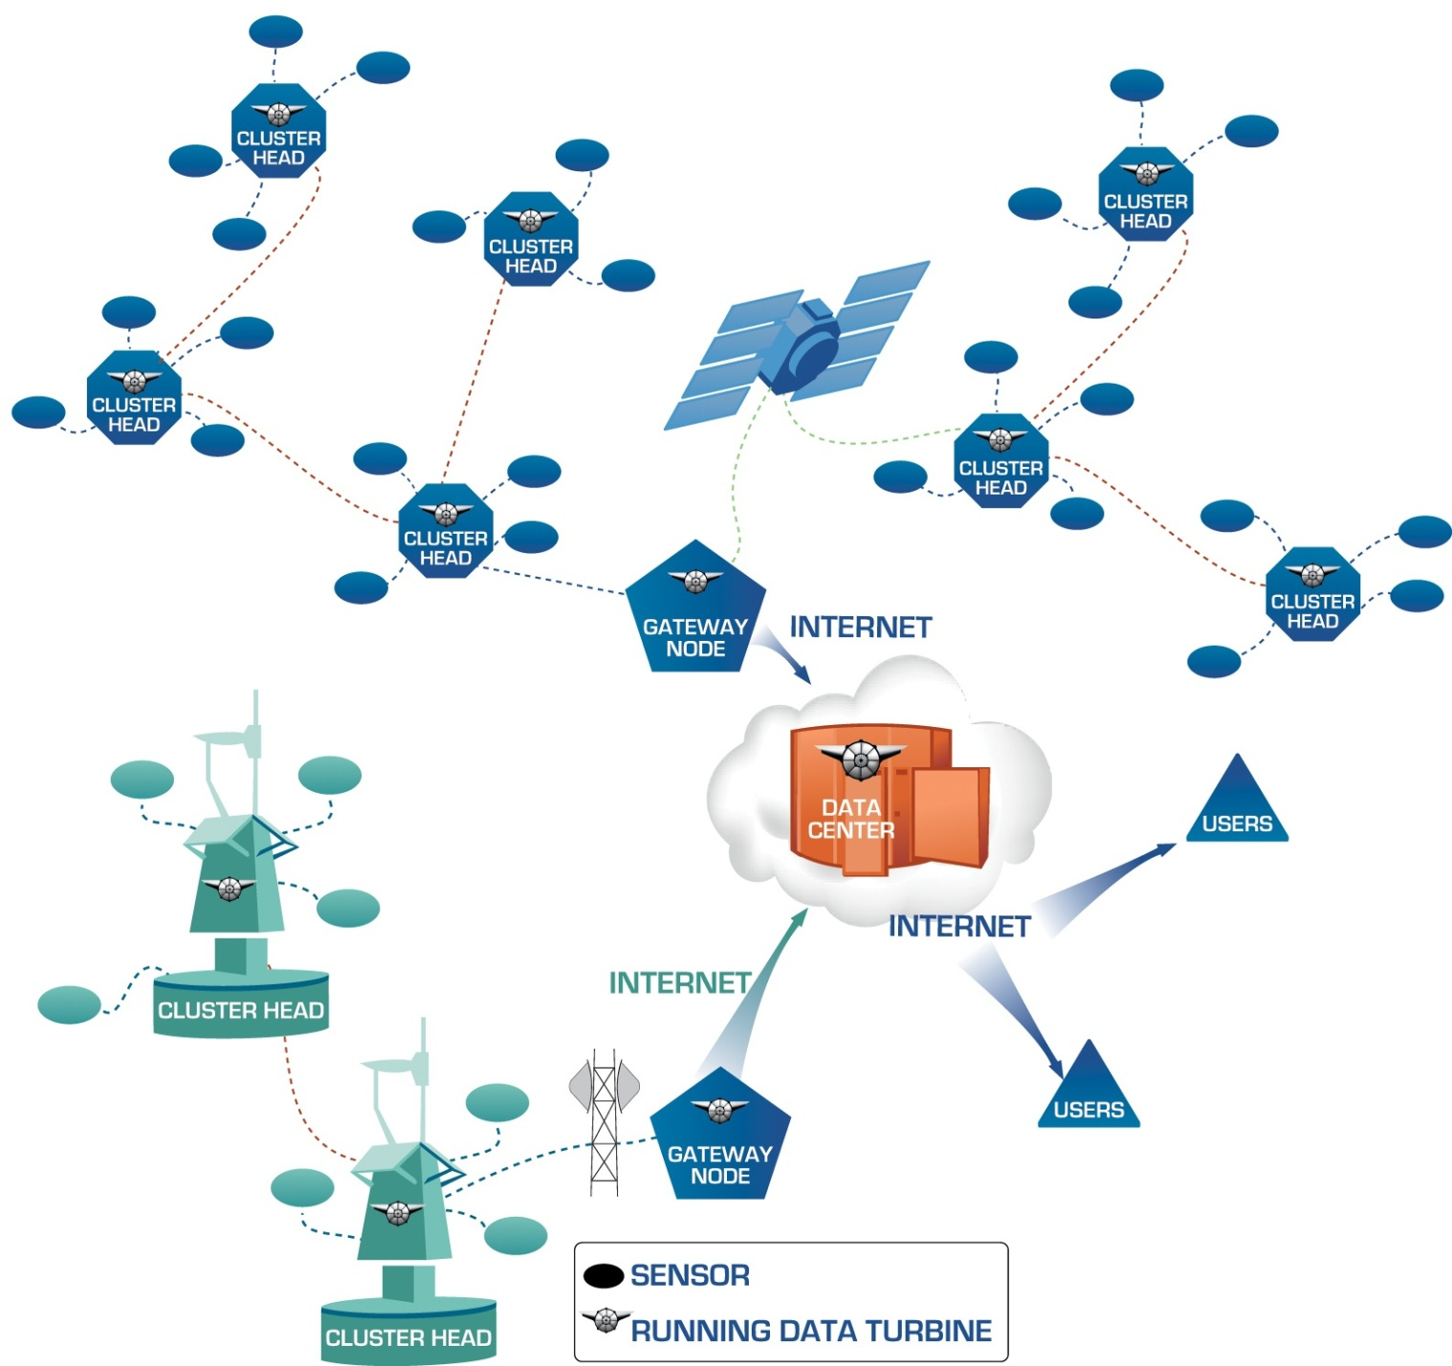
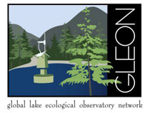





The DataTurbine Android Buoy Controller for Lake Monitoring
Peter Shin, Gesuri Ramirez, Sameer Tilak, Tony Fountain, Corinna Gries, Tim Kratz, Tim Meinke, Ken Morrison, Jordan Read
Abstract
The OSDT-Android Sensor Pod is a next-generation smart controller and communications device for applications in environmental monitoring, disaster response, and other real-time sensor applications. It combines the Open-Source DataTurbine streaming data middleware with the android platform to provide a robust, scalable, embedded computing and communication platform for distributed sensor networks. In this project we customized the Sensor Pod to serve as a smart buoy controller for experiments in lake ecology (limnology). This involved a combination of software and hardware developments together with field deployments to study the effects of induced lake mixing on invasive species at the North Temperate Lake (NTL) Long Term Ecological Research (LTER) site in Northern Wisconsin.
This project is collaboration with members of the University of Wisconsin North Temperate Lakes Long Term Ecological Research (LTER) site and the Global Lake Ecological Observing Network (GLEON, http://www.gleon.org) and is funded by the Gordon and Betty Moore Foundation.
As part of the project, we ported the OSDT middleware to the Android platform and developed new software for configuring and managing real-time embedded applications. The OSDT-Android controller communicates with sensors through serial interface and manages sensor interfaces, data acquisition, and data transmission over cellular network. Developed in Java, the OSDT sensor pod can manage a local constellation of sensors and communicates with other OSDT-enabled platforms. It can be readily updated to incorporate new software modules, and dynamically reconfigured to schedule these modules to control sensor operations and communications. It is designed to support on-platform event detection and real-time control, and includes necessary software for scheduling sensor operations and communications. Data from the field-deployed system is streamed to a DataTurbine server running on Amazon Elastic Compute Cloud (Amazon EC2) platform. Amazon cloud computing platform provides several benefits including elasticity, scalability, and low start up costs.
The OSDT-Android Sensor Pod was deployed at the Crystal Lake on August 7th 2012. This deployment includes a variety of sensor for monitoring lake processes, including temperature at twenty seven depths, dissolved oxygen, conductivity, pH/ORP, flourescence sensors (Chloraphyll a, Blue-green Algae, and Rhodamine WT) and voltage. All the sensors were sampled once per minute and the gathered data is logged at multiple points within the network to tolerate system failures. The acquired data is also transmitted in real-time to a DataTurbine server running on EC2 platform. We also conducted networking tests to gather system metrics including network latency and signal strength variations. The field-deployed component has been robust to occasional power and network outages and the system has been running stably since coming online.
Power Budget and Management
Lake Deployment at Crystal Lake in Wisconsin
Rainbow smelt, a cool-water fish species that was once introduced and established in non-native lakes, led to the demise of native fish species such as yellow perch, cisco (or lake herring), or walleye due to competition for food resources or direct predation. In the case of walleye, the introduction of rainbow smelt led to degradation of recreational fishing, an ecosystem service. A new approach to eliminating rainbow smelt – whole lake thermal manipulation – takes advantage of the differences in thermal tolerances between smelt, yellow perch, and walleye. By experimentally mixing a lake via multiple large diaphragms stationed over the deepest spot in the lake during mid-summer, researchers expect that the deeper waters of a lake will warm sufficiently to eliminate the cool water habitat required by the smelt.
In August 2012, this expedition deployed a second buoy over a secondary deep spot in the study lake, Crystal Lake, away from the diaphragms and an existing observational buoy. This was done to determine the horizontal extent of mixing in the lake as well as to collect associated measures of lake attributes, including dissolved oxygen, chlorophyll, and temperature at multiple depths. To date, we have observed that the diaphragms successfully warmed the bottom waters throughout the entire lake, stressing the rainbow smelt. During the winter, the lessons learned from this deployment will be integrated into refined design of the hardware and software, and the experimentation will continue in summer 2013.
This deployment involved the following sensors: Weather station (air temperature, barometric pressure, relative humidity, rainfall, rainfall duration, rain intensity, wind speed, wind direction); Hydrolab Multiprobe (water temperature, conductivity, pH, fluorescence); thermistor chain: (27 temperature sensors at various depths).
Crystal Lake is a primary study lake of the Long-Term Ecological Research (LTER) network’s North Temperate Lake (NTL) site, which is also a key GLEON site.
The Sensor Pod is currently configured to maintain adequate system power indefinitely under reasonable operational scenarios. With 2 batteries the system will remain powered for 8 days without any charge from the solar panels (2400 Wh / 299.93). A complete recharge takes approximately 30 hours depending on solar intensity. One day of operation requires three hours of sunlight. The system is easily extensible to additional batteries and solar panels for other classes of deployments.
Power Reserve/Generation
Number of batteries | 2
Batteries voltage (V): | 12
Batteries current (Ah) | 100
Total Amps-hour (Ah): | 200.00
Total Watts-hour (Wh): | 2400.00
Time to recharge the batteries (hours): | 30.00
Number of solar panels: | 1
Watts per solar panel: | 80
Total solar panels (W): | 80.00
Total solar panels (A): | 6.67
 |  | 25% of lost in 5V conversion
Power Consumption
Total Power consumed in 24 hours (W): | 239.94 | 299.925
Total Amp drawn in 24 hours (A) @12V: | 20.00 | 24.99
Power Budget
The time to recharge the battery for 24 hour operation using solar panels (hours): | 3.00 | 3.75
Total power consumed in 72 hours (W): | 719.82 | 899.78
The time it takes to recharge the battery for 72 hour operation using solar panels(hours): | 9.00 | 11.25
Sensor Pod In a Nutshell
The Sensor Pod integrates hardware devices for computation, communications, and power management. The Samsung Galaxy Nexus phone hosts the Android OS, DataTurbine, and Control and Communications Software. The IOIO board provides power to the phone, and interface to the digital and analog sensors.
Flexible and Scalable Sensor Network Architecture
XML Configuration and Control
The Sensor Pod can be dynamically reconfigured by modifying a global XML configuration file. Common management tasks can be accomplished efficiently by on-the-fly changes to this file, e.g., adding/removing sensors, changing sample rates, modifying communication policies. This greatly simplifies system configuration and management tasks and enables new science experiments that require real-time adaptive control.
<InstrumentList>
<Instrument>
<name>seaFET</name>
<id>1</id>
<serialnumber>10.0.100</serialnumber>
<imaddress>01</imaddress>
<commandsetlist>
<commandset>
<startdatetime>08/07/2011:10:00:00</startdatetime>
<enddatetime>08/10/201123:00:00</enddatetime>
<frequency>60</frequency>
<command>
<numberofretries>3</numberofretries>
<timeout>40</timeout>
<osdt-server-address>localhost:3333</osdt-server-address>
<osdt-source-name>seaFET01ctd</osdt-source-name>
<osdt-channel-mapping>temp,pressure</channel-mapping>
…
Cluster heads and gateway nodes provide the building blocks for complex distributed sensor systems. They consolidate control and communication services into modular platforms that can be organized into complex networks. The DataTurbine middleware provides a uniform integration framework for sensor data acquisition and management over challenging networks. The Android platform provides a software environment (operating system, software libraries, and development environment) for mobile and embedded applications. The new Sensor Pod developments leverage DataTurbine and Android to create a new platform for robust and scalable sensor network applications.
Instrument
Configuration: ID, Serial number, etc.
Commands: start/end time and sampling frequency
Commands: timing information, parsing information, IM address information
DataTurbine related operations: source name, channel names

