Slide 1


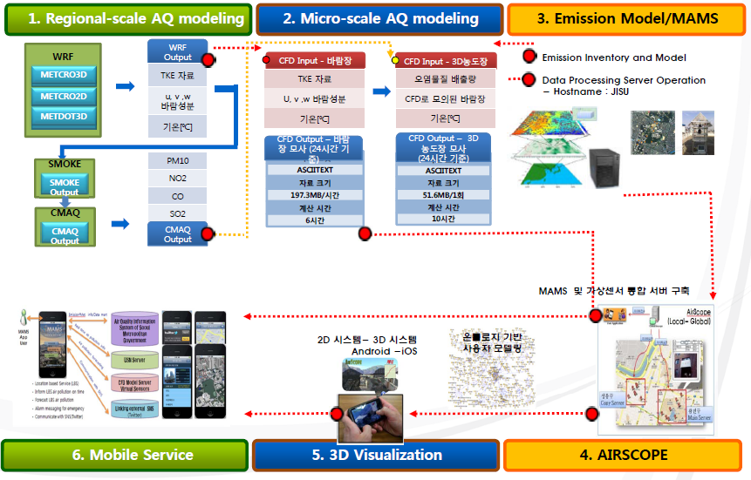
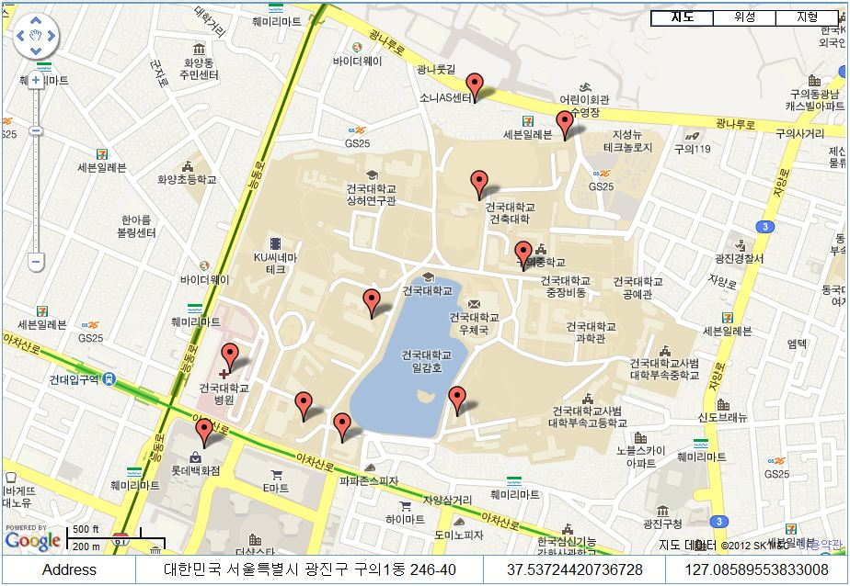
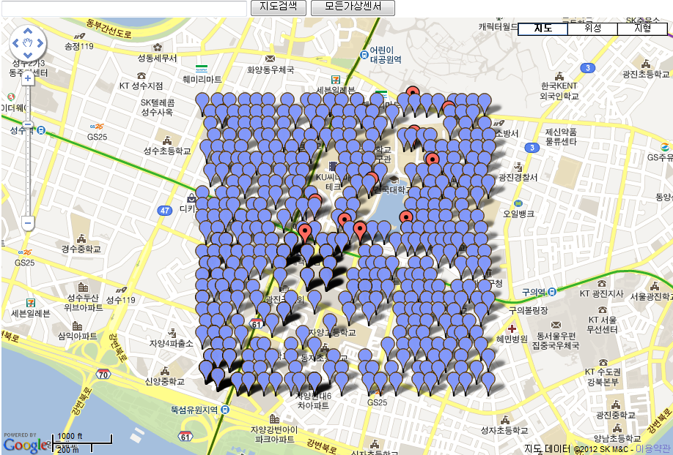
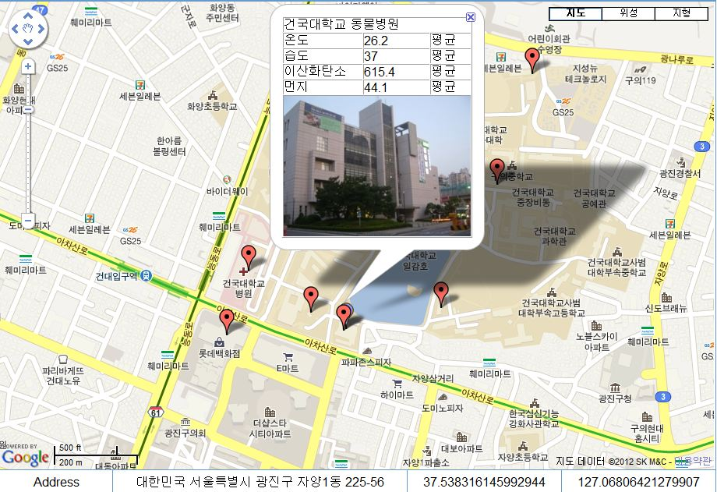
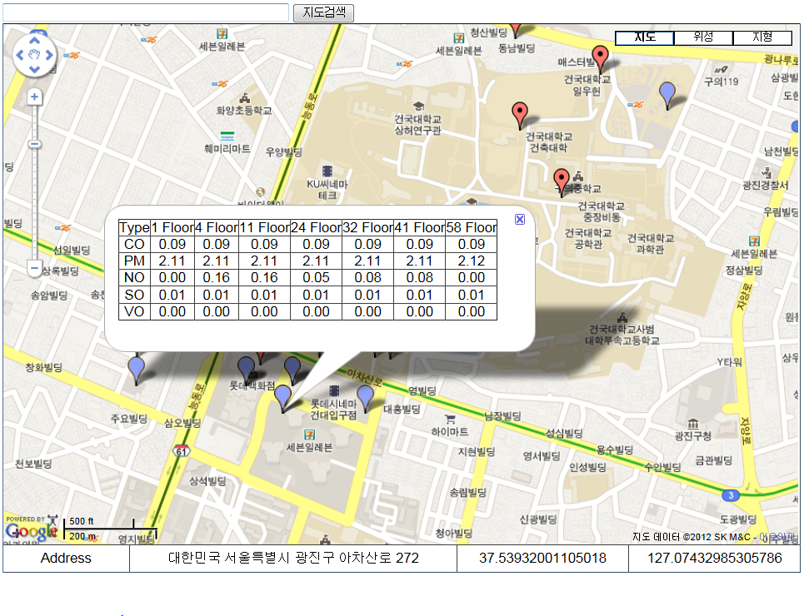
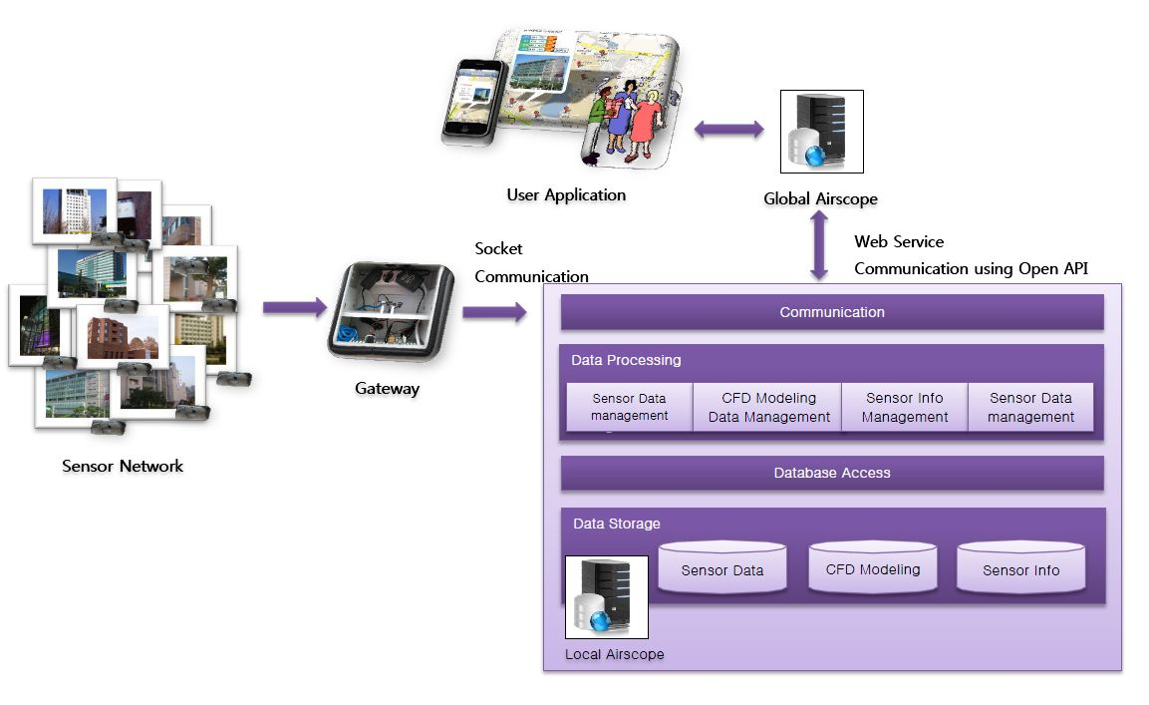
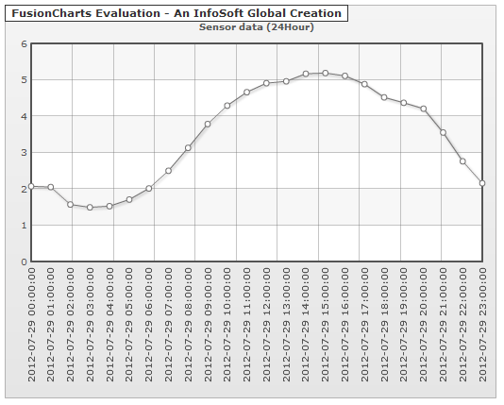
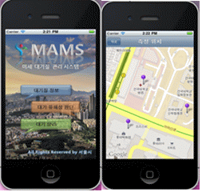
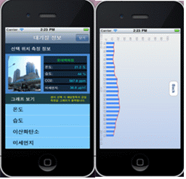
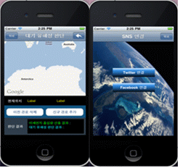
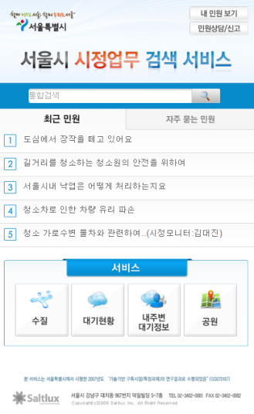
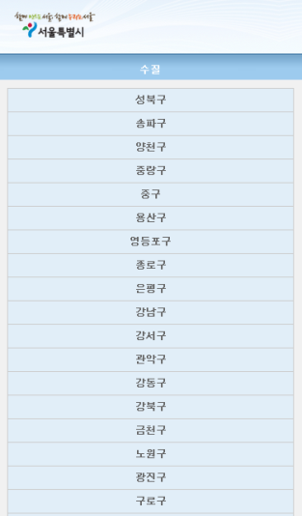
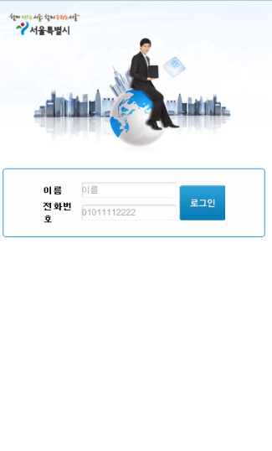
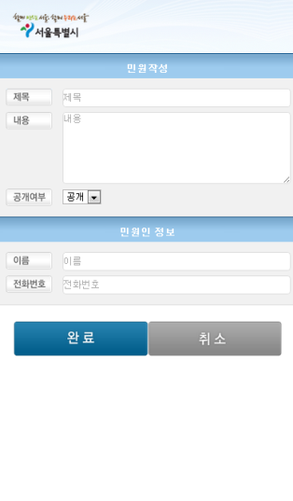
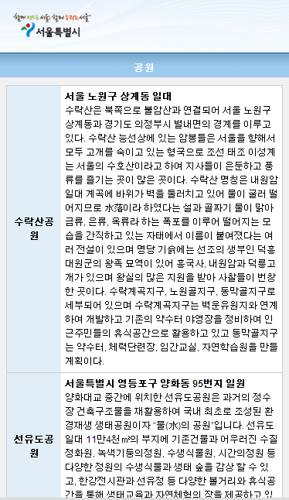
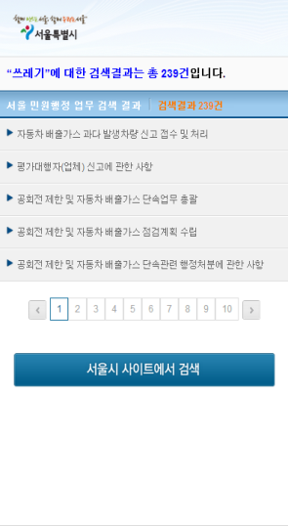
PRAGMA 23 Workshop
2012.10.10-2012.10.12 Seoul, Korea
Development of Open API for Micro-scale
Air Quality Management System based on USN
Guohua Li, Sang Boem Lim*
Interdisciplinary Computing Lab
Department of Advanced Technology Fusion, Konkuk University, Seoul , Korea
{yust, with2011, sblim}@konkuk.ac.kr
Abstract
Approach and Design
Recently, the most attention, Web Services are provided by Open APIs in IT era. Especially realized as ubiquitous times, the number of services based on sensors is improved so that we need the environment which can manage big scale information and the Open APIs which can be used by multiple devices.
In this paper, we propose developing Open APIs for micro-scale air quality services based on ubiquitous sensor network. Since 2008 we have already built sensor test bed, AirScope an air quality monitoring server and database. Depend on previous we developed Open APIs and applications using these APIs so that implement applicability and effectiveness of Open APIs.
Open API for Micro-scale Air Quality Management System based on USN
In this paper, in order to provide micro-scale air environment customized services, we develop Open APIs to contribute to commercialization of applications for Real Sensor Network and Virtual Sensor Network.
Test bed of Konkuk University
Local Airscope in Gwangjingu is selected by focusing on Konkuk University. Konkuk University in Gwangjingu is expected by sudden change of wind, because it around has high population density and education, housing, commercial facilities, buildings are crowded. And air pollution is complex and fast-spreading. It is important to identify and manage the micro scale air quality. As figure 4-1 shown below, we select 10 buildings and install real sensors on it.
Real Sensor Network
We install sensors on 10 places such as Konkuk University Hospital, Lotte Department Store, Sanhak Building, Animal Hospital, International Building, Law Building, Prof Building, New Million Building, Ilu Building, and Student Room. Base-Node as place where gateway installed is Sanhak. Entire sensors transfer data through the network by gateway.
System Overview
Virtual Sensor Network
In addition, we select around 1700m * 1700m * 820m area as domain and use CFD modeling every 20m intervals and every 5 second intervals based on calculated sensor data to provide the modeling information of PM10, CO, VOC, SO2, NO2 so that form the virtual sensor network. The figure below displays 556 virtual sensors that are extracted.
AirScope System for Micro-scale Air Quality Management System based on USN
Implementation
Local Airscope system as shown in this picture, the received sensor data is sent to Local AirScope through the Gateway and saved into Database after analyzing and processing. Database includes Sensor Data, CFD Modeling, and Sensor Info.
Real Sensor Network in Konkuk University
Virtual Sensor Network in Konkuk University
Real Sensor Marker of Desktop Application
Open API for real sensor location information (Real Sensor Network) Request URI: http://117.16.146.77:8080/LocalAirscope/resources/sensor/locationinfo
Open API for real-time information at one minute intervals (Real Sensor Network)
http://117.16.146.77:8080/LocalAirscope/resources/sensor/nowdata/kku_ani
Open API for one hour average data per day (Real Sensor Network)
http://117.16.146.77:8080/LocalAirscope/resources/sensor/todaydata/kku_ani/SI01_0001_01
Open API for virtual sensor location information (Virtual Sensor Network)
http://117.16.146.77:8080/LocalAirscope/resources/sensor/virtualsensor
AirScope System Architecture
Virtual Sensor Marker of Desktop Application
Open API for the average value of nearest five minutes at the location specified by the user (Virtual Sensor Network)
http://117.16.146.77:8080/LocalAirscope/resources/sensor/virtualsensor/37.5321951746/127.0821291
To meet the requirements, the architecture of the AirScope system has been designed as shown in picture
MAMS Mobile Application (Green Ecos)
Minwon Web Service (Saltlux)
Conclusions And Future Work
On this research, we introduced the development of Open API for micro-scale air quality management system based on USN. We describe the functionalities and output of AirScope. To develop Open APIs for micro-scale air environment services based on ubiquitous sensor network, we implemented a test-bed for integrated air quality management and equipment control using USN sensor and developed a prototype system. It consists of real sensor network and virtual sensor network. Nowadays, through the development of IT technology, users can get the information by using various devices. In the ubiquitous era of no limited time and place, it needs environment of managing big scale information which is provided by user-centered services. It also needs the Open API which is provided for the services that no limited platform devices. In the future, more and more organizations and companies need to use these APIs for their products.

