Slide 1
PRAGMA 22 – PRAGMA 23 Collaborative Activities
Resources Working Group

Slide 2
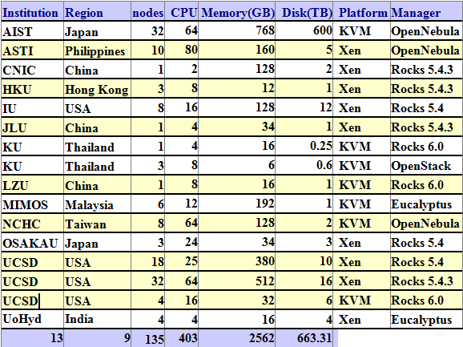
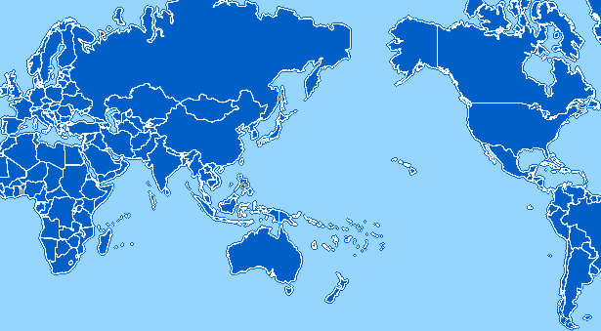
PRAGMA Cloud
JLU
China
AIST
OsakaU
Japan
CNIC
China
IndianaU
USA
LZU
China
LZU
China
NCHC
Taiwan
UCSD
USA
HKU
Hong Kong
UoHyd
India
ASTI
Philippines
KU
Thailand
MIMOS
Malaysia
13 Institutions
9 regions
Heterogeneous
KVM|Xen
OpenNebula|Rocks|OpenStack|Eucalyptus
Newest member is KU, Thailand. Welcome!

Slide 3
VC Migration Phase I
PRAGMA 22: “How to adapt the difference on configuration between Rocks and OpenNebula?” + “Building virtual clusters”
UCSD, AIST, NCHC discussion arrives:
Have an xml file describe all necessary information
Have a common user interface among different virtualization environments
Each virtualization environment automate deployment
Working in the context of VC migration
AIST and NCHC provided VC images and info
UCSD manually migrated to Rocks 6.1 with KVM roll and documented the required info and modifications
UCSD successfully migrated a Rocks/Xen cluster with bioscience applications to EC2
Ready for more extended discussion in Resources Working Group break-outs in PRAGMA 23

Slide 4
More VMs, More Deployments
UCSD’s Bioapp5
Successfully migratred to EC2, also as an experiment of VC migration (UCSD)
4 more sites deployed: IU, USA; JLU, China; OsakaU, Japan; NCHC, Taiwan
LZU bioscience VM
Created on Rocks/KVM
2 applications
Ubiquitin simulation
Species diversity simulation
6 sites deployed: LZU, China; UCSD, USA; OsakaU, Japan; AIST, Japan, JLU, China; CNIC, China

Slide 5
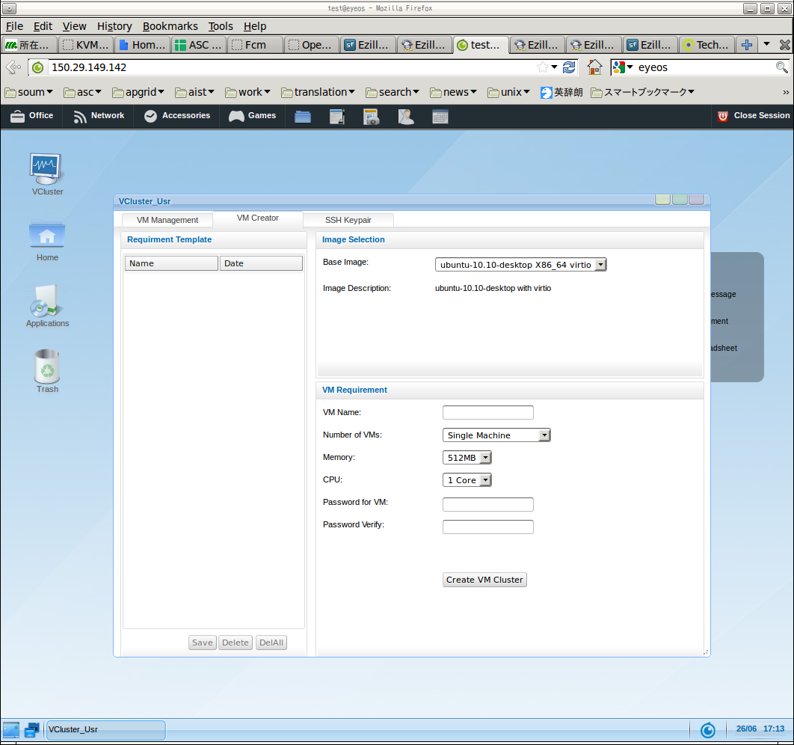
Ezilla Testing
AIST tested Ezilla in June and understood its capabilities.
Interests in routine-use, but need to consider version mismatch of OpenNebula.
AIST V3, Ezilla V2
New version of Ezilla will be available soon
Not yet tested by AIST.
Will continue discussion.

Slide 6
PRAGMA Data Cloud
How Resources WG supports geosciences/telescience, Biodiversity community
First step (done)
Federation of catalogue search
Tested interoperation between GEO Grid’s AIST-CSW and GeoPortal’s CSW
GEO Grid and e-Rium are interoperable by SOS
Next steps (to be done)
List available data sets.
How to protect/share data within a specific community
Use network overlay tech.

Slide 7
Breakouts at PRAGMA 23
Wed. 14:40-16:10
Virtual Cluster
Status review and plans towards PRAGMA 24
Thu. 11:00-12:00
Metadata schema issues for Biodiversity
Thu. 14:00-16:00
Plans of PRAGMA Data Cloud (esp. for Biodiversity)
AOB

