Slide 1
Virtual Machine Sharing → Virtual Cluster Sharing
+ Overlay Networking
== Basic PRAGMA Infrastructure

Slide 2
Single Machine Immigration/Cloning (PRAGMA Supports this Today)
VM
NCHC
VM
AIST
VM
LZU
VM
UCSD
gFarm
VM Hosting Infrastructure (site –specific)
Public Network

Slide 3
Virtual Cluster Replication
VM
NCHC
VM
AIST
VM
LZU
VM
UCSD
gFarm
VM Hosting Infrastructure (site –specific)
Public Network

Slide 4
Why Virtual Clusters?
Some analysis requires MPI parallel computing. → Cluster instead of single VM
Supports other load managers (not just Condor). SGE, Torque, …
Many understand “cluster” – makes the cloud less mysterious (or intimidating)

Slide 5
What’s the Difference?
Virtual Cluster has two images:
Frontend or head node
Compute Node image
Virtual Cluster has an internal network topology
Targeting a frontend to a new FQDN (fully qualified domain name) is more invasive
SGE, for example is tightly coupled to FQDN
Web services deployment can require reconfiguration

Slide 6
Possible to move VCs?
See Nadya Williams Demo of moving Rocks cluster to Amazon VPC (Virtual Private Cluster)
Have moved two clusters (one from NCHC, one from AIST) to UCSD
Let’s talk about what had to be changed to move AIST’s cluster to UCSD

Slide 7
What needed to be changed in the images (AIST)
Network Configuration
eth0: Public Interface, IP, Netmask, MAC Address
eth1: Private interface, IP, Netmask
Default Gateway
Name server
IPtables
Accept all traffic on private network
Enable NAT on frontend for Forwarding
udev/rules.d/70-persistent-net.rules
Had MAC address coded for OpenNebula hosting environment

Slide 8
Assumptions in Network Topology
Public Net
Public Net
VM
AIST
VM
AIST
Standard Beowulf – Public + Private network. 1 public IP
AIST Network
Public/Private on every Node
Identical virtual images, but networking assumptions different.
In our hosting environment (Rocks), we needed to understand the assumptions, so that we could allocate resources properly

Slide 9
“Proposal” – Blue boxes need to have “standard” formats
Hosting Site (any PRAGMA Cloud Site)
Virtual Cluster
Needs new naming/IP/network information in standard format
Provides VC-specific reconfiguration scripts (“pragma-reconfigure”)
Cluster Description
Resource requirements
# nodes
Memory, disk size
Networking, Public Private
Image names
Frontend, Compute
Networking details
Which is public interface? Which is private interface?
Topology
Native Hypervisor
Hosting system-provided “input”
Pragma-reconfigure
Convert/Prepare Images (local script)

Slide 10
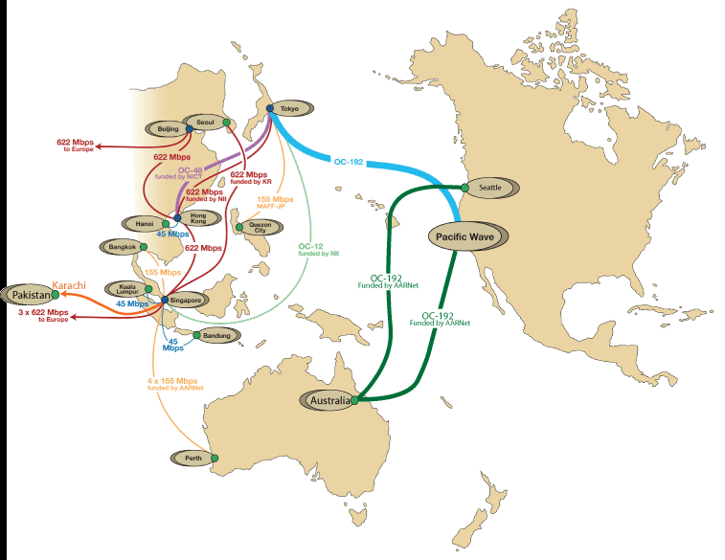


Step after this one: Network Overlays
User-Controlled Trust Envelope
Application VM
Overlay Network
Data Server
Other Networks

