Slide 1
Building PRAGMA Cloud Through Collaborations 2011-
Cindy Zheng
For
Resources Working Group

Slide 2
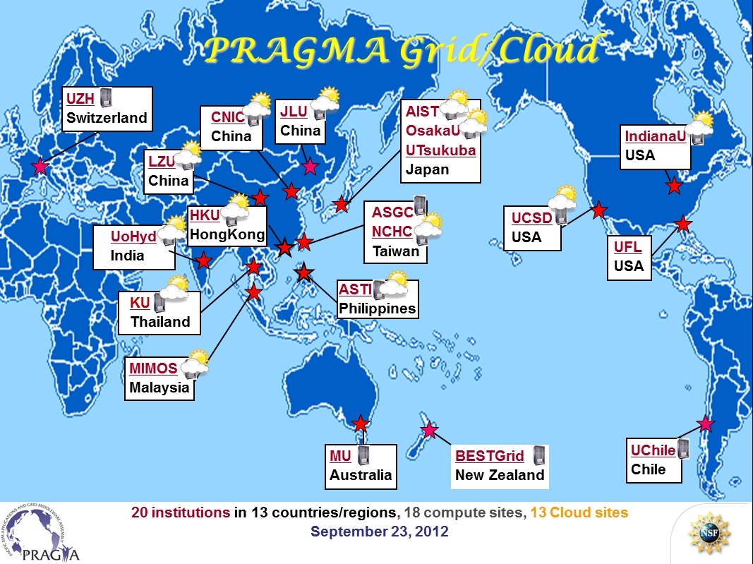
Focus from Grid to Cloud 2011
- Grid is still hard to use for scientists
- Cloud has potential for ease of use, but needs work

Slide 3













PRAGMA Heterogeneous Cloud
OpenNebula
KVM
Rocks
Xen
Rocks
KVM
OpenNebula
KVM
Rocks
Xen
Rocks
Xen
OpenNebula
Xen
vmdb.txt
AIST Geogrid + Bloss
NCHC FMotif
LZU Bio1
AIST Nyouga
UCSD BioApp5
Rocks
Xen
Rocks
Xen
AIST QuickQuake
Rocks
Xen
Rocks
KVM
OpenStack
KVM
Rocks
KVM
Eucalyptus
xen

Slide 4
Interoperation Needs Collaboration
Application driven
Created application VMs and drive experiments
Pilot groups
Ideas, discussions, pilot projects, exmaple implementations
VM migration (UCSD, AIST, NCHC)
OpenVSwitch (OsakaU, AIST, UCSD)
Expand to more sites
Projects, paths, current stage
VM migration
Pilot manual -> Pilot automation -> Expanded automation
VC migration
Pilot manual -> Pilot automation -> Expanded automation
Network overlay with OpenVSwitch
Pilot setup -> Expanded setup
Network overlay with ViNe
Pilot setup -> Expanded setup

Slide 5
VM/VC Migration- Automation
Bottom line – make PRAGMA Cloud easy to use
Automation is important and effective
Also need common user interface
UCSD Rocks automation examples:
Gfarm roll
Rocks cluster management tools
Full installed and configured
Add roll – few commands and reboot
Ready to go
http://goc.pragma-grid.net/wiki/index.php/Gfarm
Vm-deploy scripts (Thu 9am demo)
Bash – basic and common, easy for sharing
Can deploy multiple instances of a VM on single or multiple nodes
One command
% vm-deploy vm-name [number of instances] [local vm image depository path]

Slide 6
Gfarm Installation and VM deployment
LZU Bio1
LZU Bio1
UCSD BioApp5
UCSD BioApp5
UCSD BioApp5
LZU Bio1
UCSD BioApp5
vmdb.txt
AIST Geogrid + Bloss
NCHC FMotif
LZU Bio1
LZU Bio1
AIST Nyouga
UCSD BioApp5
UCSD BioApp5
AIST QuickQuake
LZU Bio1
UCSD BioApp5
LZU Bio1

Slide 7
Virtual Cluster Migration
How to migrate while maintain cluster relationship
Complication with applications
Job scheduler or software reconfiguration
With/without network overlay
Study and experiment with a few VC’s migration cases among pilot sites
Manually migrated an AIST VC to UCSD Rocks/KVM
Manually migrated a NCHC VC to UCSD Rocks/KVM
Manually migrated UCSD bioscience application VC to EC2 (Wed demo)
Document/share findings with PRAGMA community
Discuss what information we need to migrate a VC
Formulate and standardize VC configuration info in xml
Automate in various virtual environment
Deploy and test with application VCs in PRAGMA Cloud

Slide 8
Openflow network environment
Virtual network slice A
VM
VM
VM
VM
VM
VM
VM
VM
Virtual network slice B
VM
VM
VM
VM
Lead by OsakaU, joined by AIST and UCSD
Motivation
Eliminate reconfigure network
Better access control
VM
GRE
VM
AIST
Open vSwitch
VM
VM
Open vSwitch
Open vSwitch
VM
GRE
VM
Open vSwitch
GRE
VM
GRE
UCSD
Open vSwitch
GRE
VM
VM
Open vSwitch
Open vSwitch
VM
GRE
VM
Openflow Controller Trema (Sliceable routing switch)
Open vSwitch
Open vSwitch
Osaka Univ.
Openflow network
VM

Slide 9
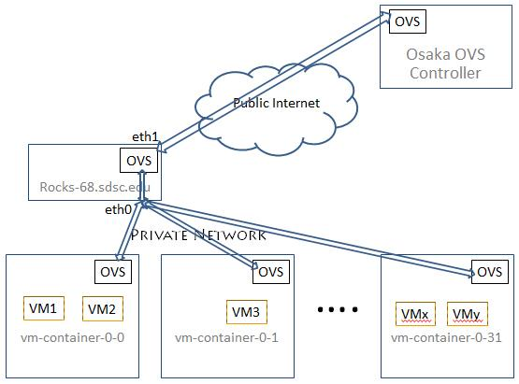
UCSD Implementation http://goc.pragma-grid.net/wiki/index.php/Network_overlay_setup_at_UCSD

Slide 10
Second Network Overlay Experiment
ViNe – UFL (demo)
Resources working group
Pilot sites
Application VM
Tasks

Slide 11
Road map for successful collaborations
Idea -> project
Pilot teams
Set goal, timed and named plan at workshop
Between workshops – work, VTC/Skype
Documentations (Examples!)
Show and tell at subsequent workshop
Expand and include as many sites as possible

Slide 12
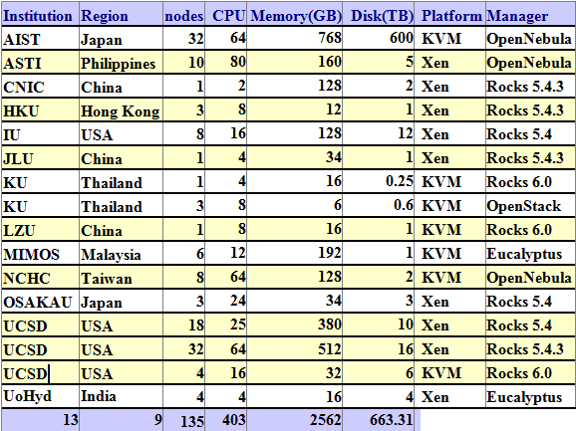
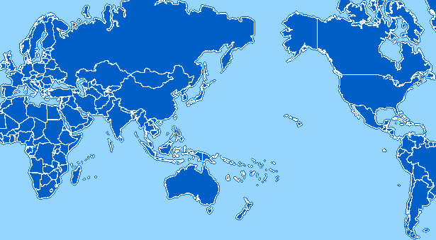
PRAGMA Cloud
JLU
China
AIST
OsakaU
Japan
CNIC
China
IndianaU
USA
LZU
China
LZU
China
NCHC
Taiwan
UCSD
USA
HKU
Hong Kong
UoHyd
India
ASTI
Philippines
KU
Thailand
MIMOS
Malaysia
13 Institutions
9 regions
Heterogeneous
KVM|Xen
OpenNebula|Rocks|OpenStack|Eucalyptus

Slide 13
You are invited
Resource working group
CI issues, works
Involve with discussions
Involve with development work
Use the resources (testing)

Slide 14
You are the future
Join the collaborations
Creating things new and better

