Slide 1
Building Grid Infrastructure
Build Resources
Contributed 64 CPUs (Hallasan) to PRAGMA
Installed GT4 on 20 CPUs (Baekdusan), but not ready to connect to PRAGMA yet
Scheduled buying some more computing nodes (about 80 core)
Utilization of e-AIRS
At 7 classes in 3 Universities, Seoul National Univ., Chungnam National Univ. and etc.
Utilize in Tohoku University (Japan)

Slide 2
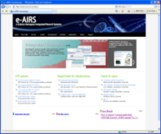

Global CFD Education System (globalize e-AIRS)
Domestic User
U.K. User
Tohoku
User
Portal in KISTI
Portal in U.K.
Local Account DB
Portal in Japan
Local Account DB
Local Account DB
ID / Password
Checking
ID / Password
Checking
ID / Password
Checking
Single Sign On
Globus Middleware (GSI)
e-AIRS in Japan
Porting e-AIRS
Tohoku University
Utilization of e-AIRS on June 21.
e-AIRS in U.K.
Maybe September or October

Slide 3
Development of KISTI-NCSA Science Gateway(KNSG)
Goals
Establishing Fundamental Technology for KISTI-NCSA Science Gateway
Build a prototype system to provide a user-friendly environment for high performance computing (HPC) resources.
Build a prototype platform to assist with building stand-alone applications in support of HPC.
Duration: 2/28/2010 – 10/31/2010 (8 mo)
Application Framework for KNSG
Scenario Manager
Analysis Manager
Repository Manager
Service Manager
PTPFlow
Medici
(Bard, Tupelo)
MyProxy
Wiki page:
https://wiki.ncsa.illinois.edu/display/KNSG/SAGE+Documentation
Separation of data model and view (presentation)

Slide 4
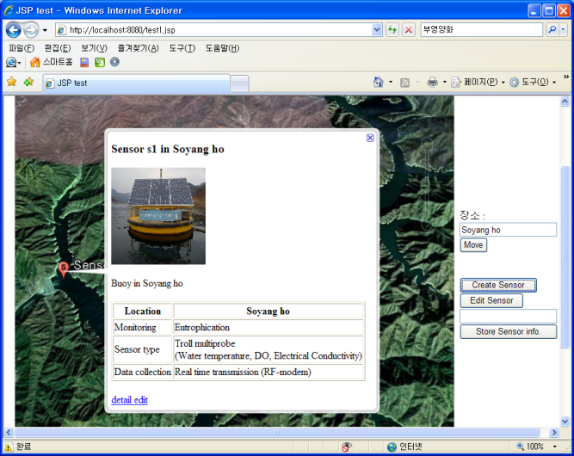
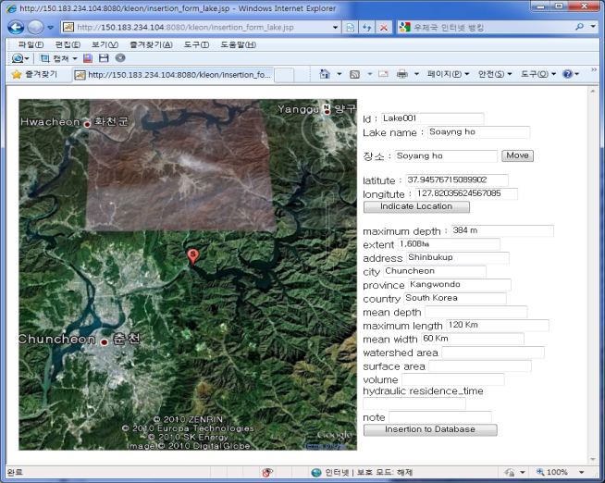
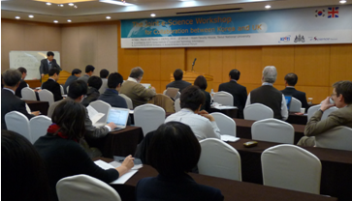
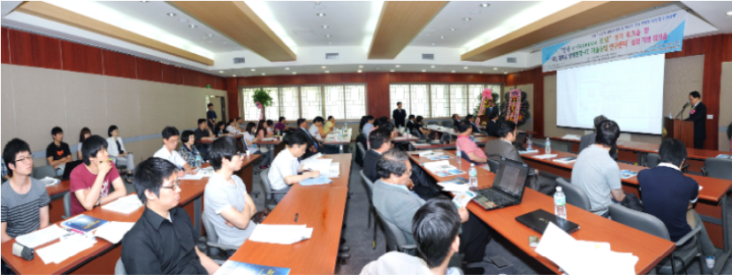
KLEON (Korea Lake Ecological Observatory Network)
Building of Korea Lake Ecological Network
- Data collection from 6 sites, Lake Soyang, Euiam and etc
- Development of data management, sensor and sampling.
- Collaboration with GLEON project
2
1
6
7
5
3
4
< Sensor information >
< Lake Soyang >
1
Domestic observation
Organized Korea e-Science forum Workshop
Date: 2010. 6. 13
Venue: Kookmin University(Seoul)

