Slide 1
PRAGMA20 – PRAGMA 21 Collaborative Activities
Resources Working Group

Slide 2
Works by PRAGMA21
VM issues
Supporting cluster environments
E.g. Condor (as a batch scheduler) + MPI
Expand three sites to more
IU, ASTI, Monash, Osaka, Tsukuba
TBC: LZU, MIMOS, USM,
Create their own VM images
Start with F-Motif and Bloss
VM repository to share VM images
Use Gfarm as back end
Deploy Gfarm at San Diego by the end of March
San Diego, AIST, Tsukuba
From prototyping to production
What is the real scenario?
Contribution by HKU
Live migration on PRAGMA?
Possible collaboration between HKU and AIST
Start Beginning of May
Start with HK, JP, US

Slide 3

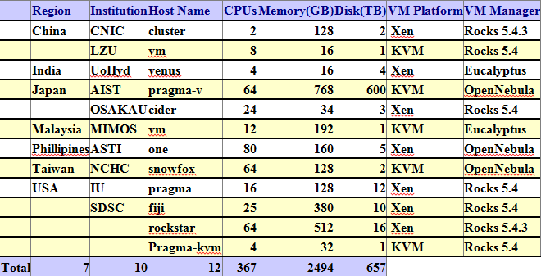

PRAGMA Grid/Clouds
UZH
Switzerland
UZH
Switzerland
CNIC
China
JLU
China
AIST
OsakaU
UTsukuba
Japan
KISTI
KMU
Korea
IndianaU
USA
LZU
China
SDSC
USA
LZU
China
ASGC
NCHC
Taiwan
HKU
HongKong
UoHyd
India
ASTI
Philippines
NECTEC
KU
Thailand
CeNAT-ITCR
Costa Rica
HCMUT
HUT
IOIT-Hanoi
IOIT-HCM
Vietnam
MIMOS
USM
Malaysia
UValle
Colombia
MU
Australia
BESTGrid
New Zealand
UChile
Chile
26 institutions in 17 countries/regions, 23 compute sites, 10VM sites

Slide 4
Gfarm Development and deployment http://goc.pragma-grid.net/mediawiki-1.16.2/index.php/Gfarm
Gfarm 2.4.2 to 2.5.1 (U. Tsukuba)
Major enhancement: GSI authentication
http://datafarm.apgrid.org
Gfarm roll for Rocks 5.4 (SDSC)
http://goc.pragma-grid.net/mediawiki-1.16.2/index.php/Gfarm_roll_user_guide
Gfarm deployed to 7 sites
SDSC (meta server, file system, client)
AIST (client)
NCHC, IU, LZU, OsakaU, CNIC (file system nodes, clients)

Slide 5
VM Deployment Automation http://goc.pragma-grid.net/mediawiki-1.16.2/index.php/VM_deployment_script
VM-deploy scripts (SDSC, AIST) – see demo
Get VM image from gfarm
Modify VM image to fit local system
Do this by scripts
Start VM
Web-OS (NCHC)
Deploy VM via internet to physical non-VM systems
User account
Access to /srv/cloud

Slide 6
Application VMs
AIST developed 3 timely and important applications
WMS Server: provide a simple HTTP interface for requesting geo-registered map images from one or more distributed geospatial databases
Hot Spot: find high-temperature, e.g. a forest fire, spot from satellite data
QuickQuake: generate ground motion map of earth quake

Slide 7

Put all together
VM images stored in Gfarm systems
Deployment scripts Run at PRAGMA Sites
Copy VM images on Demand from gFarm
Modify/start VM instances at PRAGMA sites
Jobs managed by Condor
S
gFC
S
gFC
VM Image
copied from
gFarm
VM Image
copied from
gFarm
gFS
Condor
Master
slave
slave
SDSC (USA)
Rocks Xen
AIST (Japan)
OpenNebula Xen
gFS
GFARM Grid File
System (Japan)
S
gFC
gFC
S
VM Image
copied from
gFarm
AIST QuickQuake + Condor
VM Image
copied from
gFarm
gFS
NCHC Fmotif
gFS
slave
gFS
gFS
slave
NCHC (Taiwan)
OpenNebula KVM
UCSD Autodock + Condor
IU (USA)
Rocks Xen
AIST Web Map Service + Condor
AIST Geogrid + Bloss
AIST HotSpot + Condor
S
gFC
gFS
gFS
gFC
S
VM Image
copied from
gFarm
VM Image
copied from
gFarm
gFS
gFS
slave
slave
LZU (China)
Rocks KVM
S
= VM deploy Script
Osaka (Japan)
Rocks Xen
gFC
= Grid Farm Client
gFS
= Grid Farm Server

Slide 8
Breakouts
Breakout 1
Test and confirm the demo
Breakout 2
Discuss next steps

